Slide 1
Political Influence on Business

Slide 2
The Role of the Government in the economy
Provides a legal and regulatory framework e.g. the right to own property and the right to enter into contracts
Provides Public Goods and Merit Goods
Uses tax and public spending to influence the way businesses and individuals behave – e.g. tax on smoking or subsidies on training of workers
Uses tax and public spending to influence demand in the economy – i.e. to help prevent recessions or to control inflation
Has a role in the setting of interest rates that will do the same as the above

Slide 3
Government provides goods and services
The UK government accounts for approx. 40% of all goods and services produced.
It also redistributes income through the welfare benefit system
The main areas of government spending are:
  Social protection and welfare state
  Education
  Healthcare
  Transport, including road and rail subsidies
  Defence
The private sector uses these services e.g. a healthy, educated workforce
Often, the private sector is used to produce goods and service which are then consumed by the public sector to provide these services

Slide 4
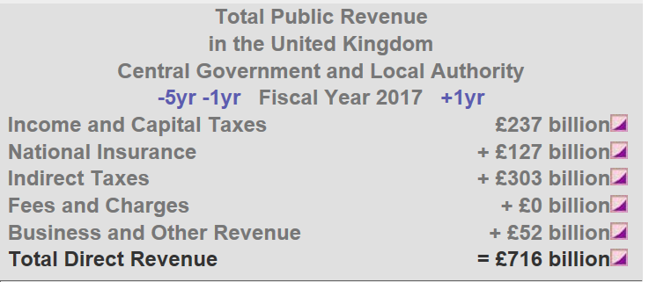
2017 tax revenues

Slide 5
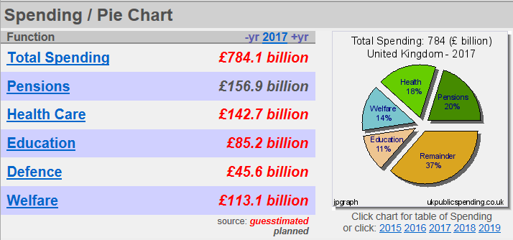
2017 public spending

Slide 6
Shortfall? National Borrowings
Public Debt in the United Kingdom is principally the debt of the central government.
In 2005 the UK National Debt was less that £0.5 trillion. But then came the worldwide financial crisis of 2008 and subsequent recession. The National Debt increased rapidly and went over £1 trillion in 2011. At the end of the 2015-16 fiscal year, the National Debt went over £1.5 trillion.

Slide 7
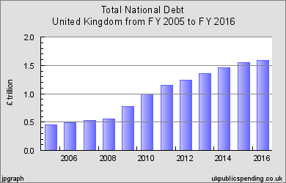

Slide 8
National debt : GDP
In terms of Gross Domestic Product the UK National Debt in 2005 was about 38 percent of GDP.
But in the last ten years, in the wake of the Crash of 2008 and subsequent recession, the National debt has doubled to over 80 percent GDP, but shows signs of levelling out as a percent of GDP

Slide 9
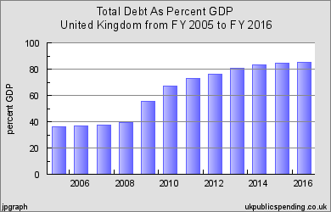

Slide 10
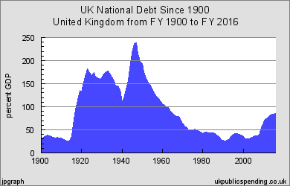
Bigger picture

Slide 11
Tax
Tax creates revenues for the government to spend on the public sector. It is also used to govern how individuals and businesses behave.
How will changes in the following taxes influence BUSINESS and the INDIVIDUAL?
Income tax
VAT
Corporation tax
Landfill tax

Slide 12
Subsidies
The government can offer financial support to certain industries to alter behaviour.
It is a grant given by government to lower the price of a good.
Example: training subsidies might be given to encourage businesses to train their workers.
A business might be given a subsidy to encourage them to set up in a deprived area of the UK

Slide 13
Fiscal Policy
Tax, government spending and borrowings can also be used to govern the economy as a whole.
Questions:
If there is a proportionately greater increase in government spending than tax, what will happen to the economy as a whole? Will it be restricted or will it expand?
If there is a proportionately greater increase in tax than government spending (direct tax like income tax, in particular) will the economy be restricted or will it expand?

Slide 14
Monetary Policy
Remember, the government has a role in the Monetary Policy Committee, who sets the interest rates. They can also control the economy in this way.

Slide 15
Task
What is the government doing at present to control the economy? Research recent newspaper articles or the BBC website to see what the rationale is for recent budget decisions.
In doing this, consider the impact of these decision on BUSINESSES and the INDIVIDUAL.
Use these links as a starting point:
http://www.bbc.co.uk/news/uk-politics-38075649
http://www.telegraph.co.uk/news/2016/10/03/philip-hammond-budget-surplus-conservative-conference-live/

