Slide 1
Macro Economics
Impact on Business of movements in INTEREST RATES

Slide 2
Lesson Aims
To revise what is meant by ‘CREDIT’ and why businesses need it
To explain what is an ‘INTEREST RATE’
To determine who sets interest rates
To examine how businesses are affected by changes in interest rates

Slide 3
Credit
What is credit?
Answer:
Credit is about BORROWING – owing money to others for a period of time.

Slide 4
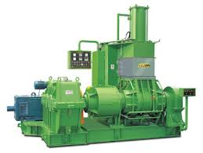
Why do Businesses Need Credit?
To purchase new assets
To help your customers spend more
To support growth

Slide 5
Examples of Business Credit
Credit does not just mean credit cards.
In business, we look at credit as being:
Bank Overdrafts
Bank Loans
Trade Credit

Slide 6
How much credit can a business obtain?
If a friend came to you to ask for money to support their business, what would you want to know?
Continued profitability?
Positive cash flow?
A good relationship between the business and its creditors?
A stable or growing industry?

Slide 7
The Credit Crunch
What happened?
Banks withdrew or lowered overdrafts
Banks refused to provide bank loans or mortgages. They also made the repayments and interest charges worse
Suppliers insisted on earlier payment of invoices
Customers took longer to pay their bills

Slide 8
What is an interest rate?
An interest rate is the cost of borrowing money or the return for investing money.

Slide 9
Interest Payments & Receipts
Interest Paid
Paid to bank when overdrawn
Paid to bank on a bank loan
Paid to credit card companies
Paid to leasing companies
Interest Received
Paid by bank on cash balances held
Paid by customers if they are late settling invoices

Slide 10
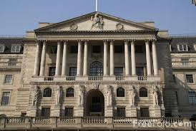
The Base Rate
Recognise this place?
The Monetary Policy Committee of the Bank of England meet each month to decide the base rate

Slide 11
The Base Rate
Banks borrow money supplied from the Bank of England. Banks will therefore set their interest rates in line with the base rate.

Slide 12
What is the impact of a change in interest rate?
http://www.thisismoney.co.uk/money/mortgageshome/article-1633415/Mortgage-calculator-How-I-afford-borrow.html

Slide 13
Impact of Interest Rates
Interest Rate Increase?
Cost of borrowing increases
Business’ costs increase
Interest Rate Increase?
Return to savers increases
Propensity to save increases
Interest Rate Decrease?
Cost of borrowing decreases
Business’ costs decrease
Then what happens?
Then what happens?
Then what happens?
Interest Rate Decrease?
Return to savers decreases
Propensity to save decreases
Then what happens?

Slide 14
Monetary Policy
This involves the use of INTEREST RATES, led by the base rate, to:
Influence bank lending
Control the growth of ‘Aggregate Demand’
Control the demand for and supply of money – i.e. INFLATION (more on this next lesson)
Influence the external value of the currency i.e. EXCHANGE RATES (more on this later in the week)
The Bank of England governs the UK’s monetary policy.

Slide 15
Interest rates over time
http://www.bbc.co.uk/news/business-11013715
During the credit crunch, the base rate was reduced to 0.5% - a historical low.

Slide 16
Business and Interest Rates
Depends upon:
The amount a business has borrowed
The amount of cash a business has
Will impact more in the luxury good market. Why?

Slide 17
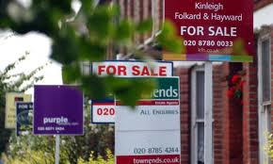
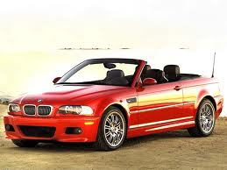
Examples of industries which suffer from an increase in Interest Rates
Housing (mortgages)
Motor vehicles
Holidays
“Big Ticket” consumer goods e.g. new kitchens, audio-visual systems

Slide 18
Strategies to help
Price discount to stimulate demand
Cut costs to maintain margins and conserve cash
Reduce capacity – e.g. redundancies, sale of assets
Improve management of working capital e.g. destocking
Cut back on investment plans
WHAT ARE THE CONSEQUENCES?

