Slide 1
Think – Pair - Share
How has your family changed over the past 50 or 100 years in terms of location, education and jobs?
Share the most dramatic changes with the person next to you?

Slide 2
Reasons for this change?
Notes:
Discuss

Slide 3
Social Factors
What do you understand by the term demographics?
A statistical view of a population and particular groups within it. Generally including age, gender, income, education, occupation etc.

Slide 4
Social Factors
Society is constantly changing and businesses must adjust to suit society.
Examples:
Aging population
24/7 culture
Healthier lifestyles
Increased leisure time
Multicultural society
Structure of family life
More women in the workforce
Changes to the labour market (more skilled and educated workforce, more temporary and part time employment)
Notes:
Pose the question: what changes have we seen to population, households and lifestyles over the last 50 years?
Choose students to share answers.

Slide 5
Social Factors
Marketing Strategies
A business must recognise cultural differences.
Consider lifestyle changes in different market segments.
Consider changes in advertising mediums (e.g. internet rather than television)
HR Strategies
Work life balance
Flexible working

Slide 6
% of population aged 65 and over
Notes:
Discuss

Slide 7
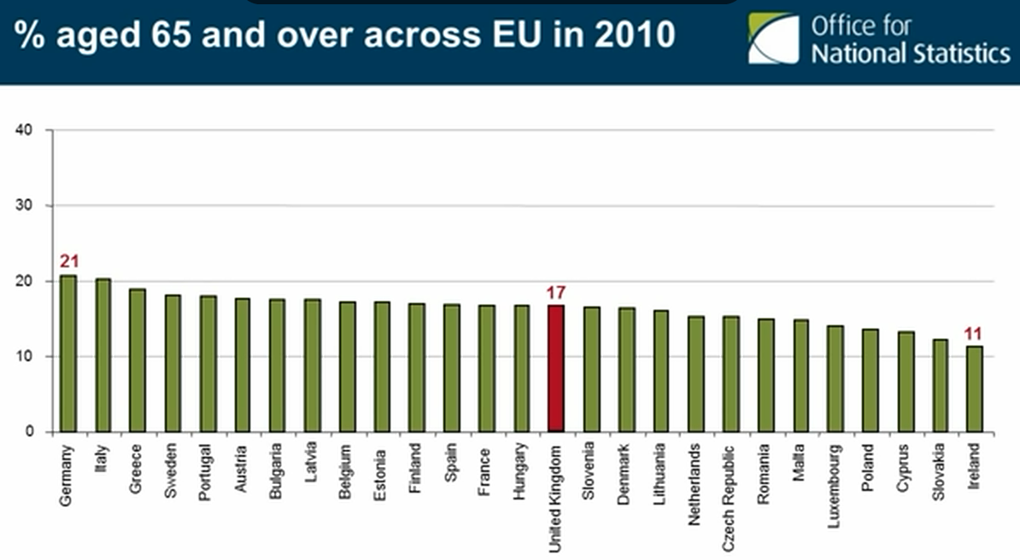
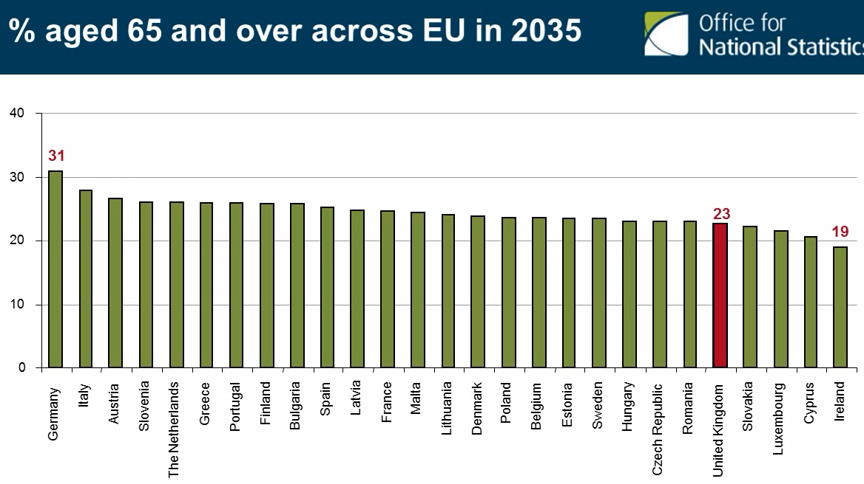

Slide 8
Social Factors
Watch
UK Aging Population
Discuss
How might an international hotel chain respond to an ageing population?
Notes:
Examples; Warner Leisure Group, SAGA

Slide 9
Why might this sort of data be useful to businesses?
Minutes per day spent using each medium: by age, 2009/10
United Kingdom |  |  | Hours and minutes per day
 | Television | Computer | Radio
16–24 | 2.56 | 3.34 | 0.25
25–44 | 3.22 | 3.20 | 1.02
45–54 | 3.17 | 2.35 | 1.27
55 and over | 4.05 | 1.12 | 1.07
Source: Ofcom
People living in households: by type of household¹
 | 2001 | 2010
 | (Millions)
One person household | 7.0 | 7.5
Under 65 | 3.7 | 4.2
65 or over | 3.3 | 3.4
One family households | 48.4 | 50.4
Couple² | 42.0 | 43.0
No children | 14.3 | 15.2
1-2 dependent children³ | 17.1 | 17.5
3 or more dependent children³ | 5.3 | 4.8
Non-dependent children only | 5.3 | 5.5
Lone parent² | 6.4 | 7.4
Dependent children³ | 4.7 | 5.3
Non-dependent children only | 1.7 | 2.1
Two or more unrelated adults | 1.9 | 2.2
Multi-family households | 1.0 | 1.3
All people in households | 58.3 | 61.4
Proportion of people living alone: by age group (UK)
 |  | Percentages
 | 2001 | 2010
16–24 | 3.3 | 3.1
25–44 | 10.1 | 9.6
45–64 | 12.8 | 14.8
65–74 | 26.9 | 24.7
75 and over | 49.1 | 45.5

Slide 10
Social Factors
In pairs, how are businesses responding to:
Greater awareness of need to consume healthier foods
Greater pressures to reduce our impact on the environment
The impact of future global food shortages
Greater numbers of single person households
Declining use of print based media
Increasing use of social media
Notes:
If discussions have taken up time and only have 45 minute lesson, give one bullet point to each pair and ask them to create mind maps. Should then join up with another pair and compare.

Slide 11
Plenary
You have been asked to summarise social factors (with the use of real-life examples) for a group of GCSE students, please write your summary and keep it to no more than half a page.
Swap your summary with a class mate. Have they included anything different that would be worthwhile adding to your own notes?

Slide 12
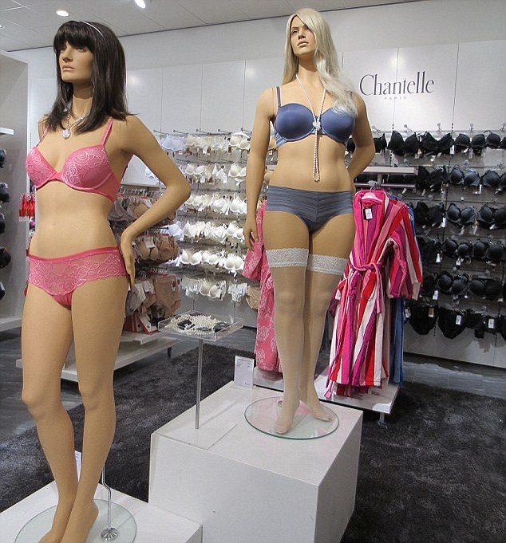
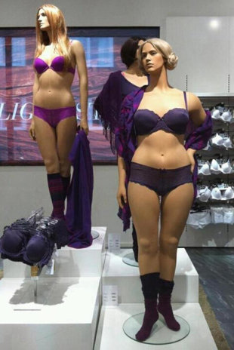
How is this an example of a business responding to changes in society?

