Slide 1
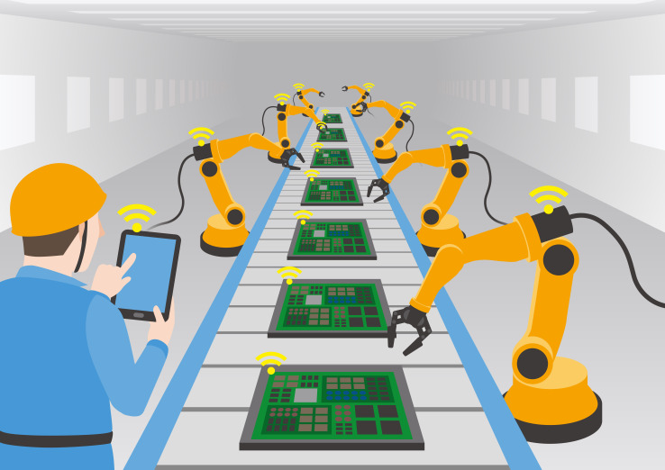
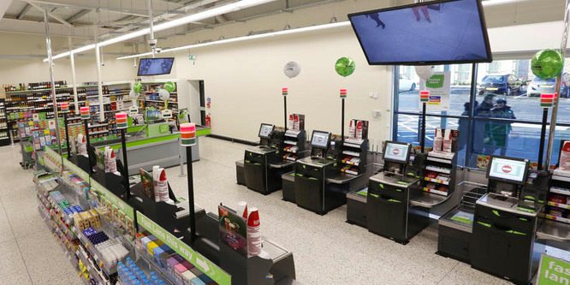
PEST – Technological factors
In what ways has technology had an impact on organisations and how they operate?

Slide 2
Learning Objectives
Explain how technological factors, including automation and communication technology, affect business activity
Evaluate the impact of technological factors on businesses and their stakeholders

Slide 3
Technological factors
All businesses in competitive markets must now accept that new technologies will have to become an integral part of their operations if they are to stay competitive

Slide 4
Automation
The process of the replacement of workers by machines
With the person next to you, discuss how automation has changed the operations in the following areas:
Retail
Banking
Warehousing
Online services
Utilities

Slide 5
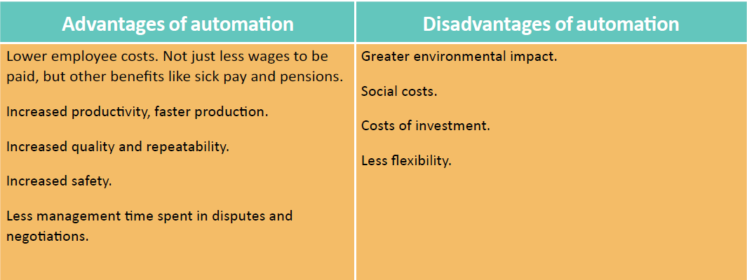
Automation

Slide 6
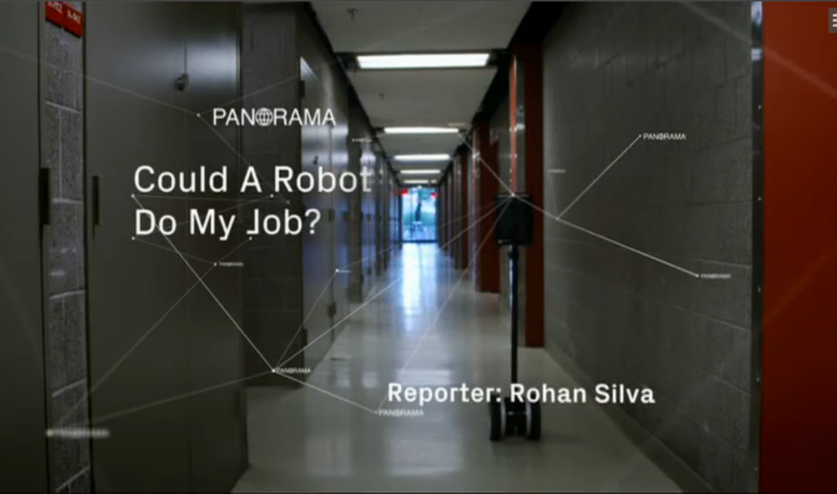
To view the video – http://estream.godalming.ac.uk/View.aspx?id=11240~55~liB7cewdfg
Use your GOL login to access e-stream. You should make notes of the impact of tech on the industries mentioned in the video

Slide 7
Consolidation Activity
Create a one side of A4 revision sheet which summarises the following:
How information and communication technologies impacted the way businesses are run in respect of internet marketing, web-based consumer relationships, B2B, manufacturing resource planning 2, electronic point of sales systems.
Describe how CAD and CAM have changed business operations.
General impact of technology on businesses
Impact of technology on consumers

Slide 8
Research Activity
Consider the extent to which changes in new technology have had an impact on one of the following organisations:
British Airways
AstraZeneca
Volkswagen
NatWest
To do this:
Identify the types of new technology that will have affected these businesses in recent years;
Explain how each type of new technology has affected the business, using as many examples as you can;
Consider and explain the impact of the technological changes on at least 3 stakeholders;
Decide (evaluate) whether the technological development has been a help or a hindrance to the company. Judge the firm in terms of the extent to which it managed the changes effectively. Decide whether the business is now in a good place as a result of the technological developments it faced.

