Slide 1
Legal Factors Affecting Business
Employment and anti-discrimination law
Minimum Wage
Health and Safety

Slide 2
Employment laws
These are designed to ensure that employees are protected at work, and that employers and employees are fairly dealt with.
Main Acts:
The Equality Act
The Employment Rights Act
Minimum Wage
Employment Tribunals

Slide 3

Equality Act
Protection from discrimination against anyone for any of the protected characteristics:
  Age
  Disability
  Gender Reassignment
  Marriage and Civil Partnership
  Pregnancy and Maternity
  Race
  Religion or belief
  Sex
  Sexual Orientation

Slide 4
Employment Rights Act
Give employees rights to:
a written statement of employment, setting out the main terms of their employment for example who they are employed by, where and when they work, what they will be paid
receiving pay including minimum wage,
maternity/paternity leave and pay,
flexible working,
fair notice periods
protection against unfair dismissal
Redundancy rights, including payment
http://www.bbc.co.uk/news/uk-scotland-36479939

Slide 5
Implications for businesses
Increased motivation of staff
Increased productivity of staff
Burden on smaller businesses (complying with employee rights and admin)

Slide 6

Minimum Wage
The National Minimum Wage is the minimum pay per hour almost all workers are entitled to. The National Living Wage is higher than the National Minimum Wage - workers get it if they’re over 25.
It doesn’t matter how small an employer is, they still have to pay the correct minimum wage.
Notes:
Sports Direct's founder Mike Ashley has admitted workers at its Derbyshire warehouse were paid below the minimum wage and its policy of fining staff for being late was unacceptable.
HMRC is investigating the firm over the minimum wage issue, Mr Ashley told MPs

Slide 7
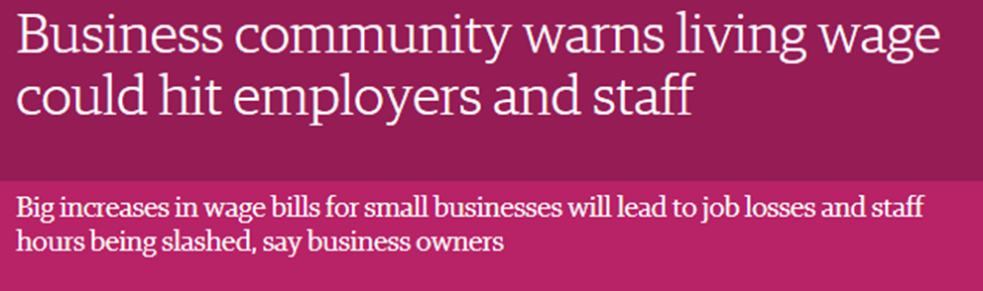

Minimum Wage
TASK: research the impact of minimum wage on the care homes industry (30 mins)

Slide 8
Health and Safety
Aims to provide a safe working environment for employees and customers on the premises
Main Act:
  Health and Safety at Work Act 1974 – this controls things such as working hours, working practices, lifting and handling, use of computers and rights of pregnant workers.

Slide 9
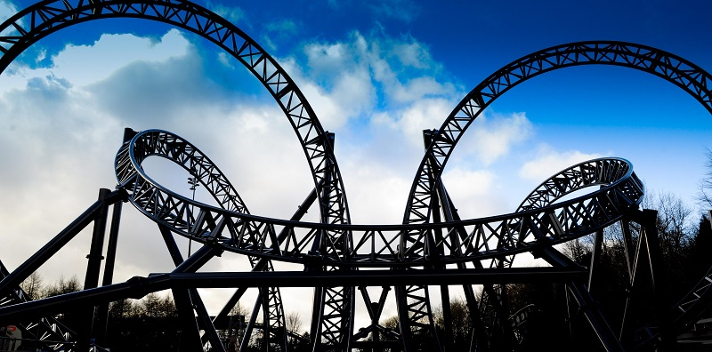
http://news.sky.com/story/1496893/alton-towers-boss-safety-not-adequate
“Alton Towers bosses face paying out millions in compensation for Smiler rollercoaster crash” Metro, 9 June 2015
“Three more rollercoasters shut down at parks run by Alton Towers owner” The Guardian, 5 June 2015
Notes:
See hyperlink news story

Slide 10
Implications for businesses
Additional costs – advice and compliance
Influence on firms reputation
Influence on employees motivation – benefits them

