Slide 1
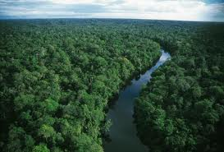
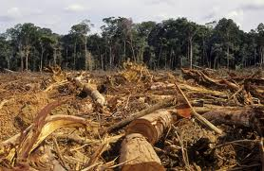
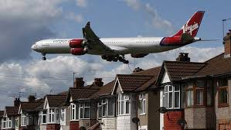
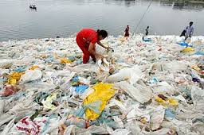
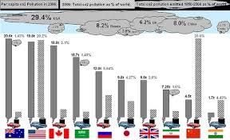
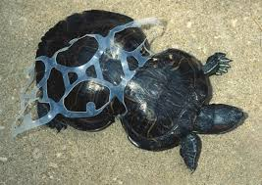
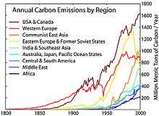
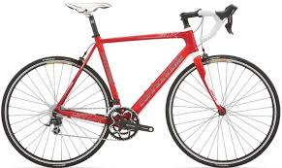

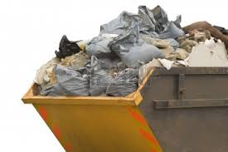


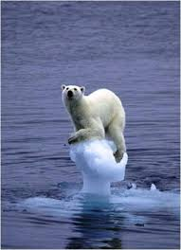
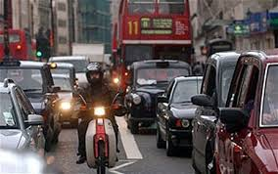
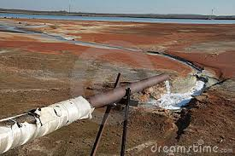
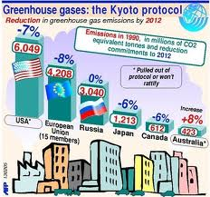
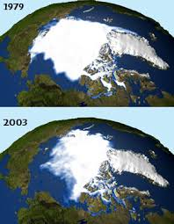
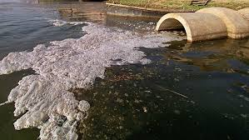
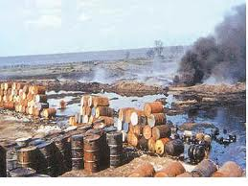
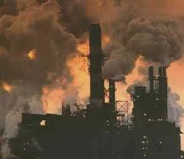


Slide 2
Starter: Environmental Factors
Make a list or a mind map of all the different ways in which businesses contribute to environmental damage.
Come up with two examples of businesses who HAVE caused environmental damage.
Notes:
Compare examples with person next to you
Choose students to share with whole group

Slide 3

Emissions of gas though production processes
Pollution caused by transporting raw materials
Using less packaging
Global warming
Energy consumption
Recycling
Congestion
Waste disposal
Efficient use of resources
Use of non renewable resources
Pollution of the sea by using it as a ‘free’ dumping ground
Destruction of natural environment

Slide 4
Learning Objective
Explain the potential environment costs of business activity including:
    Air, water and noise pollution
    Climate change
    Congestion
    Destruction of the environment
    Waste disposal

Slide 5
The costs and benefits of business activity
When businesses produce and sell products or services it is relatively easy for them to see the costs involved and the benefits they will gain.
These are known as PRIVATE COSTS (e.g. wages paid to employees, costs of advertising) and PRIVATE BENEFITS (e.g. total revenue earned from sales, any resulting profit and the dividends paid to shareholders)

Slide 6
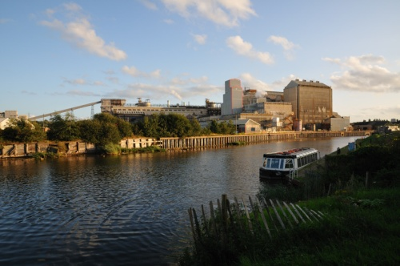
The costs and benefits of business activity
However, businesses may also create SOCIAL COSTS due to EXTERNALITIES. Externalities occur when private costs are different to social costs and private benefits are different to social benefits.
Social costs are made up of the private costs of the business plus NEGATIVE EXTERNALITIES (the costs to the rest of society).
Many externalities affect the environment.
Notes:
Explain there can also be positive externalities such as job creation, improved skills. SOCIAL BENEFITS to society are the private benefits of to business plus positive externalities (the benefits to the rest of society)

Slide 7
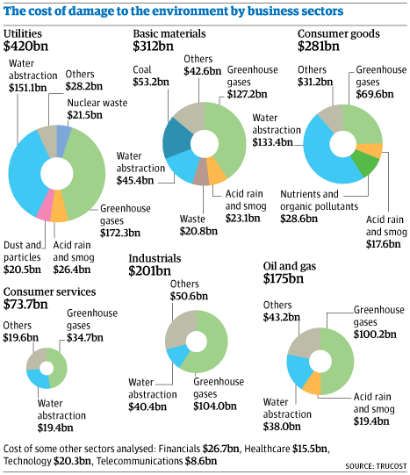

Slide 8
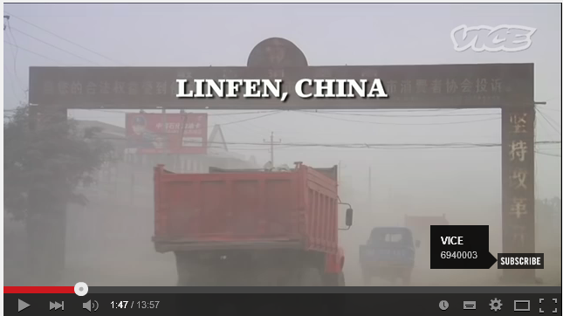
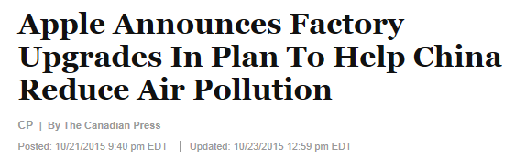
Air and Water Pollution
The pollution from factories, machines or vehicles emitting poisonous gases into the atmosphere.
Many industries use water in their production and are therefore near rivers, making it fairly easy for them to dispose of waste into nearby water.
Industries based near the coast have used the sea to dump waste. Cargo ships have also dumped their waste into the sea. The North Sea for example is one of the most polluted seas in the world!
Watch
Notes:
Use the resources on the slide to provide examples and promote class discussion (link to private costs/benefits and social costs/benefits). Click on pics to load,
Linfen video: https://www.youtube.com/watch?v=q4DtOhe2LfQ
Apple article: http://www.huffingtonpost.ca/2015/10/21/apple-china-air-pollution_n_8353408.html

Slide 9
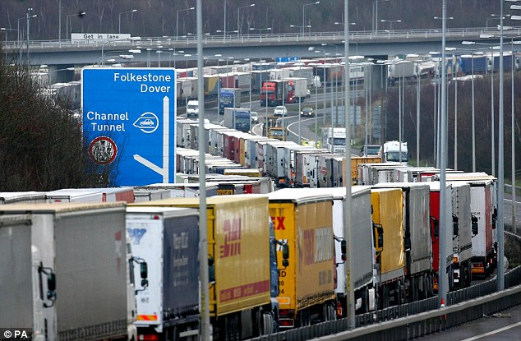
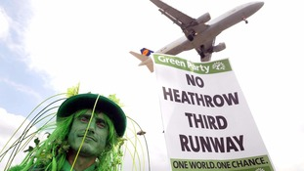
Congestion and Noise
More roads are becoming congested with traffic as a result of business activity (e.g. transportation of goods).
Some business activity can also result in noise pollution for example the opening of a new runway at an airport or the noise of lorries making deliveries to a factory could disturb local residents.

Slide 10
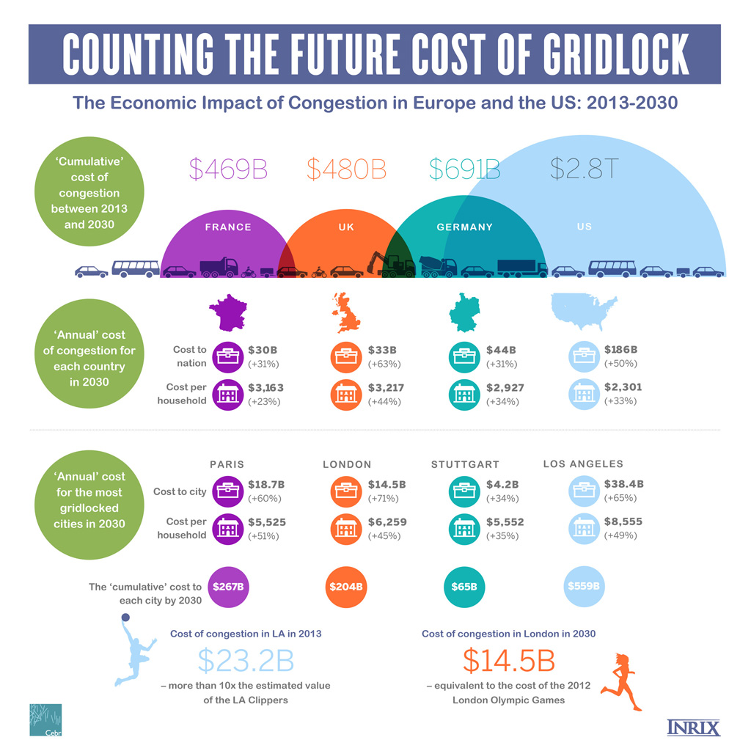
Notes:
http://inrix.com/economic-environment-cost-congestion/

Slide 11
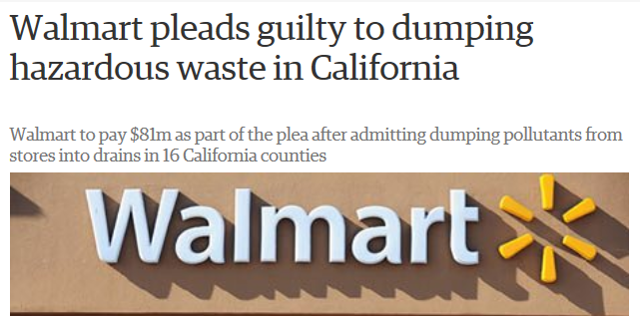
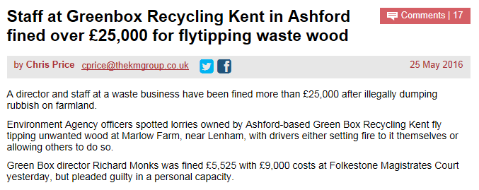
Waste Disposal
Many business operations result in waste products (chemicals, materials, packaging etc.)
Not maintaining equipment can result in waste (e.g. if a company does not maintain its water pipes and leaks occur)
Notes:
https://www.theguardian.com/business/2013/may/28/walmart-pleads-guilty-hazardous-waste
http://www.kentonline.co.uk/kent-business/county-news/ashford-firm-fined-fly-tipping-96392/

Slide 12
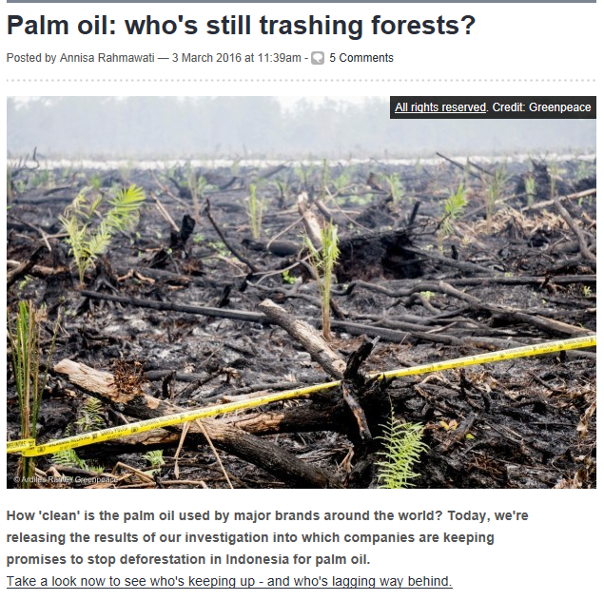
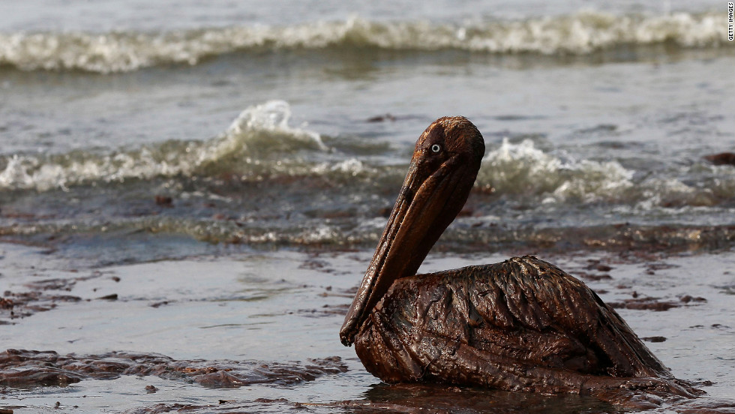
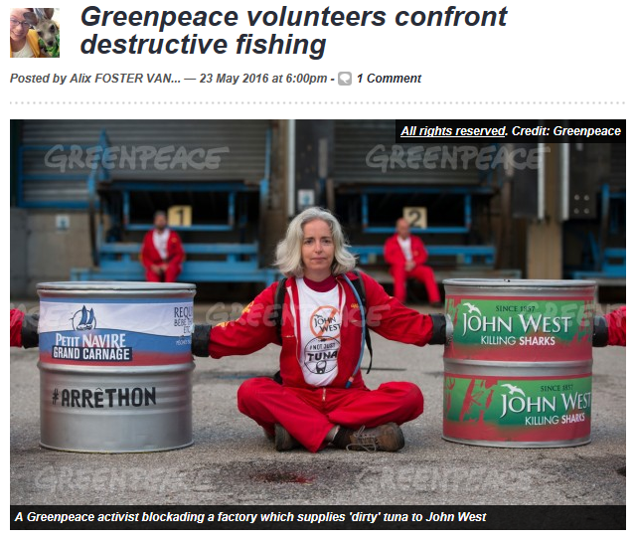
Destruction of the Environment
Examples include:
Logging and associated industries
New buildings in rural areas
Unforeseen events (e.g. BP Deepwater Horizon Oil Spill)
Notes:
Articles taken from Greenpeace blog

