Slide 1
Benefits that multinationals bring to overseas countries

Slide 2
Lesson Objectives
To be able to discuss how multinationals have contributed to an improvement in local living standards, employment and economic growth in overseas countries
To be able to answer past paper questions based on the topic

Slide 3
Starter
From what you know – would you consider that MNEs are good for the poorer countries that they operate in?

Slide 4
Suggested answers to starter
Incoming multinationals bring FDI (Foreign Direct Investment
MNEs Create jobs
New investment will increase output of goods & services
Any extra output sold abroad, thus increasing exports, also imports could be reduced
Taxes paid increases government funds enabling them to improve their services
An efficient multinational might make high-quality products available at lower prices than there were previously found, helping consumers
Increased competition
Improved trade flows

Slide 5
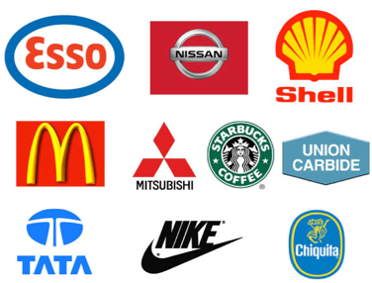
Multinational Defined
A multinational company, sometimes called a transnational corporation, is a company that owns or controls production or service facilities in more than one country.
You may see it written as:
MNC – multinational corporation or company
MNE – multinational enterprise
These are both the same
Great website with videos and activities

Slide 6
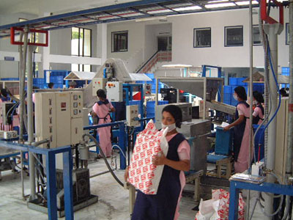
In support of MNEs
Multinationals are a beacon of global capitalism, bringing employment, income and new technologies to poorer countries, driving up incomes and aiding development.
In return wealthier countries (Like UK) get cheaper goods.
Can you argue against?

Slide 7
BIG MNEs
Most of the largest MNEs are US, Japan, or European
India and China growing rapidly
Example Tata
Tata:

Slide 8
Why have they grown? - To access new markets
Domestic market saturated, profits from expansion overseas is tempting
Extension strategy for the product life cycle
PMI (Phillip Morris International) and BAT have aggressive expansion in developing markets

Slide 9
Why have they grown? - To reduce costs
Economies of scale
Lower unit costs
Enhanced competitive advantage
Especially if products can be standardised across markets
Available, cheap adaptable labour see Global services location Index (Most attractive offshore destinations)

Slide 10
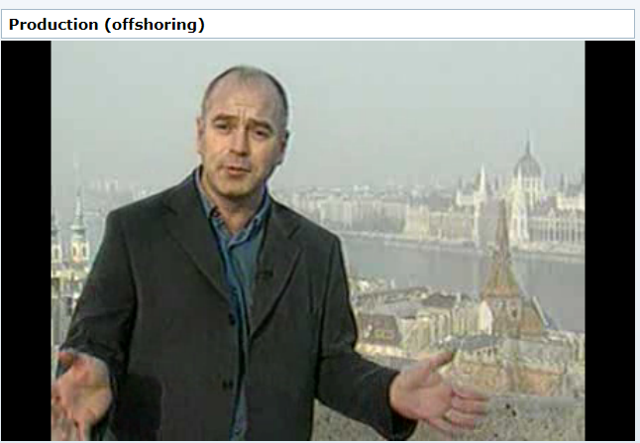
Off shoring video

Slide 11
Positive effects of MNEs in other countries
Positive effects
Creates employment
Improves infrastructure
Increases skills base
Increased standard of living
Improves balance of payments
Raises country’s profile
Video

Slide 12
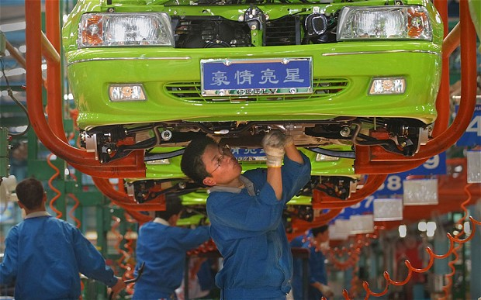
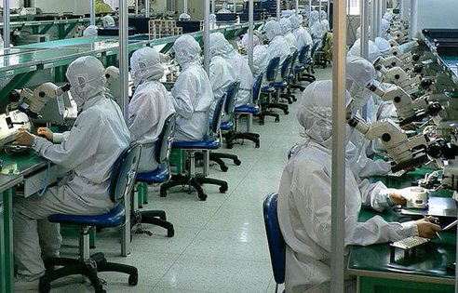
Positive impact
Creates employment
There are jobs available for local people, thus reducing numbers of unemployed and the resultant drain on local resources
Increases skills base
Many MNCs operate training schemes for local people to learn how to use machinery. Such skills also attract other firms to the country
Increased standard of living
An increase in earnings increases taxes paid within the country and gives more money to spend on services

Slide 13
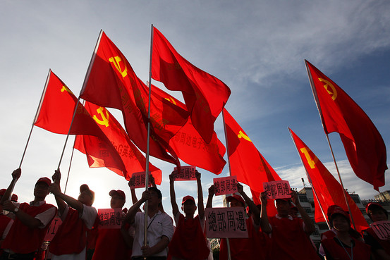
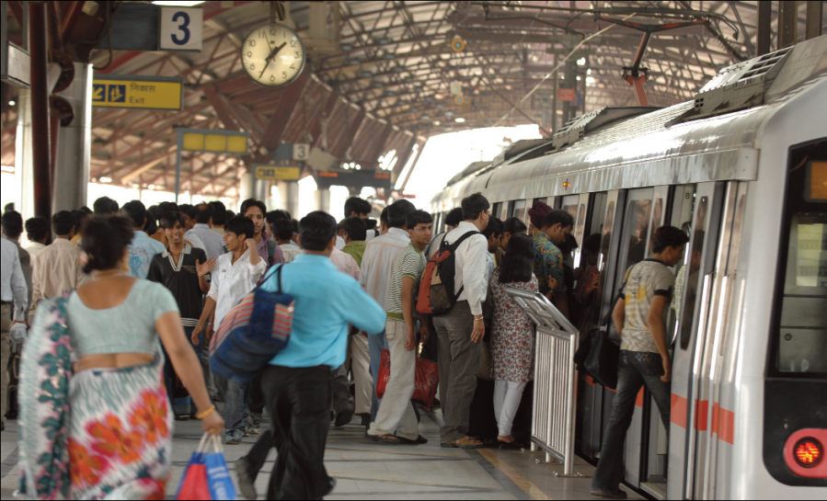
Positive impact
Raises country’s profile
MNCs plan their moves carefully. This is known worldwide and the movement into a particular country is a statement about its pro-business environment and political stability.
Improves balance of payments
Many goods made by MNCs are exported to other nearby countries. This increases amount of money earned by the country.
Improves infrastructure
MNCs often improve communication links within a country, e.g. road, rail and port facilities are updated and expanded. This benefits the country.

Slide 14
FDI
FDI stands for Foreign Direct Investment. Foreign direct investment is investment of foreign money into domestic structures, equipment, and investment in businesses and organisations based in the host country
FDI creates direct, stable and long-lasting links between economies. It encourages the transfer of technology and know-how between countries, and allows the host economy to promote its products more widely in international markets.
FDI is also an additional source of funding for investment and, under the right policy environment, it can be important for the development of the economy of the country.
Notes:
Adapted from:http://economics.about.com/cs/economicsglossary/g/fdi.htm
Also from: http://www.oecd-ilibrary.org/sites/factbook-2013-en/04/02/01/index.html?itemId=/content/chapter/factbook-2013-34-en

Slide 15
Sample question 1
Evaluate the likely impact of multinationals on the economic growth of countries such as Chile. [12]

Slide 16
Sample question 2
[15]

Slide 17
Sample question 3
[6]

Slide 18
Sample question 4
[6]

Slide 19
Revision Video
Notes:
Ignore the term agglomeration spillovers!

