Slide 1
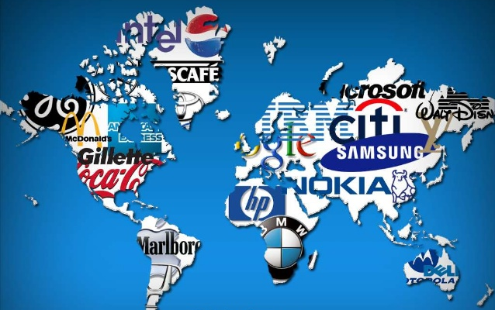
Globalisation Multinational companies
Starter:
From what you know – would you consider that MNCs are good for the poorer countries that they operate in?

Slide 2
Starter Answers
Incoming multinationals bring FDI (Foreign Direct Investment
MNCs create jobs
New investment will increase output of goods & services
Any extra output sold abroad, thus increasing exports, also imports could be reduced
Taxes paid increases government funds enabling them to improve their services
An efficient multinational might make high-quality products available at lower prices than there were previously found, helping consumers
Increased competition
Improved trade flows

Slide 3
Learning Objectives
Explain what is meant by a multinational company
Explain the reasons for the existence of multinational companies
Evaluate the decision of a business to operate as a multinational company
Evaluate the impact of multinational companies on the countries in which they operate

Slide 4
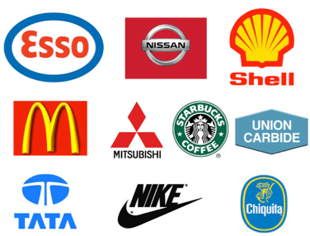
Multinational Defined
A multinational company, sometimes called a transnational corporation, is a company that owns or controls production or service facilities in more than one country.
You may see it written as:
MNC – multinational corporation or company
MNE – multinational enterprise
These are both the same

Slide 5
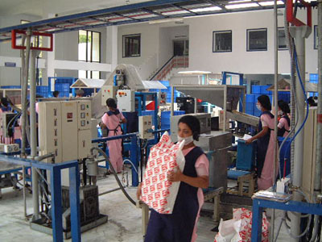
In support of MNCs
Multinationals are a beacon of global capitalism, bringing employment, income and new technologies to poorer countries, driving up incomes and aiding development.
In return wealthier countries (Like UK) get cheaper goods.

Slide 6
BIG MNCs
Most of the largest MNCs are US, Japan, or European
India and China growing rapidly
Example Tata
Tata:

Slide 7
Why have they grown? To access new markets
Domestic market saturated, profits from expansion overseas is tempting
Extension strategy for the product life cycle

Slide 8
Why have they grown? To reduce costs
Economies of scale
Lower unit costs
Enhanced competitive advantage
Especially if products can be standardised across markets
Available, cheap adaptable labour see Global services location Index (Most attractive offshore destinations)

Slide 9
Positive effects of MNCs in other countries
Positive effects
Creates employment
Improves infrastructure
Increases skills base
Improves balance of payments
Increased standard of living
Raises country’s profile

Slide 10
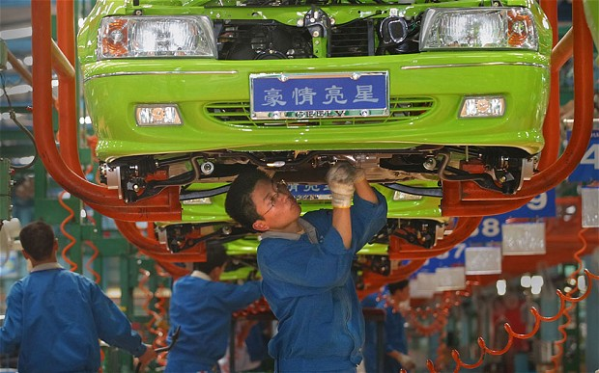
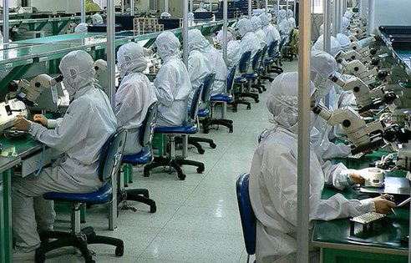
Positive impacts
Creates employment
There are jobs available for local people, thus reducing numbers of unemployed and the resultant drain on local resources
Increases skills base
Many MNCs operate training schemes for local people to learn how to use machinery. Such skills also attract other firms to the country
Increased standard of living
An increase in earnings increases taxes paid within the country and gives more money to spend on services

Slide 11
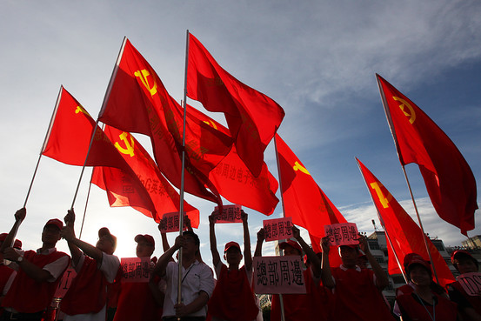
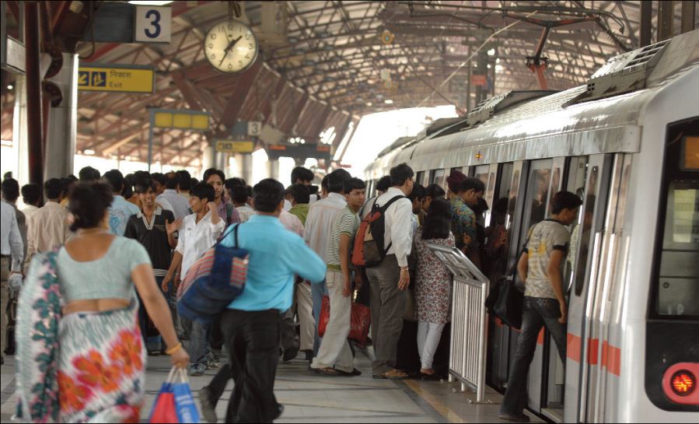
Positive Impacts
Raises country’s profile
MNCs plan their moves carefully. This is known worldwide and the movement into a particular country is a statement about its pro-business environment and political stability.
Improves balance of payments
Many goods made by MNCs are exported to other nearby countries. This increases amount of money earned by the country.
Improves infrastructure
MNCs often improve communication links within a country, e.g. road, rail and port facilities are updated and expanded. This benefits the country.

Slide 12
Foreign Direct Investment (FDI)
FDI stands for Foreign Direct Investment. Foreign direct investment is investment of foreign money into domestic structures, equipment, and investment in businesses and organisations based in the host country
FDI creates direct, stable and long-lasting links between economies. It encourages the transfer of technology and know-how between countries, and allows the host economy to promote its products more widely in international markets.
FDI is also an additional source of funding for investment and, under the right policy environment, it can be important for the development of the economy of the country.
Notes:
Adapted from:http://economics.about.com/cs/economicsglossary/g/fdi.htm
Also from: http://www.oecd-ilibrary.org/sites/factbook-2013-en/04/02/01/index.html?itemId=/content/chapter/factbook-2013-34-en

Slide 13
Advantages and disadvantages of MNCs operating in the UK
Advantages | Disadvantages
Provide employment and create better living standards | Increased competition which can have a negative impact on local industries
Investment lead to infrastructure development | Potential for increased unemployment due to local industries going out of business
Pay taxes to Government | Destroying local culture
Introduce new technology and working methods | Loss of localised products
Increased customer choice | Environmental impact such as pollution, noise, congestion and destruction of the environment.
Increased growth in the economy (many businesses will supply MNCs in their locality)

Slide 14
MNCs operating in the UK
Need investment from MNCs to help drive growth and create jobs
The UK has receive more investment from multinationals over the last 30 years than Germany, France and Italy combined, thus creating thousands of jobs and reinvigorating domestic supply chains.

Slide 15
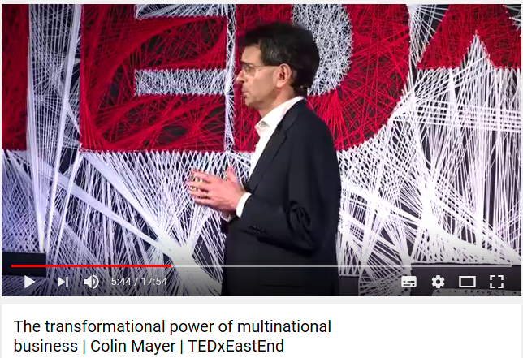

Slide 16
Knowledge and Consolidation Activities
Use the lesson slides, together with pages 688 – 692 to answer the following questions:
Explain what is meant by a MNC
Explain the reason for the existence of MNCs
Explain the possible advantages and disadvantages of MNCs to individual countries
Briefly explain why each of the following businesses might become a MNC a) an oil company b) a mass manufacturing car company c) a fast food chain
Summarise the pros and cons of MNCs operating in UK
Apply the theory you have learned to answer all parts of Question 2 on page 689 (more on next slide)

Slide 17
Research activity
Carry out research to find out:
Top 5 MNCs in the world in 2018 (or 2017 or both as a comparison) measures by revenue / profit
Which MNCs have greater revenues than some countries/economies (give specific examples include figures)
Choose one MNC, investigate where they have operations. Choose one of the countries they operate in to take a closer look at the impact the MNC has had on that country (positive and negative)

