Slide 1

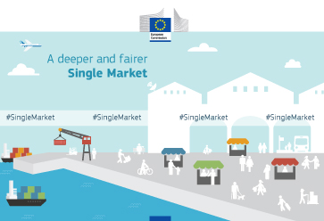
The European Union and the single market

Slide 2
Learning Objectives
Explain the nature and purpose of the European Union (EU) and the single European market
Explain the impact of the EU on businesses including free movements of goods, labour and capital, legislation regulations and standards
Explain what is meant by the single European currency (the euro) and the Eurozone.
Evaluate the costs and benefits of the single European currency to businesses and their stakeholders

Slide 3
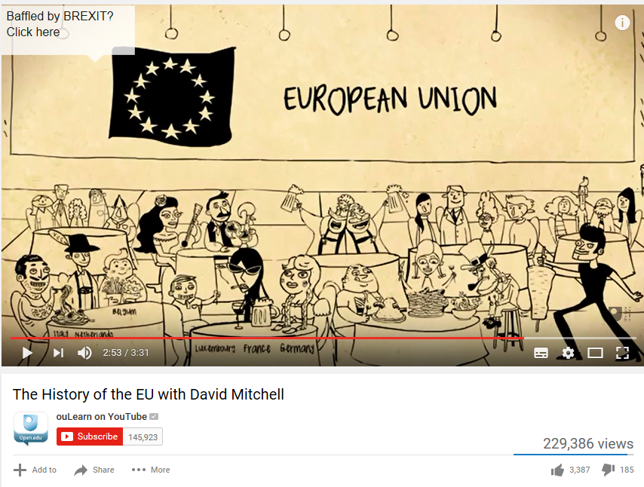
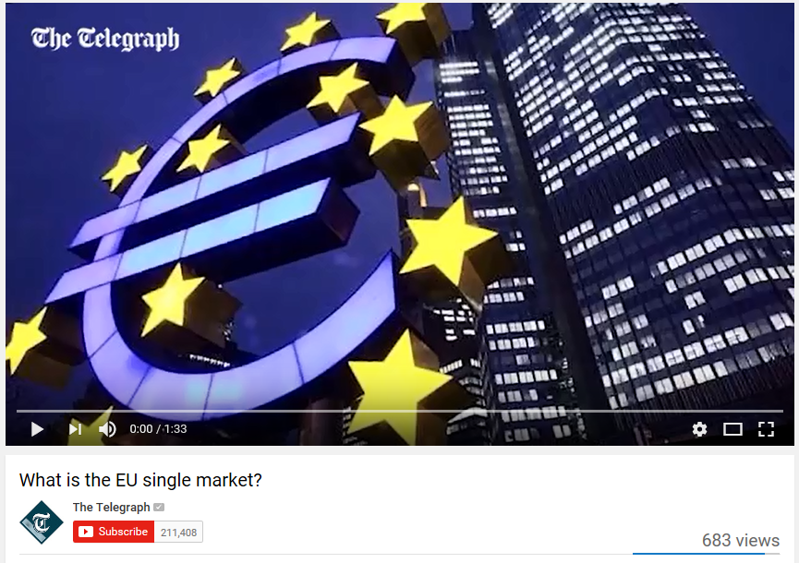

Slide 4
The EU
The EU is a political and economic grouping that currently has 28 countries
World’s largest free trade area
The single market aims to make the whole of Europe the ‘home market
EU member countries have access to an export market of over 500 million people
Many laws and regulations control large parts of business activity, economic policies and trade throughout the EU

Slide 5
The single market
Has been developing since the original establishment of the EEC and is still being refined.
It is not yet complete and there are plans to create an internal market for energy and a single digital market.
Businesses in the single market are able to trade freely
The single market has led to increased competition, increased economies of scale and improved access to resources which in turn allow businesses to increase efficiency and compete on the world stage

Slide 6
The European Union and the single market
What were the reasons for the uk’s decision not TO JOIN THE SINGLE eu CURRENCY?
What are the implications of this?

Slide 7
Learning Objectives
Evaluate the costs and benefits of the single European currency to businesses and their stakeholder
Evaluate the impact to UK businesses of being a member of the EU and Eurozone
Evaluate the impact to UK businesses of not being a member of the EU and the Eurozone

Slide 8
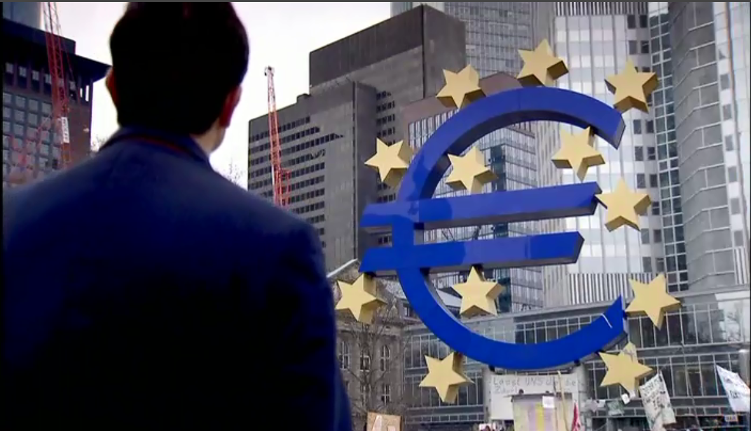
Watch
E-stream – The Great Euro Crash https://estream.godalming.ac.uk:444/View.aspx?id=8287~4z~b2w2tXQE

Slide 9
What is Brexit?
Brexit is short for "British exit" - and is the word people use to talk about the United Kingdom's decision to leave the EU (European Union).
https://www.bbc.co.uk/news/uk-46318565
https://www.bbc.co.uk/news/uk-politics-32810887

Slide 10
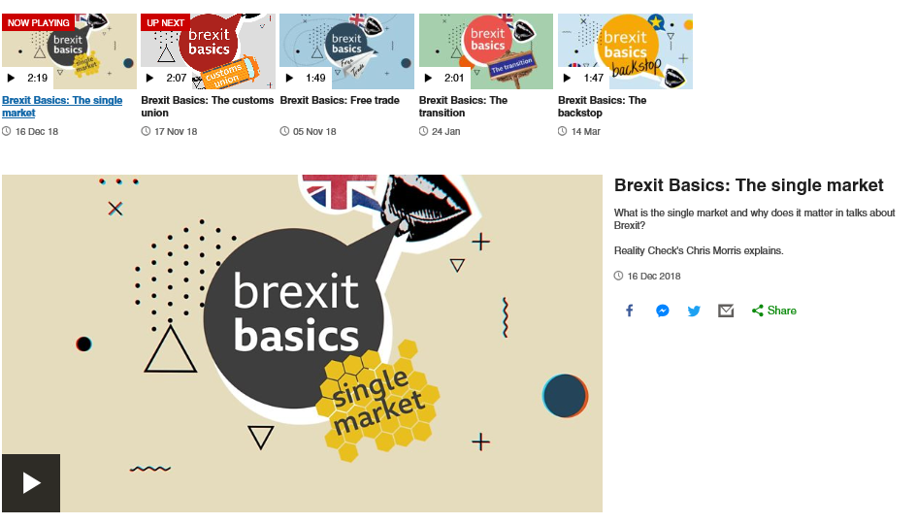

Slide 11
Why is the UK leaving?
A public vote - called a referendum - was held on Thursday 23 June 2016 when voters were asked just one question - whether the UK should leave or remain in the European Union.
The Leave side won by nearly 52% to 48% - 17.4m votes to 16.1m - but the exit didn't happen straight away. It's due to take place on 29 March 2019.

Slide 12
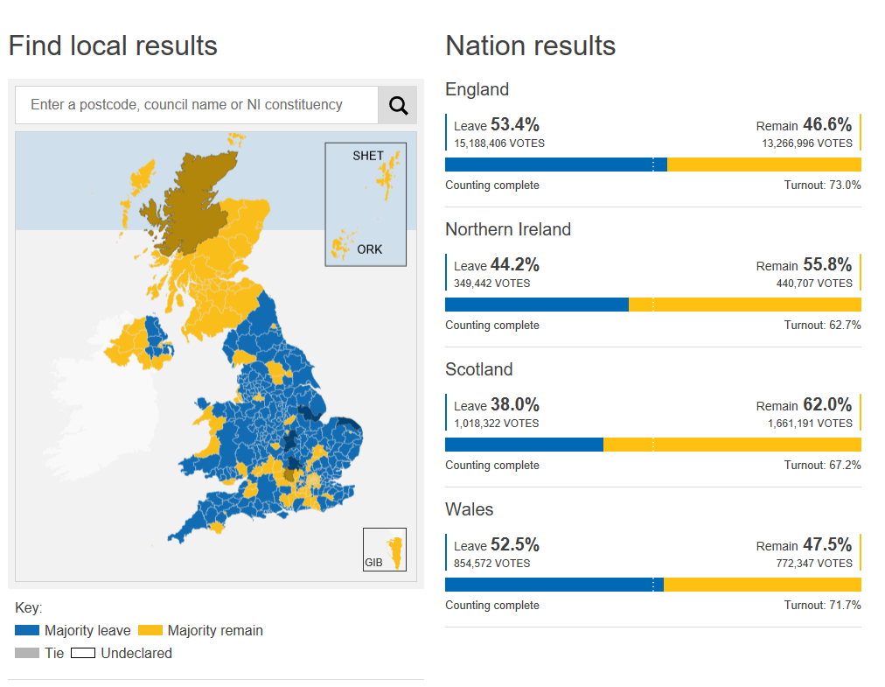
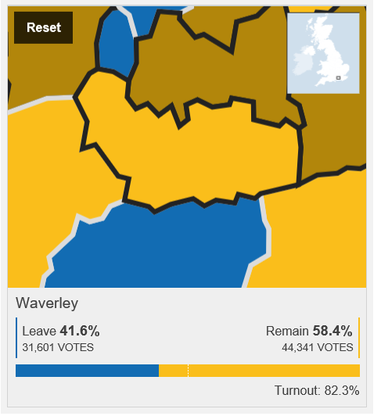

Slide 13
What happens after Brexit day?
The UK formally left the EU on 31 January 2020, but there is still a lot to talk about and months of negotiation to come.
While the UK has agreed the terms of its EU departure, both sides still need to decide what their future relationship will look like.
This will need to be worked out during the transition period (which some prefer to call the implementation period), which began immediately after Brexit day and is due to end on 31 December 2020.
During this 11-month period, the UK will continue to follow all of the EU's rules and its trading relationship will remain the same

Slide 14
What needs to be agreed?
The transition period is meant to give both sides some breathing space while a new free trade agreement is negotiated.
This is needed because the UK will leave the single market and customs union at the end of the transition. A free trade agreement will allow goods to move around the EU without checks or extra charges.
If a new one cannot be agreed in time, then the UK faces the prospect of having to trade with no deal in place. That would mean tariffs (taxes) on UK goods travelling to the EU and other trade barriers.
Aside from trade, many other aspects of the future UK-EU relationship will also need to be decided. For example:

Slide 15
What needs to be agreed?
Law enforcement, data sharing and security
Aviation standards and safety
Access to fishing waters
Supplies of electricity and gas
Licensing and regulation of medicines
Prime Minister Boris Johnson insists the transition period will not be extended, but the European Commission has warned that the timetable will be extremely challenging.
Read the article ‘What is the transition period?’ https://www.bbc.co.uk/news/uk-politics-50838994
& What trade deals has the UK done so far? https://www.bbc.co.uk/news/uk-47213842
Watch video: https://www.bbc.co.uk/news/uk-politics-50838994

Slide 16
What is the Brexit deal?
The transition period and other aspects of the UK's departure were agreed in a deal called the withdrawal agreement.
Most of that was negotiated by Theresa May's government. But after Mr Johnson replaced her in July 2019, he negotiated some changes to it.
Read the article – ‘What is in Boris Johnson’s new deal with the EU’ on GOL

Slide 17
What is the Brexit deal?
The key change is that under Mr Johnson's deal, a customs border will effectively be created between Northern Ireland and Great Britain. Some goods entering Northern Ireland from Great Britain will be subject to checks and will have to pay EU import taxes (known as tariffs).
These would be refunded if goods remain in Northern Ireland (ie are not moved to the Republic of Ireland).
The rest of the withdrawal agreement is largely unchanged from the one negotiated by Mrs May. This includes:
  The rights of EU citizens in the UK and British citizens in the EU (which will remain the same during the transition)
  How much money the UK is to pay the EU (estimated to be about £30bn).

Slide 18
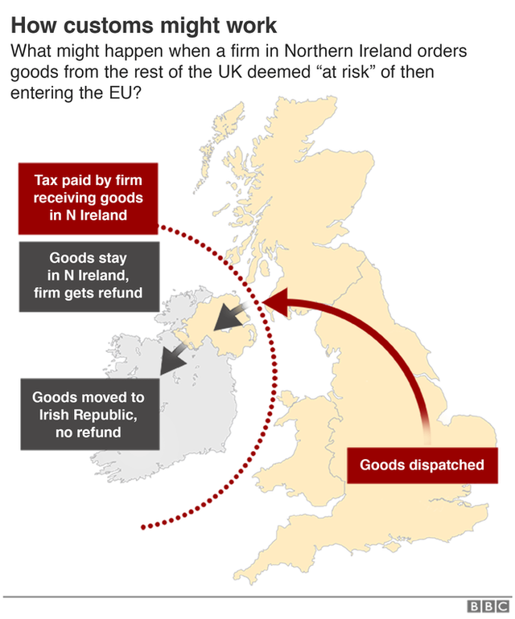

Slide 19
Why did Brexit take so long?
Brexit was originally meant to happen on 29 March 2019, but the deadline was delayed twice after MPs rejected the deal negotiated by Mrs May, the prime minister at the time.
After MPs voted down the deal for a third time, Mrs May resigned.
Mr Johnson needed a Brexit extension of his own after MPs failed to get the revised deal passed into law.
This led to the new deadline of 31 January 2020.
Mr Johnson then called an early general election, to which MPs agreed.
The election, which happened on 12 December 2019, resulted in a Conservative majority of 80.
With a sizeable majority in Parliament, it proved straightforward to pass the Brexit legislation.

Slide 20
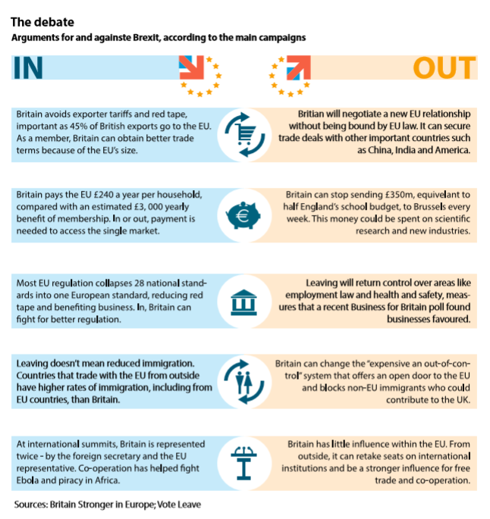
The debate
Read through the WJEC handout for the argument for and against Brexit, according to the main campaigns

Slide 21
Companies that backed the Remain Campaign
Companies that backed the Leave Campaign
Airbus
Unilever
Easyjet
Anne Summers
HSBC
Asda
M&S
Credit Suisse
BT
Vodafone
Astrazeneca (pharmaceuticals)
BAE Systems (technology)
Ryanair
JCB
Dyson
JD Wetherspoon
Reebok
Phone 4 u
Patisserie Valerie
British Hovercraft Company
JML
Timpson (shoe repairs….)
Legal and General
Tate and Lyle Sugar

