Slide 1
AQA
A Level
Computer Science
Paper 2
Adders and D-type flip-flops
Appendix B

Slide 2
Objectives
Recognise and trace the logic of the circuits of a half-adder and a full-adder
Construct the circuit for a half-adder
Be familiar with the use of the edge-triggered D-type flip-flop as a memory unit

Slide 3
Performing calculations using gates
A logic gate circuit can be used to perform the addition of two bits
We will look at two different circuits:
a half adder and
a full adder

Slide 4
Half-adder
A half-adder is a circuit that performs the addition of two bits
It takes an input of two bits A and B and outputs the result S and the carry C
Fill in the output columns:
A |  | B |  | S | C
0 | + | 0 | =
0 | + | 1 | =
1 | + | 0 | =
1 | + | 1 | =

Slide 5
Half-adder Answers
A half-adder is a circuit that performs the addition of two bits
It takes an input of two bits A and B and outputs the result S and the carry C
Fill in the output columns:
A |  | B |  | S | C
0 | + | 0 | = | 0 | 0
0 | + | 1 | = | 1 | 0
1 | + | 0 | = | 1 | 0
1 | + | 1 | = | 0 | 1

Slide 6
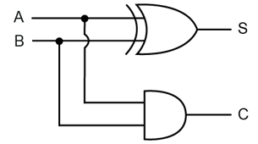
The circuit for a half-adder
S represents the Sum: S = A ⊕ B
C represents the Carry bit: C = A · B
What are the outputs S and C if A and B are both equal to 1?

Slide 7
Limitation of a half-adder
The half-adder has only two inputs so it cannot use the carry from a previous addition as a third input to a subsequent addition
It can only add one-bit numbers

Slide 8
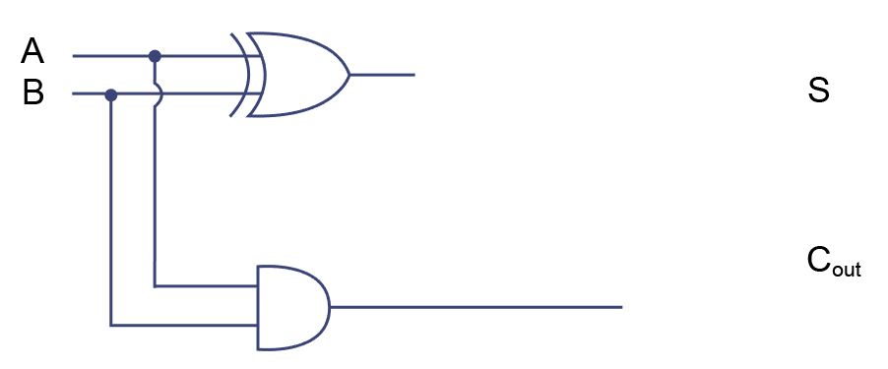
Full adders
A full adder combines two half-adders
It has three inputs, A, B and the carry bit C_{in}, and two outputs S and C_{out}

Slide 9
Full adders
The second part of the circuit, shown in pale blue, inputs the carry bit C_{in}, from the previous operation
The circuit outputs S and the new carry C_{out}

Slide 10
Complete the truth table for the full adder
A |  | B |  | C_{in} |  | S | C_{out}
0 | + | 0 | + | 0 | =
0 | + | 0 | + | 1 | =
0 | + | 1 | + | 0 | =
0 | + | 1 | + | 1 | =
1 | + | 0 | + | 0 | =
1 | + | 0 | + | 1 | =
1 | + | 1 | + | 0 | =
1 | + | 1 | + | 1 | =

Slide 11
Truth table for the full adder
A |  | B |  | C_{in} |  | S | C_{out}
0 | + | 0 | + | 0 | = | 0 | 0
0 | + | 0 | + | 1 | =
0 | + | 1 | + | 0 | =
0 | + | 1 | + | 1 | =
1 | + | 0 | + | 0 | =
1 | + | 0 | + | 1 | =
1 | + | 1 | + | 0 | =
1 | + | 1 | + | 1 | =

Slide 12
Truth table for the full adder
A |  | B |  | C_{in} |  | S | C_{out}
0 | + | 0 | + | 0 | = | 0 | 0
0 | + | 0 | + | 1 | = | 1 | 0
0 | + | 1 | + | 0 | =
0 | + | 1 | + | 1 | =
1 | + | 0 | + | 0 | =
1 | + | 0 | + | 1 | =
1 | + | 1 | + | 0 | =
1 | + | 1 | + | 1 | =

Slide 13
Truth table for the full adder
A |  | B |  | C_{in} |  | S | C_{out}
0 | + | 0 | + | 0 | = | 0 | 0
0 | + | 0 | + | 1 | = | 1 | 0
0 | + | 1 | + | 0 | = | 1 | 0
0 | + | 1 | + | 1 | =
1 | + | 0 | + | 0 | =
1 | + | 0 | + | 1 | =
1 | + | 1 | + | 0 | =
1 | + | 1 | + | 1 | =

Slide 14
Truth table for the full adder
A |  | B |  | C_{in} |  | S | C_{out}
0 | + | 0 | + | 0 | = | 0 | 0
0 | + | 0 | + | 1 | = | 1 | 0
0 | + | 1 | + | 0 | = | 1 | 0
0 | + | 1 | + | 1 | = | 0 | 1
1 | + | 0 | + | 0 | =
1 | + | 0 | + | 1 | =
1 | + | 1 | + | 0 | =
1 | + | 1 | + | 1 | =

Slide 15
Truth table for the full adder
A |  | B |  | C_{in} |  | S | C_{out}
0 | + | 0 | + | 0 | = | 0 | 0
0 | + | 0 | + | 1 | = | 1 | 0
0 | + | 1 | + | 0 | = | 1 | 0
0 | + | 1 | + | 1 | = | 0 | 1
1 | + | 0 | + | 0 | = | 1 | 0
1 | + | 0 | + | 1 | =
1 | + | 1 | + | 0 | =
1 | + | 1 | + | 1 | =

Slide 16
Truth table for the full adder
A |  | B |  | C_{in} |  | S | C_{out}
0 | + | 0 | + | 0 | = | 0 | 0
0 | + | 0 | + | 1 | = | 1 | 0
0 | + | 1 | + | 0 | = | 1 | 0
0 | + | 1 | + | 1 | = | 0 | 1
1 | + | 0 | + | 0 | = | 1 | 0
1 | + | 0 | + | 1 | = | 0 | 1
1 | + | 1 | + | 0 | =
1 | + | 1 | + | 1 | =

Slide 17
Truth table for the full adder
A |  | B |  | C_{in} |  | S | C_{out}
0 | + | 0 | + | 0 | = | 0 | 0
0 | + | 0 | + | 1 | = | 1 | 0
0 | + | 1 | + | 0 | = | 1 | 0
0 | + | 1 | + | 1 | = | 0 | 1
1 | + | 0 | + | 0 | = | 1 | 0
1 | + | 0 | + | 1 | = | 0 | 1
1 | + | 1 | + | 0 | = | 0 | 1
1 | + | 1 | + | 1 | =

Slide 18
Truth table for the full adder
A |  | B |  | C_{in} |  | S | C_{out}
0 | + | 0 | + | 0 | = | 0 | 0
0 | + | 0 | + | 1 | = | 1 | 0
0 | + | 1 | + | 0 | = | 1 | 0
0 | + | 1 | + | 1 | = | 0 | 1
1 | + | 0 | + | 0 | = | 1 | 0
1 | + | 0 | + | 1 | = | 0 | 1
1 | + | 1 | + | 0 | = | 0 | 1
1 | + | 1 | + | 1 | = | 1 | 1

Slide 19
Concatenating full adders
Multiple full adders can be connected together
n full adders can be connected together to input the carry bit into a subsequent adder along with two new inputs
The concatenated adder can thus add two binary numbers each of n bits

Slide 20
Concatenating full adders
 | 1 ^{C}₄ | 1 ^{C}3 | 1 ^{C}2 | 1 ^{C}1
 |  | 0 ^{A}₃ | 1 ^{A}₂ | 1 ^{A}₁ | 1 ^{A}₀ | 7
+ |  | 1 ^{B}₃ | 1 ^{B}₂ | 0 ^{B}₁ | 1 ^{B}₀ | 13
= | 1^{S}₄ | 0 ^{S}₃ | 1 ^{S}₂ | 0 ^{S}₁ | 0 ^{S}0 | 20

Slide 21
Worksheet 4
Try Task 1 on Worksheet 4

Slide 22
Edge-triggered D-type flip-flops
A flip flop is an elemental sequential logic circuit that can store one bit and flip between two states, 0 and 1
A D-type flip flop has one input called D, and two outputs Q and NOT Q
It also has a Clock signal input

Slide 23
The clock
The clock is another type of sequential circuit that changes state at regular time intervals
A clock is needed to synchronise the change of state of flip flop circuits
An edge-triggered D-type flip-flop only changes on the rising edge of the clock signal

Slide 24
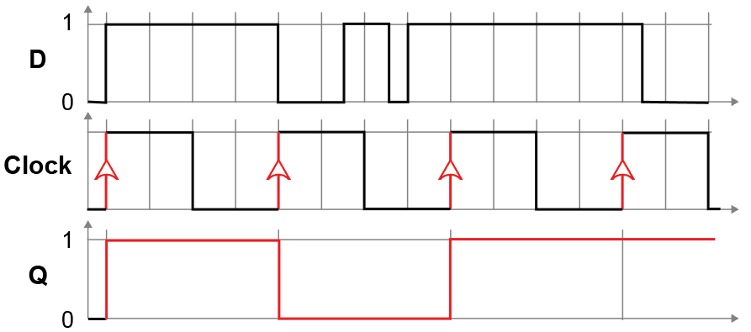
The D-type flip flop as a memory unit
Output Q only takes on a new value if the value at D has changed at the point of a clock pulse
This means that the clock pulse will freeze or ‘store’ the input value at D, in Q until the next clock pulse

Slide 25
D type flip flop
D changes at times marked A, B, C, E, F, G
If D is the same on the next clock pulse, the flip flop will retain its current value, otherwise it will flip
Output Q changes at times marked J, K, L and M
A
B
C
E
F
G
J
K
L
M

Slide 26
Use of D-type flip-flops
D-type flip-flops are used for creating registers and counters
They are used for the intermediate storage needed during arithmetic operations
Static RAM is also created using D-type flip-flops
It is faster and more expensive than regular dynamic RAM which must be periodically refreshed
Static RAM is typically used for cache memory, while DRAM is used for main memory

Slide 27
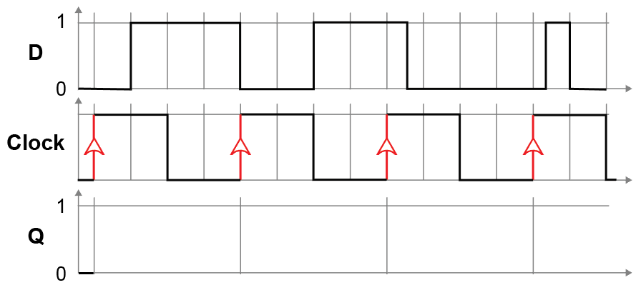
Exercise
Draw the flip flop’s output Q on the graph

Slide 28
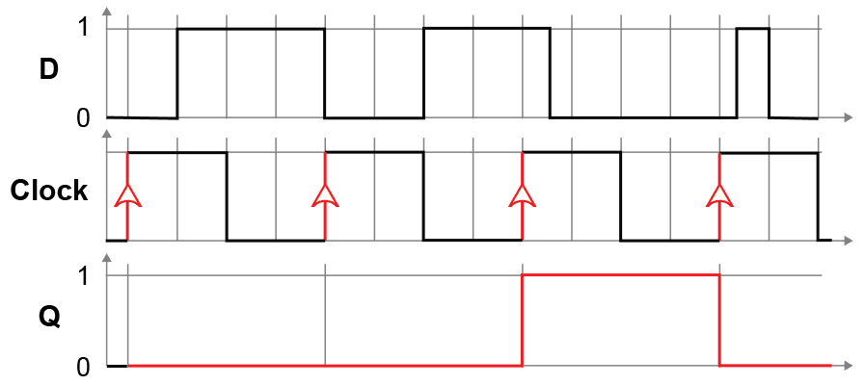
Exercise Answer
Draw the flip flop’s output Q on the graph

Slide 29
Summary
The D type flip flop captures the value of the input D on the rising edge of the clock pulse
The captured value becomes the output
At other times, the output Q does not change
Truth table:
Clock | D | Q _{next}
Rising edge | 0 | 0
Rising edge | 1 | 1
Non-rising edge | X (“Don’t care”) | Q

Slide 30
Worksheet 4
Now try Task 2 on the worksheet

