Slide 1
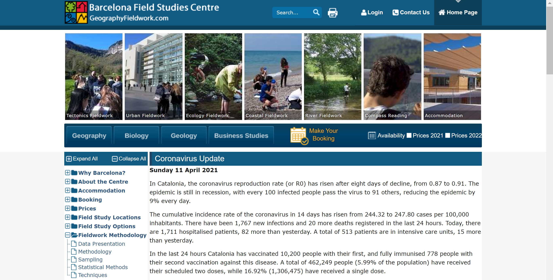
Using the Barcelona Field Study Centre Website for Data Presentation
https://geographyfieldwork.com/
Take some time to explore the different sections of Fieldwork Methodology indicated below. We cannot explore them all in the lesson but will give you lots of ideas of what can be done.
Very useful

Slide 2
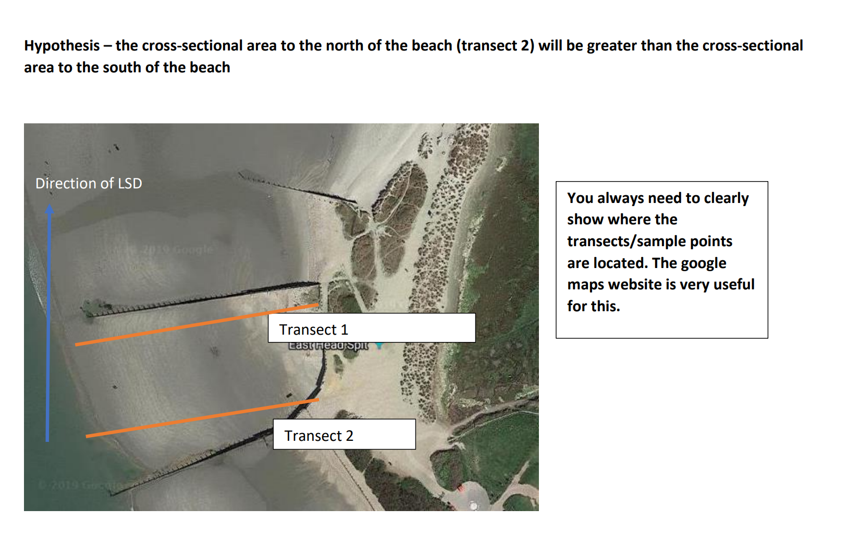
The above will give you excellent data to investigate the impact that groynes have on the profile of a beach.
You could also do a series of transects along a longer section of a beach to see the impact of LSD on transporting material along longer distances e.g. along Chesil Beach (example NEA)

Slide 3
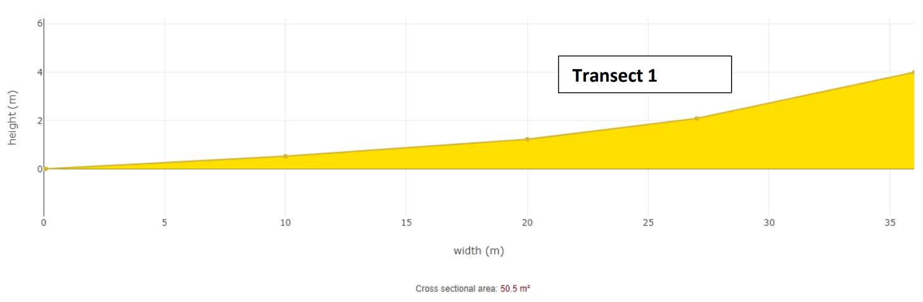
Task – creating a beach profile diagram
https://geographyfieldwork.com/BeachProfile.htm
Notice that this piece of software even calculates the cross sectional area (no maths calculations needed!)
Complete Transect 2 using the data you have been provided on p29 of the booklet and the beach profile maker.
What is the general pattern that you can see? Which transect has the highest point? Which has the greatest/smallest cross-sectional area? Remember to quote data. How does it link with your hypothesis? How does it link with the theory that you have been taught about LSD and the impact that groynes have on the process?

Slide 4
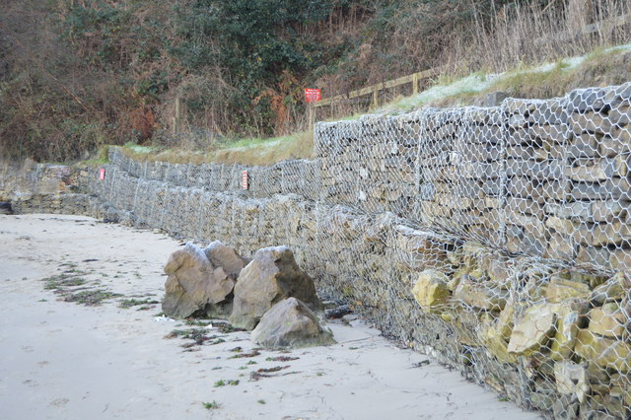
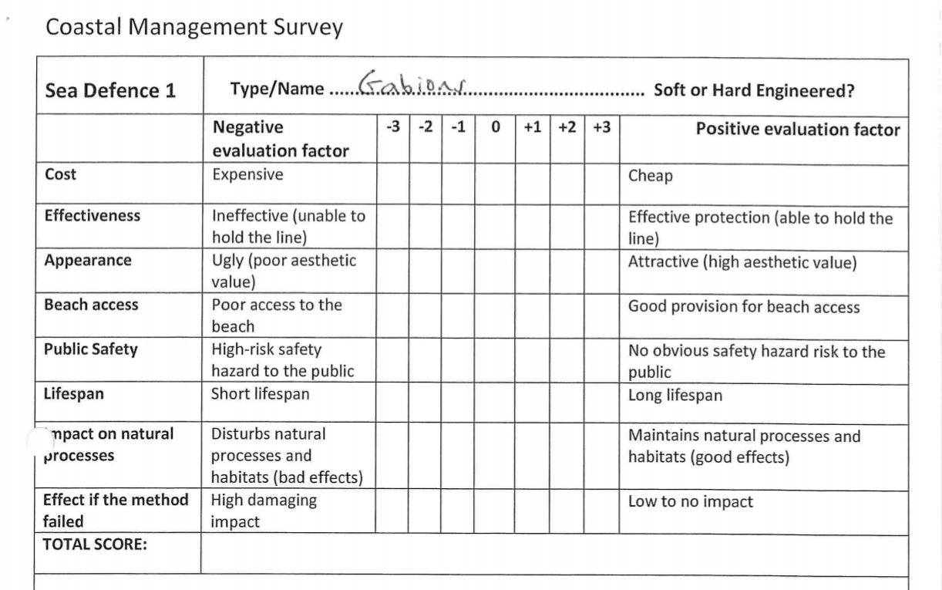
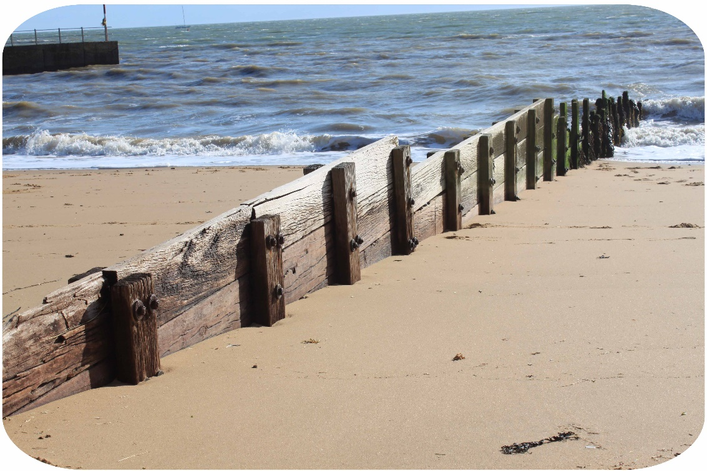
Bi-polar Surveys and annotated photos/sketches
Complete the surveys for both gabions and groynes.
A field sketch could be drawn or a photo annotated for different coastal management techniques Annotate both images with information on what they are made of, how they help reduce coastal erosion and any issues with their use (see guidance on next slide)

Slide 5
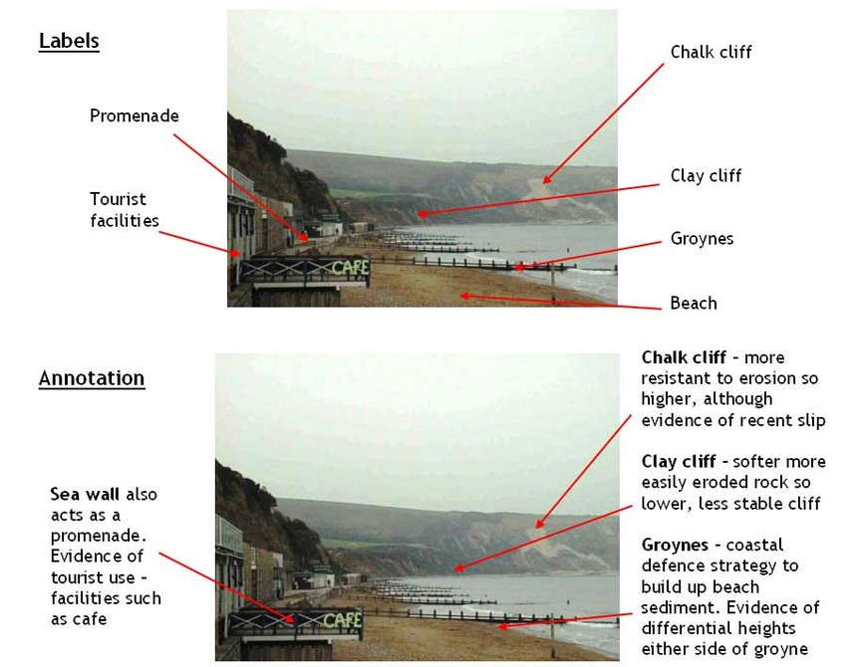
https://www.youtube.com/watch?v=7OMKgVjDB54&list=PLKcXJcNzZvmsUmlInJ4IjbJhFasz4PkNS&index=2
Watch the short clip above on rock groynes and annotate the photograph of the wooden groyne on p31 with information on what they are made of, how they help reduce coastal erosion and any issues with their use.

Slide 6
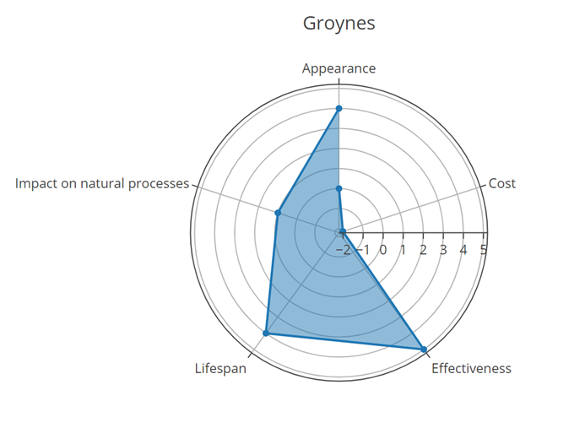
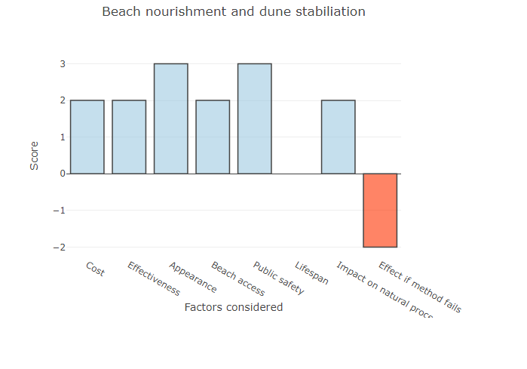
Use these 2 links to the Barcelona Field Studies website to create a bi-polar chart showing your results for the gabions survey and a radar chart for the groynes survey (either could be used to present the data from bi-polar surveys)
https://geographyfieldwork.com/BipolarChartCreator.html
https://geographyfieldwork.com/RadarChartCreator.html

