Slide 1
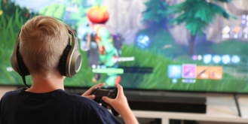
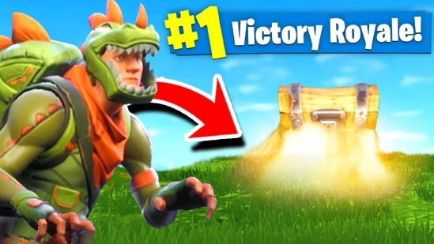
An active audience engages, interprets and responds to a media text in different ways and is capable of challenging the ideas encoded in it.
A passive audience is more likely to accept the messages encoded in a media text without challenge and are therefore more likely to be directly affected by the messages.
Is Fortnite aimed at Active or Passive audiences or both?
Discuss in your pairs.
Bullet point reasons for your response with evidence from what you know about the game so far
How does Epic Games attract this audience?

Slide 2
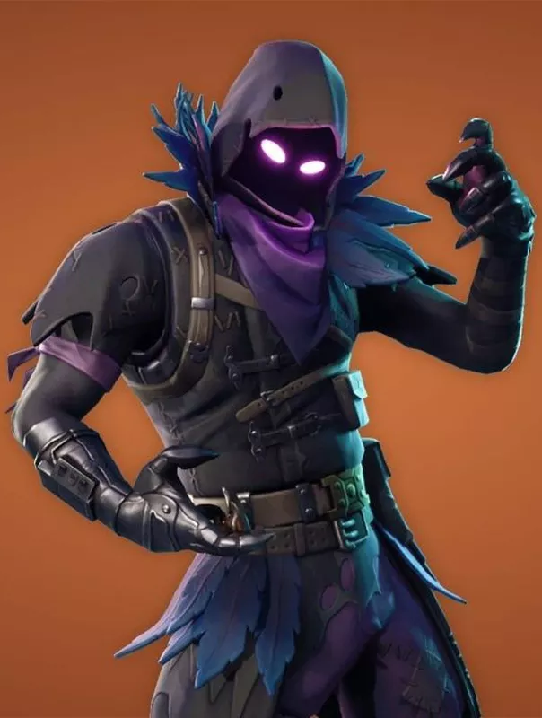
Who plays fortnite?
Do any of these statistics surprise you?

Slide 3
Let’s quickly remind ourselves of the 4 strands of Uses and gratifications theory
Personal Relationships
using the media for emotional interaction.
gaining insight into circumstances of others; social empathy
identifying with others and gaining a sense of belonging
finding a reason/topic for conversation and social interaction
having a substitute for real-life companionship
helping to carry out social roles
enabling one to connect with family, friends and society
Personal Identity
finding yourself reflected in texts
learning behaviour and values from texts
understanding yourself more through media texts
finding media texts that agree with your views, ideologies and values (e.g. political/ social)
finding models of behaviour – finding ways to behave/ act identifying with someone in the media – their views/ looks/ lifestyle etc.

Slide 4
Let’s quickly remind ourselves of the 4 strands of Uses and gratifications theory
Entertainment/ Diversion
Diversion/ Entertainment – .
escaping, or being diverted, from problems
Relaxing
getting intrinsic cultural or aesthetic enjoyment
filling time
emotional release
Information/ Surveillance
finding out about relevant events and conditions in immediate surroundings, society and the world
seeking advice on practical matters or opinion and decision choices
satisfying curiosity and general interest
learning; self-education
gaining a sense of security through knowledge

Slide 5
Independent practice: Watch the battle pass trailer and apply u&G to it
https://www.youtube.com/watch?v=Qv53Wvq_9pk

Slide 6
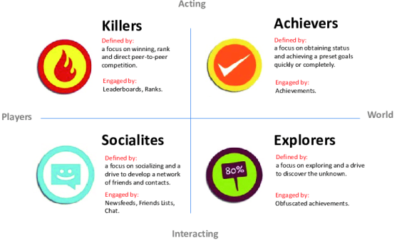
Independent practice Exam style question:
Explain how Fortnite appeals to audiences. Refer to Uses and Gratifications theory in your response.
Success criteria:
Discussed the audience in relation to Fortnite (demographics)
Demonstrated an understanding of why they play Fortnite
Referenced Uses and Gratifications theory
Used Media Language throughout
12 mark question

Slide 7
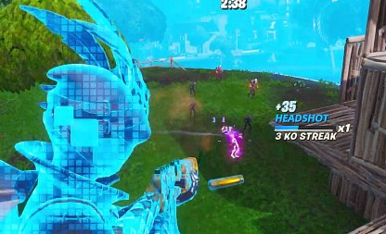
Self assess on the sheet
Make sure you are honest with yourself!

Slide 8
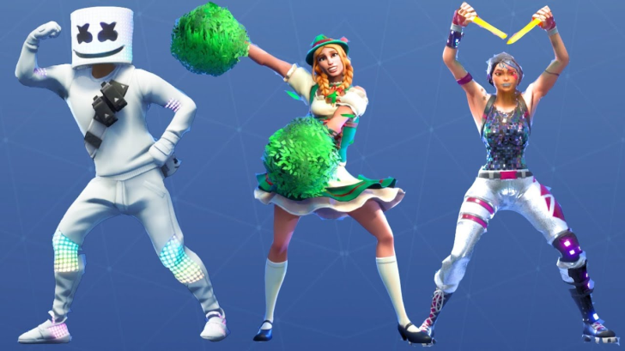
plenary
Swap answers in your pairs
Tick or cross next to the success criteria
Give them a STRENGTH
Ask them a QUESTION to help them IMPROVE their work
Explain how Fortnite appeals to audiences. Refer to Uses and Gratifications theory in your response.
Success criteria:
Discussed the audience in relation to Fortnite (demographics and Bartle’s Taxonomy)
Demonstrated an understanding of why they play Fortnite
Referenced Uses and Gratifications theory
Used Media Language throughout

