Slide 1
COMPONENT 1
Portfolio Requirements
Component 1 = 40% of your final grade

Slide 2
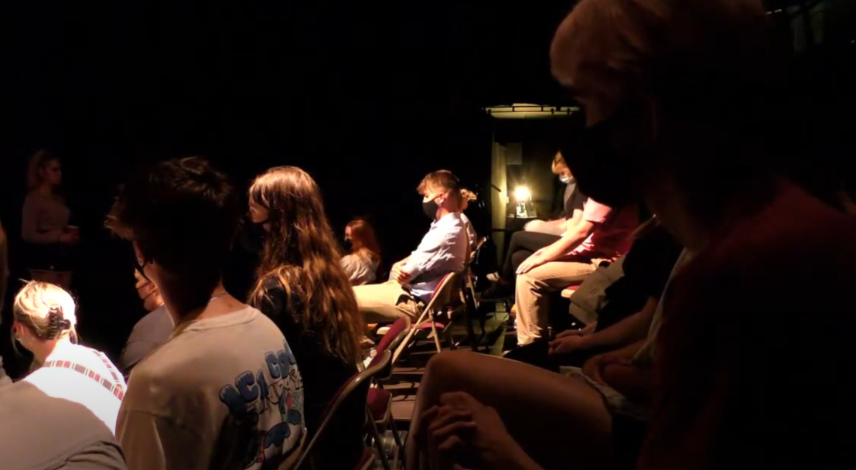
IT WILL BE EASIER TODAY IF YOU SIT IN YOUR PERFORMANCE COMPANIES

Slide 3
CONGRATULATIONS for a very successful season of devised work …
Some of you have discussed your work, others haven’t
  Work that you saw that you enjoyed / appreciated
  Work that you question / want to interrogate a little more
Brief Feedback

Slide 4
THANK YOU
To those who supported their peers on other nights – we know you would have got a lot out of that commitment
    Please remember there is an expectation that you do support the work of the department and we hope by now everyone has watched all the HOMEGROWN performances on estream

Slide 5
Please remember poor UNCHECKED spelling, grammar and sentence structures will loose you marks

Slide 6
FOOTNOTES
AN EXAMPLE (again!)
http://www.thedramateacher.com/theatre-of-cruelty-conventions/ (Accessed 19/04/22) This taught me about Artaud's own opinion on theatre, developed to pierce the boil of society.
THE ACTUAL SOURCE
WHEN THE SITE WAS LOOKED AT
A BRIEF ONE SENTENCE SUMMARY OF FINDINGS

Slide 7

TODAY our focus is QUESTION 5
QUESTION 6

Slide 8
Discuss how social, historical and cultural contexts impacted on your work (AO1) 600 words

Slide 9

This is a vital question!
THIS ONE HAS TO BE MORE THAN AMAZING!!!
If the moderator only looks at one answer then this will be it!
This is the academic answer … do the work!

Slide 10
‘The Believers’, by Bryony Lavery, was first performed in 2014 – a year after The National Crime Agency released its Child Abduction Report (which was a significant stimulus for Lavery). Our group took inspiration from this key theme in the text extract as child abductions/missing children is still a relevant topic to a contemporary audience as it is evident that child kidnappings are increasing. This first performance was a motivating force for our use of symbolic, stylised and minimalistic set as well as creating multiple settings with the same set.

Slide 11
The focus for you is to consider how the social, historical and cultural contexts has impacted the final performance, informed artistic choices and affected key decisions in the rehearsal room.
Can someone unpick this / interrogate it a little for us?

Slide 12
This requirement provides another opportunity for you to demonstrate an understanding of the play as a whole and how your key extract helps to connect to the social, historical and cultural contexts of the performance text
Can someone explain what each of the three contexts actually mean?

Slide 13
Bartlett’s ‘The Plague’ was first performed in 2017, during a time of massive uncertainty in the Western world because of the unrest caused in the UK with Brexit and the rise of Trump and ‘fake news’ in America. Furthermore, the situation with Syria instilled fear in society because of the increase in terror attacks. This puts the plague into a modern day context as Camus’ book was originally written as a response to the atrocities of WW2 and the Holocaust. Our group took inspiration from the key theme isolation which is prominent throughout our extract. We chose to contextualize this by presenting the plague as extremism and wanted to explore the right wing views regarding immigration and terrorism.

Slide 14
You might use this area of investigation to outline why and how this performance text is or is not relevant to a contemporary audience. IS IT? IF SO – WHY?
Comparisons might be made to the original performance conditions of the text. Do you know them? SHARE
There are a number of ways that you can
engage with this requirement. You might use this section of the portfolio to discuss how design elements were used to help reinforce key social/historical/cultural
ideas and contexts. SHARE …. Simply, were they?
In your small groups have a go at answering each of the questions

Slide 15
WHY IS THIS PIECE WORTH STAGING TODAY?
What relevance does it have to contemporary society?
Where have the ideas come from?
You need to put the story and its message into a context.
One practitioner will have a go at answering

Slide 16
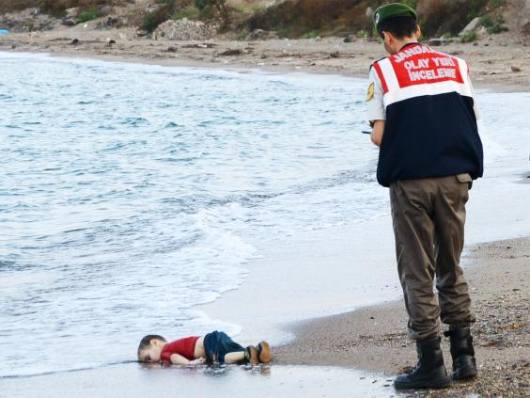
EXAMPLE
I conducted some research into the European migrant crisis which began in 2015 and was deeply shocked with the poignant image and story of Aylan Kurdi which seemed to sum up societies complete lack of compassion. We wanted to highlight the disconnect we have in our nation by representing refugees or victims of terrorism as humans and not statistics regardless of their religion or ethnic background. Using verbatim material was effective, using quotes from politicians and journalists made our production relevant to our audience and gave it an authenticity.

Slide 17
QUIETLY READ AND THE WE WILL DISCUSS ANY PROBLEMS THAT ARISE
What are the factors that inspired the stimulus/genre to be centred in the first place? An historical event or movement? An artistic viewpoint? A personal opinion or form of expression? A discovery or documenting on scientific fact or theory? What were the defining details linked to the importance or impact of the stimulus? How have you reflected these factors in your work? Have you created a sense of period, followed a particular ideology or religious motivation? Have you taken a philosophical or abstract view of the inspiring aspects of the stimulus? How was this shown in the work? What were you trying to say about the world today?

Slide 18
QUIETLY READ AND THE WE WILL DISCUSS ANY PROBLEMS THAT ARISE
How were you reflecting elements of your own experiences and opinions in the work. How might they reinforce/contradict the perceived values of the audience? Did you embrace a specific genre to reflect or illuminate a specific aspect of culture or society? Did you achieve this in performance? How did the work develop as a result of changing concepts within the group which relate to these elements? Were your chosen genres and devices in themselves a direct result of social, cultural or historical concepts or events and did you use them to achieve the same ends?

Slide 19

When was the play written? What was going on at the time of writing that may have influenced the work?
If you know the answers share them – if you don’t then allocate research tasks and how the work will be shared.

Slide 20
EXAMPLE
Our group’s key question: “how far would you go in the name of your religion?” was chosen as it’s very relevant today with the widespread fear of terrorism and radical, extremist religious groups. Our performance reflected this with the family being blinded by their faith and thus twisting their morality. Additionally, people are leaning more and more against religion nowadays, partially due to extremism, and it has become increasingly ‘fashionable’ to be an atheist in today’s Western world.

Slide 21
How did you respond to the language of the EXTRACT and how was it influenced by the socio- historical conditions of the time the play was written?
In your small groups have a go at answering each of the questions

Slide 22
What is the form and genre of the EXTRACT?
Monologues, epilogues, epic, naturalistic, abstract, dialogue, physical theatre, mime, melodrama, flashback
Comedy, Tragedy, Epic Theatre, Naturalism,

Slide 23
How did you respond to the form and genre of the text extract?
In your small groups have a go at answering

Slide 24
SOCIAL
What was your piece saying about society?
What is society’s attitude to the topic you have chosen?
Do you agree with this?
How does your piece explore the relationship between the individual and their place in society?
Why do you think this theme / idea needs to be said to an audience through theatre?
What is happening in society at the moment that impacted upon your work?

Slide 25
EXAMPLE
Due to the rise in technology, and the current generation’s attitude towards it, it’s a common widespread fear for parents to protect their children from strangers/child predators. However, from our research I discovered that it’s much more common for a family member to kidnap a child than a stranger, further leading us to the development of the idea of filicide. This idea was then reflected in the staging: the police interrogation scene opened the performance in-media-res, with the family on a lower proxemic to the interrogator. This was further enhanced by a distorted shadow projection of the missing girl upstage centre, giving her centrality in this scene and symbolising their guilt through her ominous presence.

Slide 26
SOCIAL
What was your piece saying about society?
What is society’s attitude to the topic you have chosen?
Do you agree with this?
How does your piece explore the relationship between the individual and their place in society?
Why do you think this theme / idea needs to be said to an audience through theatre?
What is happening in society at the moment that impacted upon your work?
In your small groups have a go at answering

Slide 27
CULTURAL
Who was your chosen audience?
Culturally – why did you choose this audience?
What do you think their ideas of theatre are?
What do you think their response to your piece was?
What different cultural attitudes are represented in your piece and how have they been presented? For example, youth cultures, drug culture or the culture of crime

Slide 28
EXAMPLE
Culturally, our audience were theatrically literate, white, middle-classed and aged 16-25. Therefore, our audience grew up surrounded by the case of Madeleine McCann. However, whilst devising our piece the case came back into the press. It is evident that there are still elements within both the police and public in the UK and Portugal who suspect the parent’s complicity in Madeleine’s disappearance. Additionally, the case of the McCann’s has maintained media fascination and it could be argued that this is because Madeleine is a white, blonde girl from a privileged background whose parents have been skillful in ensuring continued public attention. We took these into consideration and based the character of Grace quite similarly to Madeleine McCann (Grace being the age Madeleine would be now) and the idea of her parents as being secretive and manipulative.

Slide 29
CULTURAL
Who was your chosen audience?
Culturally – why did you choose this audience?
What do you think their ideas of theatre are?
What do you think their response to your piece was?
What different cultural attitudes are represented in your piece and how have they been presented? For example, youth cultures, drug culture or the culture of crime
In your small groups have a go at answering

Slide 30
HISTORICAL
How have you used your research and knowledge of the past to inform what you have presented?
What historical event fed into your piece / was your piece like?
Are there any historical events that you have taken to inform your work?
If your piece is political what points of view are you representing?
In your small groups have a go at answering

Slide 31
You are to upload a DRAFT of question FIVE and SIX by Wednesday 24TH May 2023
ENSURE YOU TITLE THE DOCUMENT – DRAFT QUESTION 5 and DRAFT 6 (a separate document)
Your lead tutor will mark ONE of these drafts

Slide 32

QUESTION 6
The evaluative question

Slide 33
Evaluate the creative choices you made and whether or not they were successful in performance (500 words)
Write down this question.

Slide 34
I believe our performance was successful in portraying our subject matter and raising awareness of the issues of fascism and extremism; we wanted to address the issue of disconnect the western world often have to issues regarding people of different religious and ethnic backgrounds. Our key question was, ‘Does isolation really solve extremism?’ as we wanted to challenge the hegemony and spark questions regarding the treatment of immigrants and refugees. The mirror scene was effective at using movement as a metaphor to convey the conformity which Eve was forced into, this was influenced by Frantic.

Slide 35
What is the difference between ANALYSE and EVALUATE?
IT IS VITAL YOU UNDERSTAND THIS AS IT RESPONDS TO THE MARK SCHEME
Work in your performance Company
Prepare a definition of each in relation to drama coursework

Slide 36
You must analyse and evaluate in equal measure to ensure top band marks
ANALYSE
EVALUATE
Analysis is the process of breaking a complex topic or substance into smaller parts to gain a better understanding of it.
Evaluation is systematic determination of merit, worth, and significance of something or someone using criteria against a set of standards.

Slide 37
What is the difference between TANGIBLE and INTANGIBLE feedback?
Work in your performance Company
Prepare a definition of each in relation to drama coursework

Slide 38
Intangible evidence shows that this scene shocked the audience, which was the intention. We have contrasting tangible evidence from both a critical audience member which states that this scene felt out of place and an audience member who felt this scene was powerful in its meaning, so I think this movement sequence was successful at portraying the anger in racist attitudes but we could have raised the energy throughout our piece in order for it to fit in.

Slide 39
In your small groups share feedback quotes
Work to reflect on and think about:
    What feedback have you received from audience members?
    (Tangible and Intangible)
Direct quotes that you can ALL write down and use within your work or in your footnotes. This can also include ‘critical audience’ notes from your dress rehearsal so I hope you kept hold of them?
Audience reactions:
Silence, Tension, Crying, Laughing etc

Slide 40
AIMS AND INTENTIONS
You need to all agree, so it might be worth agreeing these between you all on a group chat / email during the week

Slide 41
AIMS AND INTENTIONS
Essentially you have to know what your aims and intentions of
your piece were!!
    What did you want your audience to feel/think?
    What experience did you want them to have?
Once you have agreed this, pick FIVE CLEAR KEY MOMENTS in
your piece, and say how each moment attempts to meet your aims and
intentions and how successful it was (or not) and how you know!

Slide 42
AIMS AND INTENTIONS
TASK TO DO NOW
Essentially you have to know what your aims and intentions of your piece were!!
    What did you want your audience to feel/think?
    What experience did you want them to have?
    WHAT WERE YOUR AIMS AND INTENTIONS?
    DEVELOP YOUR KEY QUESTION NOW …

Slide 43
AIMS AND INTENTIONS
TASK TO DO NOW
Once you have agreed this, pick FIVE CLEAR KEY MOMENTS in your piece, and say how each moment attempts to meet your aims and intentions and how successful it was (or not) and how you know!

Slide 44
FIVE KEY MOMENTS
TASK TO DO NOW
For each key moment be able to:
  Describe what was happening on stage
  Say how the moment attempted to meet your aims and intentions
  Discuss Frantic’s influence on that moment
  Evaluate that moment (with specific audience feedback)

Slide 45
TO BEGIN - ANSWER ….
How well did you realize your initial intentions for staging the extract?
This is evaluation – remember to EVALUATE

Slide 46

Our key message was …
Our aims and intentions for our performance were …
There are several central themes in our production such as ……….., all of which we attempted to get across to the audience, who were ………………. through various dramatic and design techniques such as ………….

Slide 47
EXAMPLE ….
Overall our piece successfully communicated to the audience the central message “Do all acts of evil have to be forgiven?” which can be established from tangible and intangible evidence. We used the central signifiers of the missing children posters to map the journey between frozen-ness at the start when the characters were trapped by their own grief, to being unfrozen at the end, signified by the ripping up and blowing away of the posters. Ralph suddenly realizes the effects of his abuse.
Continued ….

Slide 48
Example continued …
On reflection I do not think this worked as well as we intended as at the start the posters clearly represented many missing children to universalise the narrative but at the end they just represented Rhona’s freedom. Their significance as a signifier was lost.

Slide 49
Onwards …..
How successful were you in making a contribution to the performance?
  An evaluation of WHAT YOU BOUGHT TO THE TABLE … what you contributed

Slide 50
THEN – EVALUATE YOUR FIVE KEY MOMENTS:
1
2
3
4
5
5
Focus on the performance skills and/or design elements utilised in each moment
Link back to Frantic’s influence in the moment
Did you use any symbolic design features – what were you suggesting?
How did the audience respond?
THEN MOVE ONTO THE NEXT KEY MOMENT ………

Slide 51
You are to upload a DRAFT of question FIVE and SIX by Wednesday 24TH May 2023
ENSURE YOU TITLE THE DOCUMENT – DRAFT QUESTION 5 and DRAFT 6 (a separate document)
Your lead tutor will mark ONE of these drafts

