Slide 1
COMPONENT 1 Portfolio Requirements
Component 1 = 40% of your final grade

Slide 2
SPELLING, GRAMMAR SENTENCE STRUCTURE
You can not access top band marks with weak ‘writing’
Grammar
Sentence Structure
Fluidity of writing style
Spelling
Use of key terminology
YOU MUST EDIT AND CHECK YOUR WORK BEFORE YOU HAND IT IN
If SPaG is too weak, we will not feedback on the work
We will let you know if SPaG is weak – but will not correct all mistakes

Slide 3
To achieve you need to be editing and checking your work OR ensuring someone else edits and checks your work.

Slide 4
FOOTNOTES
A reminder for some of you (again!)
10-15 footnotes per question
Websites must have a (Date Accessed 29/01/23) after them
For each source you must give a very brief one sentence summary of your findings from that site
Do not change the spacing font / font size of the footnotes that WORD generates

Slide 5
WE ARE NOW GOING TO REVISIT QUESTIONS 1-4
Sit in your performance companies for this session

Slide 6
The written portfolio essentially responds to the practical work … A DOCUMENT OF YOUR PROCESS AND YOUR THINKING.
If things have changed, but you want to discuss / LEAVE IN content that has been discarded then that is fine!
Your portfolio can be discussing work that did not make it into the final edit

Slide 7
Outline your initial response to the key extract and practitioner and track how it developed throughout the devising process (AO1) 500 words
QUESTION 1

Slide 8
THERE IS A DIFFERENCE BETWEEN … Extract Whole play text
Refer to them as these two different elements.
You are devising from THE EXTRACT making reference to THE WHOLE TEXT
Within QUESTION 1 you need to have discussed how the extract differs / is similar to the whole text

Slide 9
Outline your initial response to the key extract and practitioner and track how it developed throughout the devising process (AO1) 500 words You could make some edits to your first draft, as you now have a complete process to discuss

Slide 10
What did you discover about the first performance of the play?
FOOTNOTE sources
How has this research influenced your work
What ideas / techniques / design aspects are you taking from that first performance
If you are rejecting the above completely justify why you have made that decision
THIS MIGHT BE SOMETHING YOU WANT TO SHARE WITH THE REST OF YOUR PERFORMANCE COMPANY

Slide 11
What is the relationship between the chosen extract and the rest of the play?
Why did you chose the extract you did?
How does that extract fit into the rest of the play?
Is the extract typical (in style, form, structure, technique, genre etc) of the rest of the text?
This is an important discussion

Slide 12
IN YOUR PERFORMANCE COMPANIES BRIEFLY ..
Your Initial response to whole text?
What themes interested you?
This allows you to demonstrate your knowledge and understanding about the playwrights' overall intentions.
What characters jumped out/intrigued you?
Your Initial response to Frantic
What additional research you did
This allows you to demonstrate your knowledge and understanding about the companies’ overall intentions.
Then discuss: Your responses to any FRANTIC productions/extracts that you have seen

Slide 13
Connect your research material/s to key stages in the development process and to performance outcomes (AO1) 600 words
QUESTION 2

Slide 14
Research that is academic / mature
You need to be like an a level practitioner!

Slide 15
RESEARCH REFERS TO
The extract, play text, playwright and any individual research that has been undertaken either for specific scenes or as a general way in to your piece. Find KEY MOMENTS!
Ensure you have completed WIDER RESEARCH on the practitioner, on the performance text and the themes etc. you are exploring
PRACTICAL APPLICATION of your research. How did the research influence your piece in terms of plot outline, style of presentation, images of themes? Your personal research might include articles, DVD and film extracts, blogs, paintings or poetry.

Slide 16
It is important that any key decisions that have been developed as a result of specific research are documented and connected to key moments in rehearsal.
Research might inform:
characterisation
performance style
use of theatrical
conventions

Slide 17
QUESTION 2
THIS IS ABOUT RESEARCH so – continually mention the word RESEARCH or PRACTICE AS RESEARCH
This must have an abundance of
footnotes! Each piece of research must have a FN source and briefly, share some findings in the FN

Slide 18
IN YOUR PERFORMANCE COMPANIES BRIEFLY ..
Share the research that impacted on your work (remember you all need sources)
Discuss how at least two pieces of research have directly influenced performance outcomes or process
Discuss the PRACTICE AS RESEARCH exercises you did (should have done!) during your process work

Slide 19
Evaluate how your chosen role/s emerged and developed from initial ideas through to the final performance (AO4) 300 words
QUESTION 3

Slide 20
Read the question fully
EVALUATE
Not enough of you did this in early drafts
You have to mark/measure success

Slide 21
Unpicking the question
CHARACTER DEVELOPMENT MUST BE EMBEDDED THROUGHOUT
You will be using the phrase PRACTICE AS RESEARCH
Remember to footnote character development exercises / techniques – this is clear evidence as to how you developed your individual roles.

Slide 22
Evaluate how your chosen role/s emerged and developed from initial ideas through to the final performance (AO4) 300 words
You could be playing more than one character – that’s ok.
You may also be a different kind of ‘supporting role’
Where did your ideas come from? How are they linked to the EXTRACT / your key themes?
What function does your character play in the piece?
DEVELOPED:
We have spoken about a lot of STANISLAVSKI character development exercises. You should be utilising these (!!!) at home as part of practrical homework to develop your performance, or as a group in rehearsals
Development and discussion should have also been occurring as you wrote and developed the text together.

Slide 23
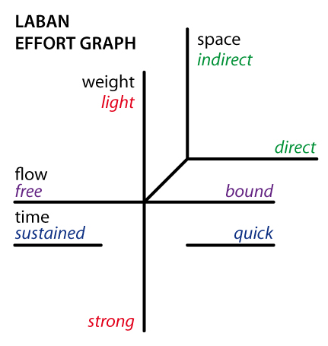
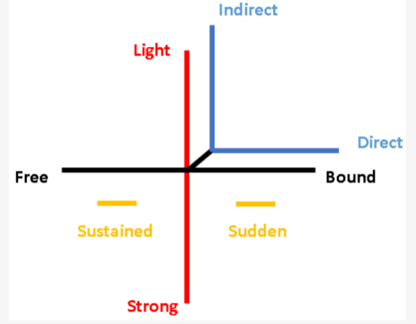
LABAN KEY TERMS:
A REMEINDER OF A LABAN EFFORT GRAPH AND HOW TO COMPLETE IT AND HOW TO USE THE KEY TERMS IN SENTENCES …..
You must include a LE Graph in your answer

Slide 25
IN YOUR PERFORMANCE COMPANIES BRIEFLY ..
Make sure you know what role / character everyone played so you all refer to the same things / names
Make a list of ‘what character development exercises’ you UNDERTOOK and maybe who led them

Slide 26
Analyse how your contribution was influenced by the selected theatre practitioner and/or theatre makers, and the impact live theatre has had on your own practical work (AO4) 500 words
QUESTION 4

Slide 27
PUSH YOURSELF ABOVE AND BEYOND ….
FORGET AND/OR YOU WILL DO BOTH!
Mention FRANTIC and LIVE THEATRE that you have seen online / in recordings or live in the past

Slide 28
DISCUSSING FRANTIC
Don’t just mention the Building Blocks
CAPITAL LETTERS !!
Also mention THEIR CONTEXT, their history and attempt to link that to your work!

Slide 29
Specific questions
How has Frantic Assembly been influenced by their theatrical context? – this requires you to analyze the contextual underpinning of the company’s work (from start to present day)
What social, political, historical aspects are they/were they responding to? – what was ‘going on’ at the time in which would have made Frantic start and continue to create work?
Do these aspects still need addressing today? – are the issues that Frantic were talking about at the time that they start created work still relevant in 2021? If so/not, why?
What social, political, historical aspects are you responding to? – what is happening at the moment that is influencing the theatre that you make?

Slide 30
RESEARCH
You still need to show your understanding of
FRANTIC ASSEMBLY has been driven and
deepened by RESEARCH.
Research includes
watching productions,
looking at their website,
looking at videos of the Building Blocks etc.
Watching other ‘live productions’ that have been influenced by Frantic
Remember to continue to FOOTNOTE SOURCES
Try and use this word RESEARCH within your answer

Slide 31
What sort of practitioner exercises did you use in rehearsal to develop an understanding of the performance and develop ideas for staging the text?
Discuss the Building Blocks
Say what they are
How you used them
Why you used them
Whether they were successful or not

Slide 32
TO DISCUSS IN YOUR PERFORMANCE COMPANIES
FRANTIC ASSEMBLY | YOUR WORK
Were responding to the zeitgeist at the time of their formation | How is your production responding to a current zeitgeist?
Wanted to appeal to a younger, fresher audience | What have you done in your production to appeal to a younger audience?
Were interested in doing something new – innovation | What are you doing to experiment and innovate?
Were responding to the physical work they saw in companies such as Volcano and DV8 | What work by DV8 have you watched? Has it influenced your work?

Slide 33
IN YOUR PERFORMANCE COMPANIES BRIEFLY ..
PICK FIVE KEY MOMENTS and know how FRANTIC ASSEMBLY have influenced your work in THOSE FIVE CLEAR MOMENTS

Slide 34
YOUR FINAL DEADLINE IS THE 16TH JUNE By 4.15pm You are to upload a FULL C1 PORTFOLIO to GOL

Slide 35
CONTROLLED CONDITIONS
The exam board require us to VERIFY your work as your own.
To do this we have to complete some work under controlled conditions (i.e. we sit and watch you work on it)
This high level of control is so we have a piece of work to compare the full portfolio against.
In your third lesson this week you will just spend 45 minutes completing a section of your portfolio (your choice) under controlled conditions and you will upload a document titled CONTROLLED CONDITIONS
You can then work on that section out of lessons so this is not a high pressure ‘test’ – this is just so we have work completed as we watch you!
When we submit your coursework next year, you will have to sign a declaration that it is all your own work.
You have one submission for your full portfolio (16th June) and will have one chance to improve that full submission (after receiving feedback on that Draft over the holidays).
THE THIRD LESSON THIS WEEK and then you have 3 lessons next week to work on your portfolio so you have others to hand to ask questions / confirm / help

