Slide 1
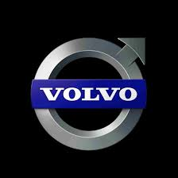
Unit 4.1 Promoting a Brand

Slide 2
What is a brand?
According to experts, a brand is much more than a product you buy. It is much more than a name, a logo, a symbol or a trademark. A brand has a unique set of values that defines its character and works like a contract, promising to deliver satisfaction by providing consistent quality each time it is bought, used or experienced.
Brands seek to connect emotionally with their consumers and create lifelong relationships.
Brands are relevant to businesses as well as to services, they can be applied to ideas and concepts as well as to products – a brand can even represent an individual celebrity.
Lets look at how Volvo and Amazon bring this to life

Slide 3
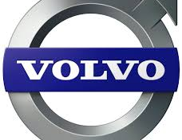
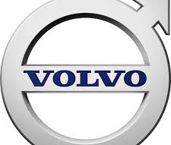
What is Volvo’s Brand?
Logo
Colours
Font
Design
Beliefs about the brand in the mind of the customer

Slide 4
What is Volvo’s brand?
Volvo have a very distinctive brand logo, with lots of silver, blue and black colours. The image of the logo represents the image of the brand: everything about the logo suggest what the company wants people to think about when they think of Volvo cars: strong, no-nonsense, reliable, clean-design, masculine.
The logo itself is formed from the symbol for the male gender.
The font used reinforces the idea that this product is bold, with clean lines. It suggests strength and reliability. This is the image Volvo wants to present to its customers.
The logo is in clear view on every Volvo car and is also used in promotional materials and all over their website. The company wants people to associate this logo strongly with the products. The logo is always the same, but sometimes the colours vary – never straying away from the male stereotype colours of black, silver and blue. It is the company name that is most strongly branded. Volvo do not create separate variations of the logo for each type of car they sell.

Slide 5
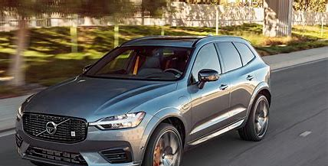
Volvo’s Brand Definition and Personality
A definition of a brand: “a brand is a person’s gut feeling about a product, service, or organization.”(Marty Neumeier)
Brand Personality:
Sincerity
Competence
Excitement
Sophistication
Ruggedness

Slide 6
Volvo’s brand definition and personality
Part of Volvo’s branding is that all Volvo cars all share similar design features. The front of their cars all look very similar for example, and the same logo is on every model. This reinforces the image of the firm and makes people think that all their cars perform in the same way. It makes people believe that ‘Volvo’ means reliability and strength. The personality of Volvo is somewhere between ‘Competence’ and ‘Ruggedness’. This personality is something Volvo have worked very hard at over the years. They make people believe their cars are rugged and strong and that their drivers are competent, hard-working and corporate. This comes through in all their advertising and all points of contact with the customer. If customers see these qualities in themselves they are more likely to be drawn to Volvo cars.

Slide 7
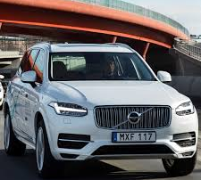
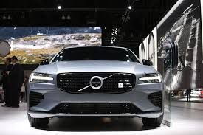
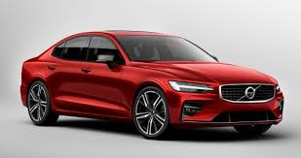
Type of Branding
Volvo is an example of CORPORATE and PRODUCT branding

Slide 8
Type of branding and why it’s used
Volvo branding is “product” branding as well as “corporate” branding – standing for the company and its values.
All Volvo cars and vehicles and all their accessories are branded in the same way. They all have the same logo and basic design features. This means customers know what they will get if they buy a new model from Volvo. The company doesn’t have to start again recreating a new brand every time they release a new car.
People tend not to buy cars very often, but when they do want a new car, Volvo have a strong brand identity so new customers might consider buying them as the brand springs to mind. Existing customers, if they like their Volvo car, are more likely to buy another Volvo car – even if it isn’t the same model as before. They will believe all Volvo cars are similar and so will be just as happy with their new purchase.
Branding the company helps communicate to stakeholders what the company is all about – it makes them want to invest in the company or to go and work there.

Slide 9
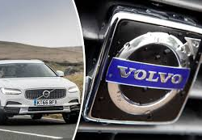
Why branding is important to Volvo
Stands out from the crowd
Instantly recognisable
Reflects company image
Stands for benefits of the product
Associated with quality
A focus point for advertising
Creates trust

Slide 10
Why branding is important to Volvo
The Volvo brand is distinctive and easy to recognise. This means customers don’t have to ‘rediscover’ what the products are trying to represent every time the company brings out a new version or a new model. This saves money and enables the company to create a much stronger brand image that reinforces itself every time a new model is released and people like it.
The brand represents many complex things like reliability and strength. At a glance, customers know what a new car means and what it will be like to drive and own just by looking at the brand.

Slide 11
How do Volvo Add Value through Branding?
New Volvos price range: £20 000 - £70 000
What do you get for this?
Strength
Reliability
Consistency
Quality
Safety
Good design
Durability

Slide 12
How branding adds value to Volvo’s business
Added value = the difference between how much a product costs to make and how much it can be sold for. Volvo cars might be expensive to make, but they sell for far more than just the cost of the car parts added together. The stronger the Volvo brand in the minds’ of its customers, the more they are prepared to pay to own and drive the car.
The Volvo brand has tried to capture all the qualities of strength, reliability and safety over the years. Everything Volvo does and has done for years tries to suggest its cars have all these qualities. When buying a new car, if customers prize these qualities highly, they may think of Volvo cars and have this brand at the top of their wishlist.

Slide 13
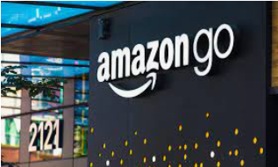
What is Amazon’s Brand?
Logo
Colours
Font
Design
Beliefs about the brand in the mind of the customer

Slide 14
What is Amazon’s brand?
Amazon have a very distinctive brand logo, with a distinctive, lowercase typeface and a delivery arrow smile. The image of the logo represents the image of the brand: everything about the logo suggests energy, pace and service with a smile - what the company wants people to think about when they think of Amazon.
The font, colours and the Amazon smile in the logo reinforces the idea that this company is all about service. This is the image it wants to present to its customers.
The logo is in clear view on every Amazon touchpoint for the customer – from its website, to its on screen apps to its delivery vans and now its physical stores.

Slide 15
Amazon’s Brand Definition and Personality
A definition of a brand: “a brand is a person’s gut feeling about a product, service, or organization.”(Marty Neumeier)
Amazon:
Customer obsessed
Sincerity
Competence
Caring

Slide 16
Amazon’s brand definition and personality
Amazon describes its brand values on its website as: “customer obsession rather than competitor focus, passion for invention, commitment to operational excellence, and long-term thinking. Amazon strives to be Earth’s most customer-centric company, Earth’s best employer, and Earth’s safest place to work.” This is what it strives for its brand to stand for.
Amazon’s brand is on everything they do. Increasingly, just the arrow smile is enough to let the customer know who they’re dealing with and the level of service to expect The personality of Amazon is somewhere between ‘Competence’ and ‘Caring’. This personality is something Amazon and their world famous CEO Jeff Bezos ave worked very hard at over the years. They strive to ensure that every aspect of their service and their products will live up to customer expectations – with on time, faster and faster deliveries, convenience and a range of products unmatched by any other retailer.

Slide 17
Type of Branding Amazon is an example of service and corporate branding

Slide 18
Type of branding and why it’s used
Amazon’s branding is “service” branding as well as “corporate” branding – standing for the company, its values and the level of service and convenience you can expect.
All Amazon services and shops are branded in the same way – whether they’re on screen or physical. They all have the same logo and basic design features. This means customers know what they will get when they go to Amazon. In a fiercely competitive global online retailing market the brand helps the company stand out from everyone else. Whatever they’re buying, customers know they can turn to Amazon for exceptional, straightforward service and a massive range of products.
Importantly too, branding the company helps communicate to stakeholders what the company is all about – it makes them want to invest in the company or to go and work there – as well as to buy from it.

Slide 19
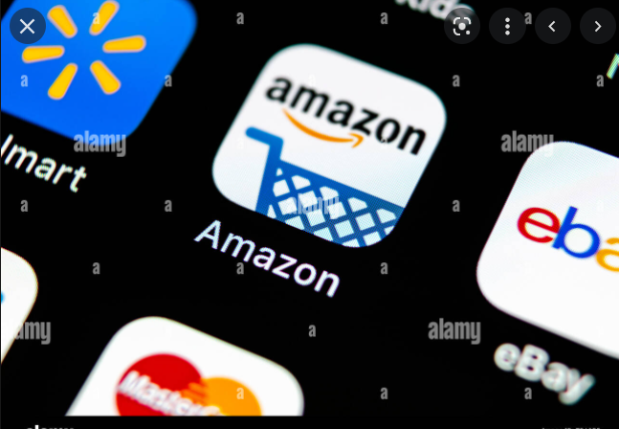
Why branding is important to Amazon
Stands out from the crowd
Instantly recognisable
Reflects company image
Stands for benefits of the service
Associated with quality and obsessive customer service
A focus point for advertising
Creates trust

Slide 20
Why branding is important to Amazon
The Amazon brand is distinctive and easy to recognise. Very often it’s working hard in tiny form on a smart phone app screen – or nowadays on the high street too, surrounded by competitors. The brand immediately connects with customers – helping them navigate straight to Amazon and reminding them that they’re there once they’ve clicked the app or walked into the shop.
The brand embodies the company’s customer service and convenience beliefs – it’s lighthearted, smiley and modern – as well as fast moving and arrow-like.

Slide 21
How Amazon branding adds value to the company
The world’s second most valuable brand – at an estimated $350bn in 2022 (just behind Apple)
Instantly recognisable, hugely successful company, drawing in 5.8bn visitors to its stores in 2020

Slide 22
How branding adds value to Amazon’s business
Amazon’s brand is all about billions of loyal customers and repeat business, coming from satisfied customers, time after time.
The brand attracts new sellers, new employees as well as well over 5 billion customers a year.
The brand helps the company grow its market share in a hugely crowded market with ever increasing customer loyalty and repeat business
Much of what the company sells isn’t itself distinctive, its available pretty much everywhere – but its Amazon’s added value of service, speed and reliability that sits behind the brand.

Slide 23
M1 Similarities and Differences

Slide 24
Similarities between Amazon and Volvo’s use of branding
Both brands:
Stand for and embody the companies’ values
Use a design element with an arrow to communicate something about themselves – Volvo’s masculine heritage, Amazon’s service with a smile
Help their companies stand out in fiercely crowded international markets
Their logos are used in multiple formats and at many different sizes – from apps on a phone screen, on TV or blown up giant on a billboard
Are instantly recognisable by loyal fans and customers as well as the general public
Serve as corporate brands
Have significant financial worth in their own right (over and above the company’s financial value) and allow their companies to charge extra and drive incremental new business ahead of their competitors

Slide 25
Differences between Amazon and Volvo’s use of branding
Amazon’s brand (that’s the brand, not the company) is worth an estimated $350bn in 2020. That makes it the second most valuable brand in the world. Analysts don’t give a separate figure for Volvo’s brand, referring instead to the value of the overall company.
Amazon’s brand is nearly fully global with buying customers in 178 countries. Volvo sells in 100 countries and its brand is best known in Europe, less so around the world.
Volvo’s brand is closely associated with vehicles and with the company. Amazon’s brand is associated with just about anything and everything – it’s an online (and physical store) retailer selling across every category as well as a tech and entertainment company. That means its brand has to be exceptionally versatile and powerful.
Amazon’s dominant brand value is service, whereas Volvo’s is strength and safety.

