Slide 1
Statistics for the NEA

Slide 2
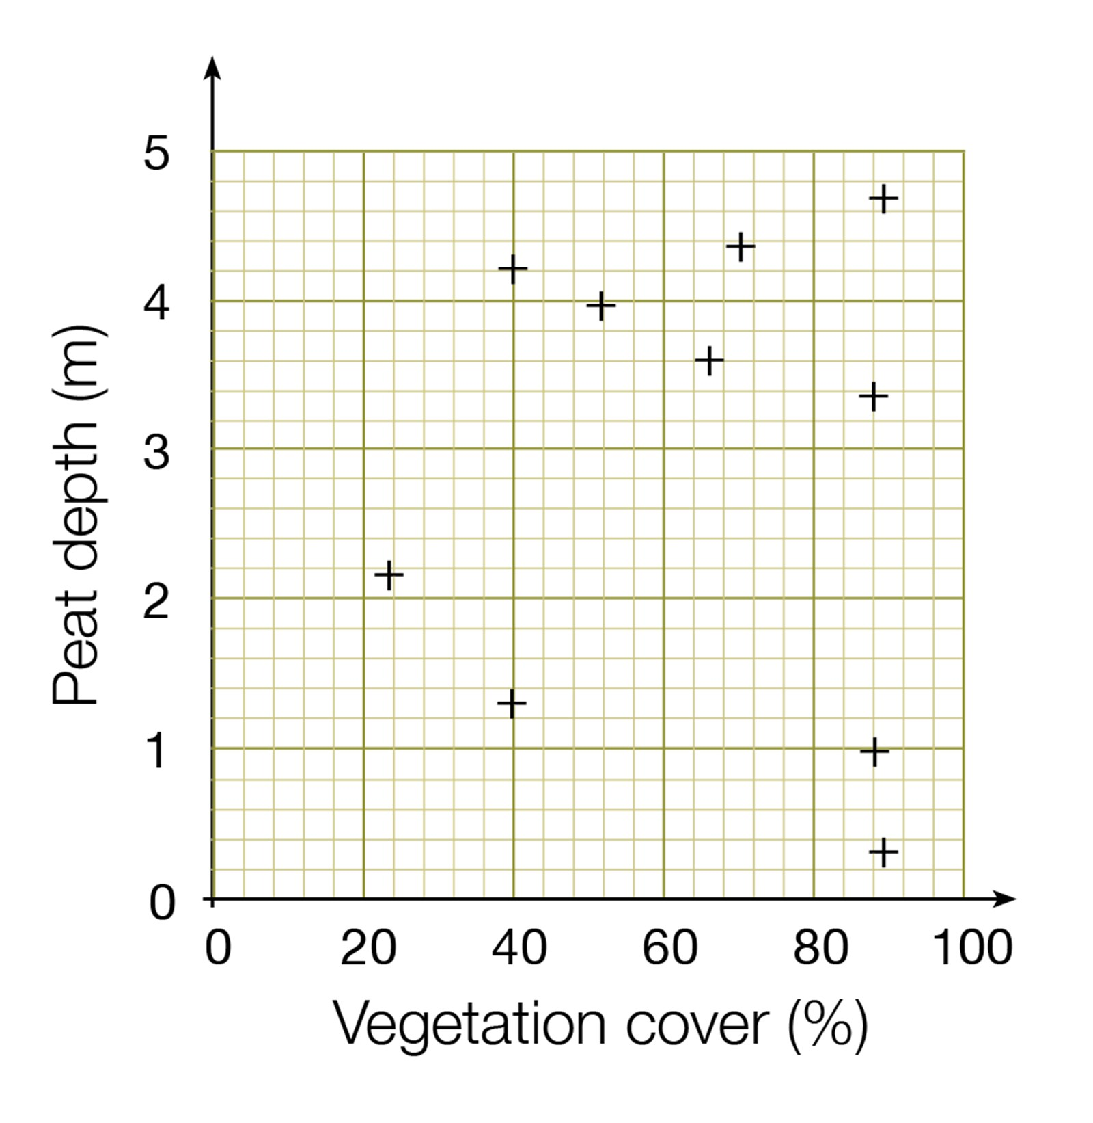
Spearman’s rank correlation
The Spearman's Rank Correlation Coefficient is used to discover the strength of a link between two sets of data.
If your data can be incorporated into a scattergraph you could conduct a Spearman’s Rank test to see how related they are.
For example you would expect that:
The further up the beach the larger the pebbles will be
The further along the beach the greater the cross sectional area
The further from the CBD the lower the temperature or greater the wind speed
The greater the educational attainment of the residents the higher the property prices
Can you think of any other examples?

Slide 3
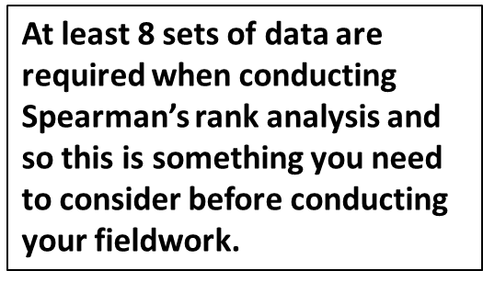
When you do a Spearman’s Rank statistical test always needs to have a null hypothesis
e.g. there is no significant correlation between the amount of hours studied and exam result
Or
There is no significant correlation between the distance up the beach and pebble size.
Read through the example of a Spearman’s Rank test in your booklet (p13 & 14) testing the strength of the link between the price of water and distance from a museum in Barcelona.

Slide 4
Convenience store | Distance from CAM (m) | Rank distance | Price of 50cl bottle (Euro) | Rank price | Difference between ranks (d) | d²
1 | 50 |  | 1,80
2 | 175 |  | 1.20
3 | 270 |  | 2.00
4 | 375 |  | 1.00
5 | 425 |  | 1.00
6 | 580 |  | 1.20
7 | 710 |  | 0.80
8 | 790 |  | 0.60
9 | 890 |  | 1.00
10 | 980 |  | 0.85
1) Rank the two data sets. Ranking is achieved by giving the ranking '1' to the biggest number in a column, '2' to the second biggest value and so on. The smallest value in the column will get the lowest ranking. This should be done for both sets of measurements.
Tied scores are given the mean (average) rank. For example, the three tied scores of 1 euro in the example below are ranked fifth in order of price, but occupy three positions (fifth, sixth and seventh) in a ranking hierarchy of ten. The mean rank in this case is calculated as (5+6+7) ÷ 3 = 6.
2) Find the difference in the ranks (d): This is the difference between the ranks of the two values on each row of the table. The rank of the second value (price) is subtracted from the rank of the first (distance from the museum).
3) Square the differences (d²) To remove negative values and then sum them ( d²).
d² =

Slide 5


Calculate the coefficient (R_{s}) using the formula below. The answer will always be between 1.0 (a perfect positive correlation) and -1.0 (a perfect negative correlation).
A further test is now required to test the significance of the relationship

Slide 6
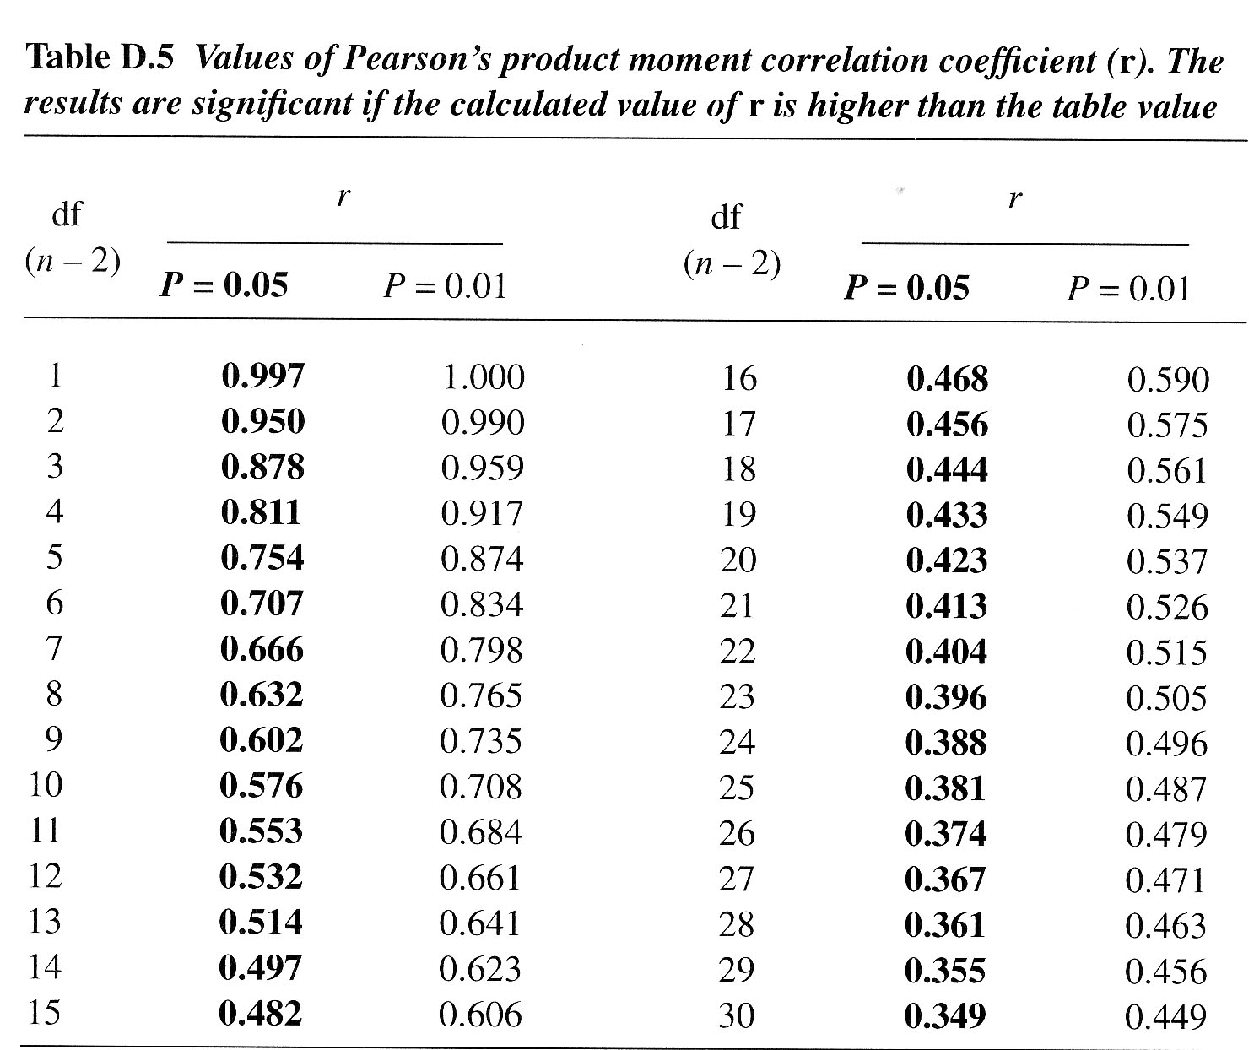
Testing the relationship
The R_{s} value of -0.73 must be looked up on the Spearman Rank significance table as follows:
Work out the 'degrees of freedom' you need to use. This is the number of pairs in your sample minus 2 (n-2). In the example it is 8 (10 - 2).
In this example if R_{s} is greater than 0.632 then we can be 95% confident that the result is not by chance.
If it is above the 0.1% significance level, then we can be 99.9% confident the correlation has not occurred by chance.
If it is above 1%, but below 0.1%, you can say you are 99% confident.
If it is above 5%, but below 1%, you can say you are 95% confident (i.e. statistically there is a 5% likelihood the result occurred by chance).
In this example you would therefor reject the null hypothesis as there is clearly a relationship between the distance from the museum and the price of water.

Slide 7
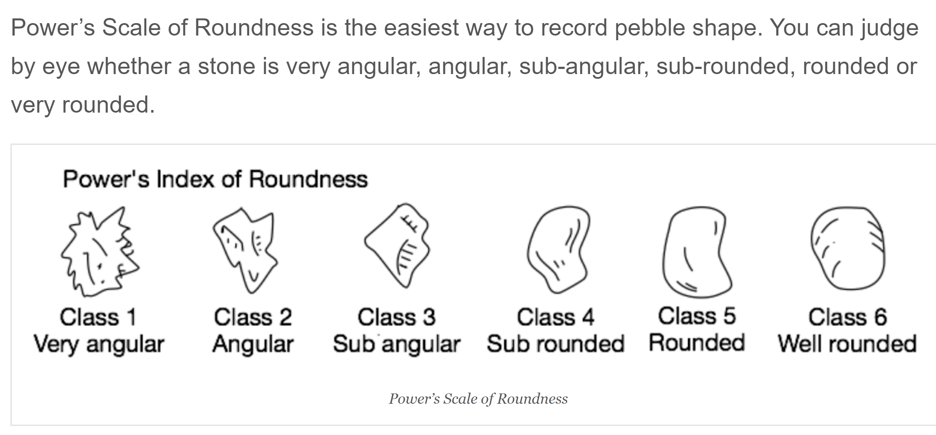
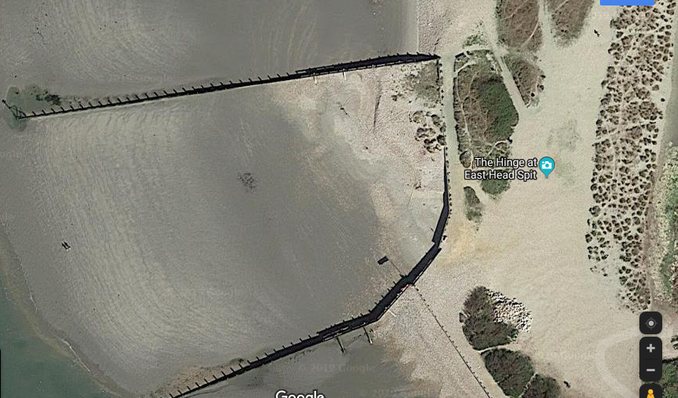
A group of students visited West Wittering Beach. They conducted a pebble roundness survey along a 100 m transect up the beach. At each sampling point they randomly selected 10 pebbles and recorded their roundness using the Power’s Index of Roundness.
What might a possible null hypothesis be?
Complete the 2 tasks on p18 & 19 of the booklet

Slide 8
Sample point | Distance up beach | Rank of distance | Mean pebble roundness | Rank size | Difference between ranks (d) | Difference between ranks squared (d²)
1 | 0 |  | 1.3
2 | 10 |  | 1.9
3 | 20 |  | 1.8
4 | 30 |  | 2.2
5 | 40 |  | 2.8
6 | 50 |  | 2.4
7 | 60 |  | 2.4
8 | 70 |  | 4.8
9 | 80 |  | 4.6
10 | 90 |  | 5.3
 |  |  |  |  | Ʃd²

Slide 9
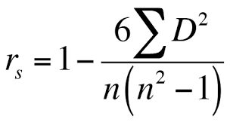
Task 2 - Analysis of your data.
Use the critical values table from p17 to find the critical value.
Critical value at 95% (0.05) _________________ Critical value at 99% (0.01) ­­­­­­­­_____________
Is the coefficient greater than or less than the 95% confidence level? What does this mean?
Is the coefficient greater than or less than the 99% confidence level? What does this mean?
Can we reject or accept the null hypothesis?
Complete the calculation above to find the coefficient (r_{s})

Slide 10
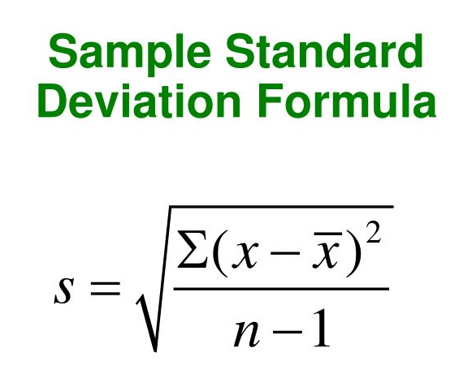
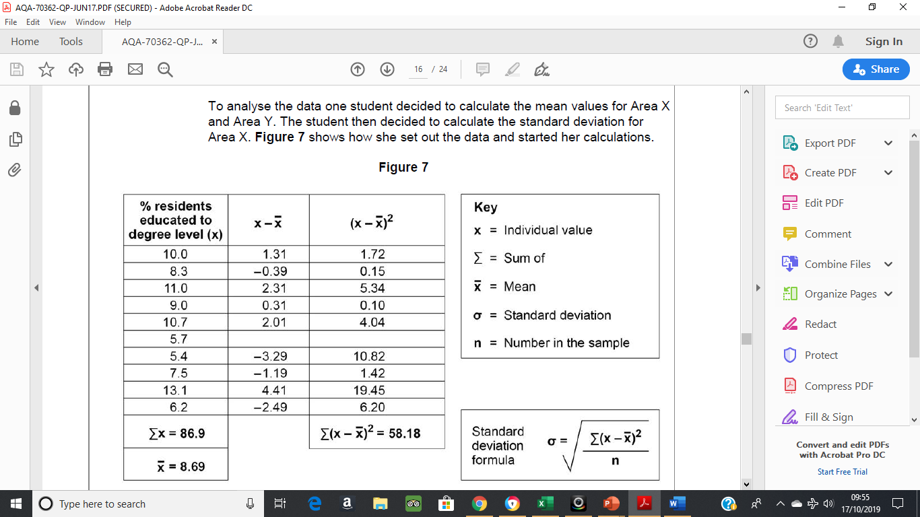
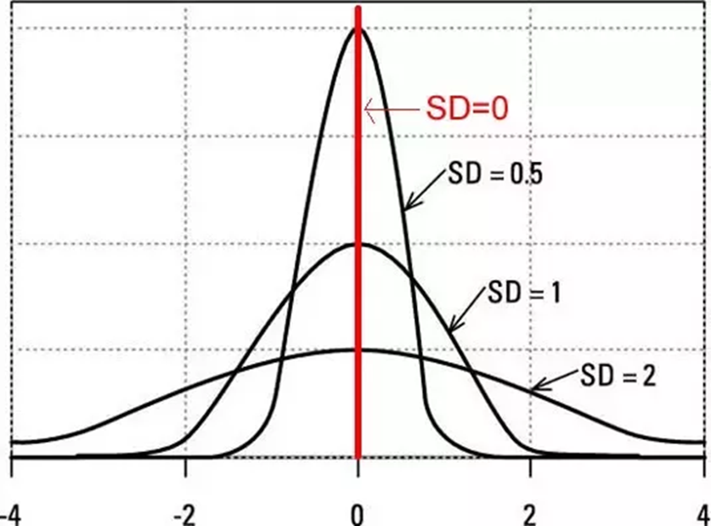
Standard Deviation
Standard deviation (SD) is a measure of the degree of dispersion about the mean.
It is possible that two sets of data can have the same mean but have a very different spread of data. SD will show you the extent of this spread.

Slide 11
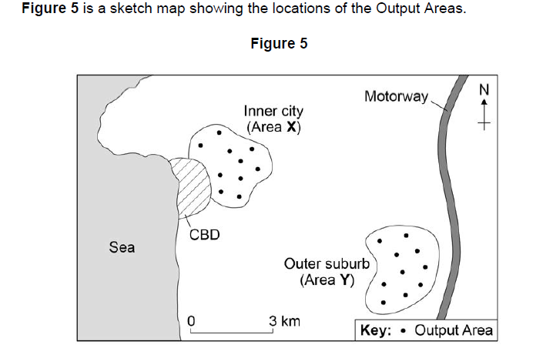
A group of students carried out an investigation into social inequality between two areas of their local town.
They chose an inner-city area (X) and an outer suburb (Y). Their idea was that there would be a greater amount of social deprivation in the inner-city area than the outer suburb. They conducted both primary and secondary data collection methods. One measure they focused on was level of education. They tested the hypothesis:
‘There will be a greater percentage of people educated to degree level in Area Y than in Area X.’
The students used the Office for National Statistics website to collect secondary data. They selected 10 Output Areas in both the inner city and the outer suburb. For each Output Area they recorded the number of residents with qualifications at degree level and converted this to a percentage of all residents.

Slide 12
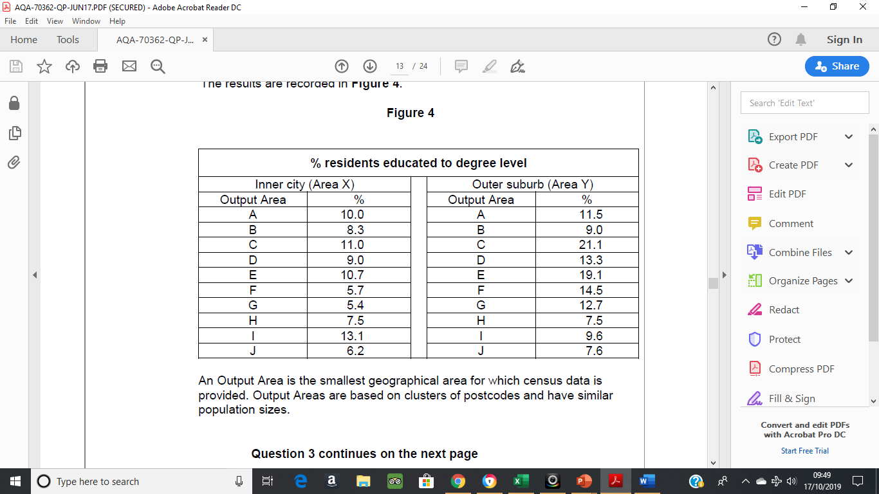
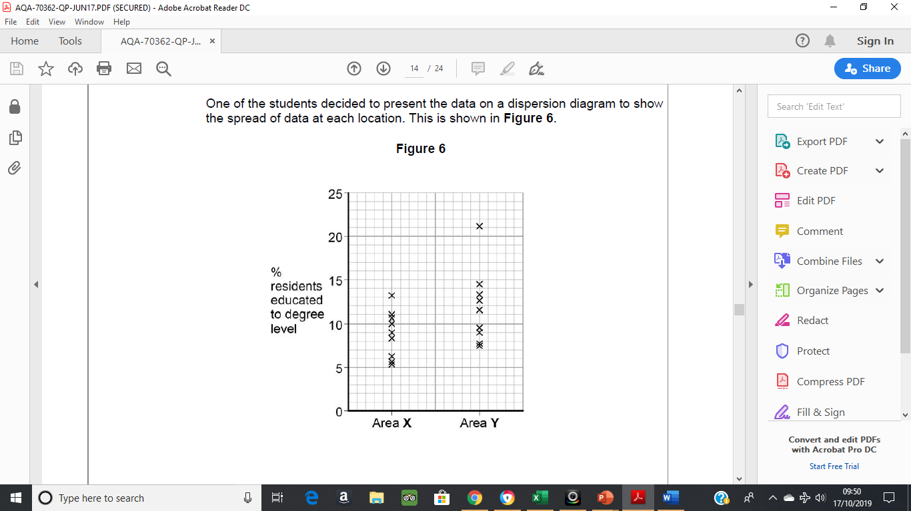
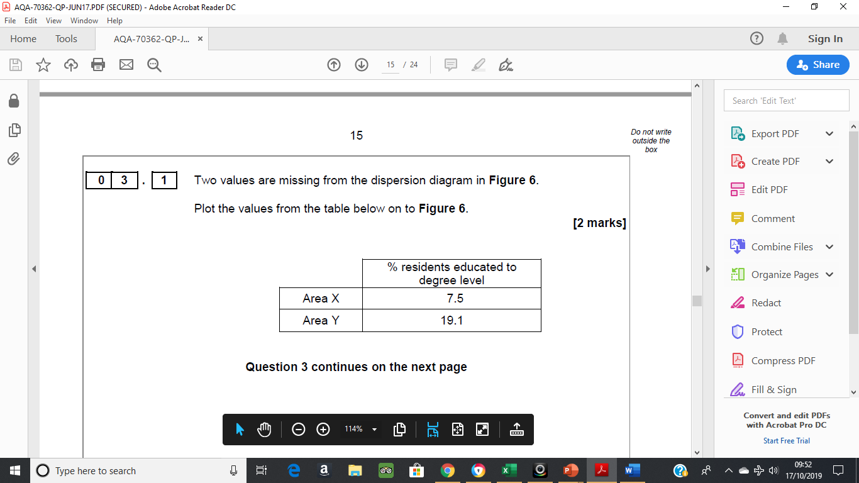

Slide 13
Complete Figure 7 and calculate the standard deviation to two decimal places. Show your working in the space provided.

Slide 14
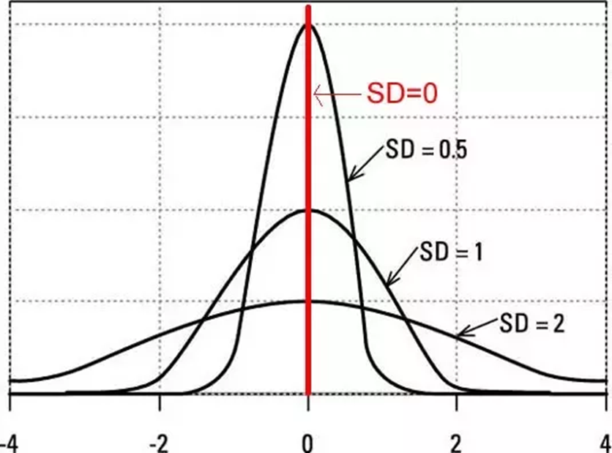
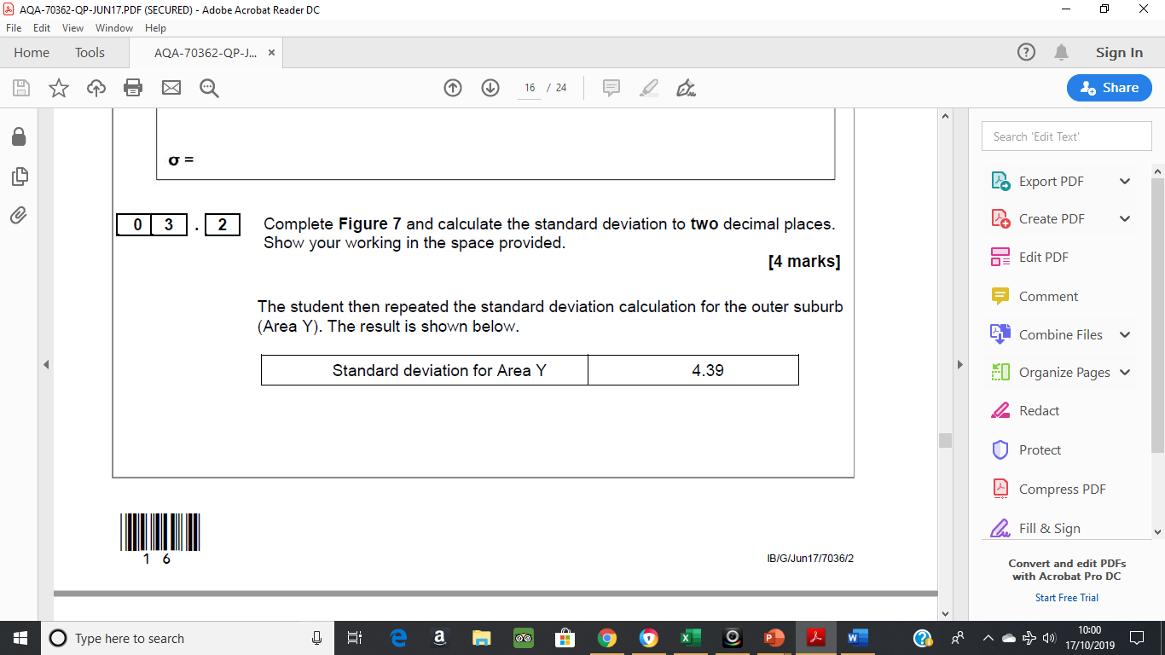
Use the standard deviation values to contrast the two data
sets.
Evaluate the usefulness of standard deviation and/or alternative techniques to analyse the data in Figure 4.

Slide 15
Mark scheme
Allow correct interpretation of an incorrect calculation.
• The SD values mean there is more variation from the mean in the % of people with degrees in the outer suburbs (1) this is because there are more extreme values in the Outer Suburbs (1)
• The SD value shows there is more clustering of % people with degrees around the mean in the Inner City Area. (1) This means that the mean is more typical of the data set in the inner city (1)
• The SD score of Y is higher than area X (1) this means that is more variation in area Y (1)
Max 1 if separate accounts or if only one area considered.
No credit for simply restating the SD values without any development.
Standard deviation is useful as it allows us to consider the spread of the data around the mean, which means that in Figure 4 we can prove that there is a greater variation in the outer suburbs.
• SD indicates the extent of the spread of data. So, it is very useful when comparing two data sets as in Figure 4. In this case SD is an appropriate technique as we can compare the two areas.
• SD is more useful than just comparing the mean as in this case the mean is much larger in the outer suburbs but this is affected by some extreme values. SD allows us to be able to show this mathematically.
• A description of the alternative analysis techniques and how they would be constructed
• It could be considered that you could use measures of central tendency such as the mean or median, allowing direct comparison and analysis of averages.
• Range could also be used to consider basic variation in education levels across each area allowing a comparison to be made

Slide 16
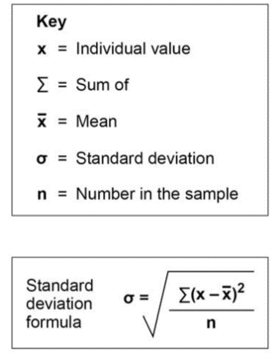
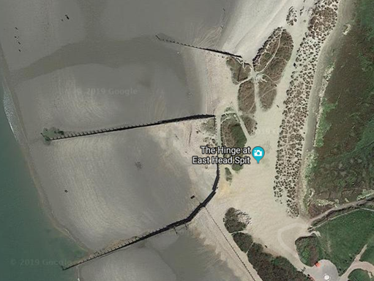
A group of students visited West Wittering Beach. They conducted a pebble size survey along at 2 locations up the beach. At each location they randomly selected 15 pebbles and recorded their size.
40 | 4 | 16
30 | -6 | 36
22 | -14 | 196
41 | 5 | 25
36 | 0 | 0
26 | -10 | 100
35 | -1 | 1
42 | 6 | 36
40 | 4 | 16
33 | -3 | 9
70 | 34 | 1156
80 | 44 | 1936
15 | -21 | 441
6 | -30 | 900
25 | -11 | 121
Ʃx = 541 |  | 4989
= 36.0
SAMPLE SITE 1
Site 1
Site 2
Show your workings as to how you would find out the standard deviation for sample site 1
(Check - Your answer should be 18.24)

Slide 17
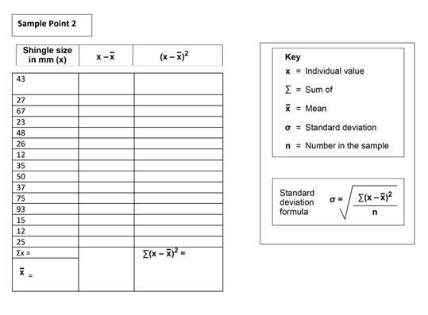
Complete the table and calculate the standard deviation for Sample Point 2
Use the standard deviation values to contrast the two data sets. (Which sample point has the greater standard deviation?)

Slide 18
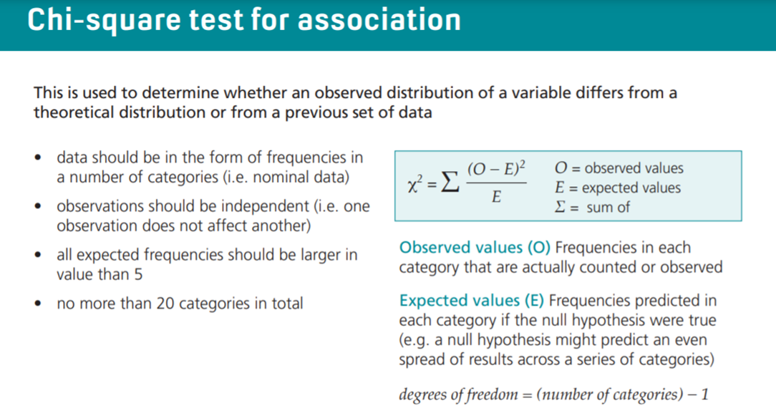
e.g. Younger people aged 16-21 are more likely to be satisfied with the development of a new skate park in the town than those aged over 60. A theoretical distribution would be that there would be no difference and an equal proportion of respondents would says that they were satisfied.

Slide 19
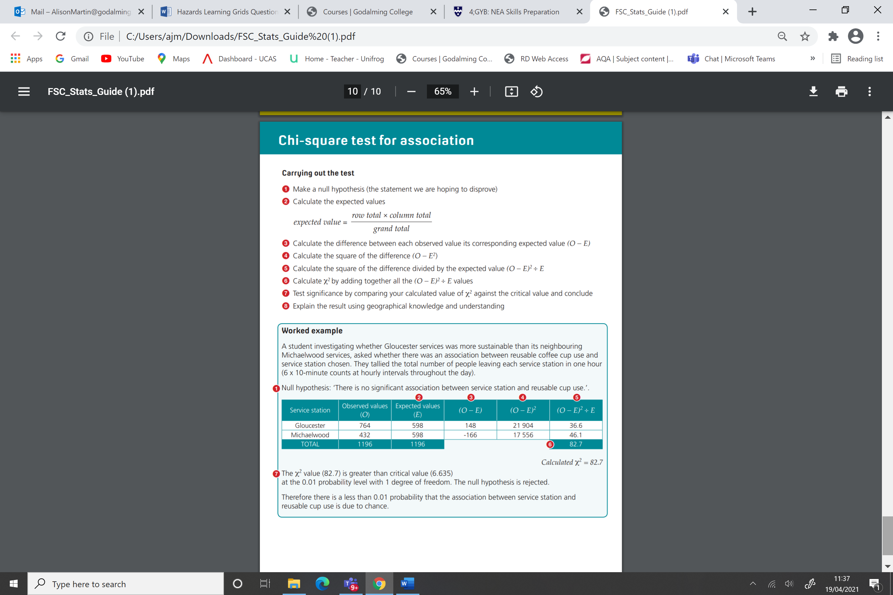
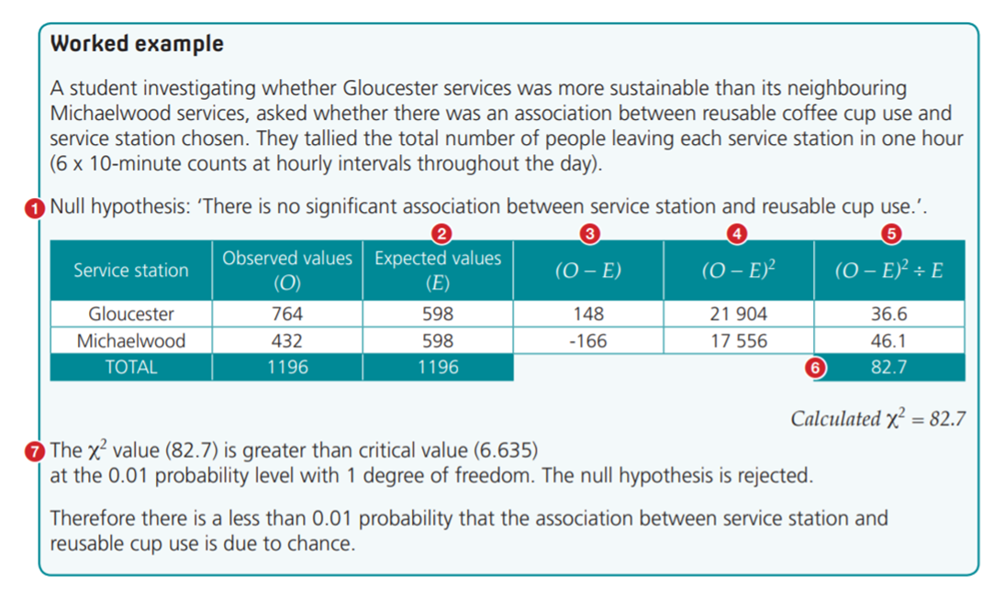

Slide 20
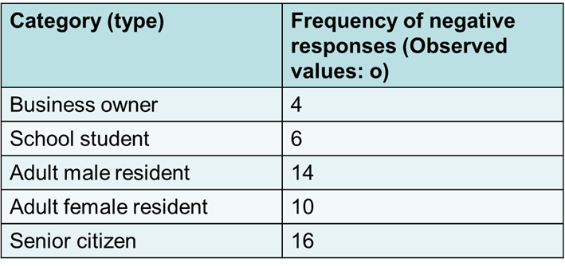
Case Study: Using chi-squared to analyse questionnaire responses
A student collected data on local people’s viewpoints about the building of the 2012 Olympic venue in Stratford, East London. She was interested in seeing if viewpoints changed according to the perspectives of different groups.
She decided to collect 20 responses from each category of local person. After this, she discontinued the data collection. She know nothing about the local population’s demographic characteristics and did not try to reflect this in her study. Her questionnaire was a survey of viewpoints about the usefulness of the new Olympic developments for different groups (categories) of locals.
This is the statement she posed:
‘The 2012 Olympic Games development will be of benefit to the whole community of Stratford, east London.’
1 2 3 4
Strongly agree Agree Disagree Strongly disagree
She wanted to find out if the type of local person influenced feelings about how useful the developments would be. She was particularly interested in those who felt negatively about the Olympic developments (disagreed or strongly disagreed)
Here are the results of the survey. The residents had to choose which category best suited their own characteristics. Some of those questioned could have fitted into more than one category. For example, a business owner may also be a local resident. In this case the person questioned was disregarded from the study. Remember that 20 people responded from each category and she only recorded the frequency of negative response, i.e. those who either disagreed or strongly disagreed with the statement.
The student added up the number of times a negative response to the question above was given. You can see that the categories seem to show large differences of opinion between the groups.
A glance at the results suggests that different groups have responded very differently to the questionnaire. The chi-squared calculation helps us decide if there is a statistically significant difference between the groups. You can then use the critical values to assess the likelihood of the results being a chance or fluke set of figures
The first task is to generate a null hypothesis (Hₒ):
‘There is no significant difference between the category of local person and the frequency of negative response.’

Slide 21
 | Business owner | School student | Adult male resident | Adult female resident | Senior citizen | Total
o | 4 | 6 | 14 | 10 | 16 | 50
e | 10 | 10 | 10 | 10 | 10 | 50
o - e | -6 |  |  |  |  | --------
(o – e)² | 36 |  |  |  |  | --------
(o – e)² e | 3.6 |  |  |  |  | --------
x² | 3.6
In this example, the expected data (e) is simply taken as being the mean negative frequency of response. It is calculated by adding up all of the observed data (o) and then dividing by the number of categories, i.e. 5. This gives an expected frequency of 10 for each category.

Slide 22
 | Business owner | School student | Adult male resident | Adult female resident | Senior citizen | Total
o | 4 | 6 | 14 | 10 | 16 | 50
e | 10 | 10 | 10 | 10 | 10 | 50
o - e | -6 | -4 | 4 | 0 | 6 | --------
(o – e)² | 36 | 16 | 16 | 0 | 36 | --------
(o – e)² e | 3.6 | 1.6 | 1.6 | 0 | 3.6 | --------
x² | 3.6 | 1.6 | 1.6 | 0 | 3.6 | 10.4
x² = 10.4
Calculate degrees of freedom:
  df = n-1 (where n is the no. of categories)
  In this case df = 5 - 1 = 4
Use a critical values table to work out the significance of your result (see table p18)
Do we reject or accept the null hypotheses and how confident can we be?

Slide 23
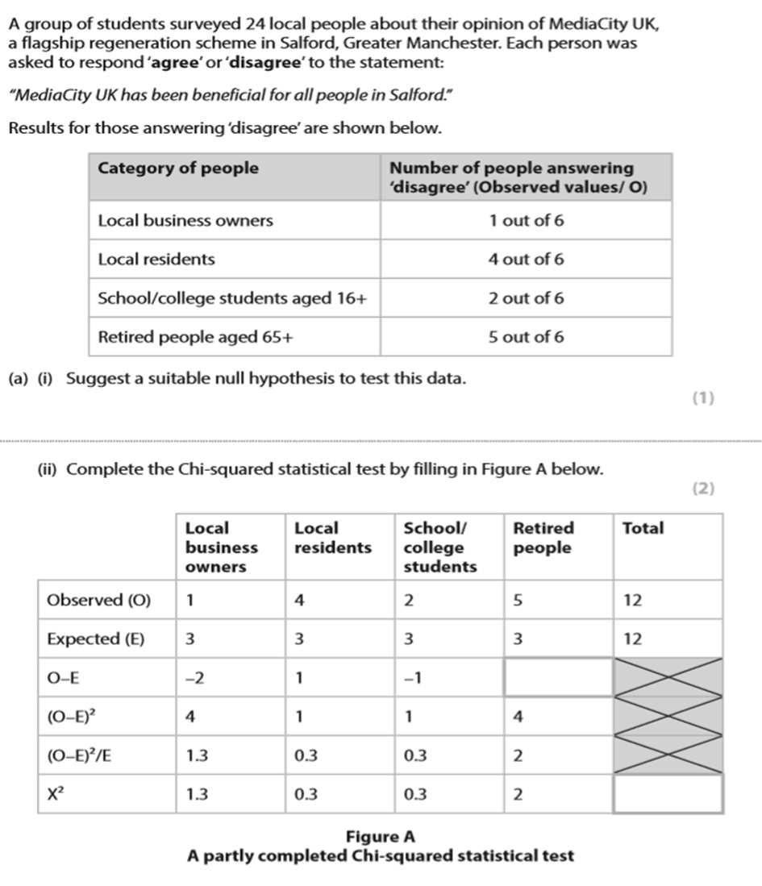

Slide 24
