Slide 1
Unit 3: Personal & Business Finance

Slide 2
Learning Outcome F
Complete statements of comprehensive income and financial position and evaluate a business's performance.

Slide 3
Financial Documents
A business needs to understand its financial performance. After all it is likely that one of their main objectives is to make a profit.
In this learning outcome we are going to investigate two documents that are used to assess and monitor financial performance.
These are:
Statement of comprehensive income (profit & loss)
Statement of financial position (balance sheet)
Ratio analyse will also be used to analyse the financial data provided in these two statements.

Slide 4
Statement of Comprehensive Income
Learning Outcome F1

Slide 5
What is a Statement of Comprehensive Income?
A statement of comprehensive income provides a business with an accurate account of its profit and loss.
It records sales, costs, gross and net profit over a period of time usually 1 year.

Slide 6
Why is it used?
Using a statement of comprehensive income is vital for understanding the business’s position financially.
Are they making a profit or a loss. If the business is making a profit then that is ideal.
However if they identify that they are making a loss then they can assess the profit & loss account to see why and where the business is losing money.

Slide 7
Activity 1 – What is it & Key Words.
As we go through a statement of comprehensive income you need to explain what it is and the key words associated with it.
Use the table in your student workbook to explain the key words. Add any extra ones you may come across.

Slide 8
Statement of Comprehensive Income
A statement of comprehensive income calculates whether a business has made a profit or loss by deducting all expenses from sales revenue.
The first item the statement of comprehensive income helps identify is the business’s gross profit.
Gross profit is the amount of money made after the cost of sales are taken away.

Slide 9
Key Terms
Sales revenue
Cost of goods sold
Inventory
Gross profit
Expenses
Depreciation
Net profit

Slide 10
Key Terms
Sales revenue
Sales revenue is the money a company earns from selling its goods and services to customers. It is income the company earns exclusively from the sale of goods or services. It does not include sources of income that derive from anything other than sales.
Cost of goods sold
Cost of goods sold (COGS) includes all of the costs and expenses directly related to the production of goods. It excludes indirect costs such as overhead and sales & marketing. Cost of goods sold is deducted from revenues (sales) in order to calculate gross profit and gross margin. Higher COGS results in lower margins.
Inventory
Inventory is the term for the goods available for sale and raw materials used to produce goods available for sale. Inventory represents one of the most important assets of a business because the turnover of inventory represents one of the primary sources of revenue generation.

Slide 11
Key Terms
Gross profit
Gross profit is the profit a company makes after deducting the costs associated with making and selling its products, or the costs associated with providing its services. Gross profit will appear on a company's income statement and can be calculated by subtracting the cost of goods sold from revenue (sales).
Net profit
Net profit is the measurement of a company's profit once operating costs, taxes, interest and depreciation have all been subtracted from its total revenues. The term is often referred to as a company's 'bottom line' and may also be described as 'net earnings' or 'net income'.

Slide 12
Key Terms
Expenses
An expense is the cost of operations that a company incurs to generate revenue. As the popular saying goes, “it costs money to make money.”
Common expenses include payments to suppliers, employee wages, leases, and equipment depreciation.
Depreciation
Depreciation is an accounting method of allocating the cost of a tangible or physical asset over its useful life or life expectancy. Depreciation represents how much of an asset's value has been used up.

Slide 13
Calculating Profit & Loss
Profit is the amount of money you still have once all expenses are been taken away from your gross profit and any other revenue income has been added.
A loss is where all expenses have been deducted and the business has made less money than it has earned in sales revenue. Meaning the business has lost money that year.

Slide 14
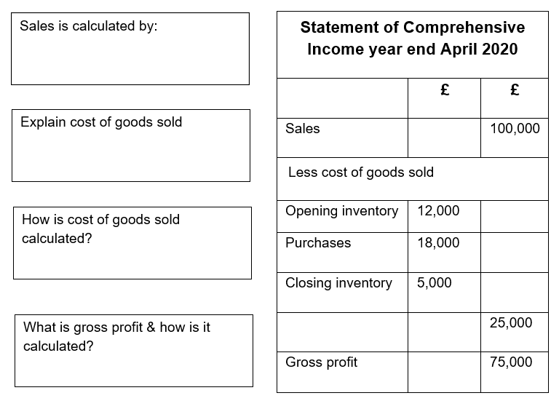
Activity 2 – Annotating & Explaining Gross Profit
As we go through the top half of a statement of comprehensive income, annotate the example in your student book and answer the questions provided.

Slide 15
How Gross Profit Looks on a Statement of Comprehensive Income
Sales revenue is the money coming into a business from selling its goods or services.
It is calculated by:
Quantity sold x Selling price
For example 1000 jackets sold for £100 would equal £100,000 in sales
Statement of Comprehensive Income year end April 2020
 | £ | £
Sales |  | 100,000
Less cost of goods sold
Opening inventory | 12,000
Purchases | 18,000
Closing inventory | 5,000
 |  | 25,000
Gross profit |  | 75,000
The costs of goods sold is the costs directly linked to providing that good or service.
It is calculated by:
Opening inventories + Purchases – Closing inventories
For example the business has £12,000 of inventory & purchases £18,000 more which after sales that year means they still have a closing inventory of £5,000.
£12,000 + £18,000 - £5,000 = £25,000.

Slide 16
How Gross Profit Looks on a Statement of Comprehensive Income
Statement of Comprehensive Income year end April 2020
 | £ | £
Sales |  | 100,000
Less cost of goods sold
Opening inventory | 12,000
Purchases | 18,000
Closing inventory | 5,000
 |  | 25,000
Gross profit |  | 75,000
Gross profit is the amount of money left over after the cost of goods sold is deducted from sales revenue.
The calculation for gross profit is:
Sales turnover – cost of goods sold
For example if the business has sales of £100,000 and cost of goods sold of £25,000 then the business would make £75,000 in gross profit (£100,000 - £25,000 = £75,000)

Slide 17
Full Statement of Comprehensive Income
That is only half of a statement of comprehensive income.
The full statement also includes:
Expenses
Revenue Income
Net profit

Slide 18
Full Statement of Comprehensive Income
The first section is still there. However to calculate the profit or loss for the year then the following needs to be accounted for…
Expenses
These need to be subtracted from the gross profit figure as these are costs that are associated with selling a product or service. In this example the total expenses equal £60,000.
Revenue Income
This is income generated by the business other than its core business activity. Interest from the bank can be classed as revenue income.
Net profit
This is the final figure on the statement of comprehensive income and is calculated by
Gross profit – expenses + other revenue income
This is the figure that the business will pay tax on.
Statement of Comprehensive Income year end April 2020
 | £ | £
Sales |  | 100,000
Less cost of goods sold
Opening inventory | 12,000
Purchases | 18,000
Closing inventory | 5,000
 |  | 25,000
Gross profit |  | 75,000
Less Expenses
Rent |  | 12,000
Salaries |  | 20,000
Advertising |  | 3,000
Business rates |  | 5,000
Distribution |  | 12,000
Depreciation |  | 8,000
Total expenses |  | 60,000
Revenue Income |  | 0
Net profit |  | 15,000

Slide 19
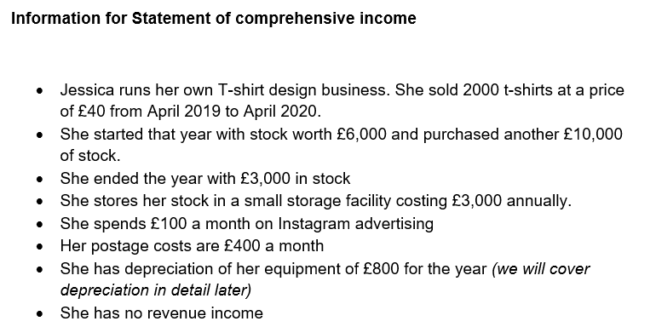
Activity 3 – Full Statement of Comprehensive Income
Answer the questions regarding a full statement of comprehensive income and then complete the blank statement with the information provided about Jessica’s t-shirt business.

Slide 20
Using a Statement of Comprehensive Income
Now the busines has a clear picture of its net profit for the year it can ensure it pays the correct amount of tax.
The net profit is the amount that the business pays tax on.
They can assess things like their expenses and make amendments for the following year. They may notice that they spend too much on cost of goods sold and try to reduce this or that wages are too high and need reducing to improve their net profit margin.
It is vital that the business completes the statement of comprehensive income accurately because if they do not then they could end up paying too much or too little tax.
One expense they do need to calculate is depreciation.

Slide 21
Adjustment for Depreciation
Depreciation is an accounting method of allocating the cost of a tangible or physical asset over its useful life or life expectancy. Depreciation represents how much of an asset's value has been used up over time.
It is shown on the statement of comprehensive income as an expense as the asset has lost value and is now worth less therefore the business has lost this value in the asset.
It is important that depreciation of these assets are calculated.

Slide 22
Depreciation
Why is depreciation important?
If a business buys a car valued at £30,000 when bought. This same car will not be valued at £30,000 in a years time as it will have depreciated in value.
This needs to be represented as an expense to the business in its statement of comprehensive income.
There are two ways of calculating how much an asset has depreciated:
Straight-line method
Reducing-balance method.

Slide 23
Depreciation Key Terms
Historic Value
The cost of an asset when it was first purchased e.g. a Mac Book at £1400
Expected life
How long the asset is expected to be used within the business e.g. 3 years
Residual value
The value of the asset at the end of its expected life. How much the asset is worth once it is disposed of. After 3 years the Mac book may be valued at £500.
Mac Book Historic value £1400 – Residual value £500 = £900
£900 divide by expected life 3 years = £300 a year.
Depreciation of £300 a year on a statement of comprehensive income

Slide 24
Straight Line Depreciation
Historic Value – Residual Value
Expected Life
Historic value = 30,000
Residual value = 12,000
Expected life = 3 years
18,000 / 3 = 6,000
Therefore the car will depreciate £6,000 a year. This will be added to the statement of comprehensive income as an expenses to the business.

Slide 25
Reducing Balance Depreciation
Take the historic value and reduce the price by 20% a year.
Historic Value = 30,000
Year 1 30,000 x 0.8 = 24,000
Year 2 24,000 x 0.8 = 19,200
Year 3 19,200 x 0.8 = 15,360
Value after 3 years £15,360
Depreciation after 3 years £14,640

Slide 26
Activity 4 – Calculating Depreciation
Watch the video on ‘how to calculate straight line and reducing balance depreciation’. Then answer the following questions in your student workbook.
DEPRECIATION VIDEO LINK

Slide 27
Adjustments for Prepayments, Accruals
Prepayments
These are when an expense is made in advance of the period where it is used. It is a pre payment.
For example you may pay rent in advance and therefore these expenses may be incurred in one tax year but then the premises may be used in another year. This needs adjusting on a statement of comprehensive income.
Accruals
This is the opposite and is when an expense is paid after the period where it was incurred. An example could be utility bills.

Slide 28
Interpretation, Analysis and Evaluation – Statement of Comprehensive Income
No point in just creating a statement and then leaving it. It needs to be used!
The data produced on a statement of comprehensive income needs analysing.
It can be used to:
Compare figures such as gross and net profit. It will allow you to look at how expenses have impacted the difference between the two.
Compare years. Have sales improved from one year to the next? Has net & gross profit improved? Have expenses increased or decreased?
Compare different departments and products within the business (intrafirm comparison).
Compare how the business is performing in relation to its competitors (interfirm comparison) For example How is Nike’s gross profit compared to GymShark’s.

Slide 29
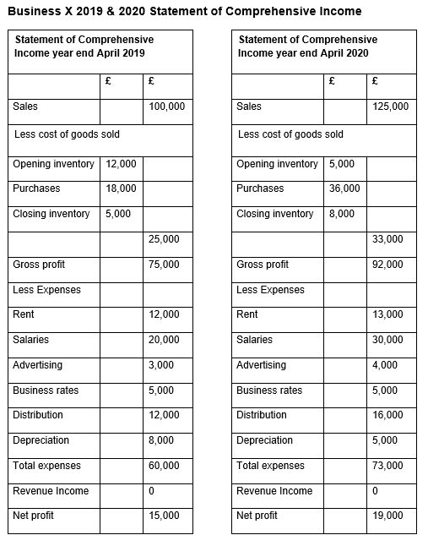
Activity 5 – Analysing a Statement of Comprehensive Income
Analyse the data for Business X & Y.
Using the data provided in your student booklet, answer the questions analysing both Businesses financial data.

Slide 30
F2 - Statement of Financial Position

Slide 31
Purpose & Use of a Statement of Financial Position
A statement of financial position (also known as a balance sheet) shows a business’s net worth at a particular point in time and is usually produced at the end of the financial year.
It shows everything that the business owns (assets) and everything the business owes (liabilities).

Slide 32
Statement of Financial Position (Balance Sheet)
A balance sheet is useful because it shows:
Assets (things the business owns)
Liabilities (debts a business owes)
Capital Employed (how the business is financed)

Slide 33
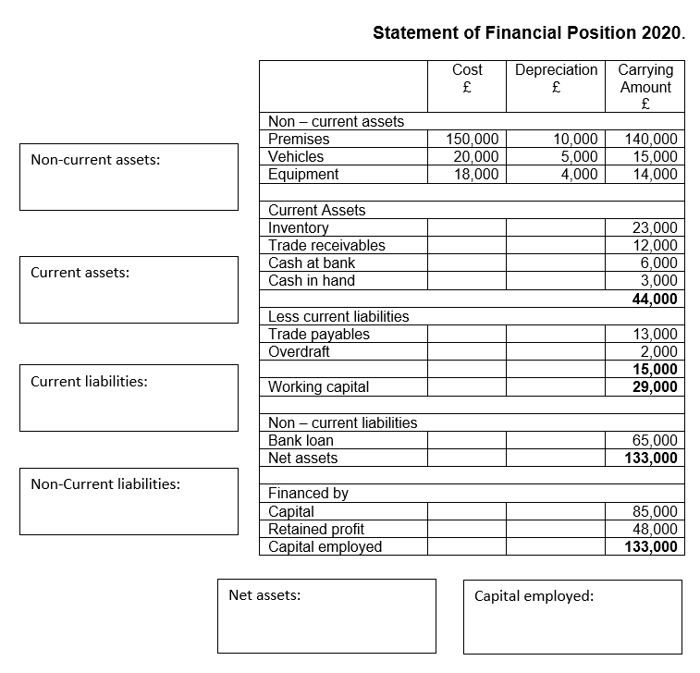
Activity 6 – Statement of Financial Position Explained
While I go through the statement of financial position and the various sections. Answer the questions in the student booklet and annotate the various key points about the statement.

Slide 34
What a Statement of Financial Position looks like
The first part of the statement calculates the non current assets that the business owns including any depreciation.
It uses the initial cost and then deducts the depreciation to find out the assets current value (carrying amount)
As you can see, these are things such as premise, vehicles and equipment.
Non current assets can either be tangible or intangible.
 | Cost £ | Depreciation £ | Carrying Amount £
Non – current assets
Premises | 150,000 | 10,000 | 140,000
Vehicles | 20,000 | 5,000 | 15,000
Equipment | 18,000 | 4,000 | 14,000
Current Assets
Inventory |  |  | 23,000
Trade receivables |  |  | 12,000
Cash at bank |  |  | 6,000
Cash in hand |  |  | 3,000
44,000
Less current liabilities
Trade payables |  |  | 13,000
Overdraft |  |  | 2,000
 |  |  | 15,000
Working capital |  |  | 29,000
Non – current liabilities
Bank loan |  |  | 65,000
Net assets |  |  | 133,000
Financed by
Capital |  |  | 85,000
Retained profit |  |  | 48,000
Capital employed |  |  | 133,000

Slide 35
Tangible & Non Tangible Non Current Assets
Tangible (something that can be physically touched)
Premises
Vehicles
Fixtures and Fittings
Intangible (something that cannot be touched)
Patents
Goodwill
Branding
Copyrights

Slide 36
Current Assets
Current assets are all the assets of a company that are expected to be sold or used as a result of standard business operations within the current year.
Current assets include:
Cash in Hand
Cash in the Bank
Inventories
Trade receivables (people that owe the business money)
 | Cost £ | Depreciation £ | Carrying Amount £
Non – current assets
Premises | 150,000 | 10,000 | 140,000
Vehicles | 20,000 | 5,000 | 15,000
Equipment | 18,000 | 4,000 | 14,000
Current Assets
Inventory |  |  | 23,000
Trade receivables |  |  | 12,000
Cash at bank |  |  | 6,000
Cash in hand |  |  | 3,000
44,000
Less current liabilities
Trade payables |  |  | 13,000
Overdraft |  |  | 2,000
 |  |  | 15,000
Working capital |  |  | 29,000
Non – current liabilities
Bank loan |  |  | 65,000
Net assets |  |  | 133,000
Financed by
Capital |  |  | 85,000
Retained profit |  |  | 48,000
Capital employed |  |  | 133,000

Slide 37
Next up is Current Liabilities
A liability is something that the business owes.
Current liabilities are debts that the business owes that need repaying in under one year.
Overdrafts
Accruals (an expenses paid after the period it was used)
Trade payables (people the business owes money to)
 | Cost £ | Depreciation £ | Carrying Amount £
Non – current assets
Premises | 150,000 | 10,000 | 140,000
Vehicles | 20,000 | 5,000 | 15,000
Equipment | 18,000 | 4,000 | 14,000
Current Assets
Inventory |  |  | 23,000
Trade receivables |  |  | 12,000
Cash at bank |  |  | 6,000
Cash in hand |  |  | 3,000
44,000
Less current liabilities
Trade payables |  |  | 13,000
Overdraft |  |  | 2,000
 |  |  | 15,000
Working capital |  |  | 29,000
Non – current liabilities
Bank loan |  |  | 65,000
Net assets |  |  | 133,000
Financed by
Capital |  |  | 85,000
Retained profit |  |  | 48,000
Capital employed |  |  | 133,000
Working capital is the current assets – current liabilities.
The higher the working capital is the more it shows how easily the business can pay back its short term debts. If currently liabilities are greater than current assets then this could indicate cash flow problems.

Slide 38
Non - Current Liabilities & Net Assets
Non-current liabilities are long-term debts that need to be paid back in more than one years time.
Examples include:
Bank Loan
Mortgages
Once you have a picture of your assets and liabilities then you can work out the net assets for the business.
 | Cost £ | Depreciation £ | Carrying Amount £
Non – current assets
Premises | 150,000 | 10,000 | 140,000
Vehicles | 20,000 | 5,000 | 15,000
Equipment | 18,000 | 4,000 | 14,000
Current Assets
Inventory |  |  | 23,000
Trade receivables |  |  | 12,000
Cash at bank |  |  | 6,000
Cash in hand |  |  | 3,000
44,000
Less current liabilities
Trade payables |  |  | 13,000
Overdraft |  |  | 2,000
 |  |  | 15,000
Working capital |  |  | 29,000
Non – current liabilities
Bank loan |  |  | 65,000
Net assets |  |  | 133,000
Financed by
Capital |  |  | 85,000
Retained profit |  |  | 48,000
Capital employed |  |  | 133,000
Net assets = Non current assets + current assets – (current liabilities + non current liabilities)
In this example that would be:
169,000 + 44,000 – (15,000 + 65,000) = 133,000
Net assets = £133,000

Slide 39
Last One… Capital Employed
This shows the capital that has been used to finance the business.
In this case it is the capital that has been put into the business, plus any retained profits that the business has
Capital + Retained profit
Retained profits are profit the business has reinvested back into the business.
 | Cost £ | Depreciation £ | Carrying Amount £
Non – current assets
Premises | 150,000 | 10,000 | 140,000
Vehicles | 20,000 | 5,000 | 15,000
Equipment | 18,000 | 4,000 | 14,000
Current Assets
Inventory |  |  | 23,000
Trade receivables |  |  | 12,000
Cash at bank |  |  | 6,000
Cash in hand |  |  | 3,000
44,000
Less current liabilities
Trade payables |  |  | 13,000
Overdraft |  |  | 2,000
 |  |  | 15,000
Working capital |  |  | 29,000
Non – current liabilities
Bank loan |  |  | 65,000
Net assets |  |  | 133,000
Financed by
Capital |  |  | 85,000
Retained profit |  |  | 48,000
Capital employed |  |  | 133,000

Slide 40
Adjustments for Depreciation
Just as we did for the statement of comprehensive income the cost of depreciation needs to be calculated and recorded on a statement of financial position for each non current asset.
This can be calculated using either the straight line or reducing balance method of depreciation.
It is important to include the depreciation of the asset as this is its current value and therefore provides a truer picture of the value of the business’s non-current assets

Slide 41
Adjustments for Prepayments & Accruals.
Prepayments
These are recorded on a statement of financial position under a current asset. This is due to the amount already being prepaid and therefore that prepayment is an asset to the business.
Examples of prepayments could be rent, utility bills or insurance.
Accruals
An expense that is paid after its period of use. This means that it is shown as a current liability on a statement of financial position as it is owed.
Examples of accruals could be a phone bill, rent & broadband.

Slide 42
Analysing a Statement of Financial Position
Just like with a statement of comprehensive income, there is no point creating a statement of financial position and then doing nothing with it.
The use and analysis of a statement of financial position is very similar to what you would be looking for in a statement of comprehensive income in terms of comaprisons.
It can be used to:
Compare figures such as the current assets and current liabilities. What is the difference between the two figures? and what can be done?
Compare years. Have assets increased or decreased? Has the business got more or less working capital? Has the business increased or decreased in value?
Compare how the business is performing in relation to its competitors. For example How is Nike performing financially in comparison to GymShark.

Slide 43
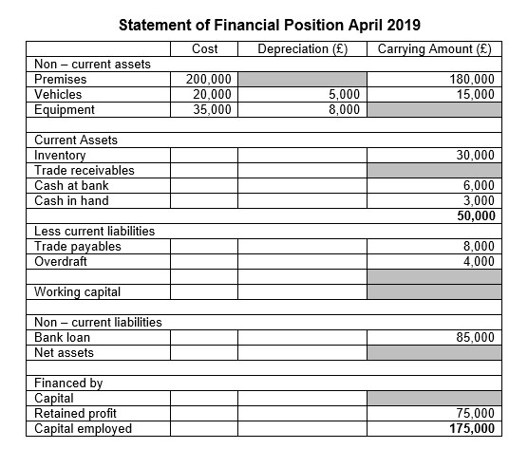
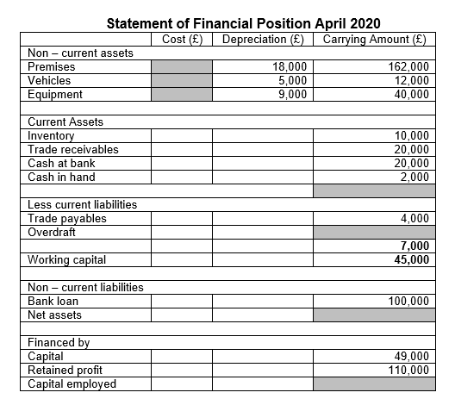
Activity 7 – Interpreting & Analysing a Statement of Financial Position
First answer the questions regarding a statement of financial position and then complete both of the financial statements for 2019 and 2020 by filling in the missing amounts in the grey boxes.
Finish the activity by justifying which year the business was in the best financial position.

Slide 44
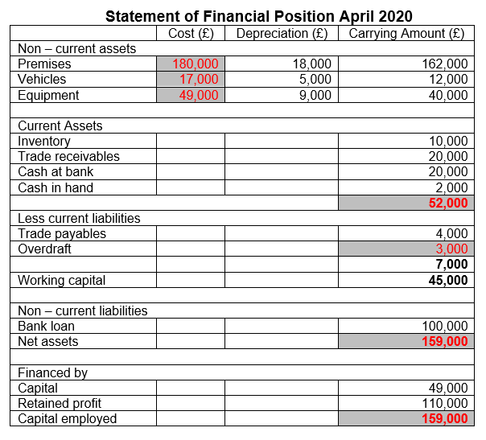
Activity 7 – Statement Answers

Slide 45
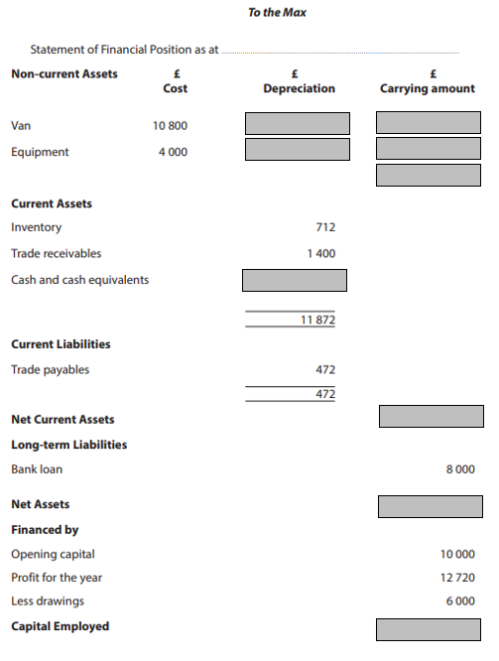
Activity 8 - Exam Question
Complete the sample exam question in your student booklet by completing the figures in the grey boxes.

Slide 46
Activity 8 – Exam Answer

Slide 47
F3 – Measuring Profitability

Slide 48
Ratio Analysis
Ratio analysis is a form of financial statement analysis that is used to obtain a quick indication of a business’s financial performance in several key areas.
It uses the financial documents covered previously;
Statement of comprehensive income (Profit and loss)
Statement of financial position (Balance sheet)

Slide 49
Why is it important?
Ratio analysis helps businesses to see how it is performing now and how it compares to last year or the year before and against other competitors in the industry.
Although we have analysed both the statement of comprehensive income and the statement of financial position, ratio analysis provides concrete data that shows;
Profitability
Liquidity
efficiency
Rather than just commenting on figures on the statement. These areas can be analysed using ratio analysis.

Slide 50
Student Booklet
Throughout this ratio analysis section I will be going through how to calculate each ratio and what each one shows.
It is important that you take notes because in your student book you have quick practice questions to complete after each ratio and then a larger question on all of them.
Listen carefully and take notes!

Slide 51
Measuring Profitability
Profitability ratios are used to assess a business's ability to generate a profit.
Profitability ratios allow managers and stakeholders to compare the performance of the business with past years and other companies.
For example two different companies could be making a net profit of £100,000 however one may be making sales of £1million and the other £200,000. Therefore one has a much higher net profit margin (I’ll explain this soon). Meaning one is more profitable per sale.

Slide 52
Types of Profitability Ratio
There are various calculations a business can use to show them their profitability:
Gross profit margin
Net profit margin
Mark-up
Return on capital employed (ROCE)

Slide 53
Gross Profit Margin
Gross profit margin = Gross profit x 100
revenue
Remember:
Revenue can also be known as sales or turnover
Gross Profit = revenue – cost of sales
This information is found on a statement of comprehensive income.
Notes:
71.6%

Slide 54
What Does Gross Profit Margin Tell us?
The profit a business makes on its sales minus the cost of goods sold.
It is the percentage of gross profit made on sales.
If a business had a gross profit margin of 70% that means for every £1 made in sales the business makes 70p in gross profit.
Gross profit is the profit earned before any expenses, usually it is a lot higher than net profit.
It can help a business decide whether it needs to raise prices or reduce the cost of goods sold.

Slide 55
How Gross Profit Looks on A Statement of Comprehensive Income
Statement of Comprehensive Income year end April 2020
 | £ | £
Sales |  | 100,000
Less cost of goods sold
Opening inventory | 12,000
Purchases | 18,000
Closing inventory | 5,000
 |  | 25,000
Gross profit |  | 75,000
Remember this>>>
Gross profit margin
Gross profit x100
revenue
75,000
100,000 x 100 = 75
Gross profit margin = 75%

Slide 56
Activity 9 – Quick Practice
Calculate the gross profit margin using the information provided.
Explain whether the business is performing well in terms of its gross profit margin.
Statement of Comprehensive Income year end April 2020
 | £ | £
Sales |  | 217,000
Less cost of goods sold
Opening inventory | 13,500
Purchases | 58,000
Closing inventory | 27,250
 |  | 44,250
Gross profit |  | 172,750
Write out the formula in words
Gross profit x100
revenue
Then covert it to numbers
172,750
217,000 x100
Write out your workings
172,750
217,000 = 0.79608 x 100 = 79.61
Answer
Gross profit margin 79.61%

Slide 57
Net Profit Margin
Net profit margin = Net profit
revenue x 100
Remember:
Revenue can also be known as sales or turnover
Net profit is gross profit - expenses
This information is also found on a statement of comprehensive income.
Notes:
24.8

Slide 58
What Does Net Profit Margin Tell us?
Shows the percentage of net profit made on sales taking into account expenses.
If a business has a net profit margin of 35% then this means that for every £1 made in sales the business makes 35p in net profit.
If the net profit margin is too low then it will usually be because expenses are too high. The business will then look at reducing expenses to improve the net profit margin.
It could be due to too high wages, expensive rent or distribution costs.

Slide 59
How Net Profit Looks on A Statement of Comprehensive Income
Remember this>>>
Net profit margin
Net profit x100
revenue
15,000
100,000 x 100 = 15
Net profit margin = 15%
Statement of Comprehensive Income year end April 2020
 | £ | £
Sales |  | 100,000
Less cost of goods sold
Opening inventory | 12,000
Purchases | 18,000
Closing inventory | 5,000
 |  | 25,000
Gross profit |  | 75,000
Less Expenses
Rent |  | 12,000
Salaries |  | 20,000
Advertising |  | 3,000
Business rates |  | 5,000
Distribution |  | 12,000
Depreciation |  | 8,000
Total expenses |  | 60,000
Revenue Income |  | 0
Net profit |  | 15,000

Slide 60
Activity 9 Continued – Quick Practice
Calculate the net profit margin using the information provided.
Explain whether the business is performing well in terms of its net profit margin.
Write out the formula in words
Net Profit x100
Revenue
Then covert it to numbers
87,750
217,000 x100
Write out your working
87,750
217,000 = 0.40437 x 100 = 40.437
Answer
Net profit margin 40.44% (rounded up)
Statement of Comprehensive Income year end April 2020
 | £ | £
Sales |  | 217,000
Less cost of goods sold
Opening inventory | 13,500
Purchases | 58,000
Closing inventory | 27,250
 |  | 44,250
Gross profit |  | 172,750
Less Expenses
Rent |  | 10,000
Salaries |  | 22,000
Advertising |  | 4,000
Business rates |  | 5,000
Distribution |  | 32,000
Depreciation |  | 12,000
Total expenses |  | 85,000
Revenue Income |  | 0
Net profit |  | 87,750

Slide 61
Activity 10 - Gross & Net Profit Margin
Watch the video named ‘Gross Profit vs Net Profit | Differences, Calculations and Interpretation Explained’ and answer the questions in your student booklet.
GROSS AND NET PROFIT VIDEO LINK

Slide 62
Activity 10 – Calculation Answers

Slide 63
Mark-up
Mark-up = ___gross profit___ x 100
cost of goods sold
This also is found on a statement of comprehensive income.

Slide 64
What Does Mark-up Tell us?
Mark-up looks at profit as a percentage of cost of goods sold.
It shows what percentage is added to the cost of goods sold to reach the selling price.
For example, a mark up of 20% would mean that if the cost of raw materials used to produce a product were £1, then the product would be sold for £1.20 as it has been marked up by 20%.

Slide 65
How Mark-up Looks on A Statement of Comprehensive Income
Statement of Comprehensive Income year end April 2020
 | £ | £
Sales |  | 100,000
Less cost of goods sold
Opening inventory | 12,000
Purchases | 18,000
Closing inventory | 5,000
 |  | 25,000
Gross profit |  | 75,000
Mark-up
Gross profit x100
cost of goods sold
75,000
25,000 x 100 = 300
Mark-up = 300%

Slide 66
Activity 11 – Quick Practice Question
Statement of Comprehensive Income year end April 2020
 | £ | £
Sales |  | 217,000
Less cost of goods sold
Opening inventory | 13,500
Purchases | 58,000
Closing inventory | 27,250
 |  | 44,250
Gross profit |  | 172,750
Calculate the mark-up in this statement of comprehensive income.
Explain whether the mark-up is good or bad.
Write out the formula in words
Gross profit x100
cost of goods sold
Then covert it to numbers
172,750
44,250 x100
Write out your working
172,750
44,250 = 3.903954 x 100 = 390.39
Answer
Mark-up 390.4% (rounded up)

Slide 67
Return on Capital Employed (ROCE)
Net profit x 100
capital employed
Return on the capital that has been invested in the business.
That is why the net profit figure is used as this is the profit made before tax and therefore if it is divided by capital employed it will provide a figure that shows the return from the capital injected into the business.
Notes:
32

Slide 68
What Does ROCE Tell us?
This ratio is thought to be the most important and shows if the managing director is doing their job properly.
Tells the company the percentage return the business is making in relation to the capital invested.
If the ROCE was 10% then this means for every £1 invested the business returns 10p in net profit.
This ROCE percentage is usually compared to the return from interest rates at a bank. If investors can put their money in a bank and can achieve a higher percentage than the ROCE it may not be worth the risk of investing it in the business.

Slide 69
How ROCE Looks on Financial Statements
Statement of Comprehensive Income year end April 2020
 | £ | £
Sales |  | 100,000
Less cost of goods sold
Opening inventory | 12,000
Purchases | 18,000
Closing inventory | 5,000
 |  | 25,000
Gross profit |  | 75,000
Less Expenses
Rent |  | 12,000
Salaries |  | 20,000
Advertising |  | 3,000
Business rates |  | 5,000
Distribution |  | 12,000
Depreciation |  | 8,000
Total expenses |  | 60,000
Revenue Income |  | 0
Net profit |  | 15,000
ROCE
Net profit x100
capital employed
15,000
133,000 x 100 = 11.278
ROCE = 11.28%
Bottom of a Statement of Financial Position
Financed by
Capital |  |  | 85,000
Retained profit |  |  | 48,000
Capital employed |  |  | 133,000

Slide 70
Activity 11 Continued – Quick Practice Question
Calculate the return on capital employed.
Explain whether the business is performing well in this area.
Statement of Comprehensive Income year end April 2020
 | £ | £
Sales |  | 217,000
Less cost of goods sold
Opening inventory | 13,500
Purchases | 58,000
Closing inventory | 27,250
 |  | 44,250
Gross profit |  | 172,750
Less Expenses
Rent |  | 10,000
Salaries |  | 22,000
Advertising |  | 4,000
Business rates |  | 5,000
Distribution |  | 32,000
Depreciation |  | 12,000
Total expenses |  | 85,000
Revenue Income |  | 0
Net profit |  | 87,750
Write out the formula in words
Net profit x100
capital employed
Then covert it to numbers
87,750
630,650 x100
Write out your working
87,750
630,650 = 0.1391 x 100 = 13.914
Answer
ROCE = 13.91%
Capital employed = £630,650

Slide 71
Interpret, Analyse & Evaluate Profitability
Profitability ratios show how efficiently a company generates profit and value for shareholders.
Higher ratio results are often more favourable, but ratios provide much more information when compared to results of similar companies, the company's own historical performance, or the industry average.
Again these figures can be used to:
Compare figures such as gross and net profit. It will allow you to look at how expenses have impacted the difference between the two figures.
Compare years. Have sales improved from one year to the next? Has net & gross profit improved? Have expenses increased or decreased?
Compare different departments and products within the business (intrafirm comparison).
Compare how the business is performing in relation to its competitors (interfirm comparison) For example How is Nike’s gross profit compared to GymShark’s.

Slide 72
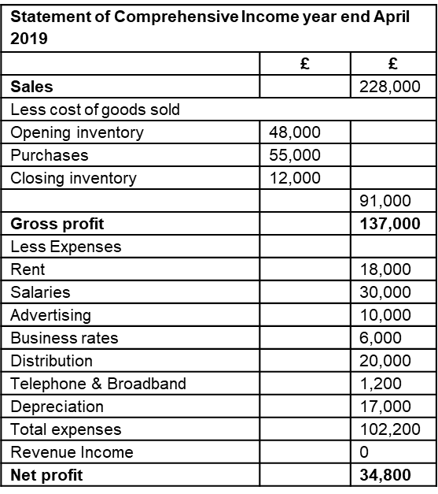
Activity 12 – Calculate, Interpret and Analyse Profitability Ratios
You are working as a financial advisor for DC Socks LTD and they have provided you with a statement of comprehensive income for 2019 & 2020.
They have also provided you with the amount of capital they employed.
Capital employed 2019 - £114,500
Capital employed 2020 - £66,000
They would like you to perform some profitability ratios and then use them to analyse the profitability of the business.

Slide 73
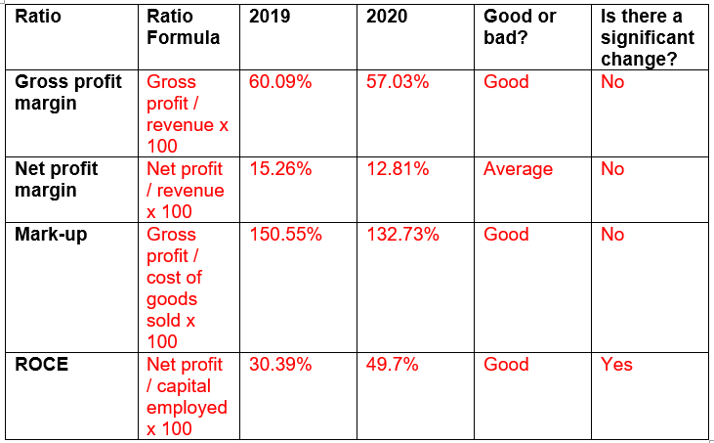
Activity 12 – Calculation Answers

Slide 74
F4 – Measuring Liquidity

Slide 75
Why is Liquidity Important?
Liquidity ratios are used to determine whether the business has enough current assets to pay off any debts that may need repaying.
Current liabilities are analysed in relation to liquid assets. By doing this the business is evaluating whether they have enough capital to cover short term debt obligations.
Businesses need to control and conserve their cash and assets as well as making a profit.
Liquidity is of particular interest to those who may be providing short term credit to the company.

Slide 76
Liquidity Ratios
There are two calculations that you need to know to be able to analyse the liquidity of a business, these are:
Current ratio
Liquid capital ratio
Both of these are worked out by using figures on a statement of financial position (which we covered earlier).
Notes:
They basically show if and how a firm can pay its debts.

Slide 77
Current Ratio
Current Ratio = current assets
current liabilities
The answer to this calculation is given as a ratio.
For example 1.5:1.
It shows how many current assets the business has for every 1 liability. In this case it means that for every £1 of current liabilities the business has £1.50 in current assets.

Slide 78
What Does the Current Ratio Show?
The general concept of the current ratio is examining the relationships between assets and liabilities.
If the current assets are greater that the liabilities, then the business is in a healthier shape than if it were the other way around.
Like previously mentioned if the business has 1.5:1 then this shows that the business has more current assets than current liabilities.
However if this was 0.5:1 this would mean that the business has half the amount of current assets than it does current liabilities.

Slide 79
Where to Find the Information for Current Ratio?
Current Ratio
Current assets
Current liabilities
44,000
15,000 = 2.933
Current ratio = 2.93:1
 | Cost £ | Depreciation £ | Carrying Amount £
Non – current assets
Premises | 150,000 | 10,000 | 140,000
Vehicles | 20,000 | 5,000 | 15,000
Equipment | 18,000 | 4,000 | 14,000
Current Assets
Inventory |  |  | 23,000
Trade receivables |  |  | 12,000
Cash at bank |  |  | 6,000
Cash in hand |  |  | 3,000
44,000
Less current liabilities
Trade payables |  |  | 13,000
Overdraft |  |  | 2,000
 |  |  | 15,000
Working capital |  |  | 29,000
Non – current liabilities
Bank loan |  |  | 65,000
Net assets |  |  | 133,000
Financed by
Capital |  |  | 85,000
Retained profit |  |  | 48,000
Capital employed |  |  | 133,000

Slide 80
Activity 13 – Quick Practice Question
Calculate the current ratio.
Explain whether the business is performing well in this area.
 | Cost £ | Depreciation £ | Carrying Amount £
Non – current assets
Premises | 210,000 | 20,000 | 190,000
Vehicles | 40,000 | 10,000 | 30,000
Equipment | 18,000 | 4,000 | 14,000
Current Assets
Inventory |  |  | 52,000
Trade receivables |  |  | 22,000
Cash at bank |  |  | 16,000
Cash in hand |  |  | 8,000
98,000
Less current liabilities
Trade payables |  |  | 23,000
Overdraft |  |  | 6,000
 |  |  | 29,000
Working capital |  |  | 69,000
Non – current liabilities
Bank loan |  |  | 105,000
Net assets |  |  | 198,000
Financed by
Capital |  |  | 150,000
Retained profit |  |  | 48,000
Capital employed |  |  | 198,000
Write out the formula in words
Current assets
Current liabilities
Then covert it to numbers
98,000
29,000
Write out your workings
98,000
29,000 = 3.379
Answer
Current ratio = 3.38:1

Slide 81
Liquid Capital Ratio
Liquid Capital = Current assets - inventory
Current liabilities
The liquid capital ratio calculation answer is also expressed as a ratio to 1.
It shows the number of current assets the business has (excluding inventory) to the number of current liabilities.

Slide 82
What Does the Liquid Capital Ratio Tell us?
It works out current assets in comparison to current liabilities, however this time excludes inventory from current assets as it is seen as the least liquid of the current assets.
It is important to measure a business’s liquidity without the inclusion of inventory as inventory is the least liquid as it takes time to sell.
This is a much tougher financial measure as inventory can make up a large amount of a business’s current assets. Usually this figure is much lower in most industries.

Slide 83
Where to Find the Information for Liquid Capital Ratio?
Liquid Capital Ratio
Current assets - inventory
Current liabilities
44,000 – 23,000
15,000
= 1.4
Current ratio = 1.4:1
 | Cost £ | Depreciation £ | Carrying Amount £
Non – current assets
Premises | 150,000 | 10,000 | 140,000
Vehicles | 20,000 | 5,000 | 15,000
Equipment | 18,000 | 4,000 | 14,000
Current Assets
Inventory |  |  | 23,000
Trade receivables |  |  | 12,000
Cash at bank |  |  | 6,000
Cash in hand |  |  | 3,000
44,000
Less current liabilities
Trade payables |  |  | 13,000
Overdraft |  |  | 2,000
 |  |  | 15,000
Working capital |  |  | 29,000
Non – current liabilities
Bank loan |  |  | 65,000
Net assets |  |  | 133,000
Financed by
Capital |  |  | 85,000
Retained profit |  |  | 48,000
Capital employed |  |  | 133,000

Slide 84
Activity 13 Continued – Quick Practice Question
Calculate the liquid capital ratio.
Compare the current ratio with the liquid capital ratio and suggest what it means for the business.
 | Cost £ | Depreciation £ | Carrying Amount £
Non – current assets
Premises | 210,000 | 20,000 | 190,000
Vehicles | 40,000 | 10,000 | 30,000
Equipment | 18,000 | 4,000 | 14,000
Current Assets
Inventory |  |  | 52,000
Trade receivables |  |  | 22,000
Cash at bank |  |  | 16,000
Cash in hand |  |  | 8,000
98,000
Less current liabilities
Trade payables |  |  | 23,000
Overdraft |  |  | 6,000
 |  |  | 29,000
Working capital |  |  | 69,000
Non – current liabilities
Bank loan |  |  | 105,000
Net assets |  |  | 198,000
Financed by
Capital |  |  | 150,000
Retained profit |  |  | 48,000
Capital employed |  |  | 198,000
Write out the formula in words
Current assets - inventory
Current liabilities
Then covert it to numbers
98,000 – 52,000
29,000
Write out your working
98,000 – 52,000
29,000 = 1.586
Answer
Liquid capital ratio = 1.59:1

Slide 85
Activity 14 - Liquidity Video
Watch the video on liquidity ratios and complete the tasks in the student booklet to apply your knowledge.
LIQUIDITY RATIOS VIDEO LINK

Slide 86
Activity 14 – Calculation Answers

Slide 87
Interpret, analyse and evaluate liquidity
It can be used to:
Compare figures such as the current assets and current liabilities. What is the difference between the two figures? and what can be done?
Compare years. Have assets increased or decreased? Have the ratios increased or decreased? Is this down to an increase in assets or a decrease in liabilities?
Compare how the business is performing in relation to its competitors. For example How is Nike performing financially in comparison to GymShark.

Slide 88
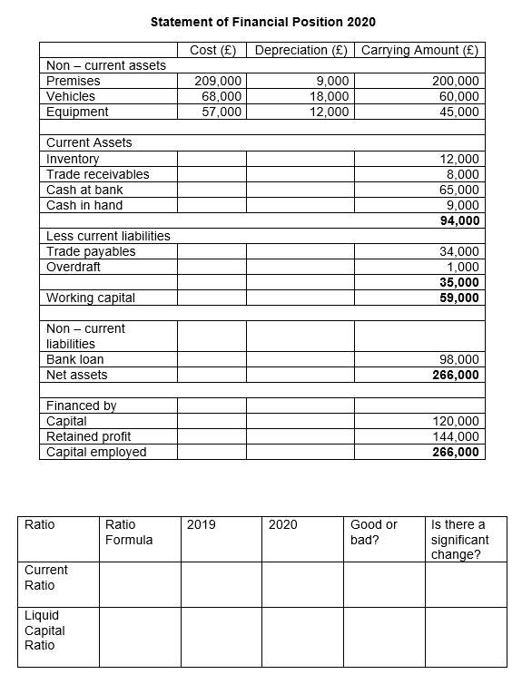
Activity 15 – Calculate, Interpret and Analyse Liquidity Ratios
You did such a great job with the evaluation of DC Socks LTD profitability that they now want you to advise them on their liquidity.
They have provided you with a statement of financial position for 2019 & 2020.
They would like you to calculate the current ratio and liquid capital ratio for both years and then use it to analyse the liquidity of the business.

Slide 89
Activity 15 – Calculation Answers

Slide 90
F5 – Measuring Efficiency

Slide 91
Measuring Efficiency
Efficiency ratios are used to help management determine how key areas of the business are performing, mainly in terms of cash flow and inventory.
The ratios used to determine efficiency are:
Trade receivable days
Trade payable days
Inventory turnover

Slide 92
Trade Receivable Days
Trade receivables
credit sales x 365
How long it takes debtors to pay for goods they have purchased on credit.
The answer is displayed in days and is why the answer is multiplied by 365 as this represents the days in a year.
IMPORTANT: If you can not find the amount of sales that were made on credit then it is acceptable to use the overall sales figure on a statement of comprehensive income.

Slide 93
What Does Trade Receivable Days Show?
This ratio measures the average amount of days it takes for debtors to pay for a product or service.
It expresses the figure as the amount of days it takes for something to be paid for that is bought on credit.
It is very important to know in terms of cash flow as you want to receive the money owed as quickly as possible. Certainly quicker than it takes the business to pay its creditors.
Depending on the industry/sector the acceptable amount of days to receive payment is different. For example 60 day terms may be acceptable in manufacturing but 30 days may be the norm in retail.

Slide 94
Trade Receivable Days on Financial Statements
Trade receivables
credit sales x 365
12,000
100,000 x 365
= 43.8 days
Statement of Comprehensive Income year end April 2020
 | £ | £
Sales |  | 100,000
Less cost of goods sold
Opening inventory | 12,000
Purchases | 18,000
Closing inventory | 5,000
 |  | 25,000
Gross profit |  | 75,000
Less Expenses
Rent |  | 12,000
Salaries |  | 20,000
Advertising |  | 3,000
Business rates |  | 5,000
Distribution |  | 12,000
Depreciation |  | 8,000
Total expenses |  | 60,000
Revenue Income |  | 0
Net profit |  | 15,000
 | Cost £ | Depreciation £ | Carrying Amount £
Non – current assets
Premises | 150,000 | 10,000 | 140,000
Vehicles | 20,000 | 5,000 | 15,000
Equipment | 18,000 | 4,000 | 14,000
Current Assets
Inventory |  |  | 23,000
Trade receivables |  |  | 12,000
Cash at bank |  |  | 6,000
Cash in hand |  |  | 3,000
44,000
Less current liabilities
Trade payables |  |  | 13,000
Overdraft |  |  | 2,000
 |  |  | 15,000
Working capital |  |  | 29,000
Non – current liabilities
Bank loan |  |  | 65,000
Net assets |  |  | 133,000
Financed by
Capital |  |  | 85,000
Retained profit |  |  | 48,000
Capital employed |  |  | 133,000

Slide 95
Activity 16 – Quick Practice Question
A small business called Reed Guitars wants to know its trade receivable days. They have told you that they have £40,000 in trade receivables and £70,000 in credit sales.
Calculate their trade receivable days.
Help Reed Guitars by explaining what this figure you have calculated means.

Slide 96
Trade Payable Days
Trade payable
credit purchases x 365
This measures how long it takes a business to pay for the goods or services bought on credit.
As with trade receivable days, the answer for trade payable days is displayed as days and is why the answer is multiplied by 365 as this represents the days in a year.
IMPORTANT: If you don’t know the amount of purchases that were made on credit then it is acceptable to use the purchases figure on a statement of comprehensive income.

Slide 97
What Does Trade Payable Days Show?
This ratio measures the average amount of days it takes for the business to pay creditors for the goods or services it has received.
The answer is expressed as a number of days as this shows how the average amount of days it takes the business to pay.
This figure is usually compared with the trade receivable days and the business will want to receive the money it is owed quicker than paying the money it owes. This will positively impact cash flow.
A lot of business provide other businesses with 30 day credit terms.

Slide 98
Trade Payable Days on Financial Statements
Trade payables
credit purchases x365
13,000
18,000 x 365
= 263.6 days
Statement of Comprehensive Income year end April 2020
 | £ | £
Sales |  | 100,000
Less cost of goods sold
Opening inventory | 12,000
Purchases | 18,000
Closing inventory | 5,000
 |  | 25,000
Gross profit |  | 75,000
Less Expenses
Rent |  | 12,000
Salaries |  | 20,000
Advertising |  | 3,000
Business rates |  | 5,000
Distribution |  | 12,000
Depreciation |  | 8,000
Total expenses |  | 60,000
Revenue Income |  | 0
Net profit |  | 15,000
 | Cost £ | Depreciation £ | Carrying Amount £
Non – current assets
Premises | 150,000 | 10,000 | 140,000
Vehicles | 20,000 | 5,000 | 15,000
Equipment | 18,000 | 4,000 | 14,000
Current Assets
Inventory |  |  | 23,000
Trade receivables |  |  | 12,000
Cash at bank |  |  | 6,000
Cash in hand |  |  | 3,000
44,000
Less current liabilities
Trade payables |  |  | 13,000
Overdraft |  |  | 2,000
 |  |  | 15,000
Working capital |  |  | 29,000
Non – current liabilities
Bank loan |  |  | 65,000
Net assets |  |  | 133,000
Financed by
Capital |  |  | 85,000
Retained profit |  |  | 48,000
Capital employed |  |  | 133,000

Slide 99
Activity 16 continued – Quick Practice Question
Reed Guitars were really happy with what you told them about their receivable days that they want you to:
Calculate their trade payable days and explain the figure to them
Compare their trade receivable days and payable days so they understand what this means for the business financially.
They have trade payables of £4,000 and credit purchases of £60,000.

Slide 100
Inventory Turnover
Average inventory
cost of goods sold x 365
How to calculate average inventory:
Average inventory = opening inventory + closing inventory
2
This measures the average amount of time an item is held by the business before it is sold.
If a business has an inventory turnover of 10 days then that means the business holds each item for an average of 10 days until it is sold.

Slide 101
What Does Inventory Turnover Show?
The average number of days stock is held within the business before it is sold.
If the average number of days is high then the item could go out of date or out of trend.
Depending on the industry there are acceptable averages. i.e. a fresh fruit and vegetable store will have a much lower inventory turnover than a luxury car company.
If inventory turnover for a fresh fruit and vegetable store was the same as a luxury car company then it is likely the product will go out of date and would not be able to be sold.

Slide 102
Inventory Turnover on Financial Statements
Average inventory
cost of goods sold x 365
Average inventory = opening inventory + closing inventory
2
Opening inventory 12,000 + Closing inventory 5,000 = 17,000
17,000
2 = 8,500
8,500
25,000 = 124.1
Answer
Inventory turnover = 124.1 days
Statement of Comprehensive Income year end April 2020
 | £ | £
Sales |  | 100,000
Less cost of goods sold
Opening inventory | 12,000
Purchases | 18,000
Closing inventory | 5,000
 |  | 25,000
Gross profit |  | 75,000
Less Expenses
Rent |  | 12,000
Salaries |  | 20,000
Advertising |  | 3,000
Business rates |  | 5,000
Distribution |  | 12,000
Depreciation |  | 8,000
Total expenses |  | 60,000
Revenue Income |  | 0
Net profit |  | 15,000

Slide 103
Activity 16 continued – Quick Practice Question
Reed Guitars have opening inventory of £26,000, closing inventory of £7,000 and cost of goods sold of £33,000.
Calculate their inventory turnover.
Explain what this suggests about the business.

Slide 104
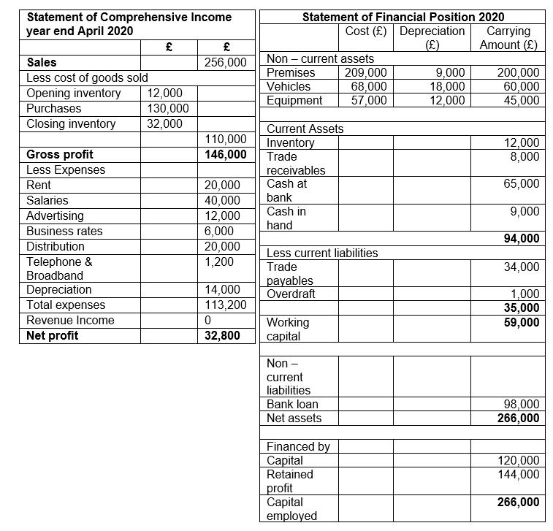
Activity 17 – Calculate, Interpret and Analyse Efficiency Ratios
Finally DC Socks LTD want you to investigate the efficiency of their business in 2020 and have provided you with financial statements for you to analyse.
They want you to tell them some information about trade receivable days, trade payable days and inventory turnover. They also want you to calculate the ratios for them.

Slide 105
Activity 17 – Calculation Answers

Slide 106
F6 – Limitations of Ratios

Slide 107
Positives and Negatives of Using Ratio Analysis
Although ratio analysis does have its limitations it is important to remember the advantages of using it, such as:
Ratios help compare current performance with previous records.
Ratios help compare a firm’s performance with similar competitors.
Ratios help monitor and identify issues that can be highlighted and resolved.

Slide 108
The Limitations
Despite the positives ratio analysis has when analysing financial data, there are some limitations to its usefulness, such as:
The data is historic, meaning that it is calculated using past data which may not reflect current performance.
Ratio analysis does not take into account external factors such as a worldwide recession.
Ratio analysis does not measure qualitative impacts such as workplace culture.
Financial records are easy to manipulate which can lead the ratios to be misleading or false.
Interfirm comparison can be difficult with large companies that report their accounts using different formats.

Slide 109
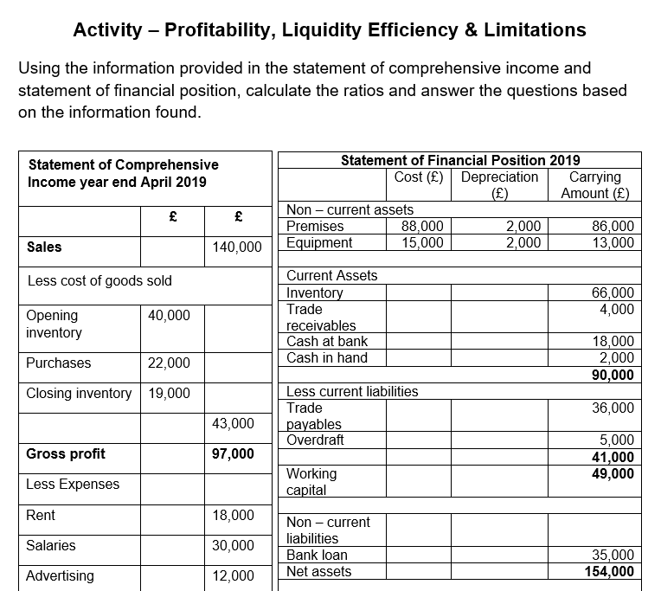
Activity 18 – Profitability, Liquidity and Efficiency Ratios

Slide 110
Activity 18 – Calculation Answers

Slide 111
Activity 19 – Test Your Knowledge Learning Outcome F Kahoot
Attempt the Kahoot quiz to test your knowledge of Learning Outcome F of Unit 3: Personal and Business Finance.
Link to the Kahoot: Click here to play the Kahoot
Once you have completed the quiz, answer the questions in your student book to assess your strengths and areas of development.

Slide 112
Activity 20 – Word Scramble Learning Outcome F
1. GSORS FIROTP ______________________________________
2. TEN FTIORP ________________________________________
3. QUDIIL LTIPACA ____________________________________
4. TCRUENR OTARI _____________________________________
5. AANFCILNI IPIOSTNO ________________________________
6. EERMVHESOICNP OCNIME ______________________________
7. XSENEPES __________________________________________
8. NEIVTRNOY _________________________________________
9. ADRNCETOIPIE ______________________________________
10. EADTR IEVCREAELB DAYS _____________________________
11. NVEEURE ___________________________________________
12. LLSEIAITBII _______________________________________

Slide 113
Word Scramble Answers
1. GSORS FIROTP __Gross profit________________________
2. TEN FTIORP __Net profit____________________________
3. QUDIIL LTIPACA __Liquid capital____________________
4. TCRUENR OTARI __Current ratio______________________
5. AANFCILNI IPIOSTNO __Financial position____________
6. EERMVHESOICNP OCNIME __Comprehensive income________
7. XSENEPES __Expenses________________________________
8. NEIVTRNOY __Inventory______________________________
9. ADRNCETOIPIE __Depreciation________________________
10. EADTR IEVCREAELB DAYS __Trade receivable days______
11. NVEEURE __Revenue__________________________________
12. LLSEIAITBII __Liabilities__________________________

Slide 114
Activity 21 – Word Search Learning Outcome F

Slide 115
Word Search Answers

Slide 116
Activity 22 – Ratios Crossword Learning Outcome F
Across 2. Net profit ÷ revenue x 100 = 4. Trade receivables ÷ credit sales x 365 = 6. Current assets ÷ current liabilities = 7. Average inventory ÷ cost of goods sold x 365 = 8. Trade payable ÷ credit purchases x 365 = 9. Gross profit ÷ revenue x 100 = | Down 1. Current assets - inventory ÷ current liabilities = 3. Gross profit ÷ cost of goods sold x 100 = 5. Net profit ÷ capital employed x 100 =

Slide 117
Crossword Answers

Slide 118
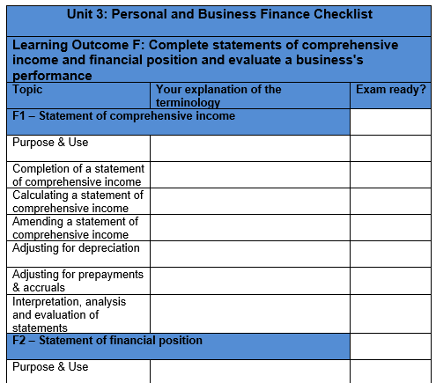
Activity 23 – Personal and Business Finance Learning Outcome F
Well done, you have now completed the input and set activities for Learning Outcome F, you have one final task which is to complete the specification checklist below.
First, you should explain the terminology and topic areas in the space provided and then tick the box in the last column when you feel exam ready with regards to that specific element of the specification.

