Slide 1
AQA
    AS Level
      Computer Science
      Paper 2
Representing sound
Data representation

Slide 2
Objectives
Describe the digital representation of sound in terms of sampling rate and resolution
Describe the principles of operation of an analogue to digital converter and a digital to analogue converter
Understand and apply the Nyquist theorem
Calculate sound sample sizes in bytes
Describe the purpose and advantages of MIDI and the use of event messages

Slide 3
Image representation
What are the steps involved in converting an analogue image into a digital photograph?
What factors affect digital image quality?

Slide 4
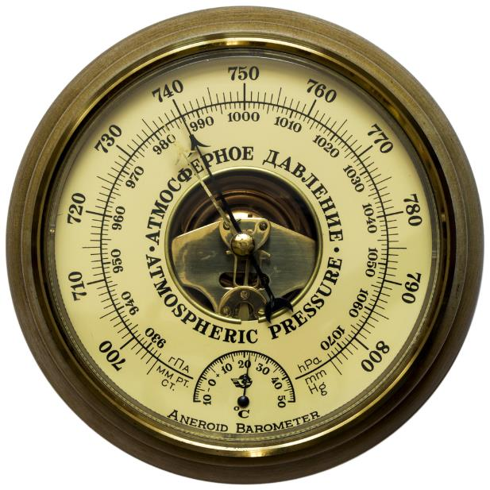
Real-world data
Real-world data is usually analogue in nature with values that vary by any amount over time
  Sound is a result of changes in air pressure
  Pressure fluctuations cause our eardrums to vibrate
  Nerve signals are interpreted as sound

Slide 5
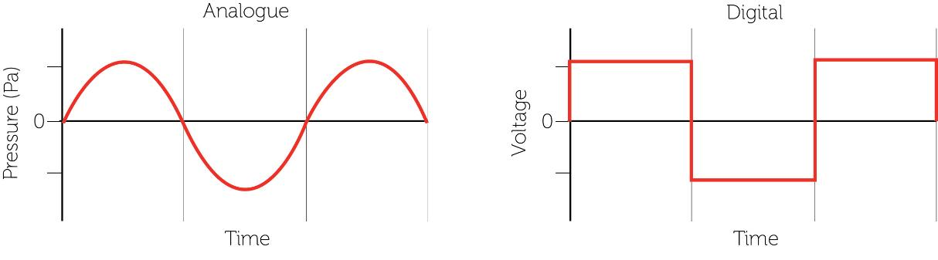
Analogue and digital signals
Analogue signals are continuous, whereas digital signals are discrete
Signals can be converted from one form to another

Slide 6
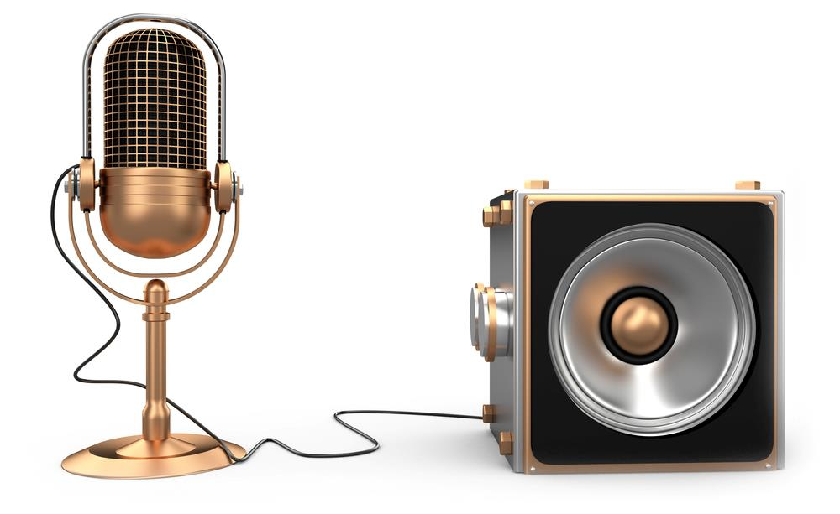
Analogue to digital convertors
Examples of ADCs and DACs are:
  Microphones
  Speakers

Slide 7
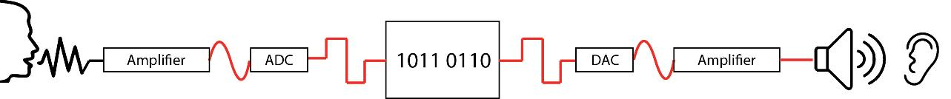
Analogue to digital conversion
Analogue sound samples are recorded via an amplifier
Each sample is quantised to measure its wave height and translate this into an integer value
The integer value is then converted and stored digitally as a binary value
To output a sound, the reverse happens

Slide 8
Analogue and digital signals
Complete Task 1 on Worksheet 5

Slide 9
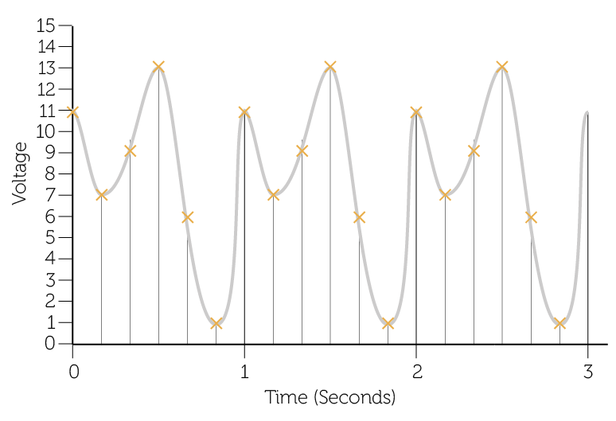
Sampling
An analogue signal is measured at regular periods
  The amplitude (or voltage of the analogue signal at that point in time) is referred to as the sample resolution
  This is referred to as the sampling rate and is measured in Hertz (The number of samples taken in one second)

Slide 10
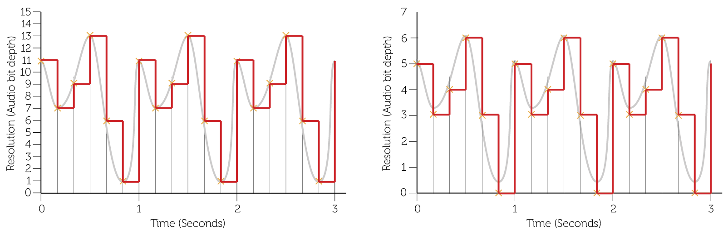
Sample resolution
The number of bits (audio bit depth) used to record each measurement is known as the resolution
  More bits used per sample enables the height of the wave to be more accurately measured but increases file size
High resolution
Low resolution

Slide 11
How does resolution actually affect a sound sample?
Listen to Sample 1
Changes in resolution are indicated by a beep:
  16bits, 12, 10, 8, 6, 4, 2, 1
What do you notice as the resolution gets worse?
Is there a point where you can no longer recognise the music?

Slide 12
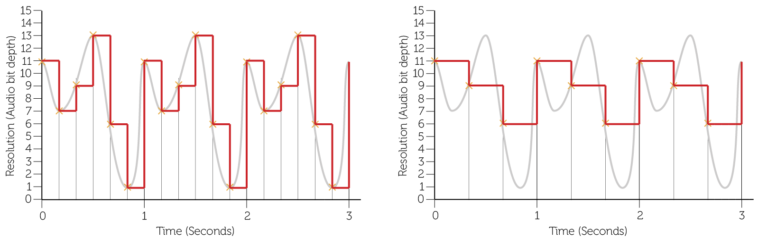
Sampling rate
The frequency or sample rate per second affects the level of detail in the digital representation
  The greater the frequency, the greater the accuracy, and file size
High frequency
Low frequency

Slide 13
How does sample rate affect a sound sample
Listen to Sample 2
Sample rates are:
  16kHz
  8kHz
  4kHz
  2kHz
How does the sample rate affect the music?

Slide 14
File size
The sampling rate and the resolution allow us to determine the size of file required to create a digital copy of the sound waves
  Sampling rate indicates number of samples per second (Hertz)
  Resolution is number of bits used per sample
  File size =
  sample rate x resolution x length in seconds

Slide 15
Calculating audio file size
A 30 second audio track is recorded
The sample rate is set at 44,000 Hertz (or 44kHz)
The resolution is selected as 16 bit
The size of the file produced is:
  (44,000 x 16) x 30 = 21,120,000 bits
  21,120,000 / 8 = 2,640,000 bytes / 1,000,000 = 2.64MB
For stereo sound, two channels are recorded for left and right, doubling the file size

Slide 16
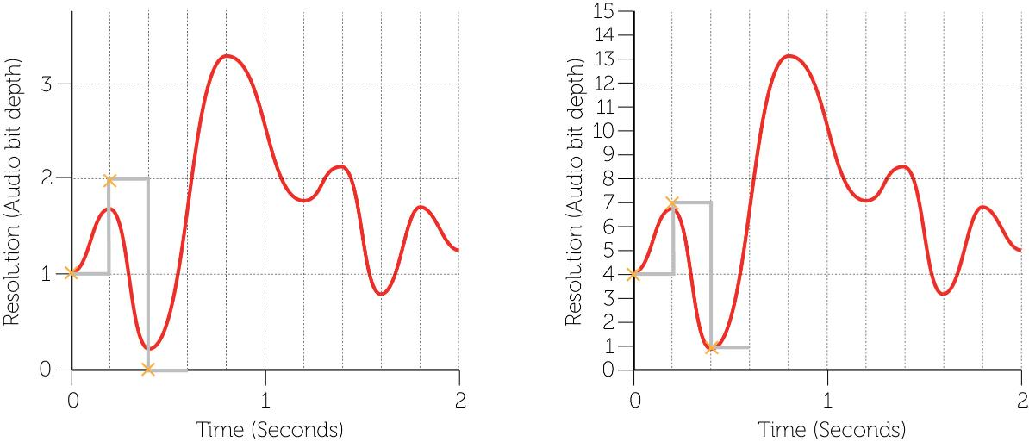
Sampling sound
Complete Task 2 of Worksheet 5

Slide 17
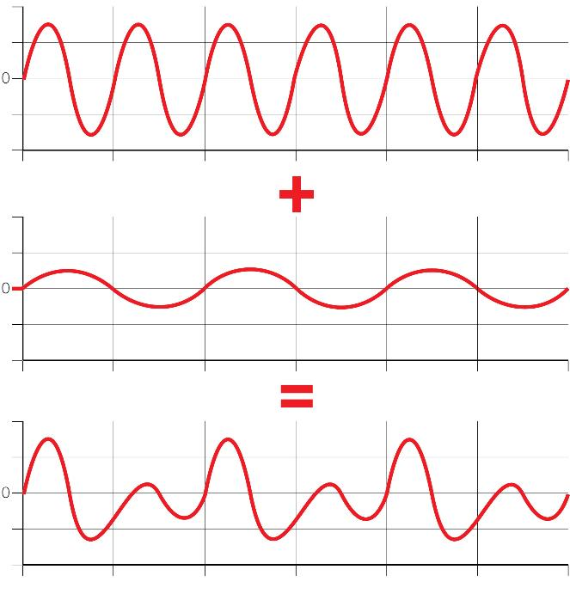
Real sound
Sound in the real-world is made up of combinations of different frequencies
  A sound wave is a combination of these different frequencies:

Slide 18
Sampling limitations
There is a limit on the lowest sampling rate (f_{s}) that can be used for an accurate recording
  Because sound is made up of many components each at different frequencies, samples must be twice the highest frequency in order to replicate the original sound wave
  This concept is known as the Nyquist Theorem:
f_{s} > 2f_{max}

Slide 19
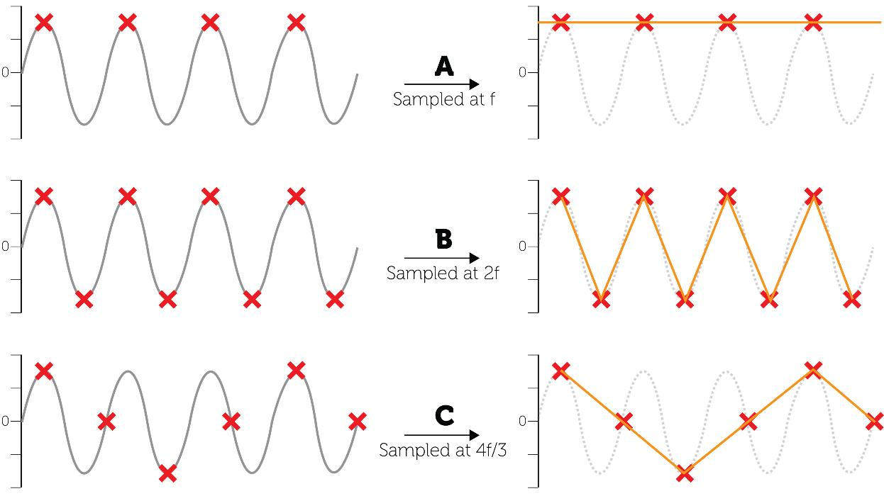
Nyquist’s theorem

Slide 20
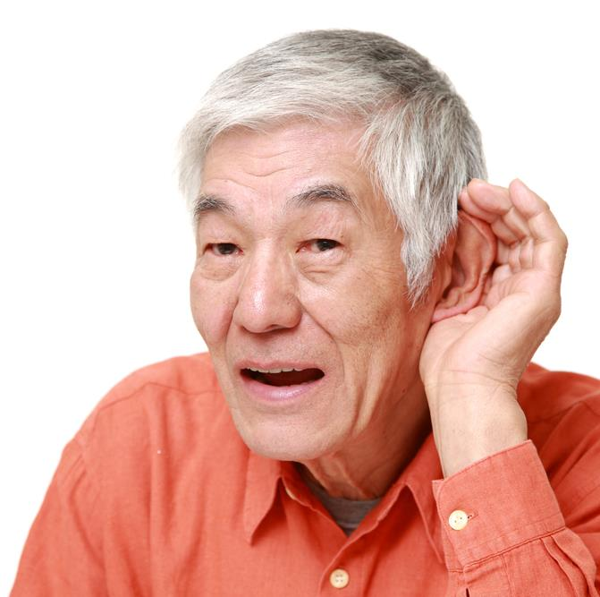
The human ear
Humans can hear frequencies of between 20Hz and 22kHz
  This reduces as we age
  Listen to the samples and
  test your own hearing
  Why are CD’s sampled at 44.1kHz?

Slide 21
Activity
Complete Task 3 on Worksheet 5

Slide 22
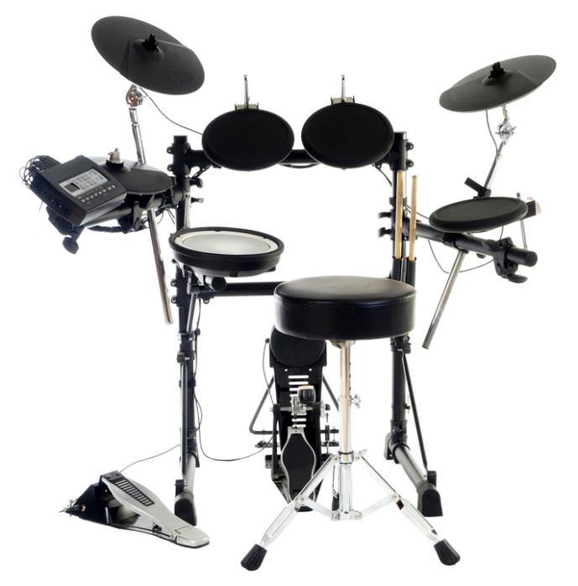
MIDI
The MIDI standard (Musical Instrument Digital Interface) creates sounds as requested either from an instrument of piece of software
  It is not a live recording, but a synthesised sound

Slide 23
MIDI benefits
With this system the full sound signal does not need to be transmitted, only the instructions to play the sound need to be transmitted as ‘event messages’
  It is up to the instrument to create the sound, so the instrument can be changed using the same messages for a different sound
  MIDI messages are usually only 2 or 3 bytes long which significantly reduces the amount of data transferred
  As sounds are synthesised, they may be less realistic but since no data is lost about musical notes, the quality can
  be higher

Slide 24
Event messages
A sound processor can be linked to several instruments or computers
This can send a timed sequence of event messages to:
  Synchronise tempo
  Control pitch
  Change volume
  Introduce and silence other instruments in a digital orchestra

Slide 25
Plenary
Real world analogue sound data can be digitised
Sound sampled at a specified rate and resolution
Signals can change due to interference but this can be detected
MIDI is an alternative system for producing sound

