Slide 1
AQA
    AS Level
      Computer Science
      Paper 2
Data compression and encryption algorithms
  Data representation

Slide 2
Objectives
Understand how and why image, sound and text data are compressed
Contrast lossy and lossless methods of compression in terms of size and accuracy of data
Use and compare the Caesar and Vernam encryption techniques for encrypting messages

Slide 3
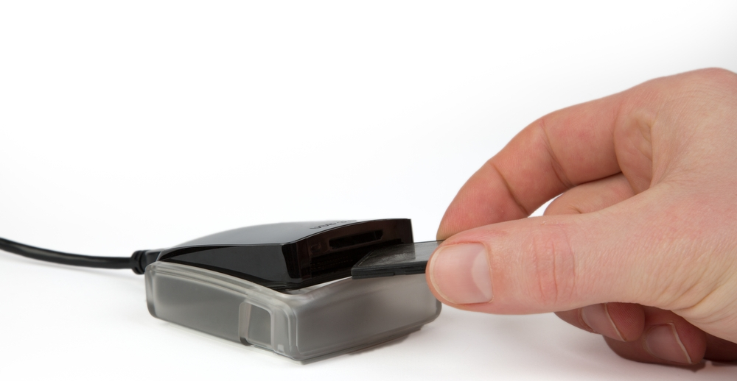
Data transfer and storage
Data is constantly being moved around computer systems and networks
  Transfer is usually high-speed and accurate
  As distances get longer, transfer is slower
  and more susceptible to interference
  Storage space can be limited

Slide 4
Reducing data requirements
  Text, image and sound data can be significantly reduced in size
  Reducing the amount of data to send or store ensures that:
  Data is sent more quickly
  Less bandwidth is used as transfer limits may apply
  Buffering on audio and video streams is less likely to occur
  Less storage is required

Slide 5
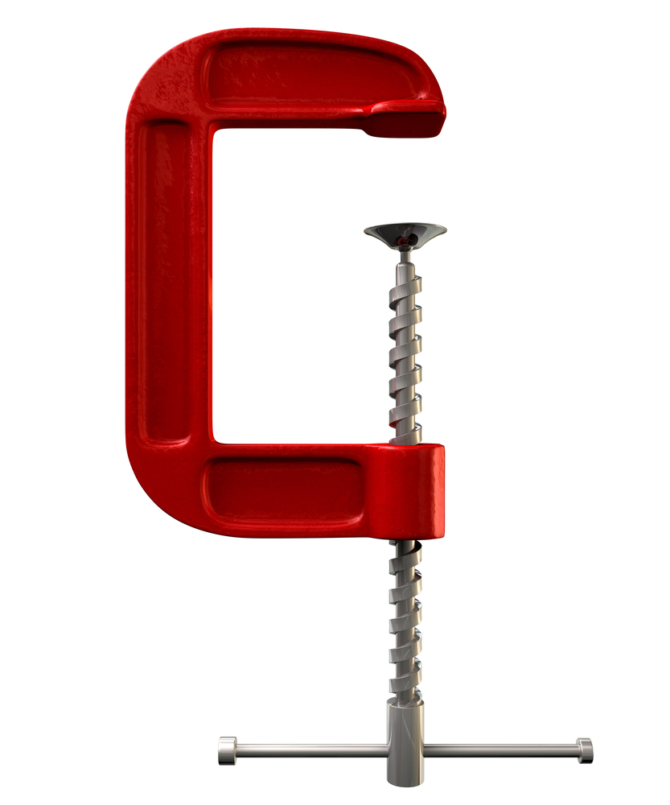
Compressing data
There are two different types of compression:
  Lossy: Non-essential data is permanently removed, for example, different shades of the same colour in an image or frequencies of sound outside the range of human hearing
  Lossless: Patterns in the data are spotted and summarised in a shorter format without permanently removing any information

Slide 6

Lossy compression – JPG
Removes data permanently to reduce file size
Tries to reconstruct an image without the missing data
  What is the effect of compression on quality and file size?
120 KB
3.8 KB

Slide 7
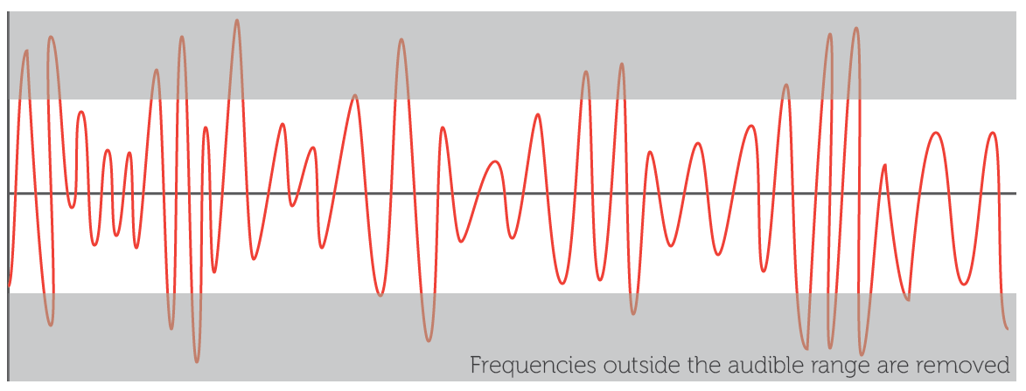
Lossy compression – MP3
Lossy compression removes the sounds in the frequency ranges that we can’t so easily hear or that least affect the perceived playback quality
Quieter notes played at the same time as louder sounds are also removed

Slide 8
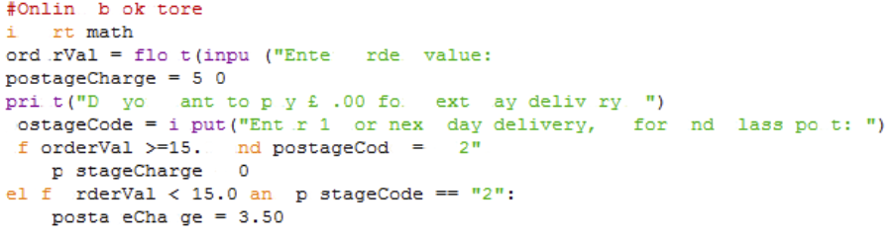
Lossless compression
Lossless compression works by recording patterns in the data rather than the data itself
  Using this pattern information, a new file can be replicated exactly without any loss of data
  The reduction in file size is less than for lossy compression
  Why is it used for compressing text files or software code?

Slide 9
Run Length Encoding (RLE)
A basic method of compression that summarises consecutive patterns of the same data
Works well with image and sound data where data could be repeated many times
10
7 | 2 | 1
7 | 2 | 1
10
5 | 1 | 4
1 | 4 | 3 | 2
1 | 1 | 3 | 2 | 3
1 | 4 | 5
1 | 1 | 2 | 1 | 2 | 3
1 | 2 | 1 | 2 | 4

Slide 10


RLE of sound
A sound recording could have many thousands of samples taken every second (typically 44,000)
  The same sound or note played for a fraction of a second could result in hundreds of identical samples
  RLE records one example of the sample and how many times it consecutively repeats
For example, notes in music could be reduced:
F
D
3 | B | 1 | F | 2 | G | 1 | F
2 | D | 2 | C | 1 | B
B
G
E

Slide 11
Dictionary compression
Spots regularly occurring data and stores it separately in a dictionary
  The reference to the entry in the dictionary is stored in the main file thereby reducing the original data stored
  Even though the dictionary produces additional overheads the space saving negates this problem

Slide 12
Forming a dictionary
  Compress the phrase “no pain no gain ” [15 bytes]
  Split the phrase up into repeated words or characters
  Using the simple dictionary example above:
  “no pain no gain ” = 0001 1000 1110 = [12 bits]
Number | Entry | Binary
1 | no_ | 00
2 | p | 01
3 | ain_ | 10
4 | g | 11

Slide 13
Compressing larger volumes
In a text document each letter could be stored as an ASCII code of 8 bits
In this document the word ‘because’ requires 56 bits of data (7 letters x 8 bits)
Instead, the word could be added to a dictionary and assigned the binary code 01 which is a reduction of 54 bits for each occurrence
A saving for 50 occurrences of the word:
  50 x 54 bits saving = 2,700 bits saved, or 338 bytes

Slide 14
Compression activities
Complete Tasks 1, 2 and 3 of Worksheet 6

Slide 15
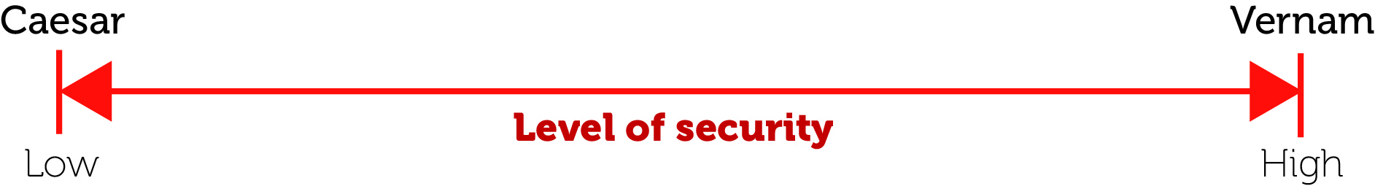
Encryption
A way of making sure data cannot be understood if you don’t possess the means to decrypt it
  Plaintext of a message sent is encrypted using a cipher algorithm and key into equivalent ciphertext
  When received, the ciphertext is decrypted back to plaintext using the same or different key
  Two methods at the opposite end of the security spectrum are the Caesar cipher and the Vernam cipher

Slide 16
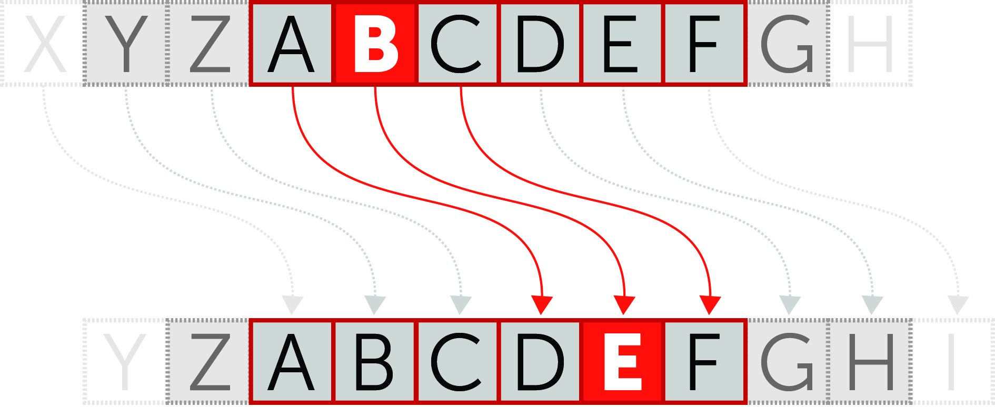
Caesar cipher
The Caesar cipher is most basic type of encryption and the most insecure
Letters of the alphabet are shifted by a consistent amount

Slide 17
Brute force attack
A brute force attack attempts to apply every possible key to decrypt ciphertext until one works
How many attempts might this take with the Caesar cipher?
  Spaces are often removed to mask word lengths
  Use the brute force method to decrypt the following: (Or, you could start by assuming vowels have the most occurrences)
GAGDC NNQPV CTIGV

Slide 18
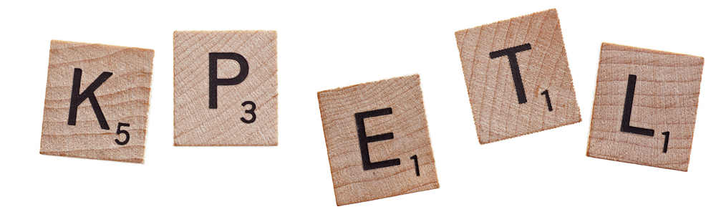
Frequency analysis
Letters are not used equally often
In English, E is by far the most common letter, followed by T, A, O, I, N, S, R, then H
Other letters like Z, J, K, Q, X are fairly rare
In Czech, the letter Z is only worth 4 points in Scrabble! It’s worth 10 in the English version

Slide 19
Vernam cipher
The encryption key, also known as the one-time pad, is the only cipher proven to be unbreakable
The key must be:
  a truly random sequence greater or equal in length than the plaintext and only ever used once
  Shared with the recipient by hand, independently of the message and destroyed immediately after use
kluyH 7nhgb i6uJY G^mhG VTk7u N7hjh GNUTf ku&57 HVj,n k7t,j HgnU7 tnk(j yG76t t;o.0 9[p.g
DESTROY IMMEDIATELY AFTER USE

Slide 20
Decoding
Encryption and decryption of the message is performed bit by bit using an exclusive or (XOR) operation with the shared key
L | = | 0 | 1 | 0 | 0 | 1 | 1 | 0 | 0
XOR
c | = | 0 | 1 | 1 | 0 | 0 | 0 | 1 | 1
 |  | 0 | 0 | 1 | 0 | 1 | 1 | 1 | 1 | = | /

Slide 21

The one-time pad
  The one-time pad must be truly random, generated from a physical and unpredictable phenomenon
  Sources may include: atmospheric noise, radioactive decay, the movements of a mouse or snapshots of a lava lamp
  A truly random key will render any frequency analysis useless as it would have a uniform distribution
  Computer generated ‘random’ sequences are not actually random

Slide 22
Activity
Complete Task 4 on Worksheet 6

Slide 23
Algorithmic security
Ciphers are based on computational security
  The keys are determined using a computer algorithm
  A key derived from an algorithm, can also be unpicked
  Given enough ciphertext, computer power and time, any key (except the one-time pad) can be determined and the message cracked

Slide 24
Plenary
Encryption and compression change the contents of a source file for different reasons
Lossy compression is most effective at reducing storage space
Lossless compression maintains the integrity of the original data
Encryption can be used to obscure a message

