Slide 1
AQA
AS Level
Computer Science
Paper 2
Programming language classification
Unit 4
Hardware and software

Slide 2
Objectives
Be aware of the classification of programming languages into low- and high-level languages
Describe low-level languages: machine-code and assembly language
Explain the term ‘imperative high-level language’ and its relationship to low-level programming
Understand the advantages and disadvantages of machine-code and assembly language programming compared with high-level programming

Slide 3
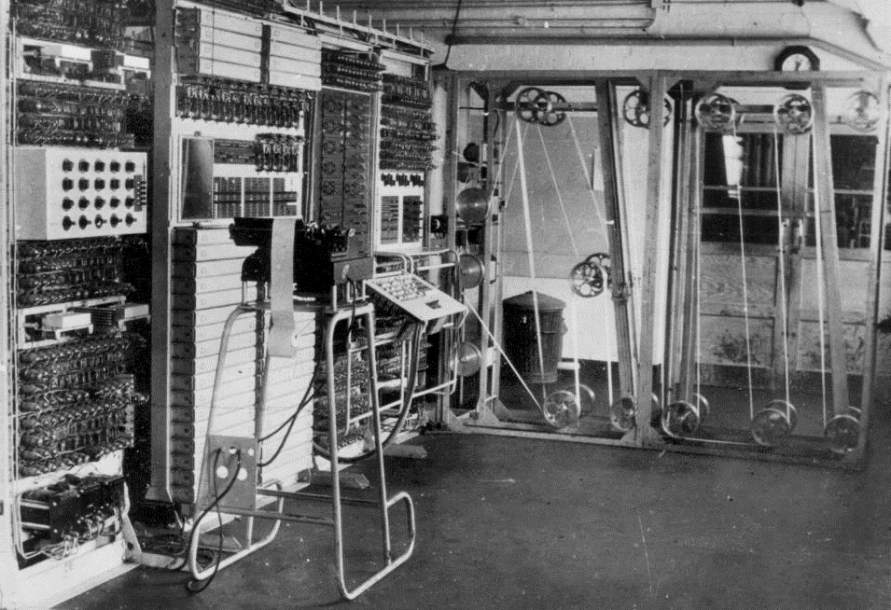
First programmable computer

Slide 4
Colossus
Colossus Mark 1 was developed by Tommy Flowers and built at Bletchley Park in 1943
Input was a continuous loop of paper tape with 20,000 5-bit characters
It was programmed using switches and plug panels
Output was an indicator lamp panel

Slide 5
Bletchley Park
Alan Turing and his colleagues used the Colossus to break the Enigma Code used by the Germans in the Second World War
The code used a Vernam-type cipher and the key changed every day
The ciphertext was read in from the paper tape
The urgency of the situation led to Britain’s best brains being recruited to develop both the hardware and the software to solve the problem

Slide 6
Late 1940s
By the late 1940s there were still only a handful of computers around, used by large companies for commercial applications such as payroll
These early computers had limited memory, with each memory cell consisting of a vacuum tube the size of a light bulb
They had a control unit and an accumulator where instructions were carried out
They were programmed using machine code, entered using a series of switches

Slide 7
Machine code
In machine code, a typical instruction holds an operation code (opcode) in the first few bits and an operand in the rest of the bits
Nowadays computers typically use 16, 24, 32 or 64 bits for a machine code instruction
How many different instructions are possible using 8 bits for the opcode?
What is the largest value of the operand that can be held in 16 bits?

Slide 8
An instruction set
The instruction set of a computer is all the instructions that it can understand and execute
If each instruction is held in 8 bits, with 4 bits for the opcode and 4 bits for the operand, the computer can execute 16 different instructions
The operand can be either an actual value or the address in memory where the value is held

Slide 9
Opcodes
Can you think of some other useful instructions?
Instruction | Meaning
0000 | Load the value stored in memory location specified by the operand into the accumulator
0001
0010
0011

Slide 10
Some sample instructions
Instruction | Meaning
0000 | Load the value stored in memory location specified by the operand into the accumulator
0001 | Store the value in the accumulator in memory location specified by the operand
0010 | Add the value specified in the operand to the value in the accumulator
0011 | Compare the contents of the accumulator with the contents of the location specified by the operand

Slide 11
Worksheet 3
Have a go at interpreting and writing machine code in Task 1

Slide 12
Assembly language
The next stage in the development of programming languages was assembly language
This featured two major improvements:
Each opcode was replaced by a mnemonic which gave a clue as to what the operation did
The operand was replaced by a decimal (or hexadecimal) number
There is still a one-to-one correspondence between assembly language and machine code instructions

Slide 13
Assembly code instructions
Here are some examples:
Instruction | Meaning
LDA | Load the value stored in memory location specified by the operand into the accumulator
STO | Store the value in the accumulator in memory location specified by the operand
ADD | Add the value specified in the operand to the value in the accumulator
CMP | Compare the contents of the accumulator with the contents of the location specified by the operand

Slide 14
What does this program do?
1 LDA 13
2 ADD 14
3 CMP 15
4 BGT 6
5 STO 15
6 STOP

Slide 15
Assembly language vs machine code
What advantages did assembly code bring to programmers?
Were there any disadvantages?

Slide 16
Assembly language vs machine code
What advantages did assembly code bring to programmers?
Answer: It is much easier to write, understand and debug programs in assembly language
Were there any disadvantages?
Answer: The assembly code has to be translated into machine code by an assembler

Slide 17
High-level languages
In the 1960s, John Backus and his team at IBM made a giant step for mankind with the invention of FORTRAN, the first high-level language
FORTRAN statements look like Maths or English:
x = y – 76
if (x .gt. 0) then
z = sqrt(x)
else
print *. x, “ is negative”

Slide 18
Imperative high-level languages
An imperative high-level language consists of commands for the computer to perform
This is in contrast to a declarative language which focuses on what the program should do without listing the steps needed to achieve the result
Database query languages such as SQL are declarative languages
How many imperative languages can you name?

Slide 19
Why high-level?
Languages such as FORTRAN, Pascal, Delphi, Visual BASIC and Python are called high-level languages
This implies that the programmer can think and code in terms of algorithms rather than worrying about how the computer will execute each tiny step
This is an example of abstraction

Slide 20
Worksheet 3
Now do the questions in Task 2

Slide 21
Translating high-level language statements into machine code
A high-level program has to be converted into machine code before it can be executed
Assembly language instructions have a one-to-one relationship with machine code
Is this true of high-level languages?

Slide 22
Advantages of high-level vs low-level languages
Much easier and faster to write, debug and maintain programs
Different high-level languages have been written specifically for different types of problem
Can you think of an example?
High-level language programs are portable – a program written for one type of computer can be recompiled for a different type of computer

Slide 23
Disadvantages of high-level vs low-level languages
The object code (compiled or interpreted code) may run slower than assembly code or machine code
The object code may occupy more space in RAM – which can be a problem in embedded systems with a small amount of memory
Most high-level languages do not have statements to allow the programmer to manipulate individual bits – essential in some applications, e.g. device drivers

Slide 24
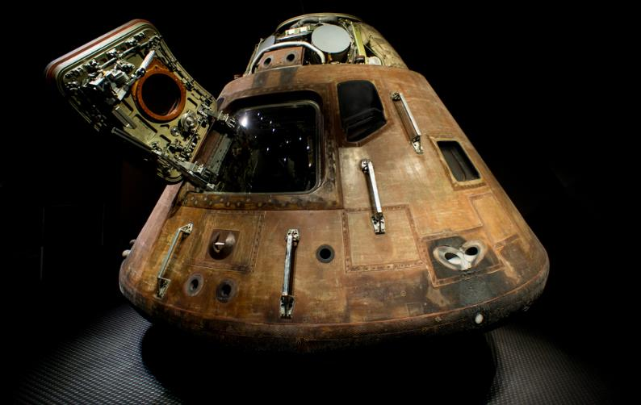
Plenary
Hardware and software have come a long way since 1943!
The computer system in Apollo 11 that landed men on the moon in 1969 had 64KB of memory
The electronics were more basic than in modern toasters

