Slide 1
AQA
    AS Level
      Computer Science
      Paper 2
Social, legal and cultural issues
  Unit 6
  Communication: Technology and consequences

Slide 2
Objectives
Understand the current capacity to distribute, publish, communicate and disseminate personal information
Understand that software and their algorithms embed moral and cultural values
Understand that computer scientists and software engineers have power, as well as the responsibility that goes with it, in the algorithms that they devise and the code that they deploy
Be able to discuss the challenges facing legislators in the digital age

Slide 3

Private information and the web
How has our connected, online world enabled us to publish and distribute personal information?
  Do you post personal information
  about yourself online?
  Do you post
  personal information
  about other
  people online?
  Is this ethical?

Slide 4

Social media sites –
good or bad?
How many people in different countries use social networking sites such as Facebook, Twitter, Instagram, Snapchat, WhatsApp, Tumblr?
  Who are these people?
  What do they use these sites for?

Slide 5
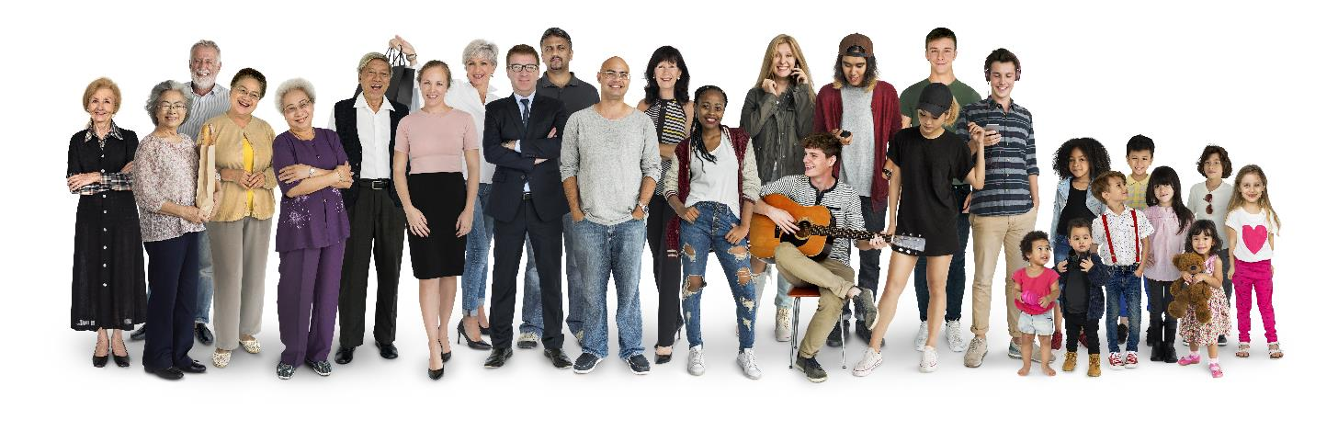
Who uses social media?
In the third quarter of 2017, Twitter averaged 330 million active users, 140 million using it every day
150 million use Snapchat every day
2.1 billion use Facebook

Slide 6
Collecting personal information
Facebook collects vast amounts of personal information on the basis of groups joined and pages “liked”
Advertisers can then specify that they wish to target people according to age, gender, interests, opinions and other characteristics

Slide 7
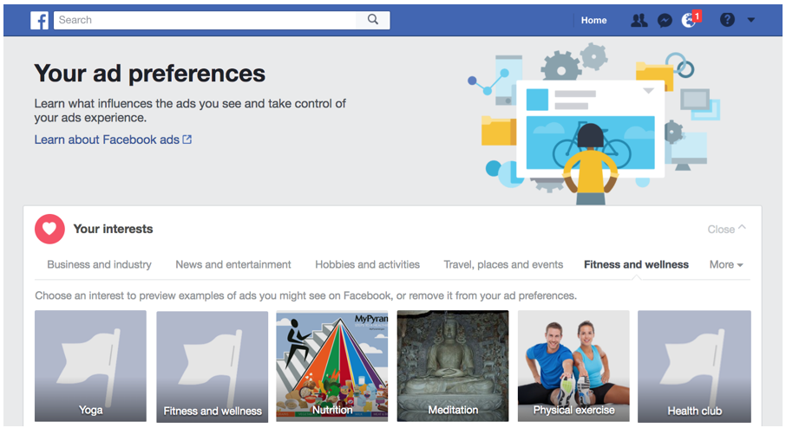
Targeted advertisements

Slide 8
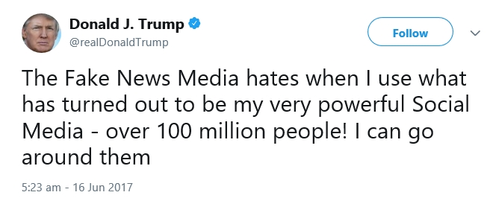
President Trump on Twitter
In October 2017 Donald Trump had more than 41 million followers
  However, almost half of these (19.7 million) were fake
  Many of Trump’s 37,000 Tweets are wild exaggerations!

Slide 9
Fake news
Facebook, Google and Twitter provide a platform for spreading false information
  Agents with links to the Russian government set up millions of fake accounts and websites and purchased thousands of advertisements on Google to spread misinformation to people whose profiles suggested they would be receptive to fake news and views
  The US election in 2017 and the UK Brexit referendum in 2016 were both targeted, possibly changing the outcomes of the votes in both cases

Slide 10
Negative aspects of social media sites
What are some of the other negative aspects of social media sites?

Slide 11
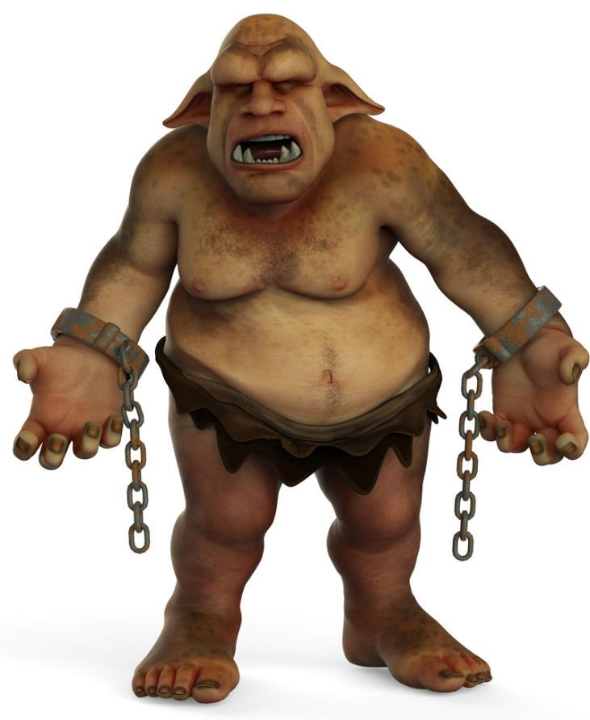
Negative aspects
Internet trolling
Cyberbullying
Anonymous blogs
Hate sites

Slide 12

Worksheet 6
Try Task 1

Slide 13
Software serving humanity
Tim Berners-Lee invented the World Wide Web in 1989 and made it freely available to all
He is a founding director of the World Wide Web Foundation, which seeks to ensure the Web serves humanity by establishing it as a global public good and a basic right

Slide 14
Software and morality
Technology is a formidable force which can be used to make the world a better place
However, it can also do great harm
  Should moral and ethical considerations be a part of technological design, research and development?
  How can this work in practice?

Slide 15
The effect of ICT applications
ICT has come to influence the way we do things
The ICT applications that software designers and engineers develop will partially determine what health care, public administration, education, science and transport will be within twenty years
  Our ICT systems must be just, fair, safe and ethical

Slide 16

A double-edged sword
Any product, however useful or benign its original purpose, can also cause harm in the wrong hands
A razor blade, syringe, pillow, car or aeroplane can all be used to kill
  Can the inventor be blamed?
  Can a software engineer be blamed
  for the manner in which his software
  is used?

Slide 17
Software and algorithms
Decisions and choices previously made by humans are now often delegated to algorithms
  Profiling algorithms determine what information can
  be accessed
  Online advertisements may be delivered according to perceived ethnicity, interests or pages viewed
  Algorithms give users directions about how and when to exercise, what to buy, what route to take
  An algorithm may be used for bail and sentencing decisions, to identify potential crime hotspots and to predict the likelihood of people reoffending

Slide 18
Do algorithms always make ethical decisions?
Algorithms are based on complex rules that
make it difficult to predict or explain the decision-making logic
  The ethics of an algorithm may be ethically questionable because of this complexity
  Machine-learning algorithms, given new training data, can define or modify their decision-making
  The human operator does not need to understand how or why the algorithm makes a particular decision

Slide 19
Ethical concerns
Algorithms may give rise to ethical concerns because of:
  Inconclusive evidence – the algorithm may not be infallible and this limitation has to be recognised
  Inscrutable evidence – the human operator may not know what data and what reasoning a decision is based on
  Inadequate algorithm or data – the conclusions can only be as reliable as the data they are based on

Slide 20
Worksheet 6
Try the questions in Task 2

Slide 21
The need for legislation
The use of new technology brings with it the need for new legislation, for example:
  Laws relating to the use of social media
  Laws relating to the use of wearable technology
  Laws relating to the use of digital currencies such as bitcoin

Slide 22
Challenges facing legislators
Enforcement is difficult and the criminals are often very hard to trace
There may not be suitable laws in place to deal with new types of behaviour on the Internet that could be viewed as criminal
The Internet is international but laws vary in different countries, so what is illegal in one country may be legal in others
New uses of technology arise so fast that the law cannot keep up – e.g. types of wearable technology

Slide 23
Worksheet 6
Answer the questions in Task 3

