Slide 1
AQA
    AS Level
      Computer Science
Abstraction and automation
  Unit 2
  Problem solving
  and theory of computation

Slide 2
Objectives
Describe the skills involved in computational thinking
Understand the concept of abstraction
Give examples of different types of abstraction
Describe the process of abstraction for solving problems

Slide 3
Computer Science…
is about using mathematical principles to solve problems
is not about how to use a spreadsheet, a word processor or a graphics package
involves learning to think computationally…
… and applying the principles of abstraction

Slide 4
Computational thinking
What information is relevant to solving a particular problem?
What computations need to be performed in order to solve the problem?
How can we be sure that the problem has been solved?

Slide 5
Abstraction
Abstraction is an important tool in problem-solving
Information hiding is one aspect of abstraction that is very useful in all kinds of simulation problems in which the real world is modelled
All the details that do not contribute to the essential characteristics of the problem are omitted
The London Underground map is a good example of information hiding
Can you think of others?

Slide 6
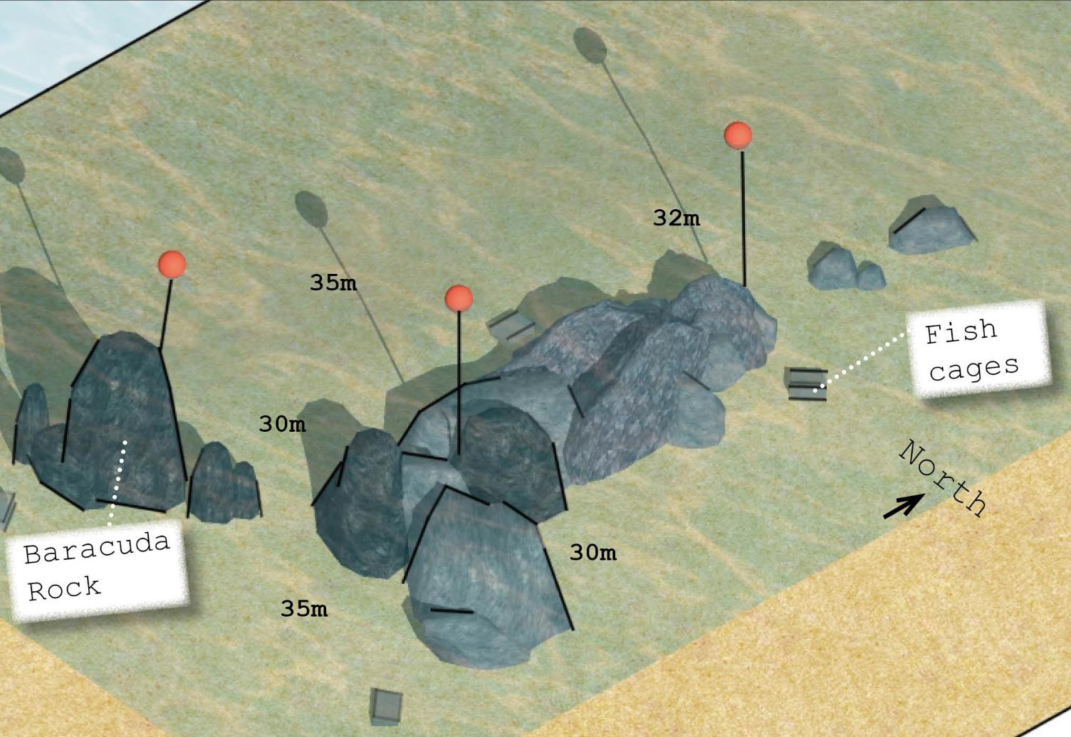
Scuba diving map
This abstract map of underwater rocks at a dive resort helps scuba divers to orient themselves

Slide 7
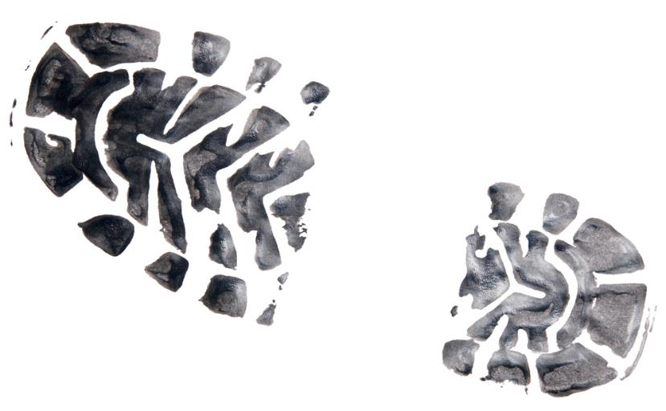
Problem abstraction
This involves removing details until the problem reduces to one which has already been solved
What do maps of a town, of the ocean floor, of a country, have in common?
What do fingerprint recognition, iris scanning, footprint scanning, text recognition, number plate recognition, have in common?

Slide 8
Automation
Automation in this context refers to building models of real world objects or phenomena in order to solve a particular problem
Computer scientists have to decide what details are relevant to the problem and discard everything else
Algorithms and data structures can then be designed to solve the problem
The algorithm is then implemented in program code and executed

Slide 9

Models of real-world problems
A financial model which calculates the likely profit from a coffee shop, based on the available data

Slide 10

Models of real-world problems
A climate change model which predicts the consequences of a 2^{O}C rise in temperature

Slide 11
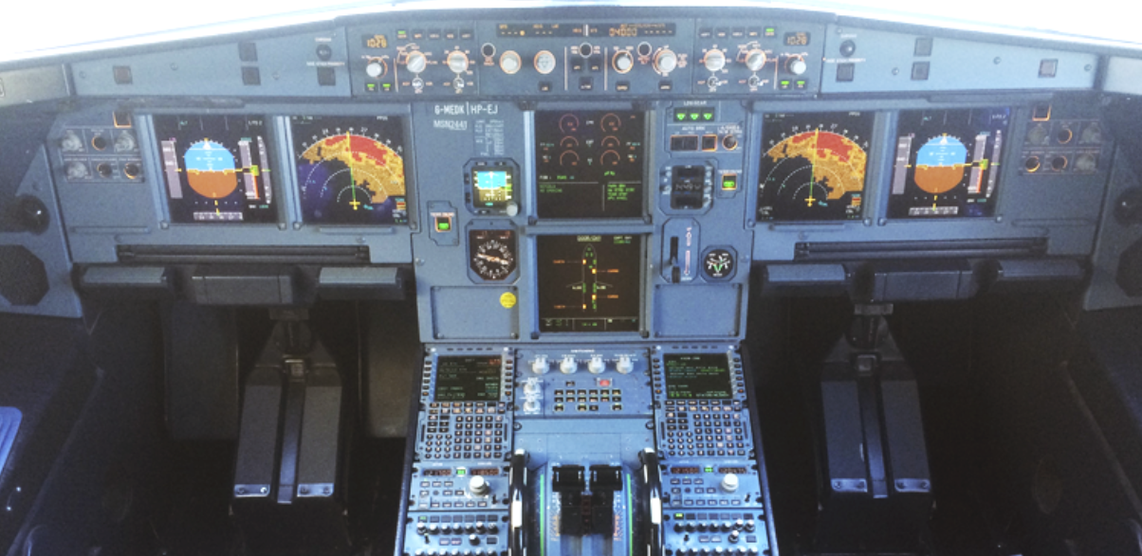
Models of real-world problems
An aircraft simulator which can be used to train pilots

Slide 12
Worksheet 5
Now try Task 1 on the worksheet

Slide 13
Programming languages and abstraction
Abstraction is a key feature of programming languages such as Python, Java and Visual Basic
Using abstraction, the algorithms used to solve a problem are far removed from the actual machine code instructions that have to be carried out
The Python instruction:
IF x > y:
print(x)
would have been written in machine code by early programmers – about 7 lines of 0s and 1s!

Slide 14
Decomposition
Procedural decomposition means breaking a problem into a number of sub-problems, so that each sub-problem accomplishes an identifiable task
The sub-problems may themselves be further subdivided
Composition is the opposite
  combining procedures to form a compound procedure
  Combining data objects to form compound data objects such as a tree or stack (which you will study next year)

Slide 15
Procedural abstraction
Procedural abstraction is used to keep the actual values used in a computation separate from the overall design
In simple terms, this involves writing procedures and passing parameters
A car dealer might use a procedure for displaying a particular model of a car, and pass parameters for colour, number of doors, wheels etc.

Slide 16
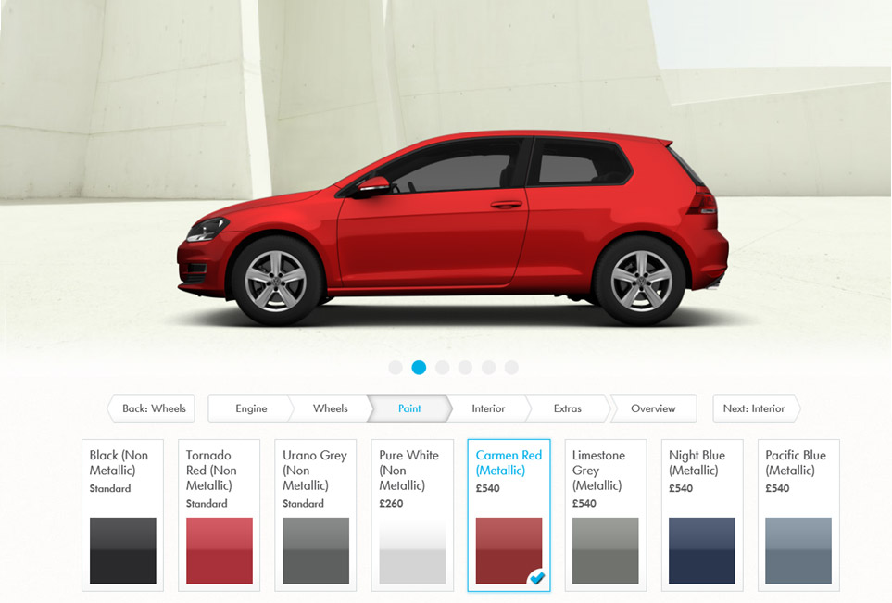
Choosing car options

Slide 17
Functional abstraction
When you call a function to calculate a square root, or generate a random number, for example, abstraction is taken one stage further
Using a function does not require you to know anything about how the computation is carried out
You simply have to know how to call the function and what parameters to pass

Slide 18
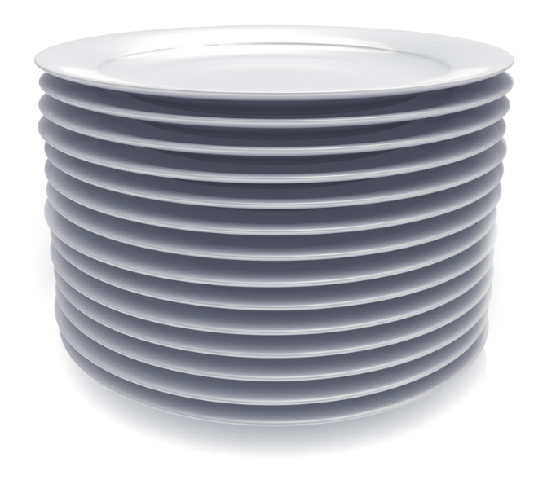
Data abstraction
The data or information that is relevant to solving a problem may be in the form of an abstract data structure such as an array, stack or queue
A stack, for example is a data structure that allows items to be added to or removed from the top
It could be implemented as an array and a pointer to the top of the stack – items do not need to be actually removed from the array or sorted within it

Slide 19
Worksheet 5
Now try Task 2 on the worksheet

Slide 20
Plenary
Abstraction in its many forms is a fundamental concept used in computational thinking and problem solving
Removing irrelevant details allows the computer scientist to focus on the essence of a problem
Data abstraction is used to create and manipulate complex data structures

Slide 21
Abstraction and automation
You should be able to explain and give examples of the types of abstraction listed below:
  Information hiding
  Procedural abstraction
  Functional abstraction
  Data abstraction
  Problem abstraction
  Decomposition/Composition
  Automation

