Slide 1
AQA
A Level
Computer Science
Paper 1
Recursive algorithms
Unit 8
Algorithms

Slide 2
Objectives
Be familiar with the use of recursive techniques in programming languages
Be able to solve simple problems using recursion
Be able to trace recursive tree-traversal algorithms: pre-order, post-order, in-order

Slide 3
Introducing factorials
Example: 5! = 5 x 4 x 3 x 2 x 1
5! (spoken 5 factorial) is a shorthand way of expressing the product of numbers 1 to 5
Calculate 5!
Now calculate 6!
Notice that 6! can be written 6 x 5!
Note also that 0! = 1 by definition

Slide 4
Recursion
The factorial function is a good example of a function that can be defined in terms of itself
n! = n x (n – 1)!
Recursion is a very powerful technique in programming
Look at the pseudocode on the next slide to see it in action…

Slide 5
A recursive routine
1. SUB calc(n)
2. IF n = 0 THEN
3. factorial ← 1
4. ELSE
5. factorial ←n * calc(n – 1)
6. OUTPUT factorial
7. ENDSUB
What will the output be if the subroutine is called with the following statement?
calc(4)

Slide 6
How does it work?
1 SUB calc(n)
2 IF n = 0 THEN
3 fac ← 1
4 ELSE
5 fac ← n * calc(n – 1)
OUTPUT fac
ENDSUB
Each time the subroutine is called, the return address, parameter and local variables are pushed onto the stack
Statement 6 is not reached until the routine is called with n = 0, when 0!=1 is output
Then statement 7 is reached, so the next return address (6) is popped, 1 x 0! is output …

Slide 7
Essential characteristics
A recursive routine has three essential characteristics:
A stopping condition or base case must be included which when met means that the routine will not call itself and will start to “unwind”
For input values other than the stopping condition, the routine must call itself
The stopping condition must be reached after a finite number of calls

Slide 8
Stack overflow!
The subroutine below is called with n = 10
SUB calcSum(n)
n ←n + calcSum(n – 1)
RETURN n
ENDSUB
OUTPUT calcSum(10)
It crashes with the following message:
RuntimeError: maximum recursion depth exceeded
Why?

Slide 9
Stopping condition
A stopping condition is required or the routine never “unwinds”
SUB calcSum(n)
IF n > 0 THEN
n ← n + calcSum(n – 1)
RETURN n
ENDSUB
OUTPUT calcSum(10)

Slide 10
The use of the call stack
Every time a subroutine is called, the return address (the line after CALL statement) is put on the call stack
Even with a stopping condition, the recursive routine can only be called a limited number of times or the stack will overflow the maximum memory capacity
If the calcSum subroutine is called with a large number, say 1000, the program may crash with the same message:
RuntimeError: maximum recursion depth exceeded
Are there any limits on an iterative routine?

Slide 11
Summing a list of numbers
Many operations can be performed using either iteration or recursion
Suppose a routine is needed to sum the numbers in a list, numbers[3, 6, 2, 8, 1]
Write an iterative routine to do this, assuming numbers[0] contains the first number, 3

Slide 12
Summing a list of numbers
An iterative routine to sum a list of numbers
SUB addNums(numbers)
sum ← 0
FOR index ← 0 TO length(numbers)-1
sum ← sum + numbers[index]
ENDFOR
RETURN sum
ENDSUB
marks ← [3, 6, 2, 8, 1]
total ← addNums(marks)
OUTPUT (total)

Slide 13
A recursive routine
Assume that list[1:] gives the list of numbers from the second element to the end of the list
SUB addNums(numbers)
IF length(numbers) = 1 THEN
RETURN numbers[0]
ELSE
RETURN numbers[0] + addNums(numbers[1:])
ENDIF
ENDSUB
marks ← [3, 6, 2, 8, 1]
total ← addNums(marks)
OUTPUT (total)
What is output?

Slide 14
Worksheet 1
Try Task 1, Questions 1 and 2 on the worksheet

Slide 15
Tree traversal algorithms
Recall that there are three ways of traversing a tree: pre-order, in-order and post-order
The prefixes pre-, in-, or post- refer to whether the root is visited before, between or after the nodes of the subtree
Write down the order of nodes visited for each traversal

Slide 16
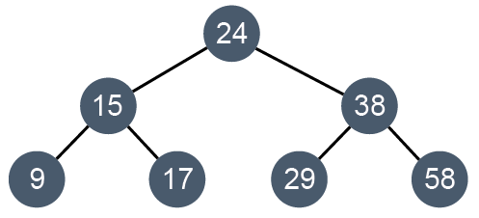
A table representing a tree
The tree can be represented in a table:
Complete the table
 | left | data | right
tree[0] | 1 | 24 | 3
tree[1] | 5 | 15 | 2
tree[2] |  | 17
tree[3] |  | 38
tree[4] |  | 29
tree[5] |  | 9
tree[6] |  | 58

Slide 17
A table representing a tree
The tree represented in a table:
 | left | data | right
tree[0] | 1 | 24 | 3
tree[1] | 5 | 15 | 2
tree[2] | -1 | 17 | -1
tree[3] | 4 | 38 | 6
tree[4] | -1 | 29 | -1
tree[5] | -1 | 9 | -1
tree[6] | -1 | 58 | -1

Slide 18
Algorithms for tree traversal
A tree is defined in terms of a root, a left subtree and a right subtree
Each subtree is itself a tree
A recursive routine is a very neat way of traversing a tree

Slide 19
Algorithms for tree traversal
Using the algorithm below, in which order is the tree traversed?
SUB traverse(p)
IF tree[p].left <> -1 THEN
traverse(tree[p].left)
ENDIF
OUTPUT tree[p].data
IF tree[p].right <> -1 THEN
traverse(tree[p].right)
ENDIF
ENDSUB

Slide 20
Algorithm for pre-order traversal
SUB preOrderTraverse(p)
OUTPUT tree[p].data
IF tree[p].left <> -1 THEN
traverse(tree[p].left)
ENDIF
IF tree[p].right <> -1 THEN
traverse(tree[p].right)
ENDIF
ENDSUB

Slide 21
Algorithm for post-order traversal
SUB postOrderTraverse(p)
IF tree[p].left <> -1 THEN
traverse(tree[p].left)
ENDIF
IF tree[p].right <> -1 THEN
traverse(tree[p].right)
ENDIF
OUTPUT tree[p].data
ENDSUB

Slide 22
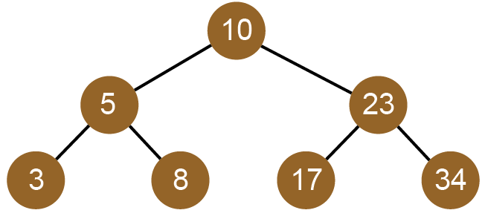
Worksheet 1
Complete the questions in Task 2 of the worksheet

Slide 23
Plenary
Recursion is a useful programming technique when the data structure or problem is recursive
A recursive routine must:
have a stopping condition or base case which when met means that the routine will not call itself and will start to “unwind”
call itself for input values other than the stopping condition
reach the stopping condition after a finite number of calls

