Slide 1
AQA
A Level
Computer Science
Paper 1
Queues
Unit 7
Data structures

Slide 2
Objectives
Understand the concept of an abstract data type
Be familiar with the concept and uses of a queue
Describe the creation and maintenance of data within a queue (linear, circular, priority)
Describe and apply the following to a linear, circular and priority queue
add an item
remove an item
test for an empty queue
test for a full queue

Slide 3
Introduction to data structures
Sort these terms into the table based on your current understanding:
array, integer, real, list, stack, Boolean, char, queue, string
Category | Word
Elementary data type
Composite data type
Abstract data type

Slide 4
Introduction to data structures
Category | Word
Elementary data type | integer, real, Boolean, char
Composite data type | string, array [list may also be in this section, depending on programming language]
Abstract data type | list, stack, queue

Slide 5
Abstraction
An abstract data type (ADT) is a logical description of how we view the data and possible operations
A queue of print jobs (add to the rear, remove from front)
A stack of books (add to top, remove from top)
A list of tasks to do (add to the end, remove most important)
We are concerned only with what the data is representing and not how it is constructed
We are creating an encapsulation around the data
Encapsulation is a type of information hiding

Slide 6
Examples of queues
What are some examples of queues in real life and information processing systems?
What operations can be carried out on a queue?

Slide 7
Modelling a queue
You might have thought of a queue at the cinema or supermarket checkout, or a queue of jobs waiting to be processed or printed
There are four distinct operations:
Add item to the rear of the queue
Remove item from the front of the queue
Check if the queue is empty
Check if the queue is full

Slide 8
Add and remove
Using only the bus cards and the queue card:
Add bus 118A Sheffield to the queue
Add another bus 92B York to the queue
Add bus 142A Leeds to the queue
Remove a bus from the queue
Remove another bus from the queue

Slide 9
Add and remove
After three buses join the queue, it looks like this:
After two buses leave the queue, it looks like this:
Is this a good way of implementing a queue?
[0] | [1] | [2] | [3] | [4]
118A Sheffield | 92B York | 142A Leeds
[0] | [1] | [2] | [3] | [4]
 |  | 142A Leeds

Slide 10
Front and rear
It’s very wasteful of CPU cycles to refill memory locations with blanks - pointers can be used instead
What should the front pointer hold after three buses have joined, and two buses have left the queue?
What should the rear pointer hold?
[0] | [1] | [2] | [3] | [4]
118A Sheffield | 92B York | 142A Leeds
front = ?
rear = ?

Slide 11
Front and rear
There are different ways of implementing a queue
The choice only affects the implementation of the operations
Recall that the implementation is abstracted away from the user
front points to the next item to remove and rear points to the last item added
[0] | [1] | [2] | [3] | [4]
118A Sheffield | 92B York | 142A Leeds
front = 2
rear = 2

Slide 12
Empty and full queues
We can’t add to a full queue or remove an item from an empty queue
Therefore, when the queue is initialised, we need to specify the maximum number that it can hold, e.g. maxSize
We may also need a variable size to hold the number of items currently in the queue
How will a full queue be detected?

Slide 13
Queue functions or methods
enQueue(item) – add an item to the rear
deQueue – remove and return an item from the front
isEmpty – indicates if the queue is empty
isFull – indicates if the queue is full

Slide 14
Worksheet
Complete Task 1
Mochi (shown here) are traditional Japanese rice cakes!

Slide 15
Problems with implementation
Problems arise with the implementation of a queue as a fixed-size array
How many items can be added? Or removed?
What happens when the queue is full, but there are some free spaces at the front?
How could these limitations could be overcome when using an array?

Slide 16
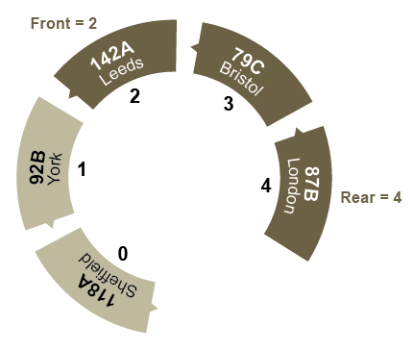
Circular queue
A circular queue algorithm overcomes the problem of reusing the spaces that have been freed by dequeueing from the front of the array
Bus 75 from Plymouth pulls in. Where will it go? Adjust the pointers

Slide 17
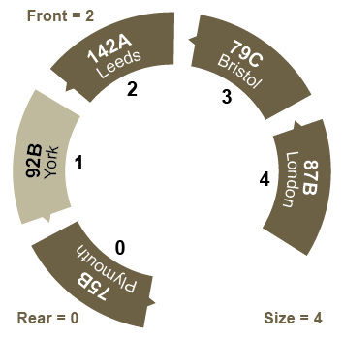
Adding to a circular queue
Pointers go: 0 → 1 → 2 → 3 → 4 → 0 → 1 …
What function can you use to implement this?
How will you test for a full queue?

Slide 18
MOD function
Complete to show the operation of the MOD function
Current Index | (Current + 1 ) | (Current + 1 ) MOD 5 | New Current Index
0
1
2
3
4

Slide 19
MOD function
Complete to show the operation of the MOD function
Current Index | (Current + 1 ) | (Current + 1 ) MOD 5 | New Current Index
0 | 1 | 1 | 1
1 | 2 | 2 | 2
2 | 3 | 3 | 3
3 | 4 | 4 | 4
4 | 5 | 0 | 0

Slide 20
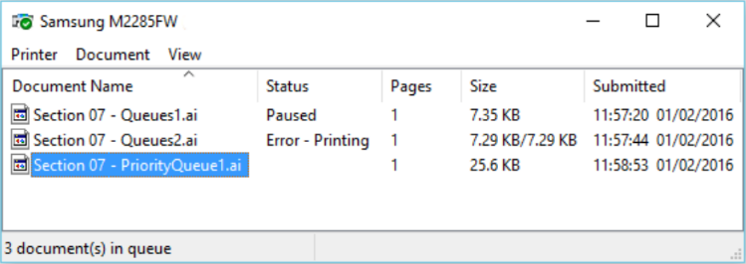
Worksheet
Complete Task 2 on the worksheet

Slide 21
Pseudocode
enqueue(item) – add an item to the rear
dequeue – remove and return an item from the front
isEmpty – indicates if the queue is empty
isFull – indicates if the queue is full

Slide 22
Functions isEmpty, isFull
How do you know if the queue is empty?
How do you know if the queue is full?
Assume a queue has been defined as:
q ← array of maxSize elements
front ← 0
rear ← -1
size ← 0
Write pseudocode for isEmpty and isFull

Slide 23
isEmpty, and isFull
SUB isEmpty
IF size = 0 THEN
RETURN True
ELSE
RETURN False
ENDIF
ENDSUB
SUB isFull
IF size = maxSize THEN
RETURN True
ELSE
RETURN False
ENDIF
ENDSUB
Can you write these subroutines in a shorter way?

Slide 24
Adding and deleting elements
SUB enqueue(newItem)
IF size = maxSize THEN
print “Queue full”
ELSE
rear = (rear + 1) mod maxItems
q[rear] ← newItem
size = size + 1
ENDIF
ENDSUB
Write a subroutine to dequeue an item

Slide 25
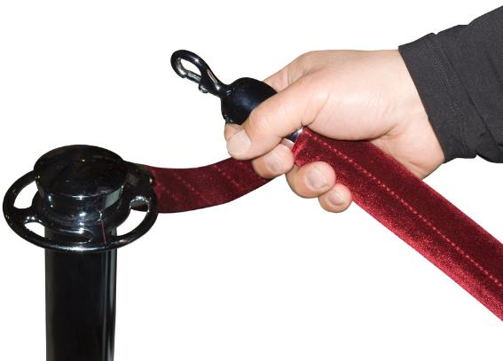
Priority queue
In a priority queue, some items are allowed to ‘jump’ the queue
This type of queue is used when the items arriving have some type of priority associated with them
What types of priority queues exist in real-life?

Slide 26
Priority queue
Each item has a priority associated with it
In the example of the buses, assume that:
Buses with numbers ending with A are high priority
Buses with numbers ending with B are medium priority
Buses with numbers ending with C are low priority
Ignoring the complications of a circular queue, insert the following buses into a priority queue:
92B, 64C,142A, 25C, 87B
What order are your buses in now?

Slide 27
Priority queue
You have added the buses 92B, 64C, 87B, 25C and 142A to the queue
The buses in the queue are in order of priority
What algorithm are you using to insert buses into the queue?
142A leaves and 75B joins the queue.
What does the queue look like now?
142A | 92B | 87B | 64C | 25C

Slide 28
Dynamic vs static
Static data structures are fixed in size
Cannot grow, shrink, or be freed during execution
An array is a static data structure
Dynamic data structures can grow and shrink
Allocates and deallocates memory from the heap (an area of memory especially used for this purpose)
Excessive allocation of memory, without deallocation, may cause overflow (exceeding maximum memory limit)
Python – list; Java - ArrayList

Slide 29
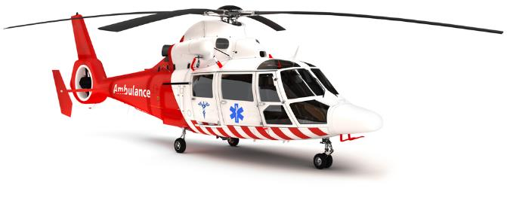
Worksheet
Complete the ‘Accident and Emergency’ Task 3 on the worksheet

Slide 30
Plenary
Fill in the following table showing a comparison between a simple linear array queue, a circular queue, and a circular priority queue
FIFO | Queue (array) | Circular Queue | Priority Queue
Advantages
Disadvantages
Usage

Slide 31
Answers
Fill in the following table showing a comparison between a simple linear array queue, a circular queue, and a circular priority queue
FIFO | Queue (array) | Circular Queue | Priority Queue
Advantages | Simple to program Predictable memory usage | Can reuse free spaces | Gives preference to more important items
Disadvantages | Fixed length Single pass Can’t reuse spaces | Slightly more complex to program | Additional processing required to keep order
Usage | Pre-board on a roller-coaster | Printer spooler | Accident & emergency

Slide 32
Extension
Changing the rules to serve the last person to arrive first, reduces the average wait time
Why does the other queue always move faster?
http://sciencenordic.com/queues-move-faster-if-last-person-served-first
http://www.bbc.co.uk/news/magazine-34153628

