Slide 1
AQA
A Level
Computer Science
Paper 1
Lists
Unit 7
Data structures

Slide 2
Objectives
Explain how a list may be implemented as a static or dynamic data structure
Show how items may be added to or deleted from a list

Slide 3
Abstraction
All programming languages have data types such as real, integer, character and operations which can be performed on them
In order to deal with complex problems, we need more complex data types that will lead to more efficient problem-solving methods
This is the idea behind the creation of abstract data types

Slide 4
Abstraction
A queue is an Abstract Data Type (ADT)
The methods used to implement the queue (e.g. enqueue, dequeue) can be used without knowledge of how they work
The data (e.g. the pointers) used in implementing a queue are hidden from the user
Job 1 | Job 2 | Job 3
Front
Rear

Slide 5
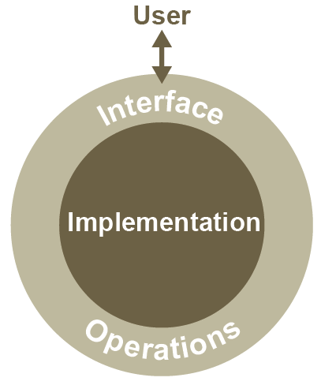
List – An ADT
A list is another example of an Abstract Data Type
Many languages (e.g. Python) have a built-in list data type
An abstract data type (ADT) allows us to view the data and perform operations that are allowed without regard to how they will be implemented

Slide 6
Dynamic vs static
In relation to size, what does static mean?
In relation to size, what does dynamic mean?
Programming languages often have an inbuilt dynamic list
Python, Java, VB.Net, and Delphi all have dynamic list support
What controls how many items can be added to a dynamic list?

Slide 7
Implementation of a dynamic list
The implementation of an inbuilt list ADT is hidden from the user
A new location is taken from the ‘heap’ - memory locations used for dynamic allocation
When an item is deleted from a list, the memory location is freed up and returned to the ‘heap’
A system of pointers keeps the list in the order specified by the user

Slide 8
Applications of lists
What are some examples of lists in real life and information processing systems?

Slide 9
Applications of lists
List of students in a class and their marks, component parts of a product, songs, friends, items in a queue, etc.
“Items in a queue” suggests that we could use the list ADT to implement a queue, with added conditions specified
In general, what operations would it be useful to include in a list?

Slide 10
Programming operations
Can you suggest some operations needed to implement a list? Here are two to get you going
List operation | Operation
isEmpty() | Test for empty list
append(item) | Add a new item to the end of a list

Slide 11
Programming operations
List operation | Operation
isEmpty() | Test for empty list
append(item) | Add a new item to the end of a list
remove(item) | Remove first occurrence of an item from list
count(item) | Return the number of occurrences of item in list
len(item) | Return the number of items in the list
index(item) | Return the position of item
insert(pos,item) | Add a new item at position pos
pop() | Remove and return the last item in the list
pop(pos) | Remove and return the item at position pos

Slide 12
Worksheet 2
Complete the ‘Random Clothing’ Task 1 on the worksheet

Slide 13
Sorting a list
You will cover sorting methods in due course
In Python, there is a built-in procedure for sorting a list, which you can try in interactive mode

Slide 14
Implementing a queue as a list
Using a dynamic data structure such as a list to implement a queue, is there any point in holding items in a circular queue?
Is it necessary to update the size variable as items are added and removed?
Do we need a variable maxSize?
Do we need a function isFull?

Slide 15
Functions to implement a linear queue as a dynamic list
Write pseudocode to implement the following operations for a queue which can hold a maximum of maxSize items:
enqueue
dequeue
isEmpty
isFull

Slide 16
Pseudocode
SUB enqueue(item)
IF q.isFull THEN
OUTPUT “queue full”
ELSE
q.append(item)
ENDIF
ENDSUB
SUB dequeue(item)
IF q.isEmpty THEN
OUTPUT “queue empty”
ELSE
q.pop(0)
ENDIF
ENDSUB
SUB isFull
RETURN (len(q) = maxSize)
ENDSUB
SUB isEmpty
RETURN (len(q) = 0)
ENDSUB

Slide 17
Operations on lists
Merging, sorting, searching and comparing lists are very common operations in computing
How could you find how many times numbers in the range 80 -100 occur in a list of unsorted integers?
How could you remove all these numbers from the list?

Slide 18
Worksheet 2
Try these operations in Task 2 on the worksheet

Slide 19
Plenary
A dynamic data structure such as list is useful for implementing other ADTs such as queues, stacks and trees
How would you choose between a static and a dynamic data structure, if you had a problem to solve?
What operations can be performed on a dynamic list?

