Slide 1
AQA
A Level
Computer Science
Paper 1
Graphs
Unit 7
Data structures

Slide 2
Objectives
Be aware of a graph as a data structure used to represent complex relationships
Be familiar with typical uses for graphs
Be able to explain the terms: graph, weighted graph, vertex/node, edge/arc, undirected graph, directed graph
Know how an adjacency matrix and an adjacency list may be used to represent a graph
Be able to compare the use of adjacency matrices and adjacency lists

Slide 3
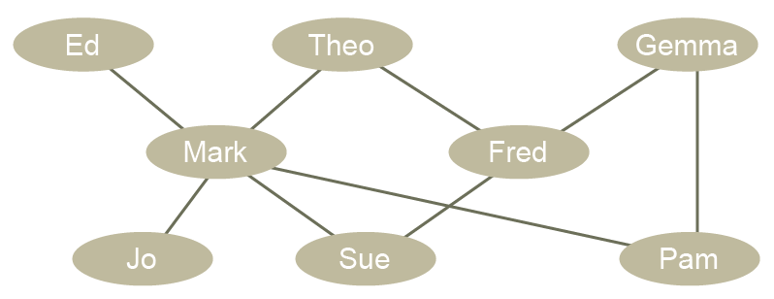
What is a graph?
In this context, a graph has nothing to do with a bar chart or line graph of x against y
It is the name given to an abstract data structure representing complex relationships

Slide 4
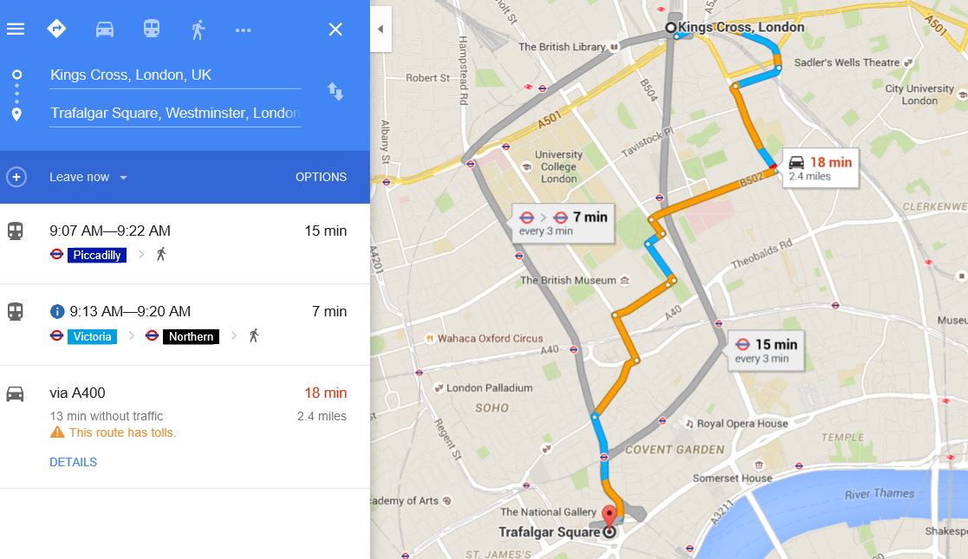
How does a satnav find a route?

Slide 5
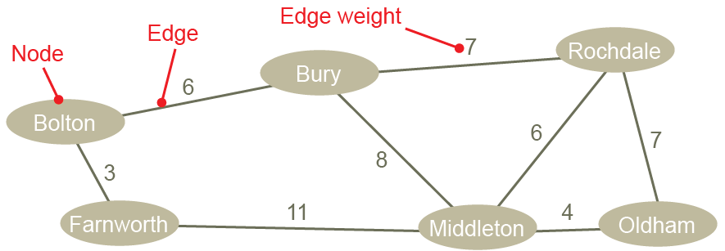
An undirected graph
In this graph, the weights represent distances between towns
It is undirected because there are no arrows on the edges indicating direction

Slide 6
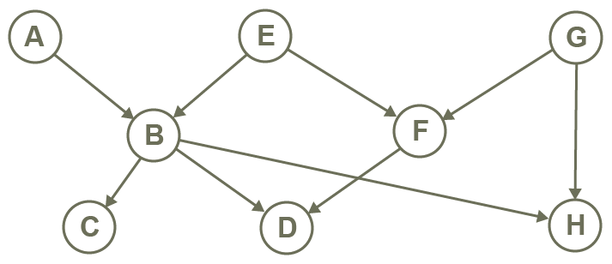
A directed, unweighted graph
This graph shows direction (e.g. A has a link to B, but B does not have a link to A)
It has no weights associated with the edges

Slide 7
Graphs - definition
A graph is a set of vertices or nodes connected by edges or arcs
Edges may be weighted, indicating a cost of traversal
In an undirected graph, all edges are bidirectional.
In a directed graph or digraph, all edges are one-way

Slide 8
Representing a graph
A human driver can find their way from one location to another using a map
A computer needs to represent the information about distances and connections in a structured, numerical way
Graphs can be implemented using one of two ways:
Adjacency matrix
Adjacency list

Slide 9
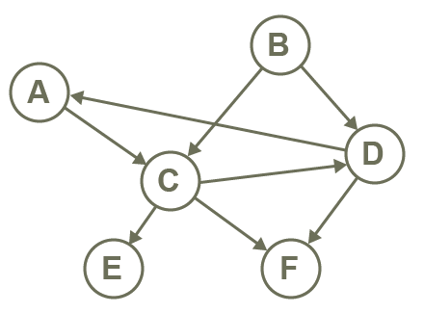
Adjacency matrix
Each row and column represents a node
The item at [row, column] indicates a connection
In a unweighted graph, this can be a 1
 | A | B | C | D | E | F
A |  |  | 1
B |  |  | 1 | 1
C |  |  |  | 1 | 1 | 1
D | 1 |  |  |  |  | 1
E
F

Slide 10
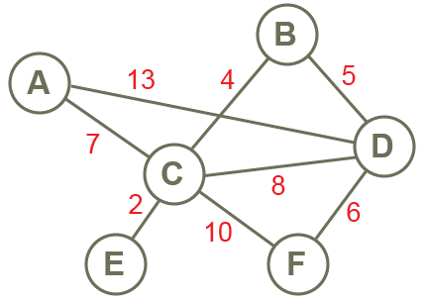
A weighted, undirected graph
In an undirected graph, the matrix will be symmetric
The entries represent the weights
Fill in the cells to represent the graph
 | A | B | C | D | E | F
A
B
C
D
E
F

Slide 11
A weighted, undirected graph
In an undirected graph, the matrix will be symmetric
The entries represent the weights
Here are the cells filled in
 | A | B | C | D | E | F
A |  |  | 7 | 13
B |  |  | 4 | 5
C | 7 | 4 |  | 8 | 2 | 10
D | 13 | 5 | 8 |  |  | 6
E |  |  | 2
F |  |  | 10 | 6

Slide 12
Worksheet 5
Now try Task 1 on Worksheet 5

Slide 13
Matrix considerations
Advantage: an adjacency matrix is convenient to work with, and adding an edge is simple
Disadvantage: a sparse graph with not many connections (edges) will leave most of the cells empty, wasting a lot of memory space

Slide 14
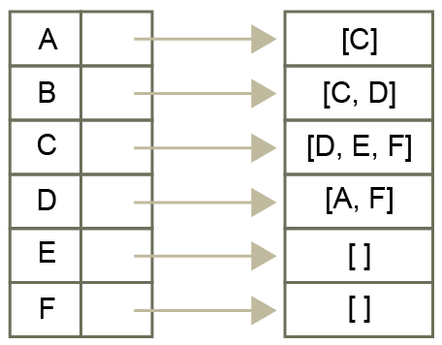
Adjacency list
An adjacency list is an alternative way of representing a graph
A list of nodes is created, and each node points to a list of adjacent nodes

Slide 15
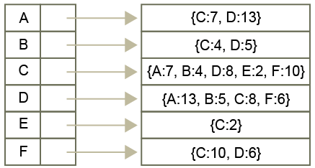
Representing a weighted graph
A weighted graph can be represented as a dictionary of dictionaries, with each key in the dictionary being the node, and the value being a dictionary of adjacent nodes and edge weights

Slide 16
Why use an adjacency list?
It only uses storage for the connections that exist, so it is more space-efficient
It is a good way of representing a large, sparsely connected graph

Slide 17
Worksheet 5
Now try questions 2, 3 and 4 of Task 2

Slide 18
Graph applications
Applications include
Computer networks, with nodes representing computers and weighted edges representing bandwidth between them
States in a finite state machine
Social networks
Web pages and links
Chemistry, with nodes as atoms, edges as connections
Project management, with nodes as tasks, edges representing sequence and weights, time or cost
Maps, with nodes representing cities or landmarks, edges representing routes

Slide 19
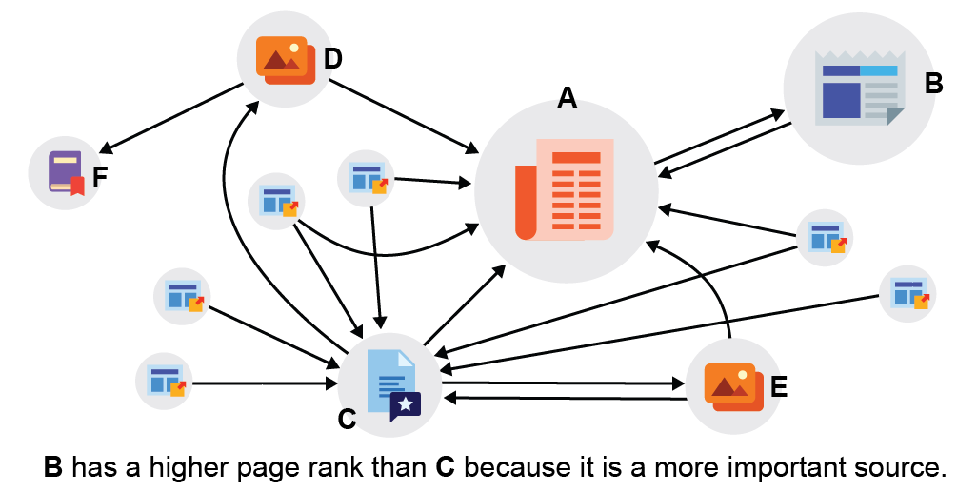
Page rank algorithm
In the 1990s two postgraduate students called Larry Page and Sergey Brin built a new search engine for the Web
This was subsequently named Google, and uses a directed graph of pages

Slide 20
Extension
Research more about the Page Rank algorithm invented by Larry Page and Sergei Brin

Slide 21
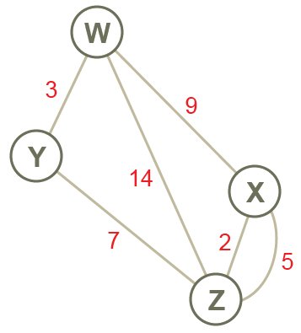
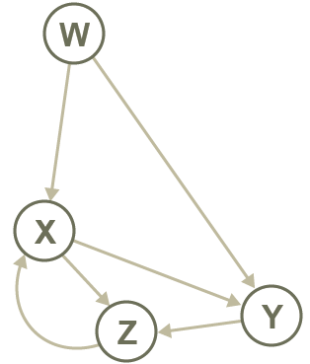
Plenary
Terminology:
Vertices
Edges
Digraph
Arcs
Weighted
Directed graph
Nodes
Undirected graph

