Slide 1
AQA
A Level
Computer Science
Paper 1
Vectors
Unit 7
Data structures

Slide 2
Objectives
Be familiar with the concept of a vector and notations for specifying a vector as a list of numbers, as a function or as a geometric point in space
Represent a vector using a list, dictionary or array data structure
Perform operations on vectors: addition, scalar vector multiplication, convex combination, dot or scalar product
Use the dot product to find the angle between two vectors

Slide 3
Abstraction
Abstraction involves constructing a model that represents only the part of reality that we are interested in
It ignores irrelevant detail in the real-world phenomenon of interest
An abstract data type (ADT) is a logical view of the data and possible operations
An ADT can help us design algorithms to solve real-world problems

Slide 4
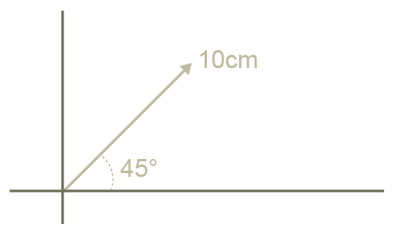
Vectors - Definitions
A scalar mathematical quantity has magnitude only
A vector mathematical quantity has both magnitude (length) and direction

Slide 5
Why use vectors?
Vector graphics and 3D graphics
Images are defined as paths, not distinct bit patterns
Rules of mathematics allow scaling without distortion
Computer games / simulations
The combination of moving forces, represented by vectors, can be resolved into a single path by using the same mathematical rules.
For example, a ship steering against the wind and sea, calculating collision paths
Multiple dimensions
Can represent 2, 3, or more dimensions

Slide 6
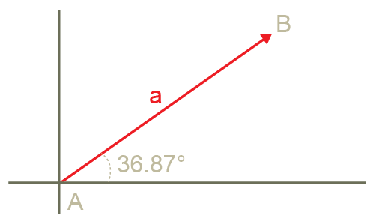
Notation used for a 2-vector
As an arrow
From the origin (0, 0) to the point (4, 3)
A 2-vector over ℝ, where ℝ is the set of real numbers
[4.0, 3.0]
ℝ² (A 2-vector)
All entries must be from ℝ
Example:
A path in a vector graphic

Slide 7
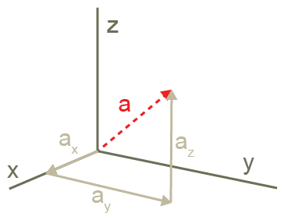
Notation (3-vector)
As an arrow
From the origin (0, 0, 0) to the point (a_{x}, a_{y}, a_{z}) in 3D space
A 3-vector over ℝ, where ℝ is the set of real numbers
[4.76, 3.0, 2.03]
ℝ³
All entries must be from ℝ
Example:
A point in space representing an asteroid in a computer game

Slide 8
Notation (4-vector)
A 4-vector over ℝ, where ℝ is the set of real numbers
[7.843, 4.254, -3.567, 2.0]
ℝ⁴
All entries must be from ℝ
Example:
4 dimensional spacetime
A 3-vector over ℝ, defined (x, y, z) and a 4th dimension, defined as time
[x, y, z, t]

Slide 9
Notation - function
In order to translate from mathematical notation to a notation more useful in programming, we use a ‘map’ function
The notation S ↦ ℝ means ‘S maps to ℝ’
A vector can be used as a location indicator, where S = {0, 1, 2, 3} maps to [2.55, -3.88, 4.11, 5.77]
0 ↦ 2.55 Location 0 maps to the value 2.55
1 ↦ -3.88
2 ↦ 4.11
3 ↦ 5.77

Slide 10
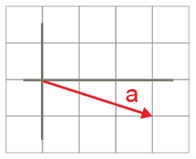
Examples
Represent the vector [3,-1] as an arrow
f is a function f: S ↦ ℝ which maps the set {0, 1, 2, 3} to [10, 11, 12, 13]
0 ↦ 10
1 ↦ 11
2 ↦ 12
3 ↦ 13

Slide 11
Exercises
Represent the vector [-3, 1] as an arrow
Give an example of a 4-vector over ℝ
Describe [8, 7, 6] as a vector, using ℝ notation
Describe the function f which maps the set {0,1,2,3} to [1.5, 3.4, 6.1, 10.0]

Slide 12
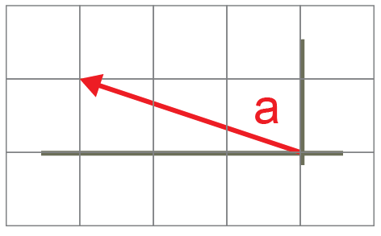
Answers
Represent the vector [-3, 1] as an arrow
Give an example of a 4-vector over ℝ [6,8,2,4]
Describe [8, 7, 6] as a vector, using ℝ notation ℝ³
Describe the function f which maps the set {0,1,2,3} to [1.5, 3.4, 6.1, 10.0]
0 ↦ 1.5 2 ↦ 6.1
1 ↦ 3.4 3 ↦ 10.0

Slide 13
Representation
Regardless of what they represent, computer science treats them all the same
However, ways to represent them inside the machine have to be identified

Slide 14
Vector representation in Python
In Python, the list is the preferred representation
A ℝ² (2-vector) could be defined as:
vector2 = [6.34, 98.75]

Slide 15
Vector representation in VB.Net
In VB.Net, which supports a list-type, an ℝ³ (3-vector) could be defined as:
Dim vector3 = New List(Of Double) from {6.34, 98.75, -15.83}
Using a 1-dimensional array, a ℝ⁴ could be defined as:
Dim vector4 = {6.12, -7.34, -8.45, 9.02}

Slide 16
A vector viewed as a function
In Python, a dictionary may be used, so for example an ℝ⁴ could represented as
dict4 = {0:6.12, 1:-7.34, 2:-8.45, 3:9.02}
In VB.Net, which supports a dictionary-type, an ℝ⁴ could be represented as
dict4 = New Dictionary(Of Integer, Double)
dict4.add (0, 6.12)
dict4.add (1, -7.34)
dict4.add (2, -8.45)
dict4.add (3,9.02)

Slide 17
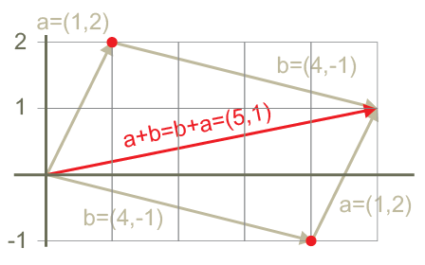
Vector addition
The vector sum (a + b) is found by relocating b so that head touches tail (translation)
Add vectors by adding the x- and y-parts separately
(1+4), (2+(-1)) → (5, 1)
The red vector has a direction of (5, 1)
The red vector has a magnitude of $\sqrt{5^{2}+1^{2}}$
In effect, addition is translation because of the shifting of the vector

Slide 18
Exercise - Addition
A = (4, 0), B = (3, 4), C = A + B
Use the arithmetic method to find C
Use the head/tail addition method and show on a graph

Slide 19
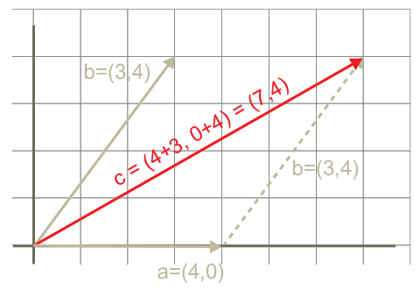
Answers
A = (4, 0), B = (3, 4), C = A + B
C = (4+3, 0+4) = (7, 4)

Slide 20
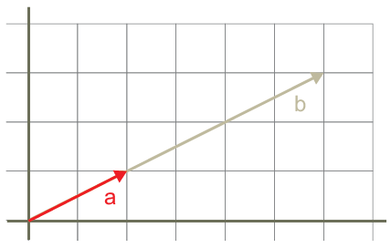
Scalar multiplication
Multiplying a vector by a scalar value changes the magnitude of the vector
Multiply both x and y parts by the scalar value
Example:
a = (2, 1)
b = 3a = (3 x 2, 3 x 1) = (6, 3)
In effect, multiplying a vector by a scalar is scaling because it affects the size

Slide 21
Exercise: Scalar multiplication
Given that a = (1, -1) and b = 3a
Use the arithmetic method to find b
Use the head/tail addition method and show on a graph

Slide 22
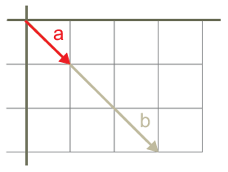
Answers
a = (1, -1) and b = 3a
Using the arithmetic method:
b = (1*3, -1*3) = (3, -3)
2. On a graph:

Slide 23
Worksheet 7
Do the questions in Task 1

Slide 24
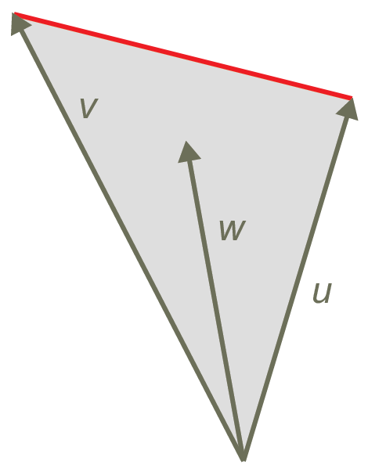
Convex combination of vectors
The convex combination of two vectors is the space bounded by the vectors u, v, and the red line
It is an expression of the form
w = αu + βv
where α, β >= 0
and α + β = 1
w will always fall inside the vector space defined by u and v

Slide 25
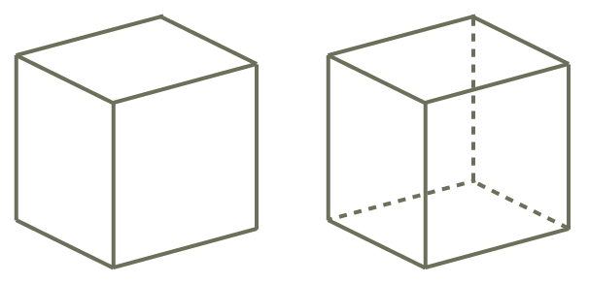
Convex combination
Used in:
3D modelling – calculating the volume of polyhedra
Drawing images in perspective (one behind another, hidden line removal)
Profile with hidden lines removed
Profile with hidden lines displayed

Slide 26
Exercise – Convex combination
u = (2,2), v = (6, -2), w= ½u + ½v
What is the value of w?
Show, using a scale diagram, that points on w fall within the convex hull of u and v

Slide 27
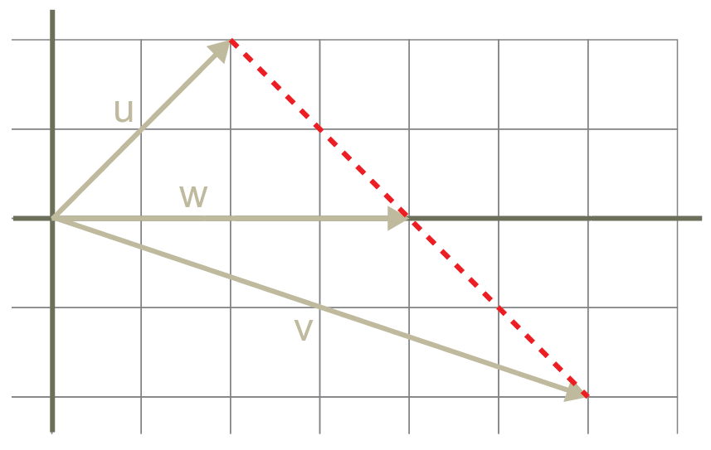
Answers
u = (2, 2), v = (6, -2), w = ½u + ½v
W = ½u + ½v
½u = (1, 1) and ½v = (3, -1)
(1, 1) + (3, -1) = (4, 0)
All points on w are inside the convex hull bounded by red line
w falls inside the vector space

Slide 28
Dot product
A method for multiplying 2 vectors
Written by using a dot (u • v)
Multiply corresponding components of each vector
u • v = u₁v₁ + u₂v₂ + u₃v₃ + … u_{n}v_{n}
Usage:
One vector contains unit prices, another vector contains numbers sold, then dot product gives amount of money taken
Finding the angle between two vectors

Slide 29
Finding the angle between two vectors
Graphics programmers often need to find the angle between two vectors
The dot product may be used to do this

Slide 30
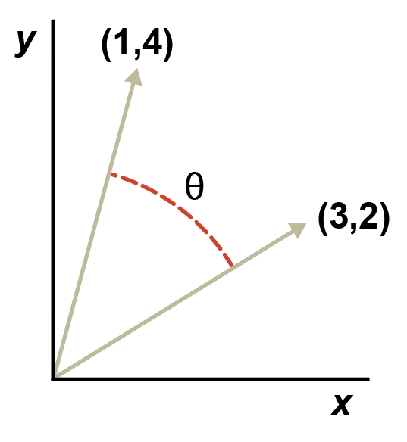
Angle between two vectors
The lengths of the vectors can be written in mathematical notation as:
ǁuǁ and ǁvǁ
The formula for finding the angle Ɵ between u and v is:
cos Ɵ = u • v
(ǁuǁ • ǁvǁ)

Slide 31
Steps to find the angle
Calculate the dot product u • v
u • v = (1 * 3) + (4 * 2) = 11
Calculate ǁuǁ and ǁvǁ
ǁuǁ = $\sqrt{(1^{2}+4^{2})}$ = $\sqrt{17}$= 4.12
ǁvǁ = $\sqrt{(3^{2}+2^{2})}$= $\sqrt{13}$ = 3.61
3. Calculate ǁuǁ • ǁvǁ
ǁuǁ • ǁvǁ = 4.12 * 3.61 = 14.87
Calculate cos Ɵ
cos Ɵ = 11 / 14.87 = 0.74
5. From tables or calculator, Ɵ = 42°
cos Ɵ = u • v
(ǁuǁ • ǁvǁ)

Slide 32
Worksheet 7
Do the questions in Task 2

Slide 33
Plenary
What 3 types of notation can be used to specify a vector?
What 3 abstract data types can be used to represent a vector?
What 4 different types of operations can be performed on vectors?
What is one application of dot product?
What formula can be used to find the angle between two vectors?

