Slide 1
Computer Architecture
Everything you have forgotten and one TINY little Extra

Slide 2
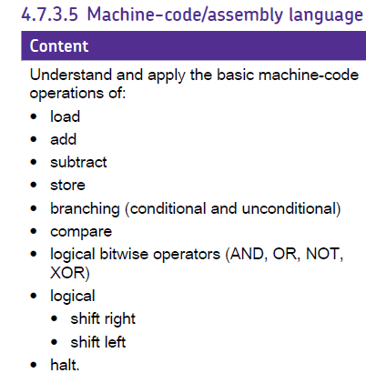
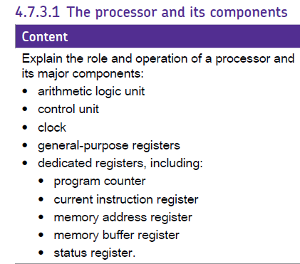
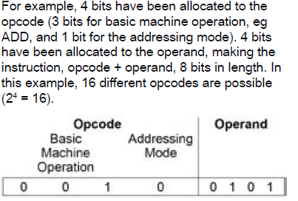
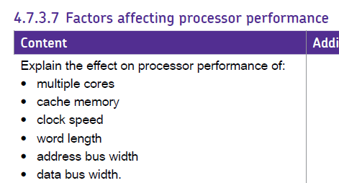
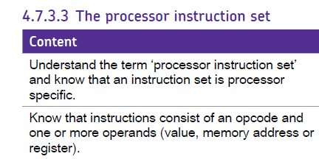
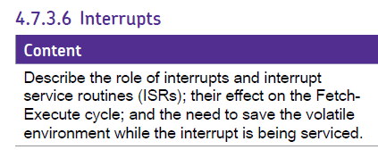
The story so far……

Slide 3
What you need to know
Why interrupts are needed
The Types of Interrupt
The simplified model of interrupt handling
Where in the FE Cycle Interrupts are handled
How the current processor state is preserved
How multiple interrupts are handled (
What are Vector Interrupt Mechanisms
What are Interrupt Service Routines.

Slide 4
FE-Cycle
Fetch
MAR ← [PC]
PC ← [PC] + 1; MBR ← [Memory] _{addressed}
CIR ← [MBR]
[CIR] decoded and executed
Execute
Load from memory Location | Store to Memory Location
MAR ← [CIR] _{Operand} MBR ← [Memory] _{addressed} ACC ← [MBR] | MAR ← [CIR] _{Operand} ; MBR ← [ACC] Memory _{addressed} ← [MBR]

Slide 5
REGISTERS
ACC
Check for interrupts
Fetch instruction from memory
MBR
MAR
1
Execute instruction
CIR
Decode
PC
1
MEMORY
Location Contents
THE PROGRAM
The address of the first instruction is copied from the PC to the MAR
23 | 14
53 | 26
72 | 35
1 | LDA 23
2 | ADD 72
3 | STA 53

Slide 6
REGISTERS
ACC
Check for interrupts
Fetch instruction from memory
MBR
LDA 23
MAR
1
Execute instruction
CIR
Decode
PC
1
MEMORY
Location Contents
THE PROGRAM
The first instruction is read into the MBR
23 | 14
53 | 26
72 | 35
1 | LDA 23
2 | ADD 72
3 | STA 53

Slide 7
REGISTERS
ACC
Check for interrupts
Fetch instruction from memory
MBR
LDA 23
MAR
1
Execute instruction
CIR
LDA 23
Decode
PC
1
MEMORY
Location Contents
THE PROGRAM
The first instruction is copied into the CIR
23 | 14
53 | 26
72 | 35
1 | LDA 23
2 | ADD 72
3 | STA 53

Slide 8
REGISTERS
ACC
Check for interrupts
Fetch instruction from memory
MBR
LDA 23
MAR
1
Execute instruction
CIR
LDA 23
Decode
PC
2
MEMORY
Location Contents
THE PROGRAM
The program counter is updated to point to the next instruction
23 | 14
53 | 26
72 | 35
1 | LDA 23
2 | ADD 72
3 | STA 53

Slide 9
REGISTERS
ACC
Check for interrupts
Fetch instruction from memory
MBR
LDA 23
MAR
23
Execute instruction
CIR
LDA 23
Decode
PC
2
MEMORY
Location Contents
THE PROGRAM
The address part of the current instruction is placed in the MAR
23 | 14
53 | 26
72 | 35
1 | LDA 23
2 | ADD 72
3 | STA 53

Slide 10
REGISTERS
ACC
Check for interrupts
Fetch instruction from memory
MBR
14
MAR
23
Execute instruction
CIR
LDA 23
Decode
PC
2
MEMORY
Location Contents
The contents of the location whose address is in the MAR are loaded into the MBR
THE PROGRAM
23 | 14
53 | 26
72 | 35
1 | LDA 23
2 | ADD 72
3 | STA 53

Slide 11
REGISTERS
ACC
14
Check for interrupts
Fetch instruction from memory
MBR
14
MAR
23
Execute instruction
CIR
LDA 23
Decode
PC
2
MEMORY
Location Contents
THE PROGRAM
The contents of the MBR are copied into the ACC
23 | 14
53 | 26
72 | 35
1 | LDA 23
2 | ADD 72
3 | STA 53

Slide 12
REGISTERS
ACC
14
Check for interrupts
Fetch instruction from memory
MBR
14
MAR
23
Execute instruction
CIR
LDA 23
Decode
PC
2
MEMORY
Location Contents
THE PROGRAM
The Status Register is checked for interrupts
23 | 14
53 | 26
72 | 35
1 | LDA 23
2 | ADD 72
3 | STA 53

Slide 13
REGISTERS
ACC
14
Check for interrupts
Fetch instruction from memory
MBR
14
MAR
2
Execute instruction
CIR
LDA 23
Decode
PC
2
MEMORY
Location Contents
THE PROGRAM
The address of the second instruction is copied from the PC to the MAR
23 | 14
53 | 26
72 | 35
1 | LDA 23
2 | ADD 72
3 | STA 53

Slide 14
REGISTERS
ACC
14
Check for interrupts
Fetch instruction from memory
MBR
ADD 72
MAR
2
Execute instruction
CIR
LDA 23
Decode
PC
2
MEMORY
Location Contents
THE PROGRAM
The second instruction is read into the MBR
23 | 14
53 | 26
72 | 35
1 | LDA 23
2 | ADD 72
3 | STA 53

Slide 15
REGISTERS
ACC
14
Check for interrupts
Fetch instruction from memory
MBR
ADD 72
MAR
2
Execute instruction
CIR
ADD 72
Decode
PC
2
MEMORY
Location Contents
THE PROGRAM
The second instruction is copied into the CIR
23 | 14
53 | 26
72 | 35
1 | LDA 23
2 | ADD 72
3 | STA 53

Slide 16
REGISTERS
ACC
14
Check for interrupts
Fetch instruction from memory
MBR
ADD 72
MAR
2
Execute instruction
CIR
ADD 72
Decode
PC
3
MEMORY
Location Contents
THE PROGRAM
The program counter is updated to point to the next instruction
23 | 14
53 | 26
72 | 35
1 | LDA 23
2 | ADD 72
3 | STA 53

Slide 17
REGISTERS
ACC
14
Check for interrupts
Fetch instruction from memory
MBR
ADD 72
MAR
72
Execute instruction
CIR
ADD 72
Decode
PC
3
MEMORY
Location Contents
THE PROGRAM
The address part of the current instruction is placed in the MAR
23 | 14
53 | 26
72 | 35
1 | LDA 23
2 | ADD 72
3 | STA 53

Slide 18
REGISTERS
ACC
14
Check for interrupts
Fetch instruction from memory
MBR
35
MAR
72
Execute instruction
CIR
ADD 72
Decode
PC
3
MEMORY
Location Contents
The contents of the location whose address is in the MAR are loaded into the MBR
THE PROGRAM
23 | 14
53 | 26
72 | 35
1 | LDA 23
2 | ADD 72
3 | STA 53

Slide 19
REGISTERS
ACC
49
Check for interrupts
Fetch instruction from memory
MBR
35
MAR
72
Execute instruction
CIR
ADD 72
Decode
PC
3
MEMORY
Location Contents
THE PROGRAM
The contents of the MBR are added to the ACC
23 | 14
53 | 26
72 | 35
1 | LDA 23
2 | ADD 72
3 | STA 53

Slide 20
REGISTERS
ACC
49
Check for interrupts
Fetch instruction from memory
MBR
35
MAR
72
Execute instruction
CIR
ADD 72
Decode
PC
3
MEMORY
Location Contents
THE PROGRAM
The Status Register is checked for interrupts
23 | 14
53 | 26
72 | 35
1 | LDA 23
2 | ADD 72
3 | STA 53

Slide 21
REGISTERS
ACC
49
Check for interrupts
Fetch instruction from memory
MBR
35
MAR
3
Execute instruction
CIR
ADD 72
Decode
PC
3
MEMORY
Location Contents
THE PROGRAM
The address of the third instruction is copied from the PC to the MAR
23 | 14
53 | 26
72 | 35
1 | LDA 23
2 | ADD 72
3 | STA 53

Slide 22
REGISTERS
ACC
49
Check for interrupts
Fetch instruction from memory
MBR
STA 53
MAR
3
Execute instruction
CIR
ADD 72
Decode
PC
3
MEMORY
Location Contents
THE PROGRAM
The third instruction is read into the MBR
23 | 14
53 | 26
72 | 35
1 | LDA 23
2 | ADD 72
3 | STA 53

Slide 23
REGISTERS
ACC
49
Check for interrupts
Fetch instruction from memory
MBR
STA 53
MAR
3
Execute instruction
CIR
STA 53
Decode
PC
3
MEMORY
Location Contents
THE PROGRAM
The third instruction is copied into the CIR
23 | 14
53 | 26
72 | 35
1 | LDA 23
2 | ADD 72
3 | STA 53

Slide 24
REGISTERS
ACC
49
Check for interrupts
Fetch instruction from memory
MBR
STA 53
MAR
3
Execute instruction
CIR
STA 53
Decode
PC
4
MEMORY
Location Contents
THE PROGRAM
The program counter is updated to point to the next instruction
23 | 14
53 | 26
72 | 35
1 | LDA 23
2 | ADD 72
3 | STA 53

Slide 25
REGISTERS
ACC
49
Check for interrupts
Fetch instruction from memory
MBR
STA 53
MAR
53
Execute instruction
CIR
STA 53
Decode
PC
4
MEMORY
Location Contents
THE PROGRAM
The address part of the current instruction is placed in the MAR
23 | 14
53 | 26
72 | 35
1 | LDA 23
2 | ADD 72
3 | STA 53

Slide 26
REGISTERS
ACC
49
Check for interrupts
Fetch instruction from memory
MBR
49
MAR
53
Execute instruction
CIR
STA 53
Decode
PC
4
MEMORY
Location Contents
THE PROGRAM
The contents of the ACC are copied into the MBR
23 | 14
53 | 26
72 | 35
1 | LDA 23
2 | ADD 72
3 | STA 53

Slide 27
REGISTERS
ACC
49
Check for interrupts
Fetch instruction from memory
MBR
49
MAR
53
Execute instruction
CIR
STA 53
Decode
PC
4
MEMORY
Location Contents
The contents of the MBR are copied into the memory location whose address is in the MAR
THE PROGRAM
23 | 14
53 | 49
72 | 35
1 | LDA 23
2 | ADD 72
3 | STA 53

Slide 28
REGISTERS
ACC
49
Check for interrupts
Fetch instruction from memory
MBR
49
MAR
53
Execute instruction
CIR
STA 53
Decode
PC
4
MEMORY
Location Contents
THE PROGRAM
The Status Register is checked for interrupts
23 | 14
53 | 49
72 | 35
1 | LDA 23
2 | ADD 72
3 | STA 53

Slide 29
Interrupts
A signal to the processor that sets a value on the Status Register (or a dedicated Interrupt Register) that instructs the processor to prioritise another routine.
What events could interrupt the normal execution of a program?
Hardware Device Event
Timing Event
Software Events
I/O Event

Slide 30
Interrupt Handling Overview
Store [PC] and [SR] to a Stack
Determine the type of Interrupt
Use a Vector Interrupt Table to get the Address of the ISR (Interrupt Service Routine)
Use FE Cycle to execute the Interrupt Service Routines Instructions.
Once ISR is completed Load [PC] and [SR] from the stack

Slide 31
Store [PC] and [SR] to a Stack
Why a stack?
Allows multiple Interrupts
Why only PC and SR
All other registers irrelevant at the end of each FE cycle
Simple Demo https://www.youtube.com/watch?v=38i5Fk-ZjfA

Slide 32
Determine the type of Interrupt
Naively:
The Interrupt Value held on the SR is the index of the
Vector Interrupt Table

Slide 33
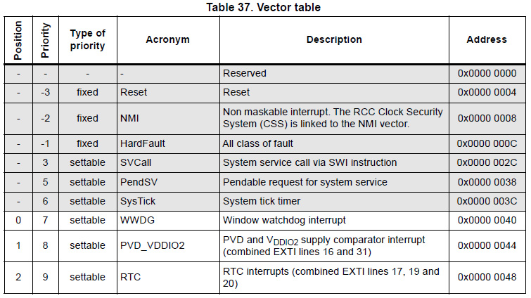
Vector Interrupt Table
Links Interrupt Value with the address of the Interrupt Service routine
Can Be added to!!!!!!
By OS
By other software

Slide 34
Interrupt Service Routines
Routines (programs) that…
Service
Interrupts.
DUH!
E.g.
A processor overheat, urgent shutdown.
LED BLINK
Hardware IO data stream

Slide 35
WHAT have you understood?
Why are Interrupts required?
Why is there a need for an interrupt Register (or part or SR)?
What is the purpose of the Interrupt stack?
Why are vector Interrupt Tables used?
What is a Interrupt Service Routine

