Slide 1
AQA
    A Level
      Computer Science
      Paper 2
Packet switching and routers
  Unit 10
  The Internet

Slide 2
Objectives
Understand the role of packet switching and routers
Know the main components of a packet
Consider where and why routers and gateways
are used
Explain how routing is achieved across the Internet

Slide 3
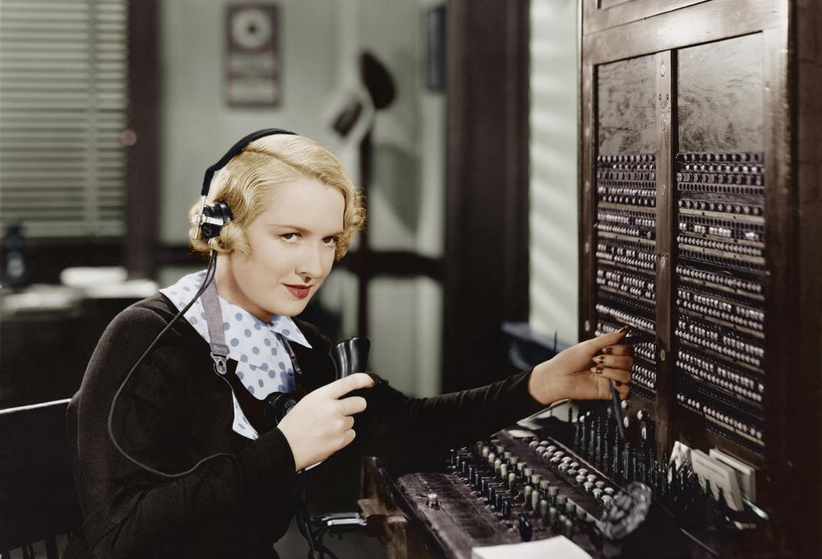
Sending data
How is voice data sent across a traditional telephone network?

Slide 4
Circuit switching
Circuit switching involves creating a communication connection between two endpoints for the duration of a phone call or transfer of data
This does not work for the billions of inter-connected parts of the Internet
  Packet switching was developed to allow a communications channel to be shared so that when one communication was temporarily not using it another could

Slide 5
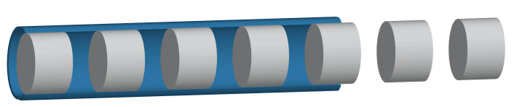
Data packet
When sending across a network, data is broken into chunks (units) called data packets and assembled again at the receiving end
This increases network efficiency and reliability

Slide 6
Chunking data
Consider that a 10GB video file needs to be transferred across a network
If each packet contains 1,500 bytes of data
  10,000,000,000 bytes to send would require…
  10,000,000,000 / 1,500
  6,666,667 packets

Slide 7
Packet switching
Packets are often sent across networks that have multiple links with multiple routes through to a destination
  These networks are also often shared

Slide 8
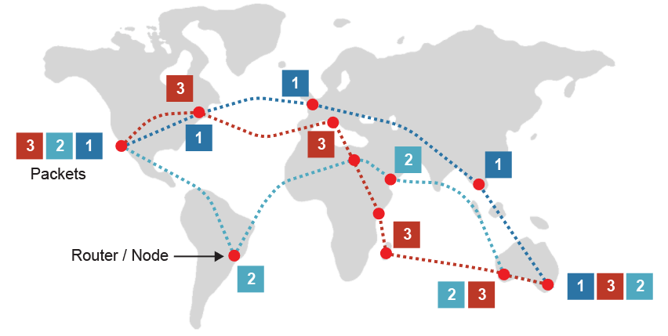
A visualisation
Each packet takes the fastest available route
  Once received, packets are reordered by the receiving node:

Slide 9
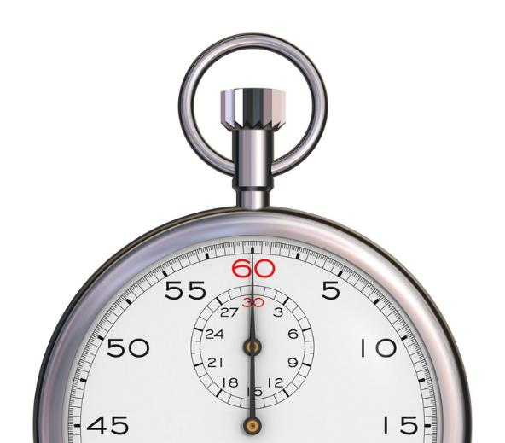
Time of travel
A packet of data from London to Sydney, Australia might take 40ms to reach its destination
In comparison a packet from London to Paris might only take 5ms
  This is known as latency

Slide 10

Routing
Routers forward data packets from one network
to another
  Each router stores data about the
  available routes to the destination node
  Looks up the destination IP address in
  its routing table to find the best router
  to which to forward the packet
  Each forwarding by (or transfer across)
  a router is known as a hop
  Routers continue to forward the packet
  until it reaches its destination node

Slide 11
Worksheet 2
Complete Tasks 1 and 2

Slide 12
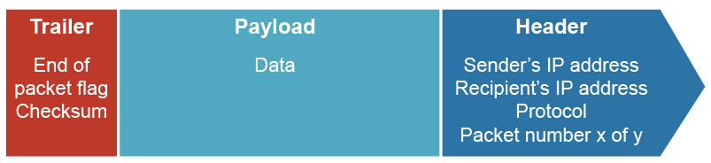
Building a packet
At its core, a data packet is a segment of data that needs to be sent, often referred to as the payload
  This part of the packet will often vary in size from 500 to
  1,500 bytes
  Packets also include additional information called
  headers and trailers

Slide 13
Packet size
Packets are deliberately kept small to ensure that individual packets do not take excessive time to transfer, preventing other packets from moving
  However, they should not be too small as the additional data added makes data transfer inefficient as unnecessary headers and trailers would be required each time
  500-1,500 bytes is an ideal compromise

Slide 14

Packet header
The header contains the recipient’s address so that it can be directed appropriately across the network
  The address of the sender is also included so that replies can be sent appropriately
  The packet number and overall number of packets in the transmission is attached to assist in reassembling the data
  The Time To Live (TTL) or hop limit is also included

Slide 15
Packet trailer
Similarly, at the end of the packet a trailer is added
  This contains error checking components that verify the data received in the payload has not been corrupted on transfer
  Techniques such as checksums or Cyclical Redundancy Checks (CRCs) are used to check the data by the receiving host
  The same checksum is recalculated at the destination end
  If they do not match, the data has become corrupted and is refused and a new copy is requested to be sent again

Slide 16

Gateways
A gateway is required where data is travelling from one network to another that use different protocols
  Networks using different transmission media can require this
  Header data are removed and reapplied using the correct format of the new network
  A router and gateway can often be combined into one integrated device

Slide 17
Plenary
Complete the sentences:
  Data _________ are used to transmit data around a network
  The most important part of a header is the ____________________________
  In a ___________, a router receives a packet, decides the next router to which it should be forwarded, and forwards it
  Gateways allow packets to travel between networks using different network ________

