Slide 1
AQA
A Level
Computer Science
Paper 2
IP addresses
Unit 10
The Internet

Slide 2
Objectives
Know that an IP address is split into a network identifier and a host identifier part
Know how a subnet mask is used to identify the network identifier part of the IP address
Know that there are currently two standards of IP address, (v4 and v6) and why v6 was introduced
Distinguish between routable and non‐routable IP addresses
Understand the purpose and function of the Dynamic Host Configuration Protocol (DHCP) system
Explain the basic concepts of Network Address Translation (NAT) and port forwarding and why they are used

Slide 3
Starter
What is an IP address?
142.67.210.8

Slide 4
IP Address
An IP addresses is a unique numerical address
This identifies a host computer or network node trying to communicate over IP on a network
The IPv4 standard uses four octets (groups of 8 bits) written in a decimal-dotted notation, for example:
10101010.00001111.10011001.11110000
Summarised in decimal form, this produces a range of addresses as follows:
0.0.0.0 - 255.255.255.255

Slide 5
Unusable addresses
Some IP addresses cannot be used as they are reserved for other purposes:
Address ranges 10.x.y.z, 172.16.0.1 to 172.31.255.255 and 192.168.y.z are private, non‐routable addresses used for LANs or private WANs only
x.y.z.0 represents an entire network
The last address in a network (e.g. x.y.z.255) is reserved as the broadcast address on that network for sending data simultaneously to all hosts on that network
127.x.y.z is reserved for loopback, in which a host’s IP software treats an outgoing packet as incoming

Slide 6
Not enough IP addresses
IPv4 only provides a theoretical maximum of 2³² or 256⁴ = 4.3 billion addresses, which is not enough for the number of devices that need them
IPv6 uses 128 bits expressed as a string of 32 hexadecimal digits, for example:
3dfb:1730:4935:0007:0340:fe2f:fb71:48af
There are 16³² = 3.4 x 10³⁸ possible IPv6 addresses
Scientist have estimated that this is enough for every atom covering the surface of the Earth with enough left over for 100 more Earths!

Slide 7
Parts of an IPv4 address
An IP address consists of two parts:
network identifier (or network ID) – left-hand bits of 32-bit number, used to define the network where nodes are communicating
host identifier (or host ID) – right-hand bits of 32-bit number, used to identify separate nodes on the network
Since the two IDs occupy complementary sets of bits within the IP address, they can be added together to form the IP address
The same principle applies to IPv6 addresses

Slide 8
Network and host identifiers
The following table gives examples of different hosts on the same network
The network ID portion remains static and each node has a different host ID
In this example, each ID occupies 16 bits, but the 32-bit address can be split at other points
IP address | Network ID | Host ID
142.67.57.253 | 142.67.0.0 | 57.253
142.67.128.86 | 142.67.0.0 | 128.86
142.67.210.8 | 142.67.0.0 | 210.8

Slide 9
Classless addressing example
The more hosts in each network, the fewer the networks that can be created:
The network 210.54.101.0/24 has a network ID of 24 bits, as confirmed by the classless suffix /24
This leaves 8 bits for the host ID, which provides 254 useable host IDs (2⁸ = 256, less the network and broadcast addresses, host IDs 0 and 255)
However, there are 2²⁴ = 16,777,216 similar network IDs available
The network 125.0.0.0/8 provides 2²⁴ – 2 = 16,777,214 host IDs, but only 256 different networks could exist

Slide 10
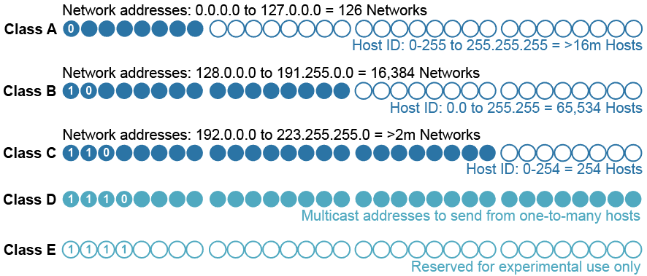
Classful IP addressing
IP addresses used to be categorised into classes to identify the network and host IDs of various ranges

Slide 11
Classless IP addressing
The use of a suffix such as /24 enables IP addresses to be used with varying proportions of network ID and host ID
IP addresses are now used without classes
The subnet mask is used to define the Network ID and this can be segmented however a network administrator sees fit
What are the advantages of this?

Slide 12
Subnet mask
A subnet mask is used together with an IP address to identify the network identifier within the address
The subnet mask has all network ID bits set to 1 and all host ID bits set to 0 so that, when compared to the IP address using a bitwise AND operation, the network is identified
 | 128 | 64 | 32 | 16 | 8 | 4 | 2 | 1 |  | 128 | 64 | 32 | 16 | 8 | 4 | 2 | 1 |  | 128 | 64 | 32 | 16 | 8 | 4 | 2 | 1 |  | 128 | 64 | 32 | 16 | 8 | 4 | 2 | 1
 | 142 |  |  |  |  |  |  |  | . | 27 |  |  |  |  |  |  |  | . | 114 |  |  |  |  |  |  |  | . | 56
IP Address: | 1 | 0 | 0 | 0 | 1 | 1 | 1 | 0 | . | 0 | 0 | 0 | 1 | 1 | 0 | 1 | 1 | . | 0 | 1 | 1 | 1 | 0 | 0 | 1 | 0 | . | 0 | 0 | 1 | 1 | 1 | 0 | 0 | 0
Subnet mask: | 1 | 1 | 1 | 1 | 1 | 1 | 1 | 1 | . | 1 | 1 | 1 | 1 | 1 | 1 | 1 | 1 | . | 1 | 1 | 1 | 1 | 1 | 1 | 1 | 1 | . | 0 | 0 | 0 | 0 | 0 | 0 | 0 | 0
Network ID: | 1 | 0 | 0 | 0 | 1 | 1 | 1 | 0 | . | 0 | 0 | 0 | 1 | 1 | 0 | 1 | 1 | . | 0 | 1 | 1 | 1 | 0 | 0 | 1 | 0 | . | 0 | 0 | 0 | 0 | 0 | 0 | 0 | 0

Slide 13
Applying a subnet mask
A network has the following subnet mask w.x.y.z/28 or 11111111.11111111.11111111.11110000
What is the maximum number of hosts that can operate on this network?
How can one sending computer use its own subnet mask to determine whether the destination computer is on the same network?
 | 128 | 64 | 32 | 16 | 8 | 4 | 2 | 1 |  | 128 | 64 | 32 | 16 | 8 | 4 | 2 | 1 |  | 128 | 64 | 32 | 16 | 8 | 4 | 2 | 1 |  | 128 | 64 | 32 | 16 | 8 | 4 | 2 | 1
 | 142 |  |  |  |  |  |  |  | . | 27 |  |  |  |  |  |  |  | . | 114 |  |  |  |  |  |  |  | . | 56
IP Address: | 1 | 0 | 0 | 0 | 1 | 1 | 1 | 0 | . | 0 | 0 | 0 | 1 | 1 | 0 | 1 | 1 | . | 0 | 1 | 1 | 1 | 0 | 0 | 1 | 0 | . | 0 | 0 | 1 | 1 | 1 | 0 | 0 | 0
Subnet mask: | 1 | 1 | 1 | 1 | 1 | 1 | 1 | 1 | . | 1 | 1 | 1 | 1 | 1 | 1 | 1 | 1 | . | 1 | 1 | 1 | 1 | 1 | 1 | 1 | 1 | . | 1 | 1 | 1 | 1 | 0 | 0 | 0 | 0
Network ID: | 1 | 0 | 0 | 0 | 1 | 1 | 1 | 0 | . | 0 | 0 | 0 | 1 | 1 | 0 | 1 | 1 | . | 0 | 1 | 1 | 1 | 0 | 0 | 1 | 0 | . | 0 | 0 | 1 | 1 | 0 | 0 | 0 | 0

Slide 14
Subnetting
An organisation can choose to further subdivide the number of available host IDs that they have between individual subnetworks
This reduces the broadcast domain, improving security
It can also reduce data collisions
How many subnetworks have been created below in red?
 | 128 | 64 | 32 | 16 | 8 | 4 | 2 | 1 |  | 128 | 64 | 32 | 16 | 8 | 4 | 2 | 1 |  | 128 | 64 | 32 | 16 | 8 | 4 | 2 | 1 |  | 128 | 64 | 32 | 16 | 8 | 4 | 2 | 1
 | 142 |  |  |  |  |  |  |  | . | 27 |  |  |  |  |  |  |  | . | 114 |  |  |  |  |  |  |  | . | 56
IP Address: | 1 | 0 | 0 | 0 | 1 | 1 | 1 | 0 | . | 0 | 0 | 0 | 1 | 1 | 0 | 1 | 1 | . | 0 | 1 | 1 | 1 | 0 | 0 | 1 | 0 | . | 0 | 0 | 1 | 1 | 1 | 0 | 0 | 0
Subnet mask: | 1 | 1 | 1 | 1 | 1 | 1 | 1 | 1 | . | 1 | 1 | 1 | 1 | 1 | 1 | 1 | 1 | . | 1 | 1 | 1 | 1 | 1 | 1 | 1 | 1 | . | 1 | 1 | 1 | 1 | 1 | 1 | 0 | 0
Network ID: | 1 | 0 | 0 | 0 | 1 | 1 | 1 | 0 | . | 0 | 0 | 0 | 1 | 1 | 0 | 1 | 1 | . | 0 | 1 | 1 | 1 | 0 | 0 | 1 | 0 | . | 0 | 0 | 1 | 1 | 0 | 0 | 0 | 0

Slide 15
Public and private IP addresses
IP addresses can be either public or private
The following ranges are considered private:
10.0.0.1 - 10.255.255.255
172.16.0.1 - 172.31.255.255
192.168.0.1 - 192.168.255.255
These addresses are non-routable across the Internet and are reserved for use within LANs or private WANs
This reduces the need for every computer to have its own unique public address

Slide 16
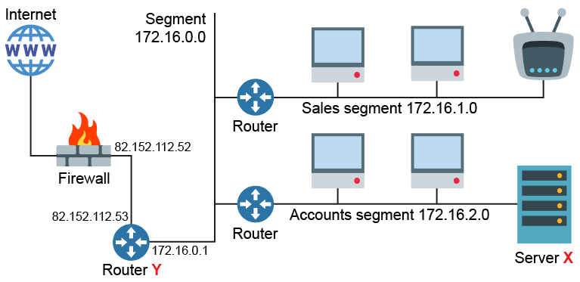
Network segments
A network diagram is shown below
Suggest a suitable IP address for Server X
Explain why does router Y has two IP addresses

Slide 17
Worksheet 5
Complete Tasks 1 and 2

Slide 18
Network Address Translation
Devices using private IP addresses cannot access the Internet directly
Instead they must communicate via another network device that provides Network address translation (NAT)
This allows a single public IP address e.g. 12.65.42.1 to be shared by any number of hosts with private IP addresses

Slide 19
NAT process
The translation device records the source and destination socket addresses for each request
It then communicates on the host’s behalf with the destination IP address
When a response returns, it is passed back to the host that made the original request
Translation table
 | Source | Apparent source / destination | Actual destination
Request | 192.168.0.3:1234 | 12.65.42.1 | 123.65.78.4:80
Response | 123.65.78.4:80 | 12.65.42.1 | 192.168.0.3:1234

Slide 20
Port forwarding
NAT can also provide port forwarding
Servers accessible to the public can be given a non-routable IP address within a private network
A public request reaches the external router of the private network using a given port
The data packets are forwarded internally to the correct device
This also provides additional filtering

Slide 21
Worksheet 5
Complete Task 3

Slide 22
DHCP
Dynamic Host Configuration Protocol (DHCP) is used to automatically assign IP addresses and any other network configuration information
This allows limited pools of dynamic IP addresses to be shared out between hosts and freed up when not needed
This allows hosts to reconfigure themselves when moving between networks and reduces the number of IP addresses required locally as not all hosts will require network access at the same time
Why are static IP addresses uncommon?

Slide 23
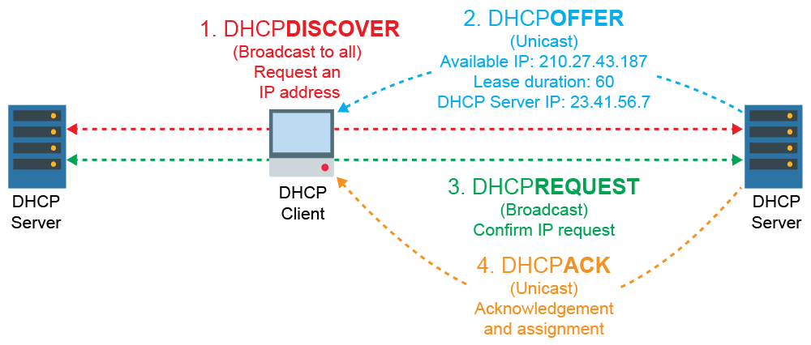
How DHCP works
DHCP can assign a limited number of temporary IP addresses to transient devices operating within a local hotspot

Slide 24
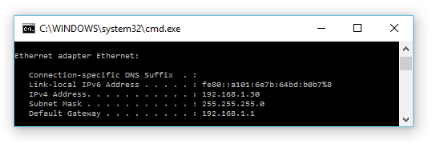
Plenary
A DHCP server has allocated the following IPv4 address information to a host:
Using IPv4, what is the network ID?
What is the host ID?
How many hosts are available on this network?

