Slide 1
AQA
    A Level
      Computer Science
      Paper 2
Client server model
  Unit 10
  The Internet

Slide 2
Objectives
Be familiar with the client server model
Be familiar with the WebSocket protocol and know why and where it is used
Understand the principles of web CRUD applications and REpresentational State Transfer (REST)
Compare JSON (JavaScript Object Notation) with XML
Compare and contrast thin‐client computing with thick‐client computing

Slide 3
Starter
A host (or client computer) on a network contacts a server to request something
What do hosts request from the following servers?
  File server
  Email server
  FTP server
  Proxy server
  DHCP server
  Print server
  Database server

Slide 4
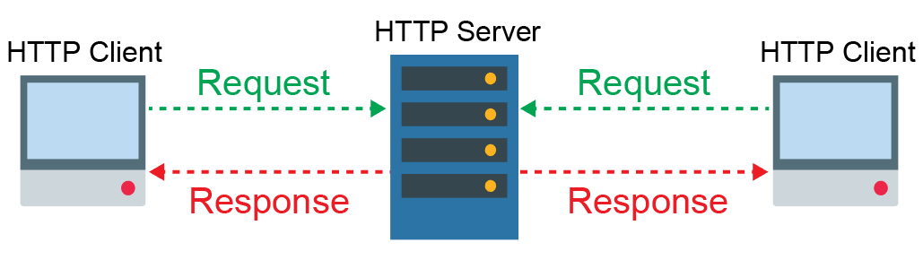
Client server model
Network services are designed to act as on-demand services where the server is responsible for the bulk of the processing
  A server presents its services to requesting clients
  If the request cannot be fulfilled a suitable notification will
  be sent

Slide 5
Application Programming Interface (API)
Servers often provide a programmable interface to their services
  An API is a set of functions and protocols that clients can use
  A server-side web API is a set of web services or web resources to enable programmers to build web applications
  Sometimes, programmers use multiple server-side web APIs to create combined web applications called mashups
  For example, programmers might use the APIs of Spotify and Google Maps to build a mashup website that combines a music playing application with an interactive map

Slide 6
API
This simple line of code allows any web page to make use of the Google Map server
  The process is initialised and defined by the client
  Once the API has been initialised, the web page can define how to interact and request data
<script src= "http://maps.googleapis.com/maps/api/js">
</script>

Slide 7
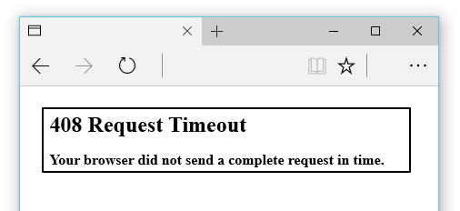
HTTP communication
Limitations of HTTP communication:
  Client has to request (“pull”) data from the server
  If too much time passes between establishing a socket connection between client and web server, and receipt of a client request, the server drops the connection to conserve its resources and returns an error message

Slide 8
WebSocket protocol
WebSocket protocol includes API for establishing a persistent TCP socket connection
  Designed for web browser and server, but any type of client and server can use it
  Connection is full-duplex (simultaneous two-way)
  Allows client and server to send data at any time
  Server can offer (“push”) data to the client
  WebSocket Secure is encrypted

Slide 9
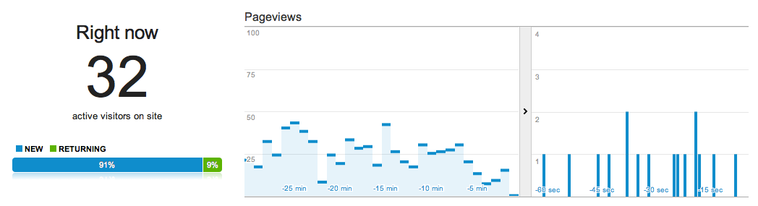
Smaller packets
With a trusted, open connection WebSocket packet sizes are greatly reduced without the usual headers
  This in turn creates a superfast, interactive connection commonly used with websites requiring real-time updates
  Server load is reduced, saving bandwidth and running costs as well as reducing the number of web servers required

Slide 10
Worksheet slide
Complete Task 1

Slide 11

Online database systems
Client server models often make use of databases to store and retrieve information
  What happens when you search for a product online?
  What other examples of online databases can you think of?

Slide 12
Web CRUD applications
There are four basic data manipulation operations (often referred to as CRUD):
  Create – write a record to a database
  Retrieve – retrieve a record from a database
  Update – amend a record
  Delete – remove a record from the database
SQL statements used to interact with a database map directly to these functions

Slide 13
HTTP request methods
HTTP uses a common set of actions:
  GET – request data from a source
  POST – submit data to be processed
  PUT – uploads a new resource to the server
  DELETE – removes a resource from the server
These map CRUD operations to SQL commands:
CRUD | HTTP Request methods | SQL database command
Create | POST | INSERT
Retrieve | GET | SELECT
Update | PUT | UPDATE
Delete | DELETE | DELETE

Slide 14
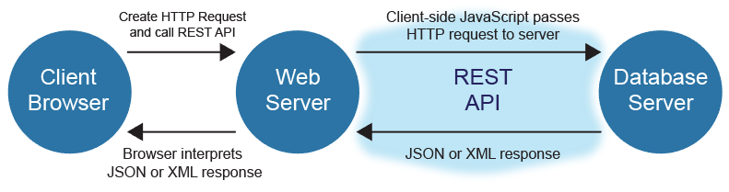
REpresentational State Transfer
REST is an architectural style which determines how systems communicate with each other
  Typically REST uses HTTP request methods to interact with online databases
  RESTful systems and APIs separate the client from the server database allowing either to be updated independently without impacting on the other

Slide 15
Using HTTP request methods with RESTful services
The following server database is named dinosaur
What is the effect of the following HTTP requests?
  PUT dino.com/dinosaur/Triceratops/period/Cretaceous
  DELETE dino.com/dinosaur/Chindesaurus
  GET dino.com/dinosaur/
name | lengthM | period
Chindesaurus | 4 | Triassic
Brachiosaurus | 30 | Jurassic
Triceratops | 9 | Jurassic

Slide 16
Worksheet slide
Complete Task 2

Slide 17
JSON and XML
There are two widely used formats for data interchange between clients and servers:
  JSON - JavaScript Object Notation is written in a standard programming form, similar to JavaScript, and can be directly used by JavaScript with many other languages able to read and write it
  XML - Extensible Markup Language has a format similar to HTML and wraps content in tags

Slide 18
A comparison of JSON and XML
JSON format
{"dinosaurs":[ {"name": "Brachiosaurus", "lengthM": 30, "period": "Jurassic"} {"name": "Triceratops", "lengthM": 9, "period": "Cretaceous”} ]}
XML format
<dinosaurs> <dinosaur> <name>Brachiosaurus</name> <lengthM>30</lengthM> <period>Jurassic</period> </dinosaur> <dinosaur> <name>Triceratops</name> <lengthM>9</lengthM> <period>Cretaceous</period> </dinosaur> </dinosaurs>

Slide 19
JSON versus XML
Despite a few disadvantages JSON, is considered to be the neatest solution to data interchange
 | Advantages | Disadvantages
JSON | Easier to for a human to read, write and maintain More compact so requires less storage and quicker to transmit and process Can be directly manipulated by JavaScript | Works with a limited range of data types
XML | Any data type allowed so more flexible | Expansive use of tags make it more difficult to follow

Slide 20
Thick clients
The easiest way of implementing a network is to use standard computers as hosts and join them via a network medium
  Each host on the network would be a powerful computer in its own right
  Unfortunately this power is relatively expensive and each node needs to be administered individually

Slide 21
Thin clients
An alternative is to use low-powered processors in hosts specifically designed as network machines
  The processing is done on a powerful central server and
  the hosts are only used to display the results and provide
  user input
  Thin client has a simple operating system requiring little maintenance or administration (configuration of settings)
  A ‘zero’ client can download the latest OS version and its configuration from a server each time a user switches it on
  Whilst there is a cost saving from not requiring multiple powerful individual machines, a powerful server and a highly responsive network infrastructure are required

Slide 22
Thin- vs thick-client computing
 | Advantages | Disadvantages
Thin | Easy to set up, maintain and add terminals Server software and updates can be automatically distributed to each client terminal More secure | Reliant on the server Requires a very powerful, and reliable server Server demand and bandwidth increased
Thick | Robust and reliable Can operate without a continuous connection to the server Generally better for running more powerful applications | Higher specification client computers required Installation of software required on each terminal separately Integrity issues with distributed data

Slide 23
Worksheet slide
Complete Task 3

Slide 24
Plenary
Identify which CRUD operation is performed on an online ticket database by the following HTTP requests:
  DELETE tickets.com/LnToBh/100916_45_1c
  PUT tickets.com/LnToBh/100916_22_2c/surname/smith
  GET tickets.com/LnToBh
  POST tickets.com/LnToBh/100916_2_1c
Describe what the requests might do

