Slide 1
AQA
A Level
Computer Science
Paper 2
Big data
Unit 12
OOP and functional programming

Slide 2
Objectives
Understand that Big Data is a term used to describe data whose volume is too large to fit on a single server and is generally unstructured
Describe examples of Big Data
Describe features of functional programming which make it suitable for analysing Big Data
Be familiar with the fact-based model for representing data
Be familiar with graph schema for capturing the structure of the dataset

Slide 3
Big Data
‘Big Data’ includes data that is collected on such a large scale that it cannot easily be analysed
Think of some organisations that collect and use huge amounts of data every day

Slide 4
Examples of Big Data use
‘Big data’ is collected and analysed by:
The NHS to help find patterns in illness or injury
Passport control to find patterns in border crossings
CCTV operators
The police

Slide 5
Finding patterns
Big Data analytics can seek out patterns. Online shopping is a common example

Slide 6
Characteristics of Big Data
Can you think of three distinguishing characteristics of Big Data?

Slide 7
Volume
Big Data is too big to be handled by one server
In the UK, there were 3.5 billion card purchases in the first quarter of 2016
Google processes more than three billion search queries every day and saves every single one
Tesco collects 70 million refrigerator-related data points from its units and analyses them to keep better tabs on performance, to gauge when machines might need to be serviced and to cut down on energy use

Slide 8
Velocity
Smartphones, sensor networks, and CCTV all create large volumes of data, continuously
The value and use of the data may require a response in the range of milliseconds to seconds

Slide 9
Variety
Big data comes in many forms; structured, unstructured, text, audio and image
60 million new photos are updated daily in Instagram
48 hours of videos are uploaded every minute on YouTube
There are three billion views of YouTube videos every day
Spotify, the music streaming service, has 100 million users

Slide 10
Worksheet 6
Try Task 1 on the worksheet

Slide 11
Big Data and functional programming
Processing Big Data often needs to be distributed across multiple servers
What are the features of functional programming which make it useful for working with Big Data distributed across multiple servers?

Slide 12
Big Data and functional programming
Large datasets require distributed processing: FP aids the production of correct and efficient distributed code.
Immutable data structures, which cannot be inadvertently altered in a function
Statelessness, so the program’s behaviour does not depend on the order in which functions are called
Higher-order functions such as map and fold allow functions to be input as arguments

Slide 13
Map and fold/reduce
What do map and fold operations do when applied to lists?

Slide 14
Map and fold/reduce Answer
What do map and fold operations do when applied to lists?
map is a higher order function which applies a function to each element of a list and returns a new list
fold (also known as a reduce) operates by applying a function recursively over a list and returning a value

Slide 15
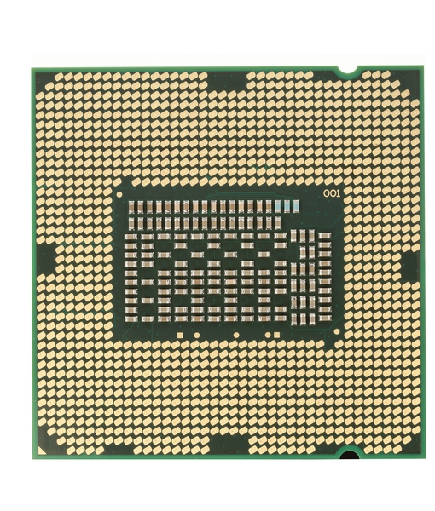
Map and fold/reduce
Map and reduce operations can be efficiently parallelised
Many processors can work simultaneously on parts of a dataset without affecting other parts

Slide 16
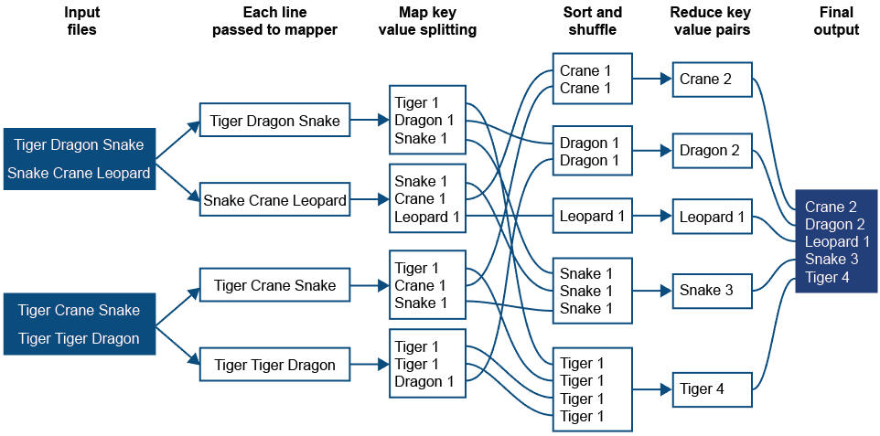
Map and reduce: wordcount

Slide 17
Fact-based model
Traditional data processing involving relational databases does not suit either the volume or the variety of Big Data
The fact-based model captures a single piece of information, such as:
Sensor location = 40.741895, -73.989308
Stock Keeping Unit = LEV-JN-SL-34-GN
Employer = Ministry of Sound

Slide 18
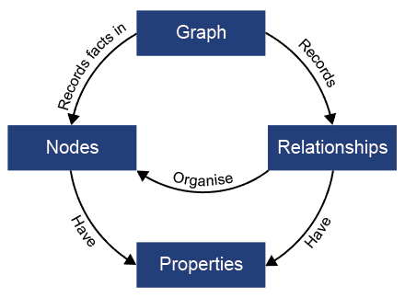
Graph schema
Often there is value in exploring relationships between connected entities in a dataset

Slide 19
Example
A large retail company sometimes hires programmers to write new modules for their computer systems
They need to find a software company employing programmers who program in a specific language, who will hire out their services
Data about the software companies and their employees are held in a graph schema

Slide 20
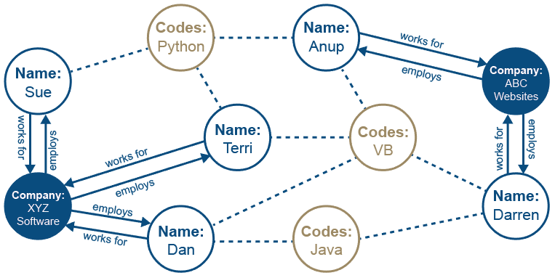
Example graph schema
Does XYZ have any programmers who can code in VB?
Which programmers can code in Java?
Who employs Terri?

Slide 21
Graph schema
Social networks are good examples of densely connected networks
Facebook had more than a billion mobile active daily users in a 3-month period in 2016
Tracking who is whose friend is a Big Data issue

Slide 22
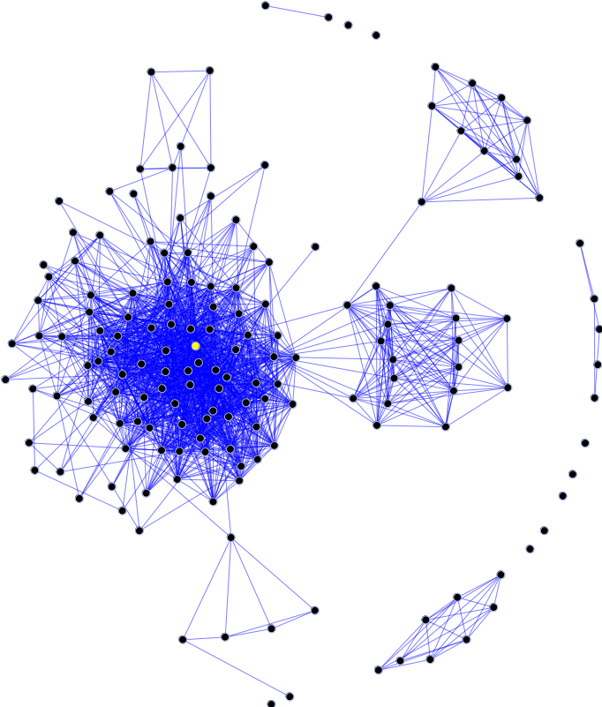
Friend of a friend
A dot, or node, represents one person
A line, or edge, represents a friendship

Slide 23
Graphs can show scale

Slide 24
Six degrees of separation?
The idea that any two people can be connected by at most five other friends started with a short story in 1929. There was no way to prove it.
Microsoft explored this in 2008 by studying records of 30 billion electronic conversations in 2006, and calculating the chain lengths between 180 billion pairs of users. Any individual user was on average 6.6 hops from another

Slide 25
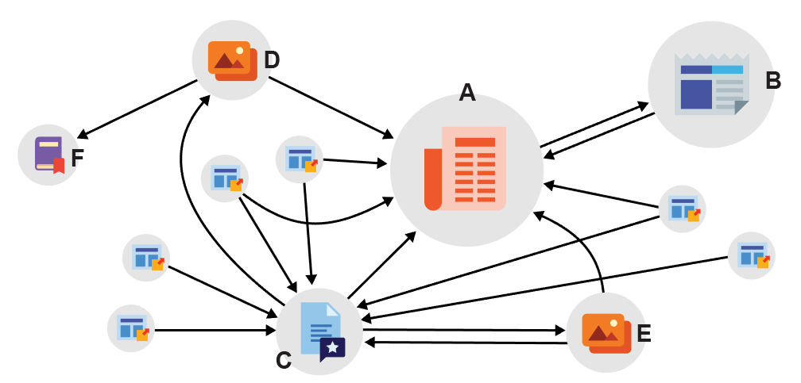
Worksheet 6 Tasks 2 and 3

Slide 26
Summary
Big Data has:
Volume
Velocity
Variety
Functional programming languages can help create correct and efficient distributed code, using
Immutable data structures
Statelessness
Higher-order functions

Slide 27
Summary
Big Data needs machine learning techniques to find patterns, because it lacks structure
Fact-based models can be combined with rules
Graph schemas can represent the structure and relationships between data items
Big Data processing enables organisations to make better decisions and take action accordingly

