Slide 1
AQA
    A Level
      Computer Science
      Paper 1
Mealy machines
  Unit 9
  Regular languages

Slide 2
Objectives
Be able to draw and interpret simple state transition diagrams for FSMs with no output and with output
Be able to draw and interpret simple state transition tables for FSMs with no output and with output

Slide 3
Finite state machines (FSM)
Recall that an FSM is an abstract model of computation used to design computer programs and sequential logic circuits, test for valid syntax, etc.
  It is an abstract representation of how something changes from one state to another in response to a condition or event

Slide 4
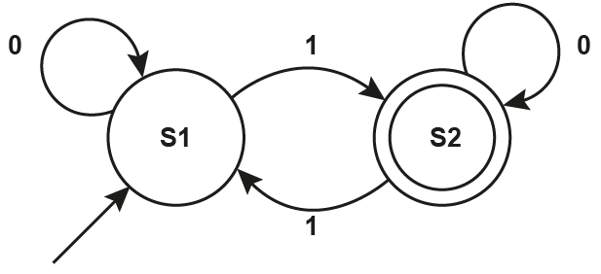
FSM
Here is a very simple FSM
  Colour the states in green
  Colour the transitions in blue
  Colour the transition conditions in red

Slide 5
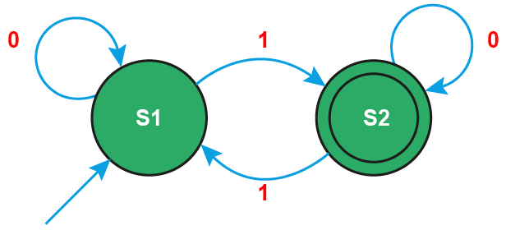
FSM Answers
Here is a very simple FSM
  Colour the states in green
  Colour the transitions in blue
  Colour the transition conditions in red

Slide 6
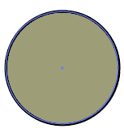
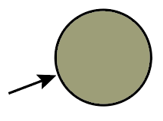


Notation
Symbol | Meaning
 | State
 | Start state
 | Accept state
 | Transition

Slide 7
Recognising a language
A finite state system accepts a string
C₁ C₂ C₃ … C_{n}
if there is a path from the start state to an accept state labelled by the symbols c_{1,} …., c_{n}
The language recognised by the FSM consists of all strings accepted by it

Slide 8
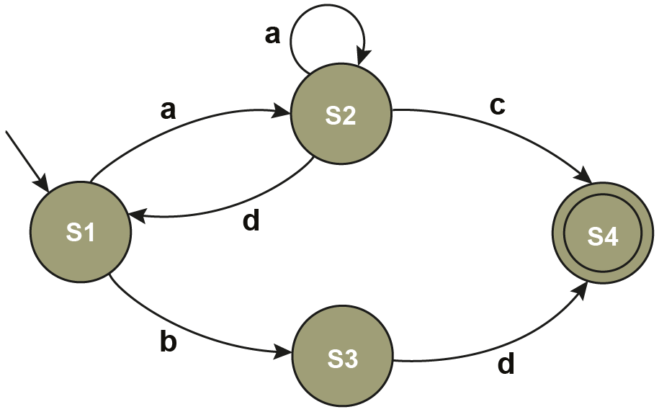
Which of the following strings will be accepted by this finite state automaton?
aaac badc adadbd ac bdaac bd
  Note: If no outgoing transition is defined from a state for a particular input symbol and that symbol is input then the string is rejected

Slide 9
Finite state machines
Draw an FSM for turning a light on and off when a button is pressed
  The light should initially start in the off state
  Label the states, transitions, and transition conditions

Slide 10
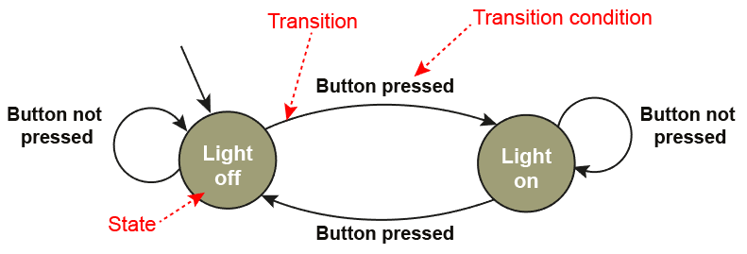
Finite state machines
Draw an FSM for turning a light on and off when a button is pressed
  The light should initially start in the off state
  Label the states, transitions, and transition conditions

Slide 11
Worksheet
Complete Task 1 on worksheet

Slide 12
Mealy machine
A Mealy machine is a type of FSM
It generates an output on each state transition
The output is determined by its current state and its current input
  It is deterministic: for each combination of state and input, only a single transition can be assigned

Slide 13
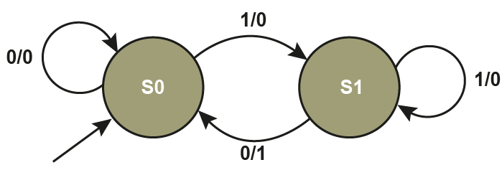
Mealy machine
The notation used for the transition condition is input/output, as shown on the Mealy machine below

Slide 14
Use of a Mealy machine
A Mealy machine can be used to map an input sequence to an output sequence
  It is used in language parsing
  It can be used to translate from one language to another

Slide 15
Example 1 – Generating output
The output for any input string can be shown
  Write down the input string, for example 110010
  Start with S0, as shown in black
  At S0, with an input of 1, output 0 and transition to S1
Input 1 1 0 0 1 0
State sequence S0 S1 S1 S0 S0 S1 S0
Output 0 0 1 0 0 1

Slide 16
Example 1 – Read the FSM
Output 1 if a particular substring is entered as part of a larger string of input values
Follow this sequence of state changes until you get an output of 1
  Move out of S0 requires a ‘1’. Is output = ‘1’? No, keep going
  Move out of S1 requires a ‘0’. Is output = ‘1’? Yes, end
  The sequence ’10’ generates an output of 1

Slide 17
Example 1 – Read the sequence
Recognising substrings in output
  How many states in this FSM? 2
  Where are the 1s in the output? See
  Count back the number of states (2 inclusive)
  What is the substring? See
Input 1 1 0 0 1 0
State sequence S0 S1 S1 S0 S0 S1 S0
Output 0 0 1 0 0 1

Slide 18
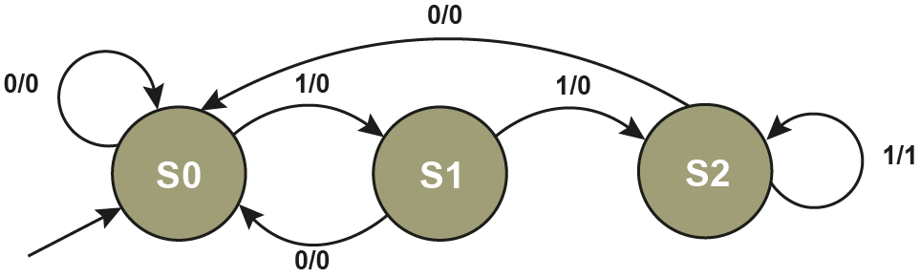
Example 2 – Generating output
The Mealy machine below outputs 1 whenever three consecutive 1s are entered. Otherwise, output is 0
  Complete the table
Input 1 1 0 1 1 1
State sequence S0
Output 0

Slide 19
Example 2 – Analysis
Is it true that this machine outputs 1 whenever three consecutive 1s are entered and 0 in all other cases?
Input 1 1 0 1 1 1
State sequence S0 S1 S2 S0 S1 S2 S2
Output 0 0 0 0 0 1

Slide 20
Worksheet
Complete Task 2 on the worksheet

Slide 21
State transition table
A state transition table may be used to define a Mealy machine. It shows all the states and possible inputs and the outputs for each combination of state and input
Input | Current state | Output | Next state
0 | S0 | 0 | S1
1 | S0 | ? | ?
0 | S1 | ? | ?
1 | S1 | ? | ?
0 | S2 | ? | ?
1 | S2 | ? | ?

Slide 22
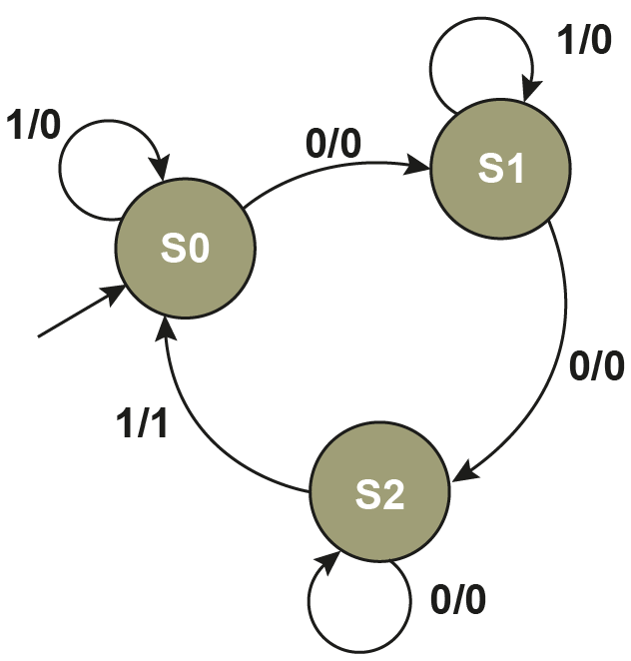
Transition tables
Complete the table for the Mealy machine
shown below:
Input | Current state | Output | Next state
0 | S0 | 0 | S1
1 | S0
0 | S1
1 | S1
0 | S2
1 | S2

Slide 23
Table equivalence
Both representations are equivalent
They define the same Mealy machine
Input | Current state | Output | Next state
0 | S0 | 0 | S1
1 | S0 | 0 | S0
0 | S1 | 0 | S2
1 | S1 | 0 | S1
0 | S2 | 0 | S2
1 | S2 | 1 | S0

Slide 24
Example 3
Input | Current state | Output | Next state
0 | S0 | 0 | S1
1 | S0 | 0 | S0
0 | S1 | 0 | S2
1 | S1 | 0 | S1
0 | S2 | 0 | S2
1 | S2 | 1 | S0
Complete the state
sequence for the
input string: 00010011
Input | 0 | 0 | 0 | 1 | 0 | 0 | 1 | 1
State | S0
Output

Slide 25
Example 3
Input | Current state | Output | Next state
0 | S0 | 0 | S1
1 | S0 | 0 | S0
0 | S1 | 0 | S2
1 | S1 | 0 | S1
0 | S2 | 0 | S2
1 | S2 | 1 | S0
Complete the state
sequence for the input string: 00010011
What substring will output a 1?
Input | 0 | 0 | 0 | 1 | 0 | 0 | 1 | 1
State | S0 | S1 | S2 | S2 | S0 | S1 | S2 | S0 | S0
Output | 0 | 0 | 0 | 1 | 0 | 0 | 1 | 0

Slide 26
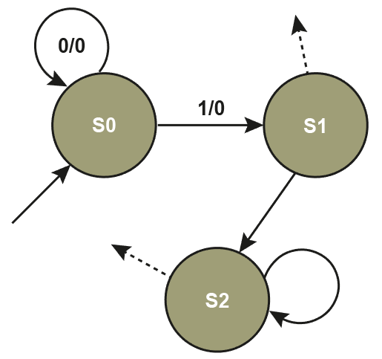
Exercise
Design a three-state Mealy machine that will output 1 when the sequence 110 is encountered and 0 for all other string sequences
  Show the state transition table for this machine
  Show the state transition sequence for the input string: 01011001

Slide 27
Exercise
Input | Current state | Output | Next state
0 | S0
1 | S0
0 | S1
1 | S1
0 | S2
1 | S2
Input | 0 | 1 | 0 | 1 | 1 | 0 | 0 | 1
State | S0
Output

Slide 28
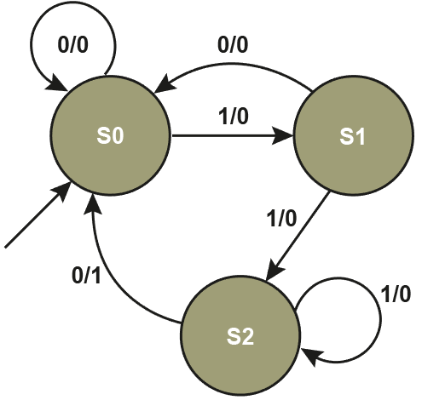
Exercise
Input | Current state | Output | Next state
0 | S0 | 0 | S0
1 | S0 | 0 | S1
0 | S1 | 0 | S0
1 | S1 | 0 | S2
0 | S2 | 1 | S0
1 | S2 | 0 | S2
Input | 0 | 1 | 0 | 1 | 1 | 0 | 0 | 1
State | S0
Output

Slide 29
Exercise
Input | Current state | Output | Next state
0 | S0 | 0 | S0
1 | S0 | 0 | S1
0 | S1 | 0 | S0
1 | S1 | 0 | S2
0 | S2 | 1 | S0
1 | S2 | 0 | S2
Input | 0 | 1 | 0 | 1 | 1 | 0 | 0 | 1
State | S0 | S0 | S1 | S0 | S1 | S2 | S0 | S0 | S1
Output | 0 | 0 | 0 | 0 | 0 | 1 | 0 | 0

Slide 30
Worksheet
Complete Task 3, Question 3 on the worksheet
Look closely at the input string
  Does there appear to be an error in this Mealy machine?
Complete Question 4 on the worksheet
  How does the behaviour of this Mealy machine compare to the one in Question 3?

Slide 31
Plenary
Mealy machines have an output dependent upon …
Mealy machines are a type of …
On Mealy machines
  States are drawn as …
  Transitions are drawn as …
  Transition notation is indicated as …
Two ways of representing a Mealy machine are …
The connection between languages and Mealy machines is …

