Slide 1
AQA
    A Level
      Computer Science
      Paper 1
Sets
  Unit 9
  Regular languages

Slide 2
Objectives
Be familiar with the concept of a set and the notations used for specifying a set and set comprehension
Be familiar with the compact representation of a set
Be familiar with the concept of finite and infinite sets, countably infinite sets, cardinality of a finite set, Cartesian product of sets
Be familiar with the meaning of the terms subset, proper subset, countable set
Be familiar with set operations: membership, union, intersection, difference

Slide 3
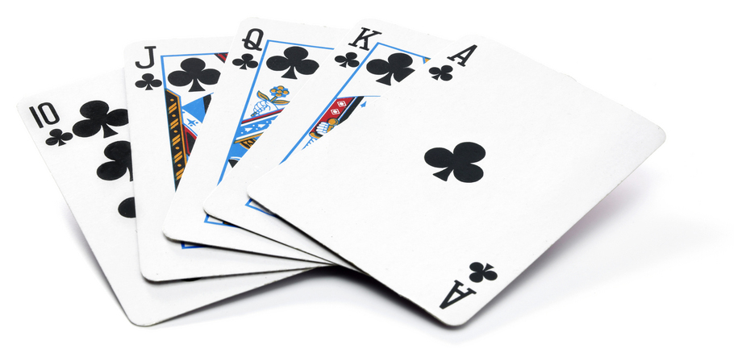
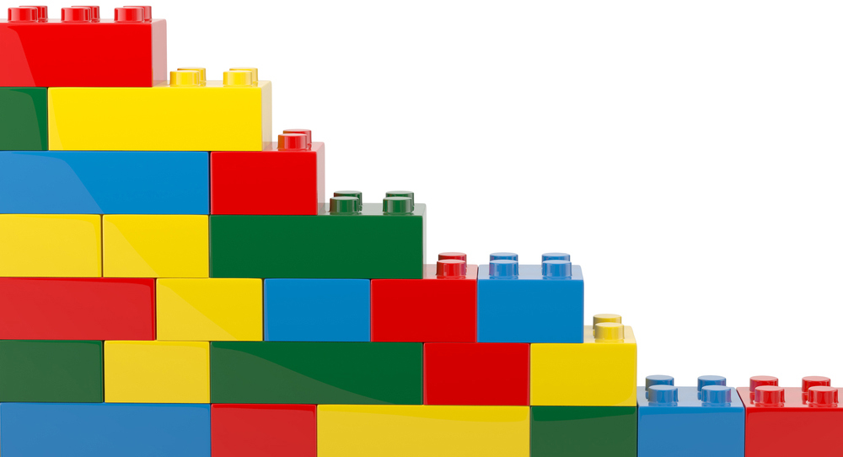
Sets – Prior encounters

Slide 4
Sets – Why bother?
Formalises the idea of grouping objects together and viewing them as a single entity
In this way, a set becomes an abstraction
There is a close relationship between set theory and logic
The laws governing sets form part of the basis for Boolean algebra
Many programming languages support sets as an abstract data type

Slide 5
Terminology
A set is a well-defined collection of objects
  Objects in the set are members or elements
  A set is unordered
  Each member in a set can only occur once
A set is usually denoted by a capital letter
  A member is usually denoted by a lower case letter

Slide 6

Examples of sets
Set X contains the even numbers between 1 and 99
Set C contains the colours in the rainbow
  C = {red, orange, yellow, green, blue, indigo, violet}
blue is a member of C

Slide 7
Listing each member
A set can be defined by listing every member
  The members are enclosed by { }
  The members are separated by a comma
Example:
  C = {red, orange, yellow, green, blue, indigo, violet}
Write set definitions for the following:
  All odd numbers between 0 and 10 inclusive
  All numbers between 1 and 100 inclusive, which are exactly divisible by 10

Slide 8
Common sets
Identify the name of these common sets:
  {0, 1, 2,…}
  {1, 2, 3,…}
  {…, -2, -1, 0, 1, 2, …}
  numbers that can be expressed as a fraction
  numbers that contain a decimal

Slide 9
Common sets
Identify the common sets which can be defined as:
  N = set of natural numbers: 0, 1, 2,…
  Z⁺ = set of positive integers: 1, 2, 3,…
  Z = set of all integers: …, -2, -1, 0, 1, 2, …
  Q = set of rational numbers (can be expressed as a fraction)
  R = set of real numbers
Note: These set names may be shown as bold letters or in a special font (N, Z⁺, Z, Q, R)

Slide 10
Questions:
Is each member of Z also a member of Q?
  Z = set of all integers: {…, -2,-1, 0,1, 2,…}
  Q = set of rational numbers (can be expressed as a fraction)
Describe an empty set
How might the empty set be represented?
How many different empty sets are there?

Slide 11
Answers:
Is each member of Z also a member of Q?
  Yes, because the number 12 for example, can be written 12/1
Describe an empty set
  One with no members
How might the empty set be represented?
  {} or ø
How many different empty sets are there?
  Just one
How could you define the set of all girls born in 2000?
  We need a new notation for this

Slide 12
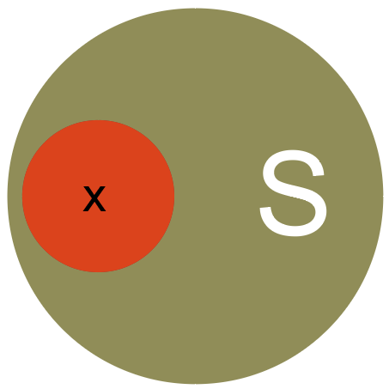
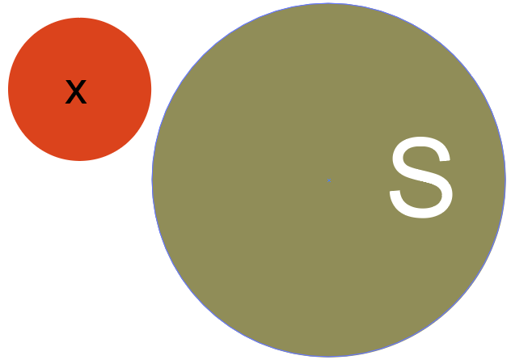
Set membership
If S is a set, then the expression
x ∈ S
means
“x is a member of the set S”
The expression
x ∉ S
means
“x is not a member of the set S”

Slide 13
Set comprehension
A set can be defined by stating the properties held by the members, but not by the non-members
Example:
  S = { x | x ∈ N ᴧ x is even }
  The set of all even natural numbers {0, 2, 4, 6, ...}
Translation:
Symbol | Meaning
| | (pipe) ‘such that’
x ∈ N | x is a member of the set of N (natural numbers {0, 1, 2, …})
ᴧ | ‘and’
x is even | the constraint for the ‘and’

Slide 14
Compact set representation
A set can be defined by a shorthand method read in the same way as set comprehension
Set comprehension:
  S = { x | x ∈ N ᴧ x is even }
Compact representation
  S = { x ∈ N | x is even }
Compact representation for strings
  T = { 0^{n}1^{n} | n ≥ 1 } = {01, 0011, 000111, …}

Slide 15
Worksheet
Complete Task 1, Questions 1-3 on the worksheet

Slide 16
Set operations
Union
  A ∪ B is the set of all members that are
  in A or in B or in both
Intersection
  A ∩ B is the set of all members
  in both A and B
Difference
  A \ B is the set of all members
  that are in A but not in B
Draw diagrams to represent these operations. (Use a circle to represent a set)

Slide 17
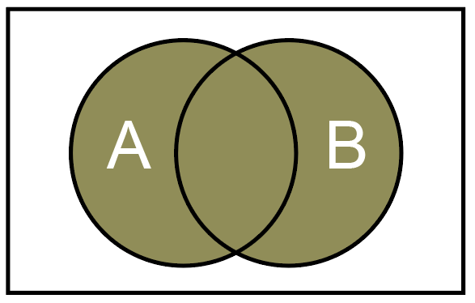
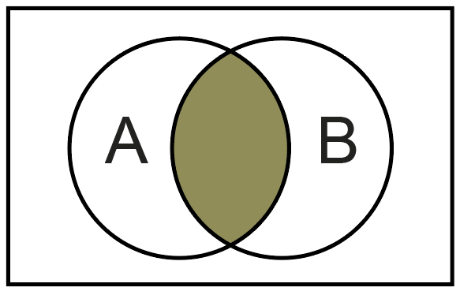
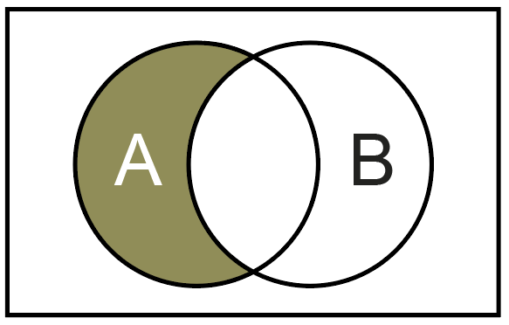
Set operations
Union
  A ∪ B is the set of all members that are
  in A or in B or in both
Intersection
  A ∩ B is the set of all members
  in both A and B
Difference
  A \ B is the set of all members
  that are in A but not in B

Slide 18
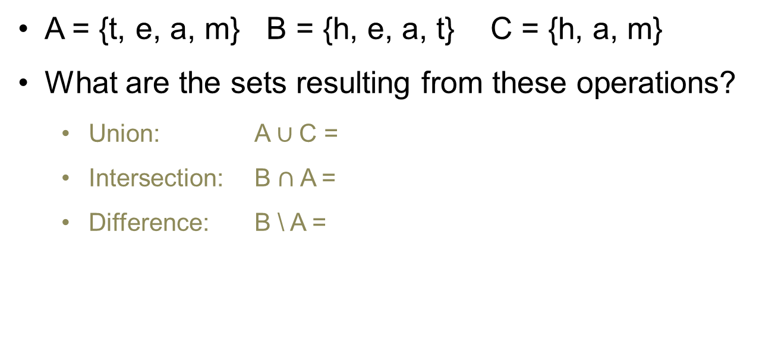
Examples
A = {t, e, a, m} B = {h, e, a, t} C = {h, a, m}
What are the sets resulting from these operations?
  Union: A $∪$C =
  Intersection: B $∩$ A =
  Difference: B \ A =

Slide 19
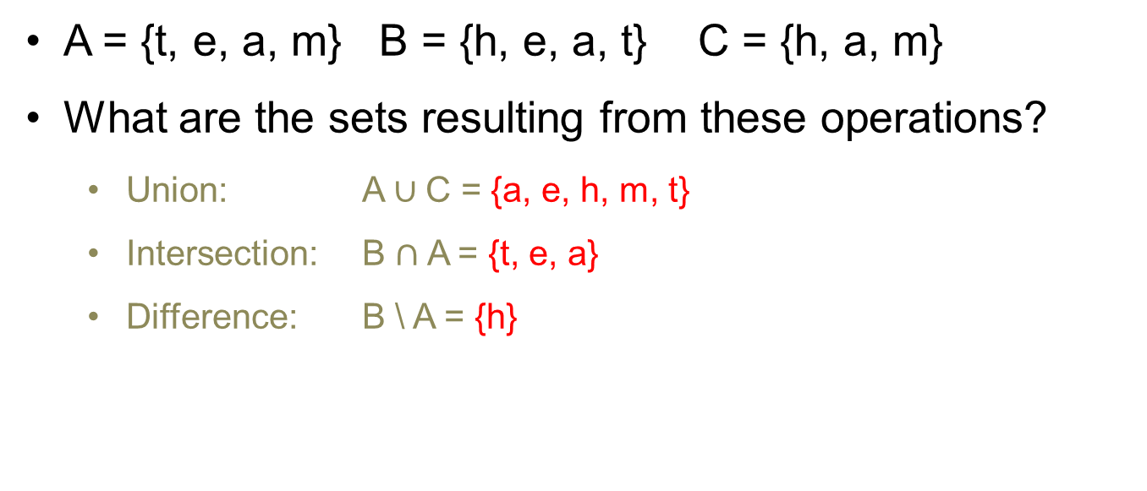
Examples Answers
A = {t, e, a, m} B = {h, e, a, t} C = {h, a, m}
What are the sets resulting from these operations?
  Union: A $∪$C = {a, e, h, m, t}
  Intersection: B $∩$ A = {t, e, a}
  Difference: B \ A = {h}

Slide 20

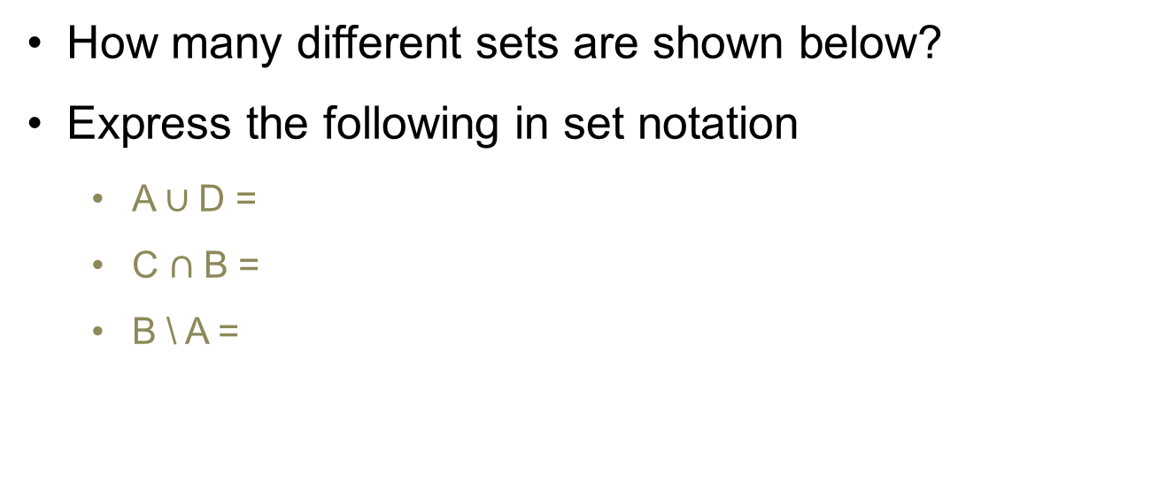
Exercise
How many different sets are shown below?
Express the following in set notation
  A $∪$D =
  C $∩$ B =
  B \ A =
A
B
C
D

Slide 21

Answer
There are three sets – A is the same as C
Express the following in set notation
  A $∪$D =
  C $∩$ B =
  B \ A =
A
B
C
D

Slide 22
Worksheet
Complete Task 2, question 4 on the worksheet
Remember the symbols
  ∈ ∉ ∪ ∩ \ { } Φ

Slide 23
Subsets
A is a subset of B, when every member of
A is also a member of B
  A ⊆ B
A is not a subset of B, if at least one member of
A is not a member of B
  A ⊈ B
A is a proper subset of B, when A is a subset of
B but A ≠ B
  A ⊂ B

Slide 24
Worksheet
Complete Task 3, question 5 on the worksheet
Remember the symbols
  ⊆ ⊈ ⊂
  ∈ ∉ ∪ ∩ \ { } Φ
Remember the common sets
  N = set of natural numbers: 0, 1, 2,…
  Z⁺ = set of positive integers: 1, 2, 3,…
  Z = set of all integers: …, -2,-1, 0,1, 2,…
  Q = set of rational numbers (can be expressed as a fraction)
  R = set of real numbers

Slide 25
Operations – Cartesian product
The Cartesian product of two sets A and B is the set of all ordered pairs (a, b), such that a ∈ A and b ∈ B
Cartesian product notation
  A x B, read as “A cross B”
Challenge: Construct the set comprehension definition for the set A x B

Slide 26
Operations – Cartesian product
The Cartesian product of two sets A and B is the set of all ordered pairs (a, b), such that a ∈ A and b ∈ B
Cartesian product notation
  A x B, read as “A cross B”
Challenge: Construct the set comprehension definition for the set A x B
A x B = {(a, b) | a ∈ A ᴧ b ∈ B}

Slide 27
Examples
A = {1,2} and B = {4,8}
What is A X B?
2. A = {p, q} and B = {p, r, s}
What is A X B?

Slide 28
Examples Answers
A = {1,2} and B = {4,8}
What is A X B?
{(1, 4), (1, 8), (2, 4), (2, 8)}
2. A = {p, q} and B = {p, r, s}
What is A X B?
{(p, p), (p, r), (p, s), (q, p), (q, r), (q, s)}

Slide 29
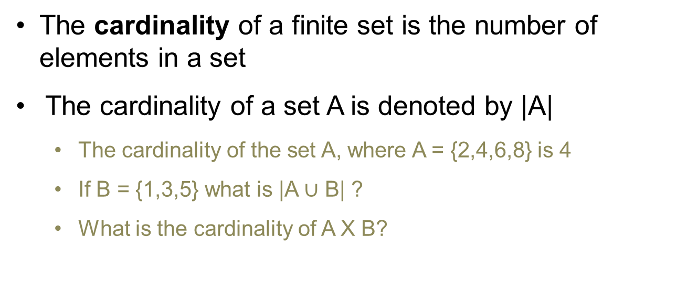
Cardinality
The cardinality of a finite set is the number of elements in a set
The cardinality of a set A is denoted by |A|
  The cardinality of the set A, where A = {2,4,6,8} is 4
  If B = {1,3,5} what is |A $∪$ B| ?
  What is the cardinality of A X B?

Slide 30
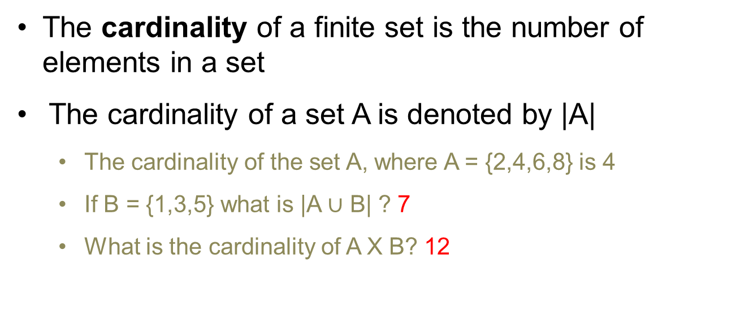
Cardinality
The cardinality of a finite set is the number of elements in a set
The cardinality of a set A is denoted by |A|
  The cardinality of the set A, where A = {2,4,6,8} is 4
  If B = {1,3,5} what is |A $∪$ B| ? 7
  What is the cardinality of A X B? 12

Slide 31
Worksheet
Complete Task 4, Question 6 on the worksheet

Slide 32
Set concepts
A finite set contains an exact number of distinct members where number ∈ N
  The English alphabet is a finite set which has 26 distinct members
  Alphabet = {a, b, …, z}
The cardinality of a finite set is the number of members in the set.
  The cardinality is written as |X|, where X is a set
  |{a, b, …, z}| = 26
  |Alphabet| = 26

Slide 33
Set concepts
An infinite set contains an infinite number of distinct members
  Both N and R are infinite sets
A countably infinite set is one whose members can be counted using the infinite set N
  The set of integers divisible by 5 {0, 5, 10, 15 …}
  is an infinite set
  Each member can be assigned a positional value from set N
  Member 1 = 0, member 2 = 5, member 3 = 10, …
  Therefore, it is a countably infinite set
  The set R, is not countable. Why might this be the case?

Slide 34
Exercise
For each set, determine if it is finite or infinite
If the set is infinite, explain if it is countably infinite or not
If it is finite, determine its cardinality
  Planets in the solar system
  Number of possible digits after the decimal point in a number
  Suits in a deck of playing cards
  Negative fractions
  Grains of sand on the planet

Slide 35
Exercise Answers
For each set, determine if it is finite or infinite
If the set is infinite, explain if it is countably infinite or not. If it is finite, determine its cardinality
  Planets in the solar system finite, 8
  Number of possible digits after the decimal in a number
  countably infinite
  Suits in a deck of playing cards finite, 4
  Negative fractions infinite, not countable since the elements of this set cannot be paired off against the natural numbers
  Grains of sand on the planet finite, countable
  You could put all the grains in order and then map each one to a natural number

Slide 36
Plenary
Sets
  What are the three different ways of defining a set?
  What are the four operations and their symbols that can be performed on sets?
  What is the difference between an infinite set and a countably infinite set?
  What is the difference between a subset and a proper subset?

Slide 37
Plenary Answers
Sets
  What are the three different ways of defining a set?
  Listing, set comprehension, compact representation
  What are the four operations and their symbols that can be performed on sets?
  Union ∪, intersection ∩, difference \, membership ∈ and ∉
  What is the difference between an infinite set and a countably infinite set?
  A set is countable if and only if its elements can be counted off using the natural numbers (N). The former does not possess this property, for example, R
  What is the difference between a subset and a proper subset?
  A proper subset disallows the two sets being equivalent

