Slide 1
AQA
    A Level
      Computer Science
      Paper 1
Regular Expressions
  Unit 9
  Regular languages

Slide 2
Objectives
Understand that a regular expression is a way of describing a set
Understand that regular expressions allow particular types of languages to be described in a convenient shorthand notation
Be able to form and use simple regular expressions for string manipulation and matching
Be able to describe the relationship between regular expressions and finite state machines
Be able to write a regular expression to recognise the same language as a given FSM and vice versa

Slide 3
What and why?
Regular expressions are patterns used to specify a set of strings
  Regular expressions are expressed using a
  special notation
Regular expressions are used for
  Finding particular words in a stream
  Finding combinations of characters in strings
  Defining a set of acceptable strings in a language
They are not equivalent to wildcards, that you may have used before such as ‘d*g’ which matches ‘dog’, ‘dig’, and ‘dug’

Slide 4
Regular Expressions
A simple way of describing a set
A way of describing some types of languages using a shorthand notation
S = set that begins with ‘a’ and is followed by zero or more of ‘b’
describes the set S where
S = {a, ab, abb, abbb, ...}
S can be defined by a regular expression ab*

Slide 5
Notation
Precedence rules (), *, +, ?, |
Symbol | Meaning
 | Members side-by-side must appear in that sequence
| | Separates alternatives (or, ⋁)
* | Indicates that there are zero or more of the preceding element
+ | Indicates that there is one or more of the preceding element
? | Indicates that there are zero or one of the preceding element
( ) | Used to identify groupings

Slide 6
Translate
Given these regular expressions, translate them to an English description and define them using the listing {mem1, mem2,…} definition of a set
  a⁺b⁺ a*b (a?b)|(ba⁺) (ab)⁺
Symbol | Meaning
 | Members side-by-side must appear in that sequence
| | Separates alternatives (or, ⋁)
* | Indicates that there are zero or more of the preceding element
⁺ | Indicates that there is one or more of the preceding element
? | Indicates that there are zero or one of the preceding element
( ) | Used to identify groupings

Slide 7
Form
Given these definitions, create a regular expression to identify the associated set
  An 01 pair repeated any number of times
  One or more 0s bounded on either end by a single 1
  S = {10, 100, 1000, … 01, 011, 0111, …}
  S = {10001, 1000, 1011, 10111}
Symbol | Meaning
| | Separates alternatives (or, ⋁)
* | Indicates that there are zero or more of the preceding element
+ | Indicates that there is one or more of the preceding element
? | Indicates that there are zero or one of the preceding element

Slide 8
Examples
Find which strings are rejected by each definition:
a⁺b
  ab, a, b, baa, aab
(bc)*a
  a, bcaa, bca, bcbca, bcabca
LL?D?D where L = {A…Z} D = {0 …9}
  SO14, gu13, BH12, 1CH87, DT6, W1
0(0|1)*
  0, 00, 01, 000, 101, 001, 010

Slide 9
Examples Answers
Find which strings are rejected by each definition:
a⁺b
  ab, a, b, baa, aab a, b, and baa are rejected
(bc)*a
  a, bcaa, bca, bcbca, bcabca bcaa, bcabca are rejected
LL?D?D where L = {A…Z} D = {0 …9}
  SO14, gu13, BH12, 1CH87, DT6, W1 gu13, 1CH87 rejected
0(0|1)*
  0, 00, 01, 000, 101, 001, 010 101 is rejected

Slide 10
Worksheet
Complete Task 1, Questions 1 and 2 on the worksheet

Slide 11
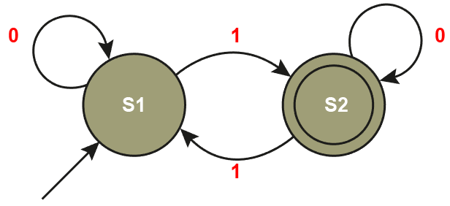
Regular language
A language is regular if it can be represented by
  A regular expression
  A finite state machine (FSM)
Recall the symbols used in an FSM
  State
  Transition
  Transition condition
  One or more accepting states

Slide 12
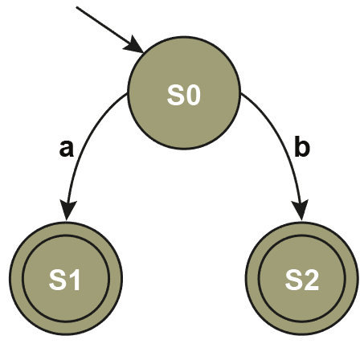
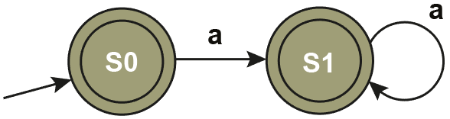
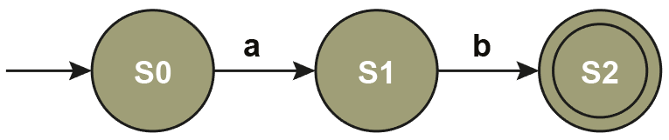
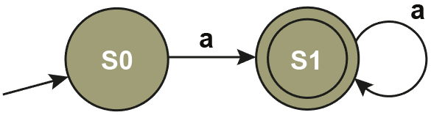
FSM building blocks
Match each FSM with a regular expression
ab a⁺ a|b a*

Slide 13
FSM building blocks Answers
Match each FSM with a regular expression
a|b
a*
ab
a⁺

Slide 14
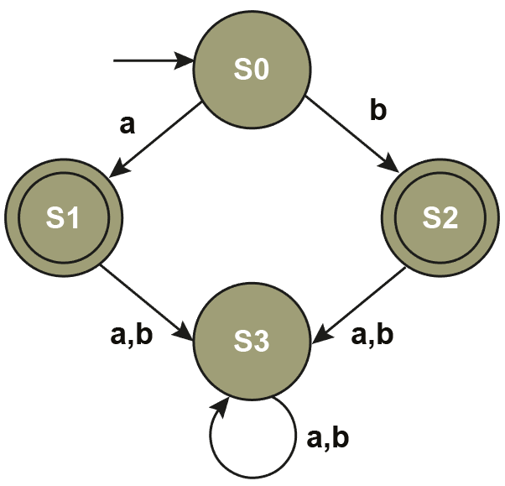
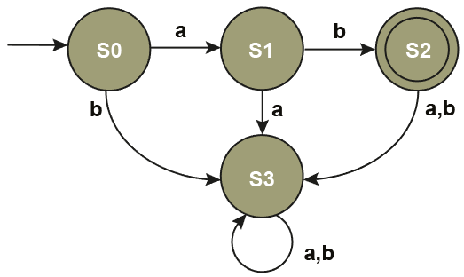
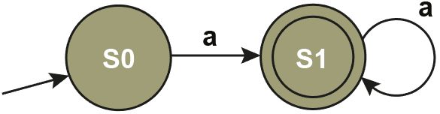
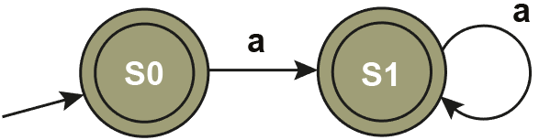
The complete FSMs
Here are the FSMs with all transitions defined for every state
a|b
ab
a+
a*

Slide 15
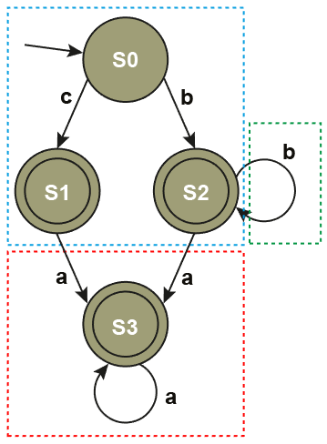
Find the Regular Expression
Step 1: Generate accepts and rejects
  {c, ca, caa, b, bbb, ba, bba, baa}
  Rejects: {a, bc, bac, cba}
Step 2: Parse
  (c|b) → (c|b+) → (c|b+)a*
Step 3: Check
  Accepts and rejects
  Note: For clarity, transitions
  that would result in rejection
  are not shown

Slide 16
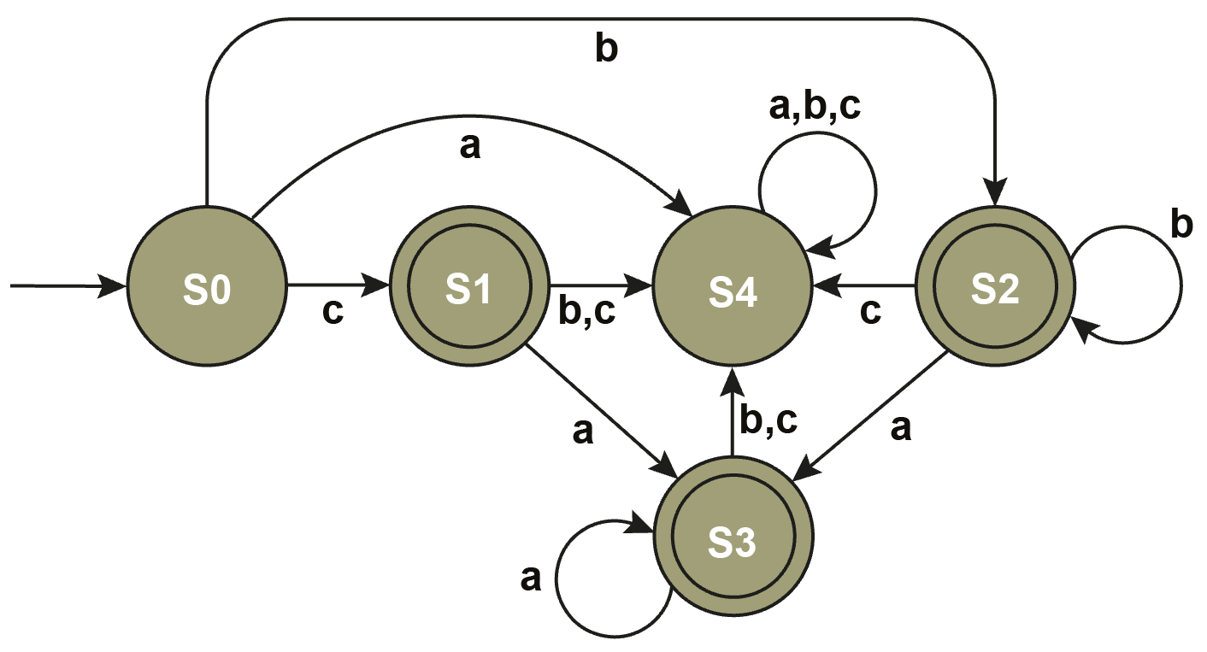
Complete FSM: (c|b+)a*
Step 3: Check
  Rejection state (S4) added
  {c, ca, caa, b, bbb, ba, bba, baa} Rejects: {a, bc, bac, cba}

Slide 17
Worksheet
Complete Task 2, Question 3 on the worksheet

Slide 18
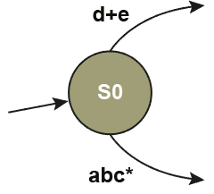
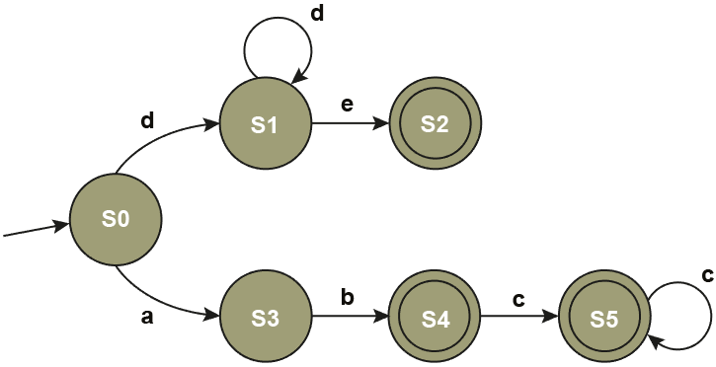
Decompose: (abc*)|(d⁺e)
Precedence: (), *, +, ?, |
  Step 1 – Either side of |
  Step 2 – Decompose left side
  Step 3 – Decompose right side
Note: 3 accepting states
  For clarity, some
  transitions are not shown
  In the finished diagram
  there will be a state (S6)
  to handle rejected strings

Slide 19
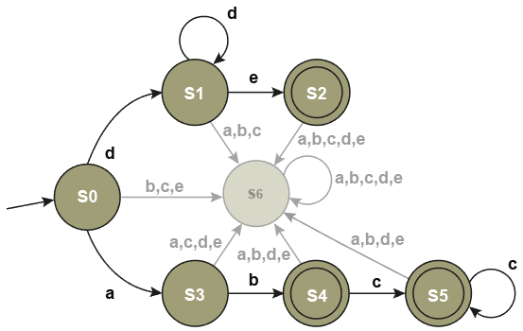
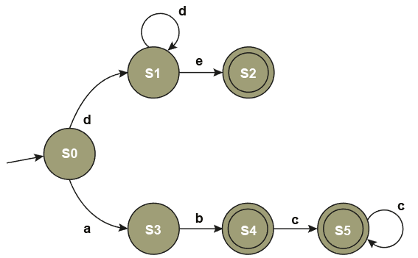
Check (abc*)|(d⁺e)
Step 3: Check
  The new diagram has a spinning rejection state (S6)
  {ab, abc, abcc, de, dde} Rejected: {a, ac, abd, cba, e, ade}

Slide 20
Exercise
Construct an FSM for a*b and a*b⁺

Slide 21
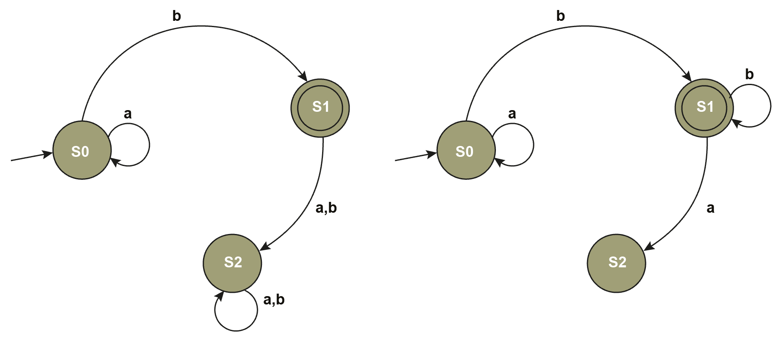
Exercise
Construct an FSM for a*b and a*b⁺
a*b
a*b⁺

Slide 22
Worksheet
Complete Task 3, Question 4 on the worksheet

Slide 23
Plenary
Name three ways to describe a regular language
Write all three for strings beginning with ‘a’ followed by zero or more of ‘b’

Slide 24
Plenary
Name three ways to describe a regular language
Set Notation, Regular Expression, Finite State Machine
Write all three for strings beginning with ‘a’ followed by zero or more of ‘b’
Set: S = {a, ab, abb, abbb, ...} or alternatively,
S = { s | s begins with ‘a’ ᴧ is followed by zero or more ‘b’}
Regular Expression: S can be defined by a ab*
Finite State Machine – see next slide

Slide 25
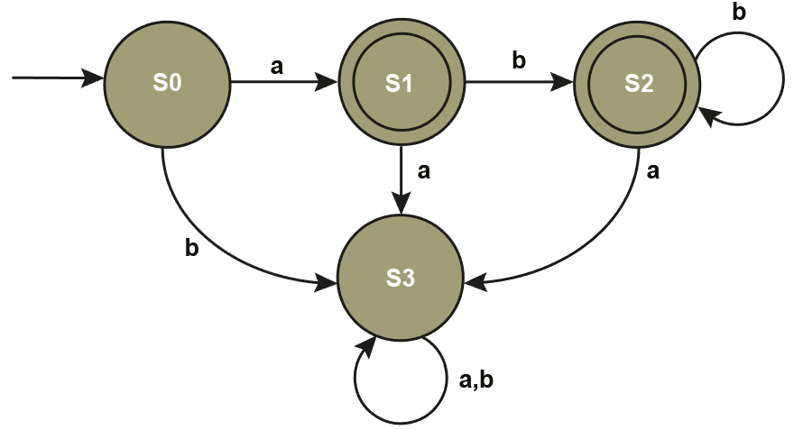
FSM for ab*

