Slide 1
AQA
    A Level
      Computer Science
      Paper 1
The Turing Machine
  Unit 9
  Regular languages

Slide 2
Objectives
Understand the structure and use of Turing machines that perform simple computations
Understand that a Turing machine can be viewed as a computer with a single fixed program
Represent transition rules using a transition function or state transition diagram
Hand-trace a simple Turing machine
Explain the importance of Turing machines and the Universal Turing machine to the subject of computation

Slide 3
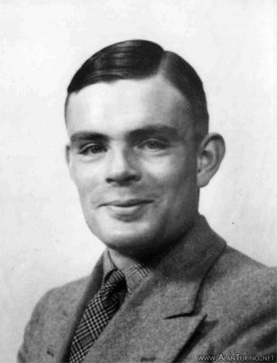
Turing machine - background
Mathematician Alan Turing was interested in defining computability, or what is mathematically computable
A Turing machine is a theoretical machine, rather than a physical object, thought up by Turing in 1936
  It can carry out ANY computer algorithm, no matter how complex

Slide 4
What is a Turing machine?
a Turing machine can be viewed as a computer with a single fixed program, expressed using:
  a finite set of states in a state transition diagram
  a finite alphabet of symbols
  an infinite tape with marked off squares
  a sensing read-write head that can travel along the tape, one square at a time

Slide 5
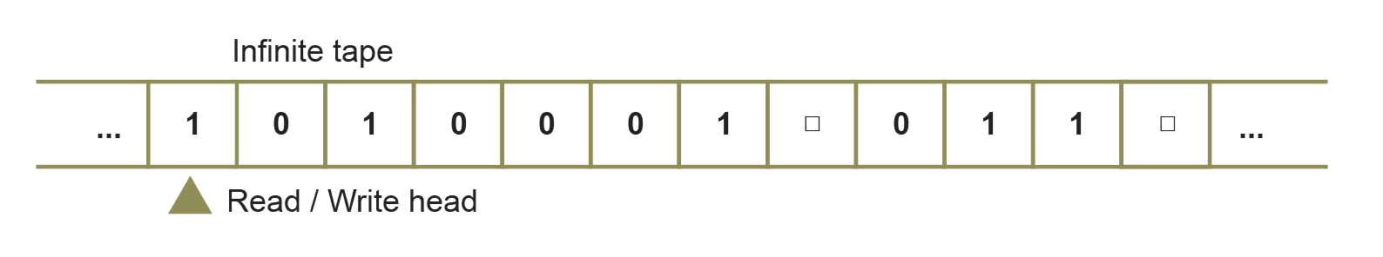
The Turing machine
A Turing Machine consists of two parts: the tape that the machine can read and write, and the controller (the program) determines what happens at each cell
  It has a read-write head that can read symbols from the tape
  The tape is infinitely long, with marked-off squares

Slide 6
The Turing machine
The machine must have a start state and at least one state, the halting state, that causes it to halt for some inputs
Any alphabet of symbols may be used but we will generally use only a binary alphabet of 0, 1 and (representing a blank)

Slide 7
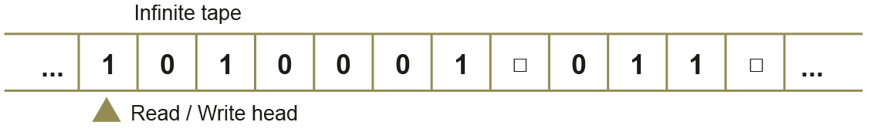
The controller – an FSM
The “controller” is a finite state machine which tells the machine what to do next
In any one transition, the machine can:
  Read the symbol on the tape
  Erase or write a new symbol on the tape
  Move the head left or right by a single space

Slide 8
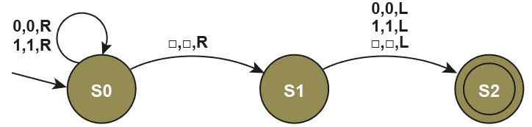
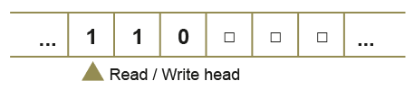
So, how does it work?
Below is a state transition diagram.
Transitions on this FSM have three parameters:
  Input, output, head movement
With an input string of 110 , the tape starts off like this:
S0

Slide 9
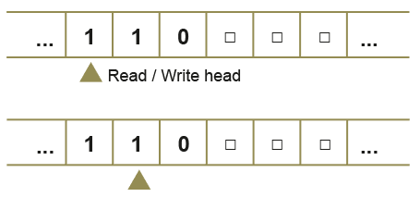
A kinaesthetic activity
Use the cards to move the read-write head and change state and symbols on the tape
  What state do you end up in, and where is the read-write head?
S0
S0

Slide 10
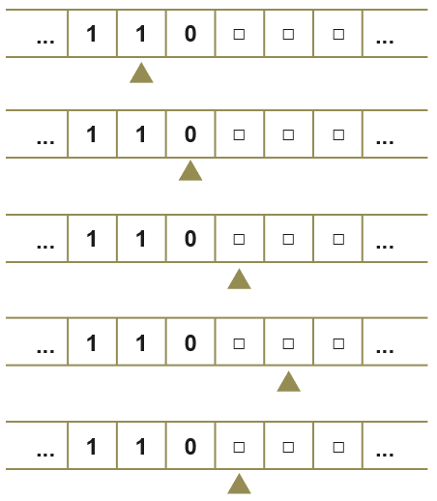
Turing machine
This machine is designed to find the first blank cell on the tape to the right of the current position of the read-write head
S0
S0
S0
S1
S2

Slide 11
Worksheet
Complete Task 1 on the worksheet

Slide 12
Transition function
A transition function is a way to represent the transition arc between two states on a state transition diagram
The symbol δ is the lower case Greek letter delta
  It means a small change
Each transition arc on a state transition diagram can be represented by the δ function using a pattern:
  δ (Current state, Input symbol) = (Next state, Output symbol, Head move)

Slide 13
δ function - interpretation
Pattern
  δ (Current state, Input symbol) = (Next state, output symbol, Head move)
δ (S0, 1) = (S1, 0, L)
  “If the machine is currently in state S0 and the symbol 1 is read from the tape, then transition to state S1, write 0 on the tape, and move head left.”
Interpret the following δ function:
  δ (S7, 1) = (S3, 1, R)

Slide 14
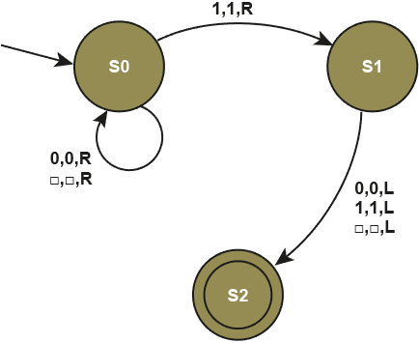
Exercise
Write the transition functions for this Turing machine
  δ (Current state, Input symbol) = (Next state, output symbol, Head move)
δ (S0, 0) = (S0, 0, R)

Slide 15
Exercise Answer
Write the transition functions for this Turing machine
  δ (Current state, Input symbol) = (Next state, output symbol, Head move)
δ (S0, 0) = (S0, 0, R)
δ (S0, 1) = (S1, 1, R)
δ (S0, ) = (S0, , R)
δ (S1, 0) = (S2, 0, L)
δ (S1, 1) = (S2, 1, L)
δ (S1, ) = (S2, , L)

Slide 16
Worksheet
Complete Task 2 on the worksheet

Slide 17
The importance of the TM
It provides a definition of what is computable
It can be proven mathematically that a Turing Machine is capable of computing anything that is computable
  The mathematical definition of a Turing machine defines what is computable

Slide 18
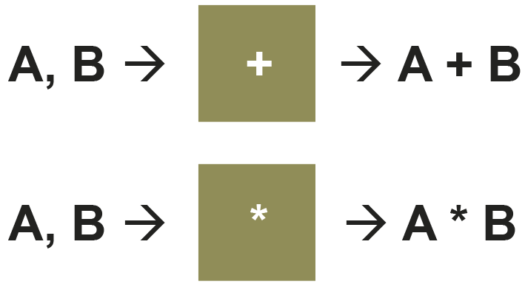
How many Turing machines?
A Turing machine:
  is a general model of computation
  can be defined to represent any computation
However, a different Turing machine would be needed for each individual operation
Turing came up with the idea of a Universal Turing Machine (UTM)

Slide 19
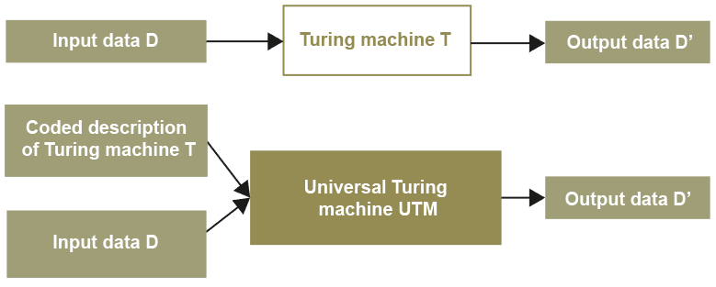
Universal Turing Machine
The Universal Turing Machine reads from the tape:
  the definition of a Turing machine T (i.e. the program)
  the input data D
In this way, the Universal Turing Machine simulates the behaviour of any Turing machine

Slide 20
The stored program computer
The Universal Turing Machine was the breakthrough that led to the idea of the stored program computer
John von Neumann designed a computer in which both the program and its data were stored in memory
A computer based on von Neumann’s design was built in the 1940s
Most computers today are still based on this model

Slide 21
The importance of the UTM
The theory of the Universal Turing Machine is very important to the subject of computation
It provides a definition of what is computable
It can be proven mathematically that a Universal Turing Machine is capable of computing anything that is computable

Slide 22
Worksheet – Extension
If time permits, complete Extension Task 3 on the worksheet

Slide 23
Plenary
State the four components that are used to express a Turing machine
Describe a state transition diagram
Describe the relationship between a transition function and a state transition diagram
Explain the impact of the Turing machine on the subject of computation
Explain why a Universal Turing machine can be considered an interpreter

