Slide 1
AQA
    A Level
      Computer Science
      Paper 1
Backus-Naur Form
  Unit 9
  Regular languages

Slide 2
Objectives
Use Backus-Naur Form (BNF) to represent language syntax and formulate simple production rules
Explain why BNF can represent some languages that cannot be represented using Regular Expressions
Draw a syntax diagram to represent an equivalent BNF expression

Slide 3
Starter
Which of the following are English sentences?
  Mice eat cheese
  Birds sing songs
  Mice sing cheese
  Birds eat songs
  Birds sing birds

Slide 4
Starter
Here are some definitions:
  noun = mice or birds or cheese or songs
  verb = eat or sing
  sentence = noun, followed by verb, followed by noun
Which of the following are sentences?
  Mice eat cheese
  Birds sing songs
  Mice sing cheese
  Birds eat songs
  Birds sing birds

Slide 5
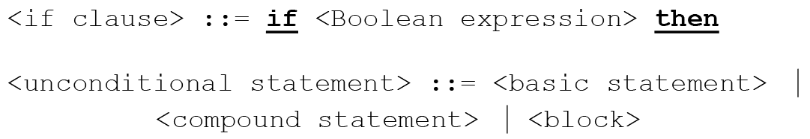
What is Backus-Naur Form?
Backus-Naur Form (BNF) is a formal notation used to describe the syntax rules of a language
It’s a meta-language: a language that describes a language
  First developed by John Backus (1959)
  Augmented by Peter Naur (1960)

Slide 6
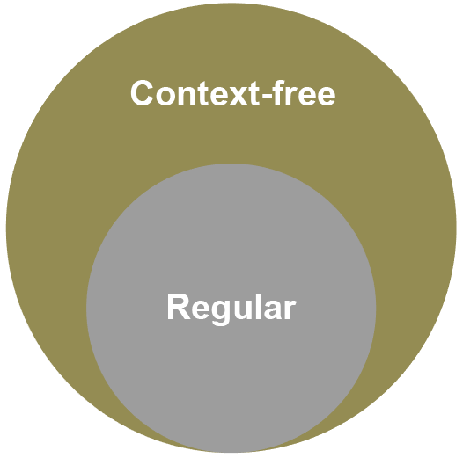
Why do we need BNF?
Regular languages are expressible by regular expressions
Some languages cannot be expressed by a regular expression
The class of languages
called context-free languages
is more expressive than
regular languages
BNF is a way to define these
context-free languages

Slide 7
BNF vs regular expressions
Regular expressions can be used to describe simple “languages” and to match patterns in text
It would be possible, but time-consuming, to define a valid identifier in a given programming language using a regular expression
However, some programming constructs involving, for example, nested brackets, cannot be defined in this way
Can the language defined by {a^{n}b^{n}| n ≥ 0} be represented as a regular expression?

Slide 8
The language {a^{n}b^{n}| n ≥ 0}
The language which allows only words in this set includes 11, 1b, b1, ab, aabb, aaabbb….
  (If you are a mathematician you will know that anything to the power 0 equals 1)
  Can you state some other items in this set?
It is not possible to represent this as a regular expression
What language is represented by a⁺b⁺ ?
What language is represented by (ab)⁺?

Slide 9
BNF vs regular expressions
Because not every “language” or pattern can be represented as a regular expression, meta-languages such as BNF have been devised
Also, many constructs that could be written using a regular expression can be expressed more succinctly using BNF

Slide 10
BNF meta-symbols
Symbol | Meaning
::= | Is defined as
| | Or
< > | Surrounds category names
Side by side | Items must follow exactly
Terminal symbols | Cannot be further broken down
Non-terminal symbols | Can be further broken down
<digit> ::= 0|1|2|3|4|5|6|7|8|9
<upper> ::= a|b|C|D|E|F|G|H|I|J|K|L|M|N|O|p|q|r|s|t|u|v|W|x|y|z
<postcode> ::= <upper><upper><digit><digit>
Identify some strings which fit this simplified definition of a postcode

Slide 11
“Or” – Don’t get confused
Identify the behaviour of the | symbol in this rule:
<code> ::= <digit><upper>|<lower><digit>
  7A, 3Q, b9, k7, m3, 3A4, 8b4, f89
In this notation, | means OR
Now look at this rule:
<code> ::= <upper><digit><digit>|<lower><digit>
Which are valid and which are not valid?
  A38, R8a4, B73, X3a9, a2, 7a2, k4

Slide 12

Language representations
Why do we need BNF to represent a programming language?

Slide 13

Language representations
An instruction for a computer must not be ambiguous in any way
  A programming language
  requires strict and precise rules
  That is why we have not yet
  been successful at natural
  language processing
  BNF can be used by compiler
  writers to represent the
  precise syntax of a
  programming language

Slide 14
Back to context-free languages
A context-free language can be defined by BNF when a single non-terminal symbol on the left can always be replaced by the definition on the right
  That’s just a fancy way of saying that the context of the
  non-terminal symbol does not influence its interpretation
There is no ambiguity in the definition
  Remember that a “non-terminal” symbol is something like “postcode”, “car registration number” or “variable name” which can be broken down further
  A non-zero digit can be defined as 1|2|3|4|5|6|7|8|9 and this is a “terminal” symbol

Slide 15
Production rules
Each individual BNF statement is called a ‘production rule’
Write production rules for digit, uppercase letter, lowercase letter and space
Write a production rule for letter by combining rules

Slide 16
Production rules Answer
Each individual BNF statement is called a
‘production rule’
Write production rules for digit, uppercase letter, lowercase letter and space
Write a production rule for letter by combining rules
  <digit> ::= 0|1|2|3|4|5|6|7|8|9
  <upper> ::= a|b|C|D|E|F|G|H|I|J|K|L|M|N|O|P|Q|R|s|t|u|v|w|x|y|z
  <lower > ::= a|b|c|d|e|f|g|h|i|j|k|l|m|n|o|p|q|r|s|t|u|v|w|x|y|z
  <space> ::= ‘ ’
  <letter> ::= <upper> | <lower>

Slide 17
Production rules
Write a production rule for simple postcodes, such as BH4 3LH
To make things simple, we will assume that postcodes always have two uppercase letters, followed by a digit, then a space, one digit and two uppercase letters
The two parts of the postcode must be separated by a space
  Consider making another rule for “part1 and part2”
  What other rule(s) might you have?

Slide 18
Postcode
Straightforward production rules
  <digit> ::= 0|1|2|3|4|5|6|7|8|9
  <upper> ::= A|B|C|D|E|F|G|H|I|J|K|L|M|N|O|P|Q|R|S|T|U|V|W|X|Y|Z
  <space> ::= ‘ ’
  Combining rules
  <twoLetters> ::= <upper> <upper>
  <part1> ::= <twoLetters><digit>
  <part2>::= <digit><twoLetters>
Final production rule for simplified UK postcode
  <postcode> ::= <part1><space><part2>

Slide 19
Worksheet
Complete Task 1 on the worksheet

Slide 20
Recursive production rules
A recursive rule is defined in terms of itself
Here are production rules for an unsigned integer:
  <digit> ::= 0|1|2|3|4|5|6|7|8|9
  <unsigned> ::= <digit>|<digit><unsigned>
Show that 321 satisfies the rule for <unsigned>…
  1 is a <digit> and therefore an <unsigned>
  21 is a <digit> followed by an <unsigned>, and therefore an <unsigned>
  321 is a <digit> followed by an <unsigned> and therefore an <unsigned> !

Slide 21

Why use recursive rules?
Using recursion allows a set of production rules to be extremely concise while allowing an infinite number of items to be precisely defined

Slide 22
Exercise – Variable name
In a certain programming language, a variable name may contain lowercase letters, uppercase letters, digits and the underscore ‘_’.
  The first letter MUST be upper case.
  The variable name can be of any length
Examples of valid variable names:
  C, Count, Count123, Count_123, C_123, CoUnT_98
Write the production rules to define a valid
variable name

Slide 23
Valid variable name Answer
First of all, we need the following rules to define the terminal symbols used in a valid variable name:
  <digit> ::= 0|1|2|3|4|5|6|7|8|9
  <upper> ::= A|B|C|D|E|F|G|H|I|J|K|L|M|N|O|P|Q|R|S|T|U|V|W|X|Y|Z
  <lower> ::= a|b|c|d|e|f|g|h|i|j|k|l|m|n|o|p|q|r|s|t|u|v|w|x|y|z
  <under> ::= ‘_‘
Write 3 more rules (1 recursive) to define <variable>

Slide 24
Variable names Answer
  <digit> ::= 0|1|2|3|4|5|6|7|8|9
  <upper> ::= A|B|C|D|E|F|G|H|I|J|K|L|M|N|O|P|Q|R|S|T|U|V|W|X|Y|Z
  <lower> ::= a|b|c|d|e|f|g|h|i|j|k|l|m|n|o|p|q|r|s|t|u|v|w|x|y|z
  <under> ::= ‘_‘
<char> ::= <lower>|<upper>|<digit>|<under>
<chars> ::= <char>|<char><chars>
<variable> ::= <upper>|<upper><chars>
How does this BNF keep ‘_ABC’ from being included?

Slide 25
Worksheet
Complete Task 2 on the worksheet

Slide 26
Production rules
Here is the BNF for arithmetic expressions in some language
  <expression> ::= <digit>|(<expression><operator><expression>)
  <digit> ::= 0|1|2|3|4|5|6|7|8|9
  <operator> ::= + | -
Each of these individual rules is known as a production
Which of these expressions are valid?
7 7+3 45 -2 (5-3) 7-(6+8) ((5-3)+4)

Slide 27
Production rules Answers
  <expression> ::= <digit> |(<expression><operator><expression>)
  <digit> ::= 0|1|2|3|4|5|6|7|8|9
  <operator> ::= + | -
7 ✓ 7+3 ✗ 45 ✗ -2 ✗ (5-3) ✓ 7-(6+8) ✗
((5-3)+4) ✓
  7 is a digit, therefore an expression
  7 is a digit, + is an operator, 3 is a digit, but 7+3 is not a valid expression because it is missing the brackets
  Can you give reasons why the others are valid or not?

Slide 28
Parsing
The act of parsing is checking an input string against the set of BNF rules to see if it is valid
When a compiler or interpreter encounters an input like (8-(6+4)), it validates the input by building a tree according to the BNF rules

Slide 29
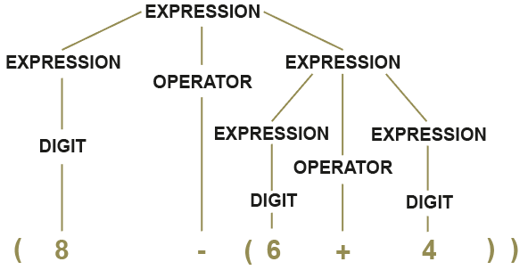
Parse tree
  <expression> ::= <digit> | (<expression><operator><expression>)
  <digit> ::= 0|1|2|3|4|5|6|7|8|9
  <operator> ::= + | -
Parse tree for (8-(6+4))

Slide 30


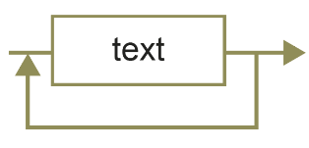
Syntax diagram - definition
Another way to represent context-free languages
It is the graphical equivalent of BNF
The symbols are:
  Ellipse / circle = a terminal symbol (cannot be further broken down
  Rectangle = a non-terminal symbol, which will be defined in another syntax diagram
  Non-terminal element that may be used more than once

Slide 31
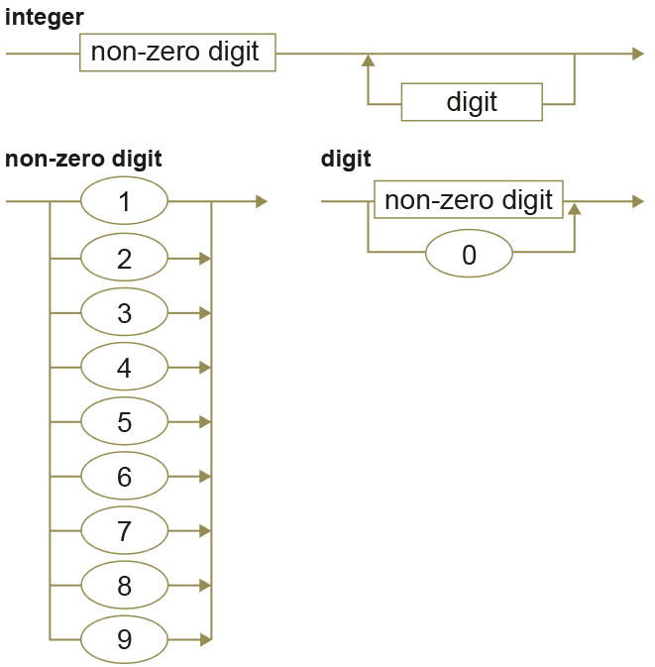
Syntax diagram – Example
The syntax diagram representing a positive integer is as follows:
Which of the following
are valid integers?
  56
  012
  -8
  0
  5,789
  7054033

Slide 32
Example
<digit> and <letter> have been defined to represent a digit from 0-9 and a letter from A-Z respectively
The + sign may also be used
value and sum are defined as follows:
  <sum> ::= <term>+<term>| <sum>+<term>
  <term> ::= <value> | letter>
  <value> ::= <digit> | <value><digit>
  Complete the table to show
  whether each expression is a digit,
  value, term, sum or not defined
expression | Digit, value, sum, term or not defined
1234
0 + A
8+1+6
XY
01
X+Y+3+1

Slide 33
Example Answer
<digit> and <letter> have been defined to represent a digit from 0-9 and a letter from A-Z respectively
The + sign may also be used
value and sum are defined as follows:
  <sum> ::= <term>+<term>| <sum>+<term>
  <term> ::= <value> | letter>
  <value> ::= <digit> | <digit><value>
  Complete the table to show
  whether each expression is a digit,
  value, term, sum or not defined
expression | Digit, value, sum, term or not defined
1234 | value, term
0 + A | sum
8+1+6 | sum
XY | not defined
01 | value, term
X+Y+3+1 | sum

Slide 34
Syntax diagram
Now draw the syntax diagram that is equivalent to the following BNF productions
  <sum> ::= <term>+<term>| <sum>+<term>
  <term> ::= <value> | letter>
  <value> ::= <digit> | <value><digit>

Slide 35
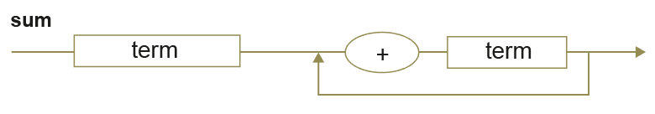
Syntax diagram (Partial answer)
  <sum> ::= <term>+<term>| <sum>+<term>
  <term> ::= <value> | letter>
  <value> ::= <digit> | <value><digit>
Identify a terminal symbol
Note: A full answer would need to include syntax diagrams for term and value and diagrams for letter and digit

Slide 36
Worksheet
Complete Task 3 on the worksheet

Slide 37
Plenary
What methods may be used to represent regular languages?
What methods may be used to represent context-free languages?
Give a description of Backus-Naur Form (BNF)
Why do we need these representations in Computing?

