Slide 1
AQA
A Level
Computer Science
Paper 1
Reverse Polish Notation
Unit 9
Regular languages

Slide 2
Objectives
Convert simple expressions in infix form to Reverse Polish Notation (RPN) and vice versa
Be aware of why and where RPN is used

Slide 3
Starter
Here are three different ways to write an arithmetic expression that adds b and c, then multiplies by a, then divides by d
They are mixed up. Can you spot which name describes each expression?
Prefix a * (b + c) / d
Infix a b c + * d /
Postfix / * a + b c d

Slide 4
Starter – Answer
Can you spot which name describes each expression?
What do you notice about the position of the operators in relationship to the operands?
What does the infix version use that neither of the others use?
Prefix / * a + b c d
Infix a * (b + c) / d
Postfix a b c + * d /

Slide 5
Terminology
Term | Description | Comment
Infix | The operator comes between the operands a * (b + c) / d | This is the notation used in the mathematics you’ve encountered before
Prefix (Polish Notation) | The operator comes before the operands / * a + b c d | This was invented in 1924 by Polish mathematician Jan Łukasiewicz
Postfix (Reverse Polish Notation) | The operator comes after the operands a b c + * d / | During the 1950s, Reverse Polish was devised as a way to do mathematics without braces. The system is used extensively in computer algorithms because evaluation can be done using a stack

Slide 6
RPN – Why use it?
Eliminates the need for brackets in sub-expressions as the order of evaluation is unambiguous
The algorithm for evaluating postfix expressions is simpler than for infix expressions
The resulting expressions can be evaluated using a stack (more later)

Slide 7
Order of precedence
In order to do arithmetic, rules need to be applied concerning which operators should be done first
Highest Precedence
~ | (Unary minus; negative; ~4 + 1 = 3)
^ | (Exponentiation; 3^2 means 3²)
* /
+ -
=
Lowest Precedence

Slide 8
Precedence – Exercise
Insert braces to show the order in which each calculation would be carried out
8 * 7 + 6 / 3^2 ==
1 + 3 * 6 / 3^2 ==
3 * ~2 / ~12 + 4 ==

Slide 9
Precedence – Answer
Insert braces to show the order in which each calculation would be carried out
8 * 7 + 6 / 3^2 == (8 * 7) + (6 / (3^2))
1 + 3 * 6 / 3^2 == 1 + ((3 * 6) / (3 ^ 2))
3 * ~2 / ~12 + 4 == (3 * (~2 /~12)) + 4

Slide 10
Conversion
We only need concern ourselves with infix and postfix (Reverse Polish Notation) conversions
Methods for converting infix to RPN
Translation by numbering
Translation by bracketing
Translation by binary tree
Methods for converting RPN to infix
Translation by scanning
Translation by bracketing

Slide 11
Translation by numbering
This algorithm works by numbering operands and operators
Starting from the left, allocate numbers 1, 2, 3… to operators and operands as follows:
Ignore brackets except in so far as they affect the order of calculation
If the token is an operand, allocate the next number
If it is an operator, move to the next operand
a * ( b + c )
1 2 3

Slide 12
Translation by numbering
Keep on numbering operands and operators
If it is an operator, and enough operands are available, then back up and number the operator, otherwise advance to next token
Keep order of precedence in mind, as it might require some reading ahead
a * ( b + c )
1 2 3
1 2 4 3

Slide 13
Translation by numbering
The multiplication will be the last operator in this postfix expression…
Back up to the final operator and allocate it the next number, 5
a * ( b + c )
1 2 3
1 5 2 4 3

Slide 14
Translation by numbering
All done!
When finished, write down the tokens in numerical order
a * ( b + c )
1 2 3
1 5 2 4 3
a b c + *

Slide 15
Try this one!
Start on left, with the number 1
If the token is an operand, allocate the next number
Ignore brackets except in so far as they affect the order of calculation
If it is an operator, and enough operands are available, then back up and number the operator, otherwise advance to next token
Keep order of precedence in mind, as it might require some reading ahead
When finished, write down the tokens in numerical order
a * ( b + c ) / d

Slide 16
Answer
Start on left, with the number 1
If the token is an operand, allocate the next number
Ignore brackets except in so far as they affect the order of calculation
If it is an operator, and enough operands are available, then back up and number the operator, otherwise advance to next token
Keep order of precedence in mind, as it might require some reading ahead
When finished, write down the tokens in numerical order
a * ( b + c ) / d
1 2 3
1 2 4 3
1 5 2 4 3
1 5 2 4 3 6
1 5 2 4 3 7 6
a b c + * d /

Slide 17
Numbering – Exercise
Convert to Reverse Polish Notation by numbering
4 / 2 + 8 * 4 – ( 5 + 2 )

Slide 18
Numbering – Answer
Convert to Reverse Polish Notation by numbering
4 / 2 + 8 * 4 – ( 5 + 2 )
1 2
1 3 2 4 5
1 3 2 7 4 6 5 8 9
1 3 2 7 4 6 5 8 10 9
1 3 2 7 4 6 5 11 8 10 9
4 2 / 8 4 * + 5 2 + -

Slide 19
Translation by bracketing
This method works by fully bracketing the expression and rearranging the operators inside the brackets
Add brackets to make explicit the order of precedence, including exponentiation
Move the operator in each set of brackets to the end position
Remove all the brackets
(Where operators are of equal precedence, brackets are added to enforce left to right processing)
a * ( b + c ) / d
( ( a * ( b + c ) ) / d )
( ( a * ( b c + ) ) / d )
( ( a ( b c + ) * ) / d )
( ( a ( b c + ) * ) d / )
a b c + * d /
a b c + * d /

Slide 20
Bracketing – Exercise
Convert to Reverse Polish Notation by bracketing
4 + 3 * 7 – 5 / 3 + 2 ^ 3 + 6

Slide 21
Bracketing – Answer
Convert to Reverse Polish Notation by bracketing
4 + 3 * 7 – 5 / 3 + 2 ^ 3 + 6
4 + 3 * 7 – 5 / 3 + 2 ^ 3 + 6
( ( ( ( 4 + ( 3 * 7 ) ) – ( 5 / 3 ) ) + ( 2 ^ 3 ) ) + 6 )
( ( ( ( 4 + ( 3 7 * ) ) – ( 5 3 / ) ) + ( 2 3 ^ ) ) + 6 )
( ( ( ( 4 ( 3 7 * ) + ) – ( 5 3 / ) ) + ( 2 3 ^ ) ) + 6 )
( ( ( ( 4 ( 3 7 * ) + ) ( 5 3 / ) - ) + ( 2 3 ^ ) ) + 6 )
( ( ( ( 4 ( 3 7 * ) + ) ( 5 3 / ) - ) ( 2 3 ^ ) + ) + 6 )
( ( ( ( 4 ( 3 7 * ) + ) ( 5 3 / ) - ) ( 2 3 ^ ) + ) 6 + )
4 3 7 * + 5 3 / - 2 3 ^ + 6 +

Slide 22
Checking your answer
Put brackets in to fully enforce precedence
Rearrange operators in brackets
If desired, brackets can be removed if they do not override precedence rules
a b c + * d /
((a (b c +) *) d /)
((a * (b + c)) / d)
a * (b + c) / d

Slide 23
Worksheet
Complete Task 1 on the worksheet

Slide 24
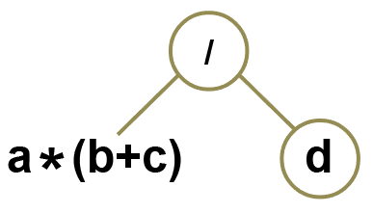
Translation by binary tree
This method works by building a binary tree from the infix expression and then traversing it using a post-order traversal algorithm. e.g. a * (b + c) / d
Decompose operands into two child nodes; pay attention to precedence and brackets
Choose the highest precedence operator not embedded in parentheses, as the root
/ has been chosen as the root in the tree below, but you could equally well choose * as it has equal precedence

Slide 25
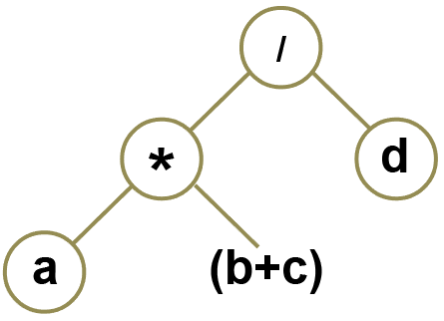
Translation by binary tree
This method works by building a binary tree from the infix expression and then traversing it using a post-order traversal algorithm. e.g. a * (b + c) / d
Decompose operands into two child nodes; pay attention to precedence and brackets
Repeat these two steps until you have a tree

Slide 26
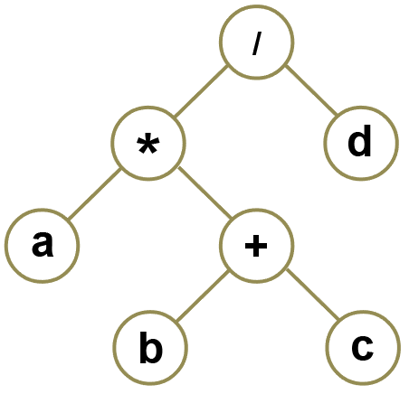
Translation by binary tree
This method works by building a binary tree from the infix expression and then traversing it using a post-order traversal algorithm. e.g. a * (b + c) / d
Decompose operands into two child nodes; pay attention to precedence and brackets
Repeat these two steps until you have a tree

Slide 27
Post-order traversal
Perform a post-order traversal of the tree to derive the post-order expression:
a b c + * d /

Slide 28
Binary tree – Exercise
Convert to Reverse Polish Notation by binary tree
w ^ x + z – x / w

Slide 29
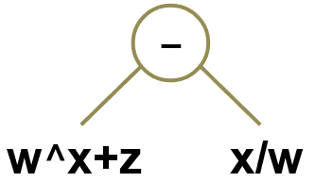
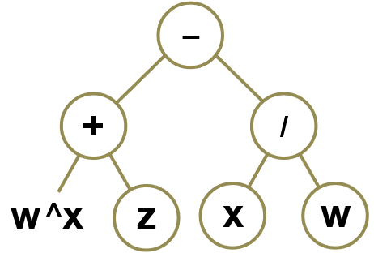
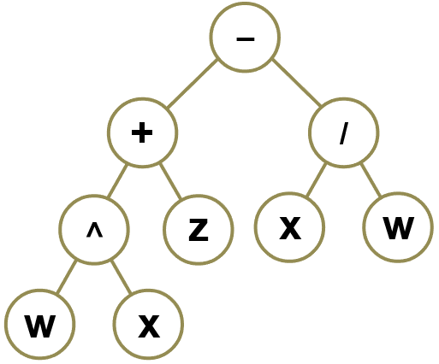
Binary tree – Answer
Convert to Reverse Polish Notation by binary tree
w ^ x + z – x / w
The RPN expression is w x ^ z + x w / -

Slide 30
Worksheet
Complete Task 2 on the worksheet

Slide 31
RPN to infix – Scanning
This method works by scanning left to right, picking out pairs of operands and single operators
Scan right, writing down operands
If you find an operator, insert it between the operands it applies to
Add brackets to make clear which operands the operator applies to
 | a b c + * d /
a b c | a b c + * d /
a (b + c) | a b c + * d /
(a * (b + c)) | a b c + * d /
(a * (b + c)) d | a b c + * d /
(a * (b + c)) / d

Slide 32
Scanning – Exercise
Convert RPN to infix by scanning
b a c * + b a c * / -

Slide 33
Scanning – Answer
Convert RPN to infix by scanning
b a c * + b a c * / -
 | b a c * + b a c * / -
b a c | b a c * + b a c * / -
b (a * c) | b a c * + b a c * / -
(b + (a * c)) | b a c * + b a c * / -
(b + (a * c)) b (a * c) | b a c * + b a c * / -
(b + (a * c)) (b / (a * c)) | b a c * + b a c * / -
(b + (a * c)) - (b / (a * c))

Slide 34
RPN to infix – bracketing
This method works by adding brackets to enforce order of execution, then moving operators between operands
Insert brackets as indicated by operators
Move operators between closest operands
Remove excess brackets
a b c + * d /
a (b c +) * d /
(a (b c +) *) d /
((a (b c +) *) d /)
((a (b + c) *) d /)
((a * (b + c)) d /)
((a * (b + c)) / d)
a * (b + c) / d

Slide 35
Bracketing – Exercise
Convert RPN to infix by bracketing
45 96 3 / - 2 3 ^ +

Slide 36
Bracketing – Answer
Convert RPN to infix by bracketing
45 96 3 / - 2 3 ^ +
Note: order of precedence means all brackets can be removed
45 96 3 / - 2 3 ^ +
45 96 3 / - 2 3 ^ +
45 (96 3 /) - 2 3 ^ +
(45 (96 3 /) -) 2 3 ^ +
(45 (96 3 /) -) (2 3 ^) +
((45 (96 3 /) -) (2 3 ^) +)
((45 - (96 / 3)) + (2 ^ 3))
45 - 96 / 3 + 2 ^ 3

Slide 37
Worksheet
Complete Task 3 on the worksheet

Slide 38
RPN Evaluation
Given an RPN expression, an algorithm can be used to evaluate it to produce a result
This algorithm makes use of a stack
Recall operations on a stack
Push
Pop

Slide 39
RPN evaluation – Stack
This method works pushing and popping operands in response to operators
If the token is an operand, push it on the stack
If the token is operator, pop required number of operands from stack; perform the operation; push the result
Note: when popping operands, pop right operand first and left operand second

Slide 40
RPN evaluation – Stack
This method works pushing and popping operands in response to operators
Evaluate 6 2 1 + * 9 /
Stack | Pop, execute, push | 6 2 1 + * 9 /
1 2 6 | 3 = 2 + 1 | 6 2 1 + * 9 /
3 6 | 18 = 6 * 3 | 6 2 1 + * 9 /
18 |  | 6 2 1 + * 9 /
9 18 | 2 = 18 / 9 | 6 2 1 + * 9 /
2

Slide 41
RPN evaluation – Exercise
Evaluate RPN by using a stack: 5 3 ~ * 4 2 / -
Stack | Pop, execute, push | 5 3 ~ * 4 2 / -

Slide 42
RPN evaluation – Exercise
Evaluate RPN by using a stack: 5 3 ~ * 4 2 / -
Stack | Pop, execute, push | 5 3 ~ * 4 2 / -
3 5 | ~3 | 5 3 ~ * 4 2 / -
~3 5 | ~15 = 5 * (~3) | 5 3 ~ * 4 2 / -

Slide 43
RPN evaluation – Exercise
Evaluate RPN by using a stack: 5 3 ~ * 4 2 / -
Stack | Pop, execute, push | 5 3 ~ * 4 2 / -
3 5 | ~3 | 5 3 ~ * 4 2 / -
~3 5 | ~15 = 5 * (~3) | 5 3 ~ * 4 2 / -
~15 |  | 5 3 ~ * 4 2 / -
2 4 ~15 | 2 = 4 / 2 | 5 3 ~ * 4 2 / -
2 ~15 | ~17 = ~15 - 2 | 5 3 ~ * 4 2 / -
~17

Slide 44
Worksheet
Complete Task 4 on the worksheet

Slide 45
Plenary
Convert RPN to infix
b f ^ 3 * e +
Convert infix to RPN
7 * ~4 + 3
Evaluate RPN, showing stack
3 4 * 12 6 / +
Build a binary tree
4 * 3 + 7 * 2
Show prefix (Polish Notation) equivalent
Show postfix (Reverse Polish Notation) equivalent

