Slide 1
3.1.3.1: Coasts as natural systems
Learning Objectives
To be able to define what is meant by ‘the coast’ and the different coastal zones
To be able to explain how the coast is a system with inputs, outputs, stores/components, flows/transfers, positive and negative feedback and dynamic equilibrium
The concepts of landforms and landscape and how these related landforms combine to form characteristic landscapes
Key words:
Inputs
Outputs
Energy
Stores / components
Flows / transfers
Positive . Negative feedback
Dynamic equilibrium
Landscape
Landforms
Concept Checker:
Can you name the different zones and the role they play?
Can you identify different inputs, processes, stores and outputs within a coastal system
Can you define and give examples of positive and negative feedback systems
What is the difference between landscape and landform?

Slide 2
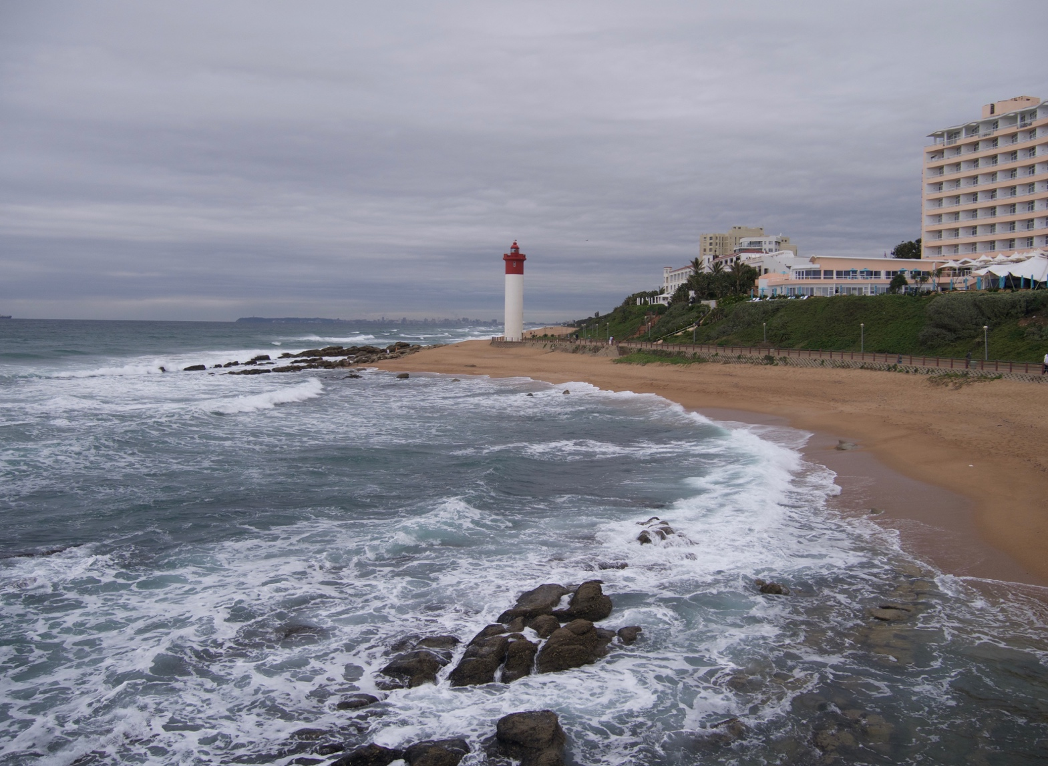
3.1.3 COASTAL SYSTEMS AND LANDSCAPES
A focus on coastal zones which are dynamic environments in which landscapes develop via coastal and geomorphological processes

Slide 3
The Coast (definition):
“Is a narrow zone where the land and the sea overlap and directly interact. Its development is affected by terrestrial, atmospheric, marine and human processes and their interrelationships. The coast is the most varied and rapidly changing of all landforms and ecosystems.”
50% of the worlds population live on coastal plains and in other locations with easy access to the sea. 10% live actually along the coast.
The littoral zone (coastal zone) is a constantly changing environment. There are many processes happening creating new landforms and landscapes.
https://www.youtube.com/watch?v=Bh2fyeLKdsM

Slide 4


Think of any experience you have of the coast – land or sea.
Do you have a memorable experience at the coast, or a favourite place to visit?

Slide 5
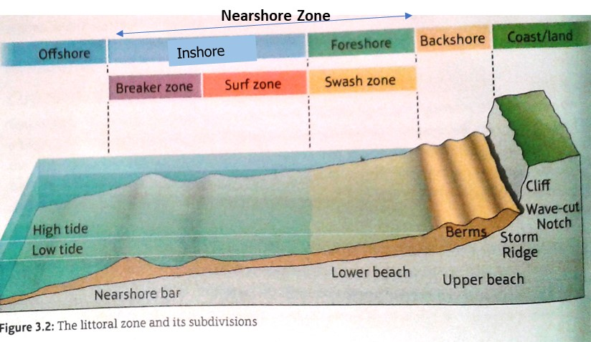
The littoral (coastal) zone
The boundary between the land and sea. This is a very dynamic zone which means that it is constantly changing. Different zones exist and are labelled here:
Most important zone for marine processes in times that are not influenced by storm activity
Only affected by waves during exceptionally high tides and major storms
Waves cease to impact upon the seabed. Activity is limited to deposition of sediments.
Waves cease to have any influence on the land beneath them
LWM
HWM

Slide 6
Backshore Zone – above high tide level and only affected by waves during exceptionally high tides and major storms
Foreshore Zone – lies between the HWM and the LWM. It is the most important zone for marine processes in times that are not influenced by storm activity
Inshore Zone – the area between the LWM and the points where waves cease to have any influence on the land beneath them
Offshore Zone – the area beyond the point where waves cease to impact upon the seabed and in which activity is limited to deposition of sediments.
Nearshore Zone – the area extending seaward from the HWM to the area where waves begin to break. It includes the swash zone, surf zone and breaker zone

Slide 7
The coast as a natural system
What is a ‘system’ in Geography

Slide 8
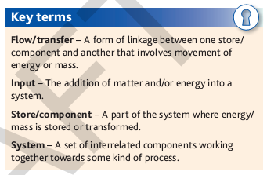
SYSTEMS APPROACH IN GEOGRAPHY
The idea of systems is a way of thinking used by geographers and scientists to simplify and help make sense of a complex world. It is one of the key A level concepts
What is a system?
  A system has a structure: It has inputs (of material and energy) – components (stores) – flows (processes) – outputs (of material and energy).
Where have you come across a systems approach in your studies at KS3 and KS4?
https://www.youtube.com/watch?v=T0XEipEdgN8 –systems (up to 1.45)

Slide 9
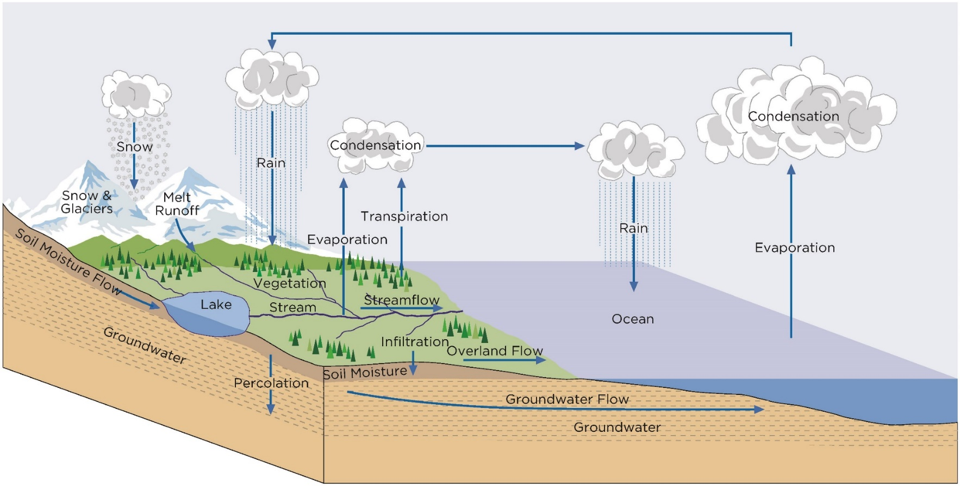
The global water cycle – closed system
Activity
A ‘system’ is - a series of interacting components (stores) linked by flows (or transfers and processes) of material and energy entering and leaving the systems as inputs and outputs
Can you name any stores?
Can you name processes?
Notes:
Diagram: KnowHow: Rivers and the water cycle (2019) Ben Steel and Richard Bustin. Geographical Association: Sheffield

Slide 10
Closed and Open Systems
Systems have boundaries: the boundary of the global hydrological system is the upper atmosphere.
This is a closed system. Energy comes from the sun, and is irradiated back from Earth, crossing its boundary, but other material does not, (apart from meteorites).
HOWEVER, many natural systems are open systems – drainage basins are an example. They have inputs and outputs of both energy (from the sun and gravity) and material (water and sediments).
Open systems are linked with other systems. There is a diagram of an open system on the next slide.

Slide 11
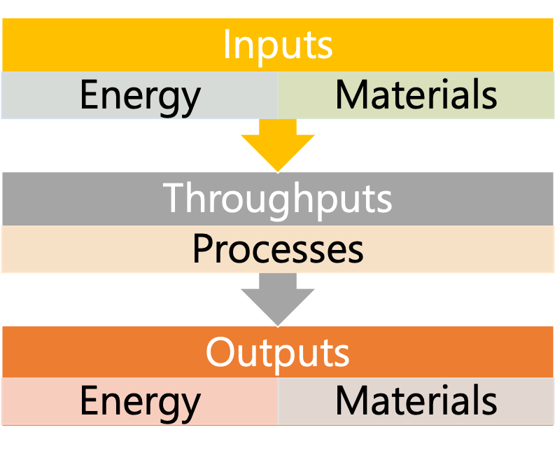
Natural systems have inputs, throughputs and outputs
System boundary
Open systems are linked with other systems - the coast has important links with other natural systems such as the atmosphere (consider the importance of wind in generating waves), tectonics and ecosystems.

Slide 12
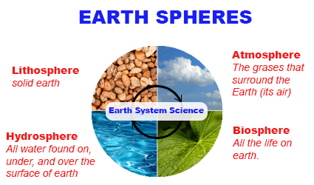
Systems approach in geography
In geography a systems approach helps us to understand the physical and human world around us. It enables us to see the whole picture. We can apply this approach to physical systems such as drainage basins or to human systems such as operations on a farm or in industry.
A systems approach helps us to understand how energy is transferred between the components of a system and how these components themselves can change. This approach also helps us to appreciate how both natural change and human activities can impact upon an environment.
The 4 major subsystems of the earth are interlinked with flows and transfers.
E.g. water erosion by rivers or sea, or wind erosion acting on the lithosphere (rocks), biological weathering of rocks

Slide 13
The Coast as a Natural System
The Coast = The part of the land near the sea; the edge of the land
The coastline is regarded as an open system with inputs, processes and outputs; interacts with surroundings. For example, waves arriving on the South West coast of Britain are generated by wind blowing from across the Atlantic Ocean thousands of miles away.
(A closed system is one that does NOT interact with its surroundings)
Geography is a bit like learning a new language; there are MANY new terms to learn.
Start a keyword section in your file or get some record cards and keep them all together.

Slide 14
The coast is an open system
System boundary
Open systems are linked with other systems - the coast has important links with other natural systems such as the atmosphere (consider the importance of wind in generating waves), tectonics and ecosystems.

Slide 15
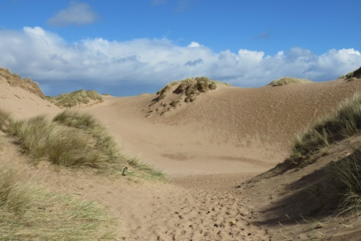
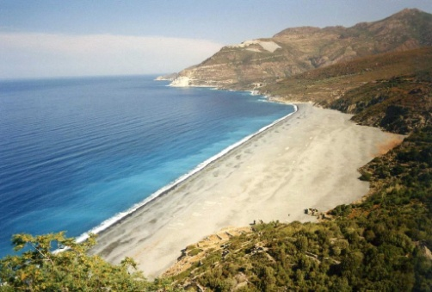
Activity: the coasts as a natural system
You are studying coastal landscape systems. Using one of the images here (e.g. a sand dune or a bay), give examples of the following:
stores and components in the system
Processes / transfers / flows (e.g. erosion, transport and deposition)
inputs and outputs to the system: energy (e.g. gravity, wave, wind, tidal) and materials (e.g. rock/sediments).
Add examples to the box at the bottom of page 3 of your booklet
Notes:
Photo top: https://www.geograph.org.uk/photo/5864521
Photo middle: https://commons.wikimedia.org/wiki/File:Margerie_Glacier_and_Mount_Fairweather_2.jpg
Photo bottom: https://www.flickr.com/photos/24814228@N06/2424706749/

Slide 16
INPUTS
External factors…
PROCESSES (flows / transfers) and COMPONENTS (stores)
OUTPUTS

Slide 17
EROSION
ARCHES
STACKS
BEACHES
HUMAN ACTIVITIES
LONGSHORE DRIFT
SEDIMENT
CHANGES IN SEA LEVEL
SPITS
DEPOSITION
BIOGENIC INPUTS (shells and marine fossils)
RELIEF
(height and steepness of coast)
WAVES
WIND
TIDES
CURRENTS
SALT MARSHES
CLIFFS
ACCUMULATIONS OF SEDIMENT ABOVE TIDAL LIMIT
SAND DUNES
HEADLANDS
LOSS OF WAVE ENERGY
ROCKS
(strength, jointing, bedding)
SEDIMENTS
(Shingle, sand and mud)

Slide 18
INPUTS
Energy (waves, wind, tides and currents)
Sediment
Biogenic inputs
Changes in sea level
Human activities
Rocks
(strength, jointing, bedding)
PROCESSES
Erosion, Longshore drift, deposition
Erosional landforms (headlands, cliffs, arches, stacks)
Depositional landforms (beaches, spits, sand dunes, salt marshes
Sediments
(Shingle, sand, mud)
Relief
(height and steepness of coast)
OUTPUTS
Accumulations of sediment above tidal limit
Loss of wave energy and sediment removed from cell
“Relationships’ exist between different parts of the system – e.g. the speed of erosion is determined by the rock characteristics or the amount of energy input

Slide 19
Storms of 2014: Enrolment Work
Using the enrolment work:
  The UK storms of 2013/2014 had a huge impact on our coastlines, illustrating just how dynamic the coastal environment is.
  What were the causes of the storms?
  What were the impacts of the storms?

Slide 20
Storms of 2014: Enrolment Work
  As a class, come up with 2/3 examples or descriptions of each of the inputs, processes, outputs and stores of the coastal system for the UK coastline affected by the 2014 storms.
  Dynamic Equilibrium – what do you think this means?

Slide 21
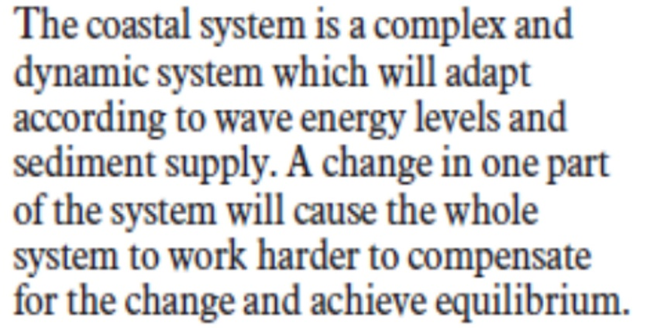
Dynamic Equilibrium in the Coastal System
Systems in steady state equilibrium change little over time. In reality, many natural systems are in dynamic equilibrium. This means they adjust to changes in short-term inputs, often through negative feedback mechanisms – see example.
However, over longer time-scales the system as a whole may gradually change.
Coastal system example
A storm event increases energy inputs to a beach. High-energy waves change the beach profile by eroding sediment, transporting it off-shore and depositing it there. Waves break over the off-shore sediment, dissipating some energy. Low-energy waves now reach the shore, switching to a net on-shore movement of sediment. This begins to rebuild the beach profile – eventually reaching a new equilibrium state.
https://www.youtube.com/watch?v=T0XEipEdgN8 – recap of systems and feedback (from 3:20 on feedback)
Notes:
A higher rate of erosion followed by deposition puts more material on the beach; this subsequently slows down the rate of erosion as the extra material on the beach absorbs the wave energy and protects the coastline. This is negative feedback (when a system responds to reverse a change).

Slide 22
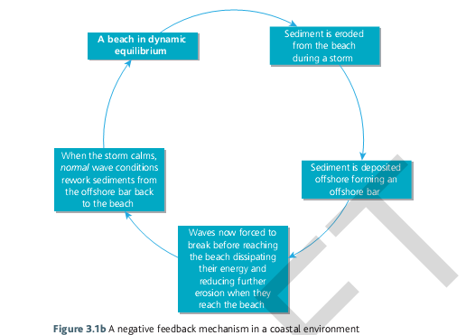
Feedback mechanisms are a major determinant of what sort of landscape is formed (as well as geological, climatic and maritime processes). Negative feedback – towards equilibrium
Negative feedback is then when an action leads to something becoming LESS than it was before; this could be a good or bad thing.
***
It’s a bit confusing in that it is called a negative feedback system but is actually a good thing.
Notes:
*** Dynamic Equilibrium = When there is a balance between the inputs and outputs then the system is said to be in a state of dynamic equilibrium.

Slide 23
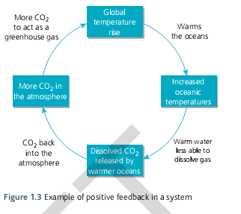
Positive feedback (away from equilibrium) is then when an action leads to something becoming MORE than it was before; this could be a good or bad thing.
Think about the impact of a sea wall on the coastal system
This is a positive feedback system but is actually a bad thing.

Slide 24
Home Learning Tasks
Look at the scan of the Oxford textbook - section 3.1 on pages 102 to 105 (also a copy on Godalming Online). Take additional notes of any new key terms.
Complete activity 3 on page 105 of the textbook scan.
Complete the summary activities in the booklet – page 6.

Slide 25
Summary activities
Explain why the coastal zone is an open system
Why is the foreshore the most important zone for marine processes? (2 marks)
Explain a negative feedback mechanism in the coastal system (4 marks) To get full marks you will need to explain what both coastal systems and negative feedback mechanism are and give an example.

Slide 26
Feedback
Positive feedback (change causes further effect):
  Sea walls may prevent flooding, but they also limit cliff erosion ---> this restricts the release of sediment into the system -----> this sediment might have been redeposited, so helping to protect the coastline ( erosion is therefore allowed to continue in unprotected areas)
Negative feedback (lessens the effect):
  Sediment eroded from the beach during a storm is deposited offshore to form a bar ---> waves break before reaching the beach, dissipating their energy and leading to reduced erosion of the beach ----> normal wave conditions rework offshore deposits back to the beach

Slide 27
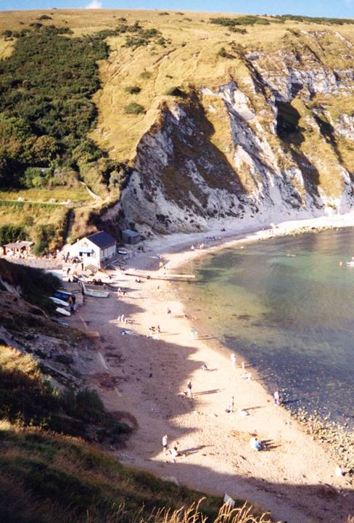
The Study of Coasts: Landscape Vs landform
As a result of feedback mechanisms and constantly changing weather conditions, dynamic equilibrium is rare in a coastal landscape.
Coastal landscapes are made up of a combination of wide-ranging landforms, which are constantly undergoing change. The various landforms of coastal areas are mainly the result of the action of ocean waves (and sub-aerial action).
Wave action creates some of the world’s most spectacular erosional landforms. Where wave energy is reduced depositional landforms, like beaches are created.

Slide 28
The concept of landform and landscape – characteristic landscapes
Think:
What is the difference between landform and landscape?
Pair:
Use your whiteboards and between you come up with a definition for each.
Share:
Join up with another pair and further refine your answers.
Check them and add to your key terms

Slide 29
Coastal landscapes and landforms
Definition of a landscape - An expanse of land/scenery that can be seen in a single view. It covers all aspects of the view, both natural landforms and human created features.
Definition of a landform - A single natural feature (such as a cliff or beach) found in a landscape.

Slide 30
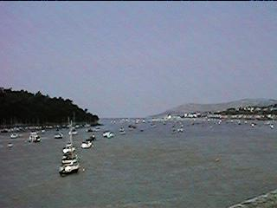
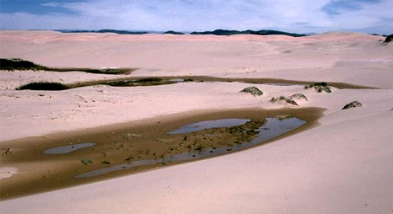

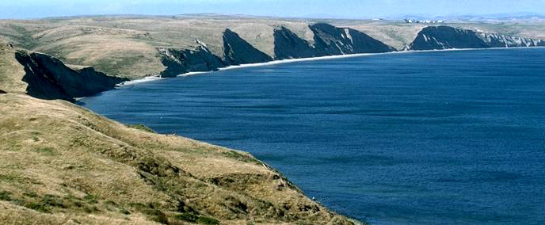


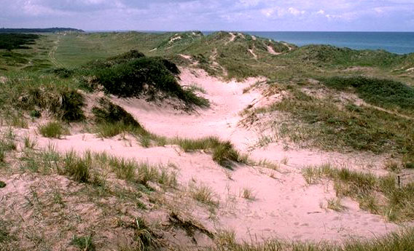

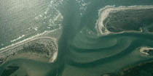
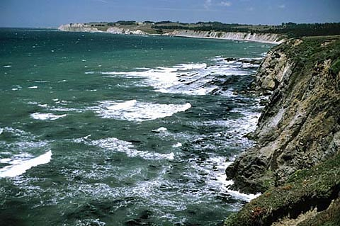
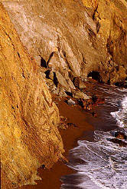
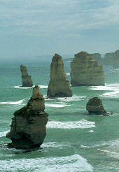
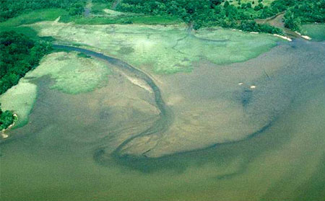

Erosional & Depositional Coastal Landforms –
which do you think is which?

Slide 31
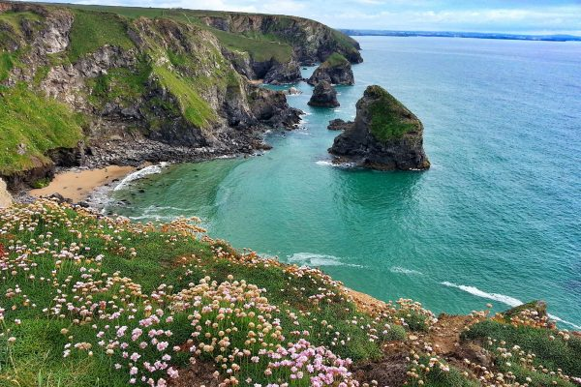
Examine this stretch of landscape and label the landforms that you can see in the image
Main points:
As a result of feedback mechanisms, and constantly changing weather conditions, dynamic equilibrium is rare in a coastal landscape.
Coastal landscapes are made up a combination of a wide range of erosional and depositional landforms, which are constantly undergoing change. They may also be affected by human activities including management.

