Slide 1
3.1.3.2: Sources of energy at the coast: sediment
Learning Objectives
To understand the sources of energy in the coastal environments
To understand sediment inputs – where sediment comes from
To understand sediment cells – transfer and budgets
Concept Checker:
The concept of the coastal system
The concept of different energy types – wind, wave (how waves are formed), tides (types), currents, sediment flows
Key words:
Sediment Cell
Sediment Budget
Longshore drift
Sediment sinks

Slide 2
Sediment sources and Cells
One of the main activities of the coastal system is the sourcing, transfer and deposition of sediment along a stretch of coastline called a sediment or littoral cell.
DEFRA (the Department for Environment, Farming and Rural Affairs) defines a sediment cell as:
  ‘A length of coastline and its associated nearshore area within which the movement of coarse sediment (sand and shingle) is largely self-contained. Interruptions to the movement of sand and shingle within one cell should not affect beaches in a neighbouring sediment cell.’
A sediment cell in theory, is therefore a ___________ system

Slide 3
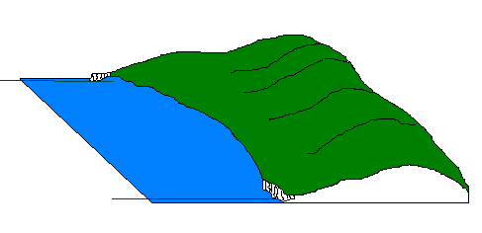
Sediment sources and cells
A littoral or sediment cell is section of coastline that is involved in the complete cycle of sediment transport and deposition.
Sediment budget describes the movement of sand sized particles and larger sediments into, within and out of a defined coastal segment (littoral cell).
The coastal sediment budget = the balance between sediment being added to and removed from the coastal system
submarine canyon
headlands
Littoral or sediment cell

Slide 4
`Sediment sources in the coastal system
The coastline must receive inputs of sediment, where does it come from?
Rivers
Seabed
Erosion of coastline
Other parts of the coastline (LSD)
Shell material
Clastic
Biogenic
Biogenic sediments from decaying sea creatures, together with clastic sediments transferred into the coastal system by mass movement of weathered and eroded rock are equally as important to the system.
Short video on ‘where coastal sediment comes from’

Slide 5
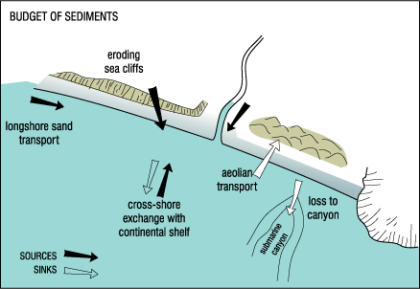
The sediment cells act as systems with sources (inputs), processes (transfers) and sinks (outputs)
Identify the inputs and outputs from this diagram.
In theory sediment cells can be regarded as closed systems from which nothing is gained or lost. However, in reality it is easy for fine sediments to find their way around headlands and into neighbouring cells

Slide 6
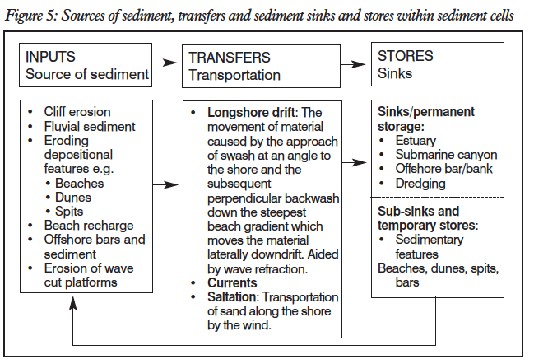
`Sediment in the coastal system

Slide 7
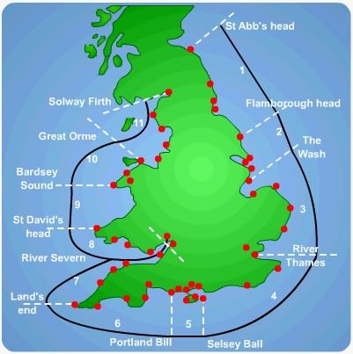
Littoral cells
There are eleven major littoral cells operating around the coast of England and Wales. Within these there are many sub-cells e.g. Christchurch Bay sub-cell in cell 5 (Dorset). Sediment comes from a variety of onshore and offshore sources and processes.
Eroded material from cliffs
Sediment from streams
BEACH
Longshore drift
Sand from offshore sand bars
Organic material including shells, coral
In theory sediment cells can be regarded as closed systems from which nothing is gained or lost. However, in reality it is easy for fine sediments to find their way around headlands and into neighbouring cells

Slide 8
Sediment cells and budgets
For a sandy beach to exist – material has to come from somewhere and remains there – action of waves, tides and currents
Processes of coastal erosion controls the level of deficit as they remove material from the shoreline
Sediment sources and sinks need to be identified too
Calculating budgets is extremely difficult – requiring complex models and calculations

Slide 9
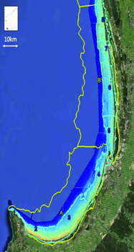
Case Study 1: Cape Naturaliste to Moore River – Western Australia.
Starting in the south at Cape Naturaliste, longshore drift moves material from the Cape, northwards towards the Moore River.
Material is deposited at certain locations along the stretch of coastline as spits, tombolos and bars.
Material is picked up by waves and currents travelling seaward and is carried out from the shore, but a large amount of this sediment is intercepted by incoming waves and carried back towards the shore. Some sediment is lost from the cell in offshore deposition.
Loss of sediment is replenished by clastic sediments deposited by rivers where they enter the ocean in the shallow bay areas. This is added to by shoreline weathering and mass movement of cliffs. Deposited sediments will then be carried along the coast by longshore drift.

Slide 10
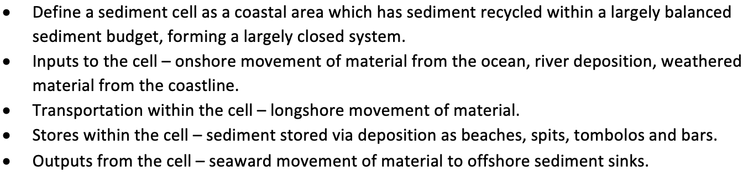
Sediment Cells
Exam style question (tutor 2 u):
Outline the sediment cell concept
How can people affect the equilibrium of a sediment cell?

Slide 11
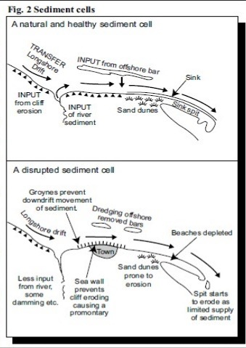
Use the two diagrams to:-
Describe the changes that humans have made to the sediment cell
Explain the impacts the changes have had on this section of coastline

Slide 12
South Downs sediment subcells
Identify the sources, transfers and sinks within the South Downs sediment cell from Geofile 575.
How might human activity have affected this cell?

Slide 13
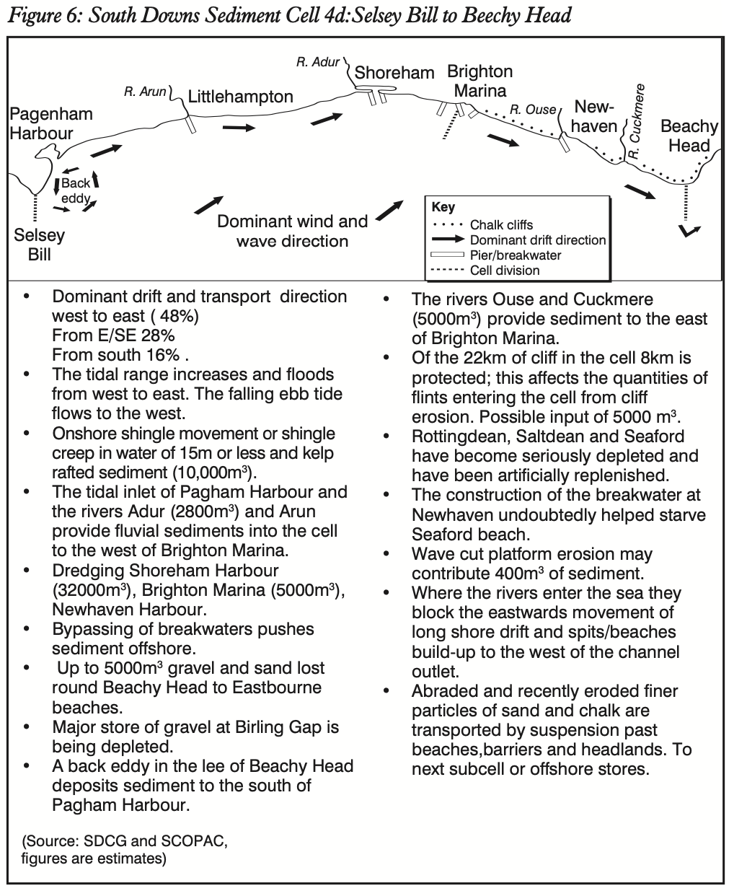

Slide 14
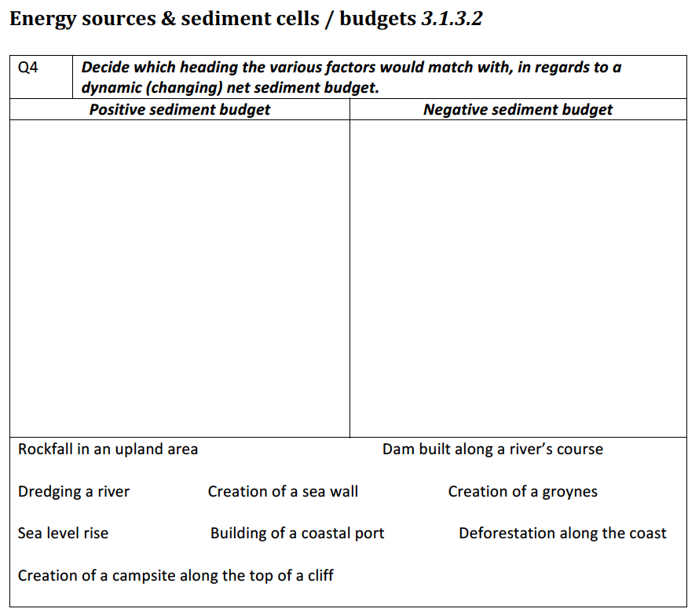
Sediment Cells

Slide 15
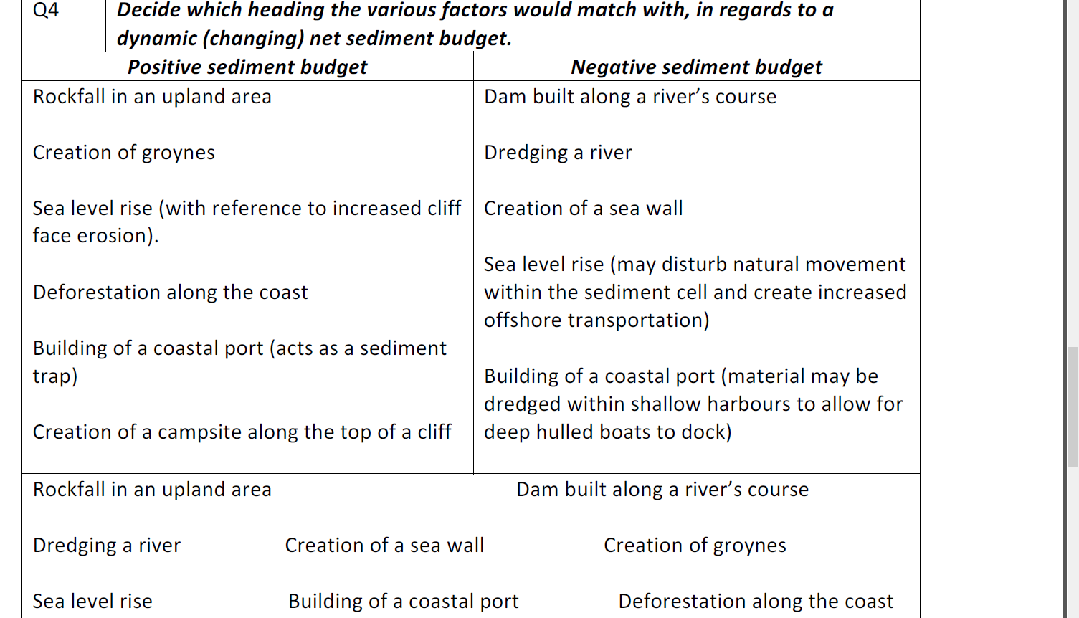

Slide 16
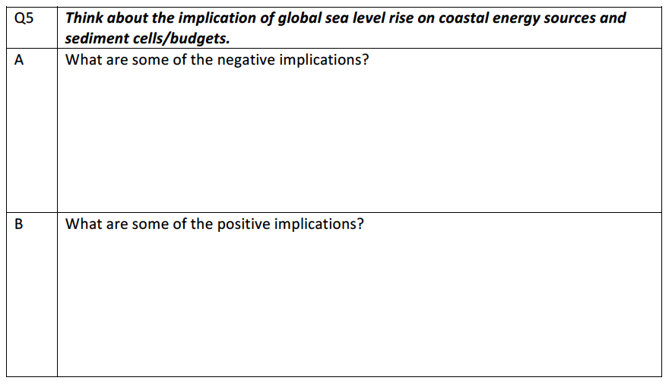
Sediment Cells

Slide 17
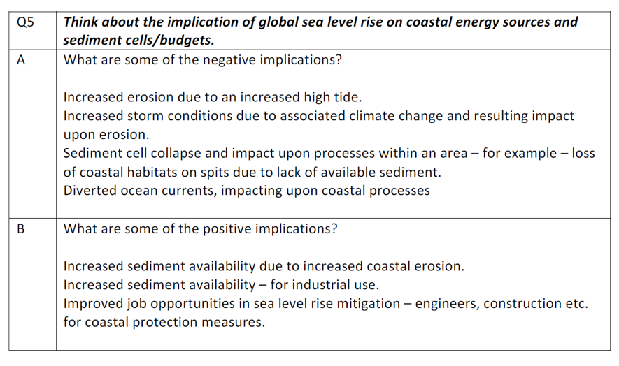

Slide 18
Sediment Cells
Notes:
Extra slide for starter / plenary

Slide 19
Flip learning for next week:
Types of weathering
Use the Hodder, Cambridge and Oxford textbooks to create notes on the different types of weathering. Whenever possible use diagrams to illustrate the processes.

