Slide 2
3.1.3.4: Weathering, mass movement and runoff
Learning Objectives
To understand the different types of weathering (physical, biological, chemical) in coastal environments
To understand and locate different types of mass movement (geology types)
Key words:
Sub-aerial
Weathering
Freeze-thaw
Salt crystallization
Carbonation
Oxidation
Solifluction
Runoff
Concept Checker:
The concept of geomorphological processes
The supply of sediment to the coastal system from various rock types and movements

Slide 3
Starter
Why has Holbeck Hall collapsed? What processes are taking place? What are the factors affecting cliff erosion?

Slide 4
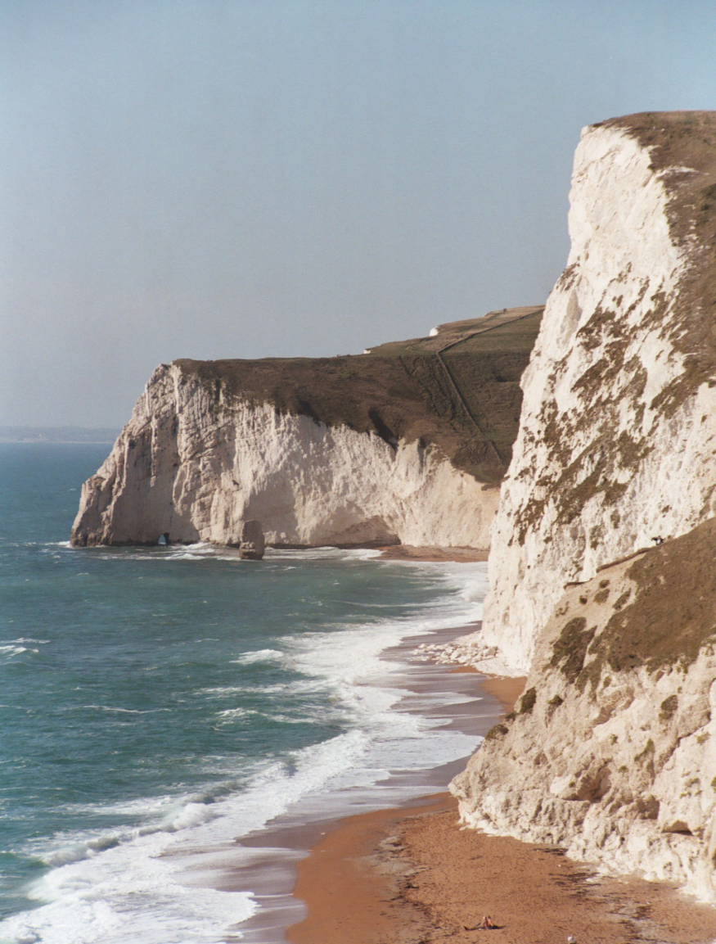
What factors affect the rate of coastal erosion?
The Dorset coast
Breaking point of wave
Rock resistance, structure and dip
Depth of sea, length of fetch
Beach shape (steeply shelving beaches create higher energy waves)
Presence / absence of protective beach

Slide 5
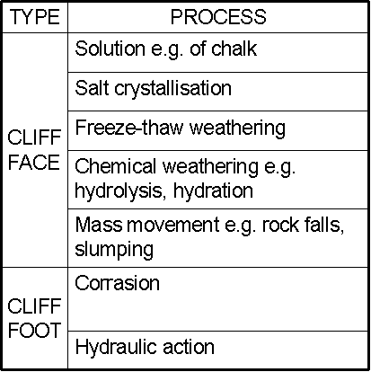
Geomorphological Processes - Weathering and erosion
Weathering: the breakdown (denudation) of rocks in-situ
Erosion: the wearing away and removal of the land
Weathering and erosion can occur on both the cliff foot and cliff face.
What are the principal processes operating on these areas?
Cliff face or sub-aerial processes
Cliff foot or marine processes
Once the material has eroded it may be broken down further by attrition.

Slide 6
Coastal Geomorphological Processes
Marine processes:
Operate upon a coastline connected with the sea, such as wind, waves, tides and longshore drift
Sub-aerial processes
Operate on the land but affect the shape of the coastline, such as weathering, mass movement and run-off
Weathering - The weakening and breakdown of rocks in situ (in place)
Mass movement – the downward movement of material (regolith) due to gravity
Run off - overland flow where material is washed down a slope potentially forming an input to the sediment cell.
The interaction of these processes along the coastline is distinctive, creating the range of uniquely coastal landscapes

Slide 7
Sub-aerial processes (“occur at base of atmosphere”) on the coast
Biological......
Assists Solution
Limestone attacked by acids
Other rock types attacked by secretions from blue green algae in inter-tidal zones
Molluscs bore into rock for food and shelter
Chemical and Mechanical Weathering https://www.youtube.com/watch?v=1tRan4DVbnQ
Flip learning – feedback task on next slide
https://www.youtube.com/watch?v=2311yO5opVk: Weathering and Erosion Song

Slide 8
Types of weathering
Mechanical (Physical)
Frost shattering (freeze thaw)
Wetting and drying
Pressure release
Salt crystallisation
Exfoliation
Biological
Plants and animals
Chemical
Oxidation
Hydrolysis
Hydration
Carbonation
Solution
Acid rain
Flip learning feedback task:
Share ideas and complete page 2 in your booklet with any missing notes on sub-aerial processes.
Complete page 3 of your booklet

Slide 9
What factors might affect the rate of weathering?
Where/when might the rate of chemical weathering be fastest?
Where/ when might the rate of mechanical weathering be fastest?
Where/when might the rate of biological weathering be fastest?
Hint - think about the following:-
Heat, cold, rain, rock type, rock structure, exposure to salt spray, vegetation cover etc

Slide 10
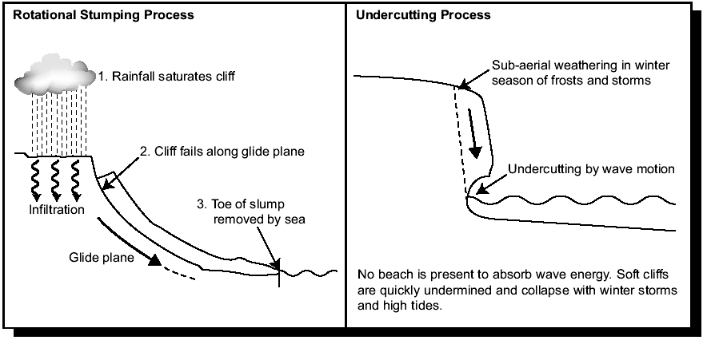
Geomorphological Processes – Mass movement
Dorset land slip - Watch video. http://www.bbc.co.uk/news/av/uk-22402387/dorset-caution-on-cliffs-advised-following-landslips
List and explain the main causes of mass movement

Slide 11
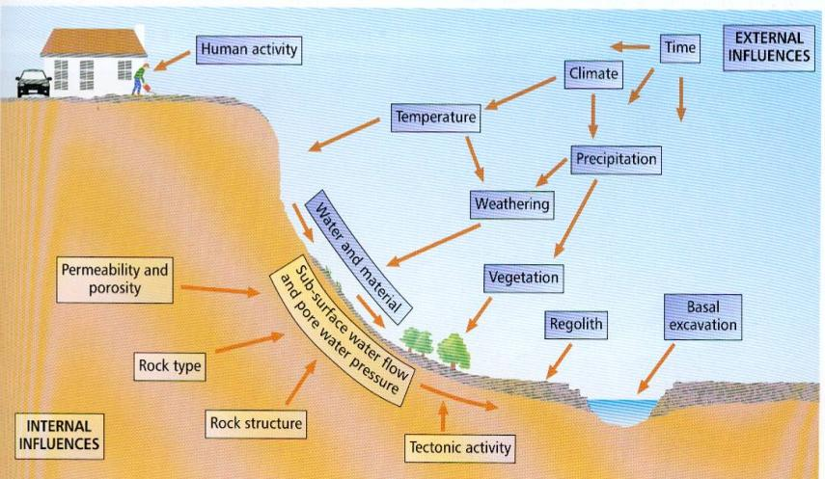
Mass movement - causes

Slide 12
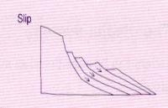
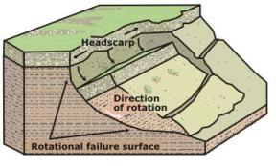
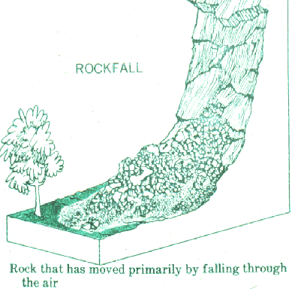
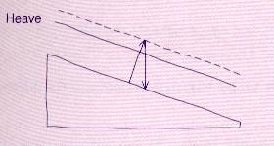
Mass movement - types
Slumping
A flow type of mass movement in which a major section of regolith, soil, or weakened bedrock comes down a steep slope as a backward-rotating slump block. Common along coastlines and on verges of main roads. Usually occur on weak rock (clay) or in soil. Human activity can intensify the condition, e.g. Holbeck Hall Hotel, Scarborough.
Rockfall
Draw your own!
Fastest form of mass movement that involves the free fall or downslope rolling of rock pieces loosened by weathering; these boulders form a talus cone or scree slope at the base of the cliff from which they broke away
Soil creep
Soil creep is a heave process whereby individual particles expand and contract due to the physical environment. Very common in UK and on clay slopes
http://www.alevelgeography.com/sub-aerial-processes/

Slide 13
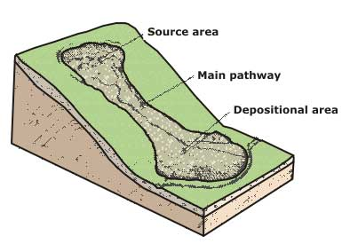
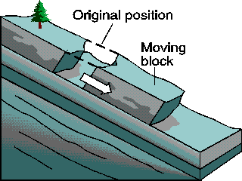
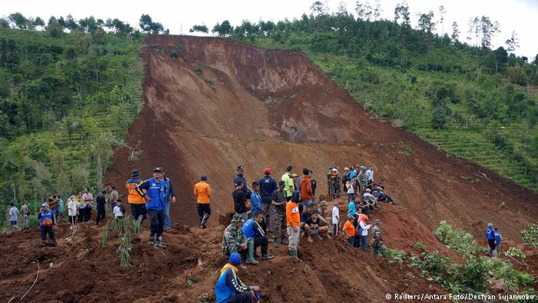
Flows
Mass movement - types
Occur when there is plentiful water and a higher clay content
Landslides
A significant section of the cliff becomes detached and slides down. Often a block of rock moving along a plane or a slump but can be rotational or a flow.

Slide 14
Booklet task
Use p116-117 Oxford textbook to complete notes on the different types of mass movement.
What role does run-off have in sub-aerial processes? P117 Oxford

Slide 15
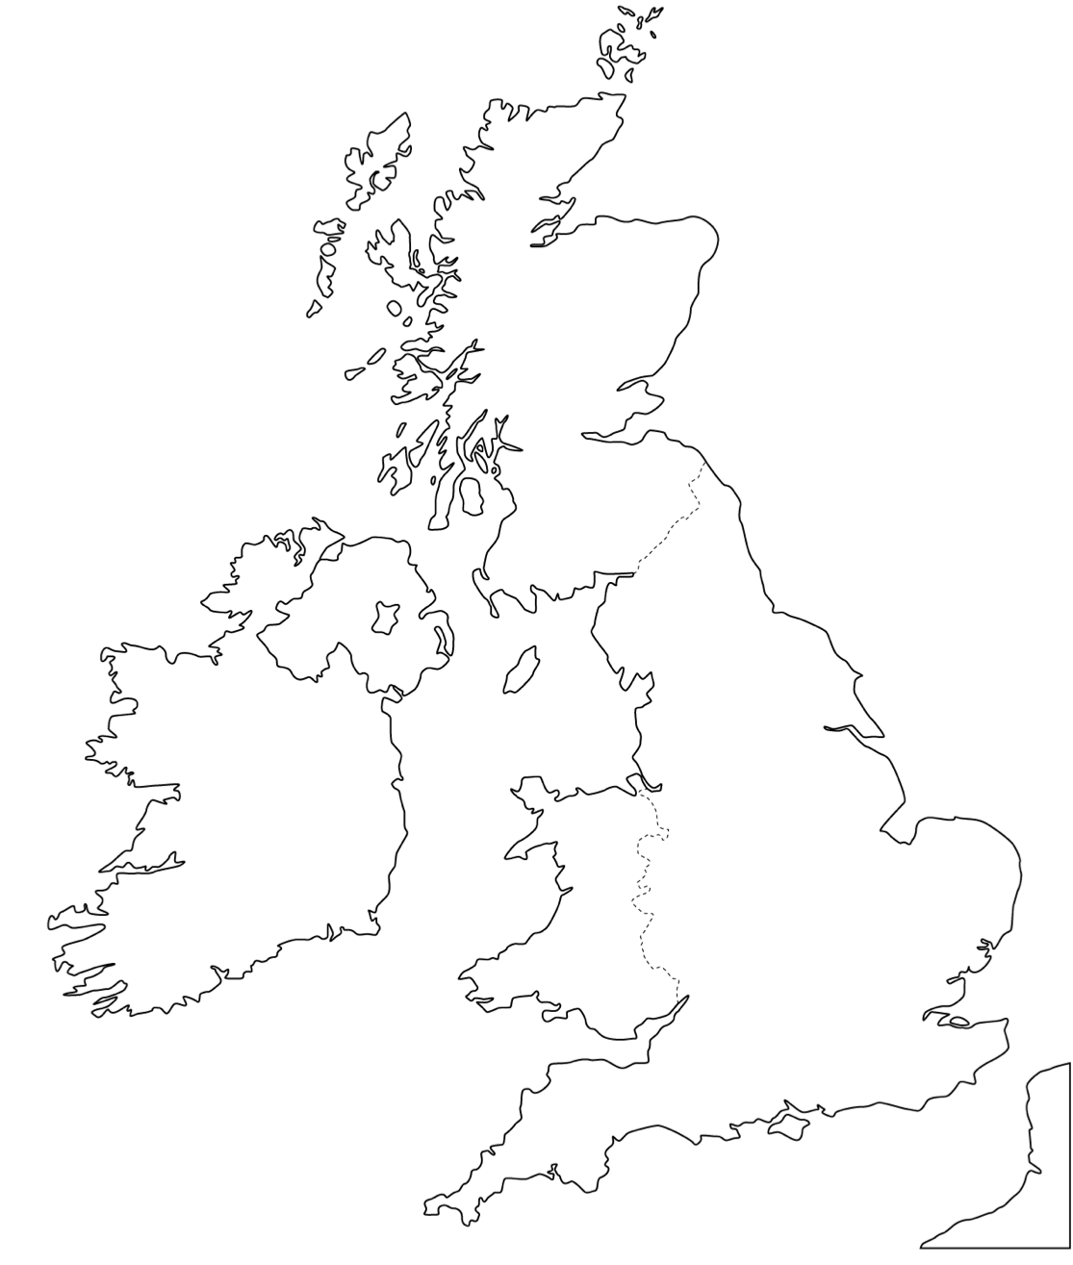
Case Studies
Using the textbooks and internet, complete the two tasks below:
Task 1: Locate the case studies, listed below, on the map
Task 2: Next to each image:
Annotate the image to highlight evidence that shows mass movement has occurred in each photo
detail the processes at work
Holbeck Hall
Barton-on-sea
Holderness
Norfolk
Beachy Head

Slide 17
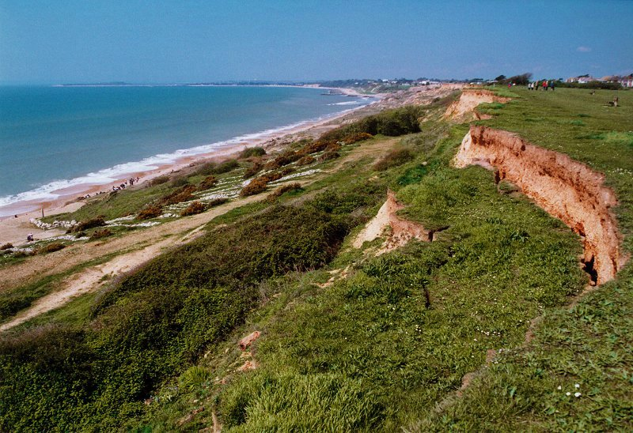
Barton

Slide 18
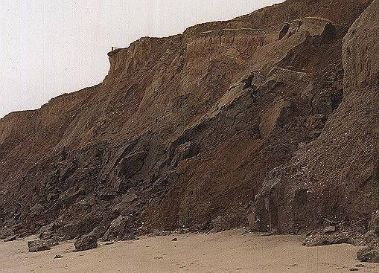
Holderness

Slide 19
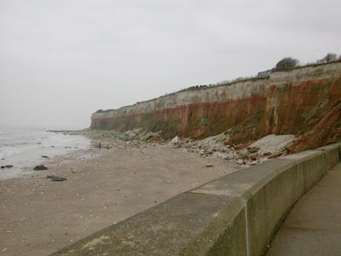
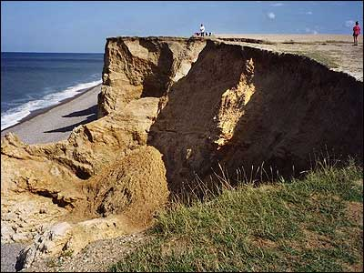
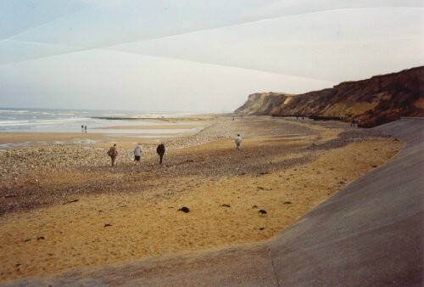
Norfolk

Slide 20
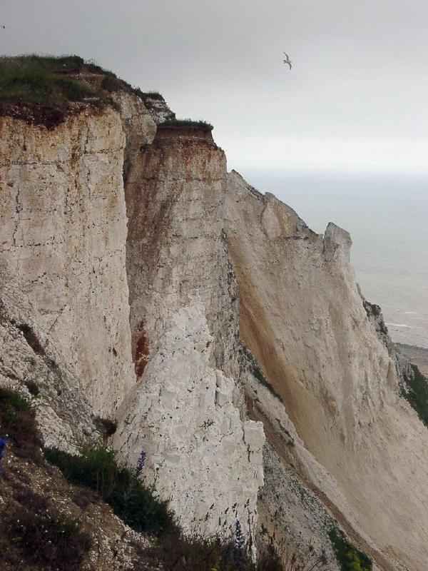
Beachy Head http://www.eastbourneherald.co.uk/news/video-footage-shows-extent-of-massive-seaford-head-cliff-fall-1-8020482

Slide 21
Video Footage
N Norfolk coast…
https://www.thesun.co.uk/news/2907411/reckless-kids-risk-lives-horror-cliff-collapse/
https://www.youtube.com/watch?v=4UdBdVpucyY

Slide 22
Fieldwork Opportunities
Visit a local beach and investigate which are the dominant weathering processes and why.
We will be visiting West Wittering Beach and East Head Spit after half term

Slide 23
Questions
What are sub-aerial processes and where do they operate?
To what extent do weathering, mass movement and runoff play a role in coastal retreat?
Why do rates of weathering vary around the world?
Assess the impact that mass movement has on the supply of sediment in a sediment cell.
Explain how the methods by which sediment are supplied to the coastal system are likely to vary between areas of resistant and weak geology.

Slide 24
Flip
Coastal processes of erosion, transportation and deposition – complete the homework in the booklet in preparation:
Go to Godalming Online/ Geography Y1 /3.1.3Coastal Systems and Landscapes / 4 Weathering and Mass Movement
Complete questions 1 and 2 from GF_388_-_L1_HW_Coastal_Erosion_-_Back_to_Nature.pdf
Read the tutor 2 u 17 Geomorphological and Coastal Processes CS.pdf – (Case Study: The Holderness Coastline) and summarise the marine processes affecting the Holderness Coastline. Use the headings: Erosion, Transportation and Deposition and complete as a mind map or list.

Slide 25
Outline the links between different parts of the coastal system shown in Figure 1. [4 marks]

