Slide 1
Coastal management: Part 2 – Sustainable Approaches
Learning Objectives
To understand human intervention in coastal landscapes
To understand why people manage coastlines in different ways
To understand sustainable approaches to flood risk and erosion management
Key words:
Hard engineering
Soft engineering
Cost-benefit analysis
Tangible
Intangible
Integrated Coastal Zone Management
Concept Checker:
The concept of cost-benefit analysis (CBA)
The concept of sustainable management

Slide 2
The Options?
Do nothing!
Sea Walls!
Beach nourishment?!
Groynes?
Breakers?

Slide 3
Sustainable approaches to coastal flood and erosion management
Some soft engineering schemes adopt sustainable principles, but they tend to be focused a particular stretch of coastline. Increasingly management authorities are looking at holistic management plans for significant stretches of coastline.
Policies have been adapted by the UK Government to make coastal management more sustainable and also policies have developed at a global level to create a common and integrated approach around the world.
Integrated Coastal Zone Management
Originated from the UN Earth Summit of Rio De Janeiro in 1992 (Agenda 21). The European Commission have developed a framework to promote ICZM to manage the fine balance between people, economy and environment. In 2013, the EC launched the maritime spatial planning (MSP) framework to support ICZM.
Shoreline Management Plans
The ICZM has been adopted and as a result SMPs have been developed to manage the shoreline aspect of coastal management.
To avoid a piecemeal approach to coastal management around the coast of England and Wales, an integrated system of SMPs was introduced in 1995 by the national government.

Slide 4
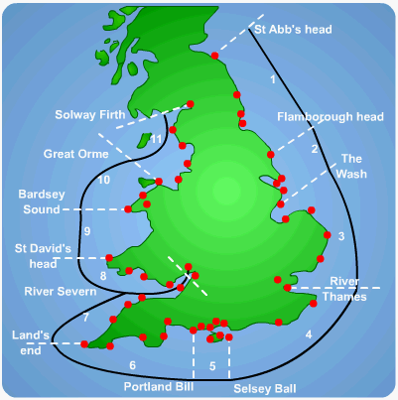
What is the aim of the SMP?
There are 22 SMPs which correspond to the sediment cells and sub cells around the coast of England and Wales.
To provide the basis for sustainable coastal defence policies within a sediment cell (specified lengths of coast) Their aim is to identify the most sustainable approach to managing the different sections of coastline and to set objectives for the future management of the coastline in the short term (0-20 years), medium term (20-50 years) and the long term (50-100 years)
They are funded mostly by the national government agency – DEFRA, along with the Environment Agency and local councils.

Slide 5
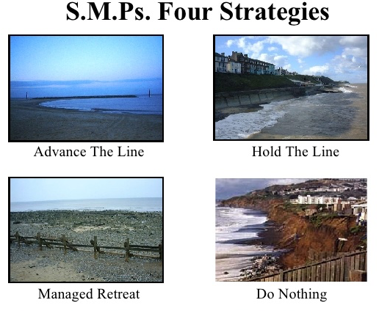
Extend the coast into what is currently the sea. (Very few examples around Britain, but the basis of Dutch polder reclamation and construction of manmade islands in Tokyo Bay).
Intervene against coastal erosion with hard or soft engineering to prevent any further shoreline retreat.
Realignment of the coast to a pre-determined line some distance further inland from the current position of the coast
Permit natural systems to modify the coastline as they are currently operating. It usually means allowing erosion and cliff retreat to continue.

Slide 6
Each SMP describes how each stretch of coastal covered by the plan is to be managed.
What factors might determine which of the above strategies is designated along a stretch of coast?
What issues might arise if different sections of coastline are designated different strategies?
There are 4 approaches used.
Analyse the map of preferred shoreline management policies.

Slide 7
Which option?
The factors that determine which of the four options is designated for a section of coast depends on:
The rate of coastal change (threatened loss of land as well as sea level rise)
The economic value of land uses put at risk by coastal change (homes, businesses, infrastructure)
The value of agricultural land at risk, along with habitats of value
The cost of intervention strategies
Issues can arise if one section of coast is selected for ‘Hold the line’ strategies but a neighbouring section is designated ‘No active intervention’ without clear justification. Even more controversial is when the ‘Hold the line’ strategy selected actually increases the rate of coastal erosion downcoast (such as with sediment-capture by groynes).

Slide 8
Costs and benefits of different management options

Slide 9
Holderness DME
The Challenges of Sustainable Management – Holderness Case Study:
Watch Parts 3 &4 of the e-stream video: Defending the coast (11.49 min +)

Slide 10
SMP Holderness
The Holderness SMP is a plan for managing coastal flood and erosion risk for stretches of coastline in the short term (up to 2025), the medium term (2026 – 2055) and the long term (up to 2105).
This Shoreline Management Plan covers the coastline from Flamborough Head to Gibraltar Point including the outer Humber Estuary.
Shoreline Management Plans identify policies for sections of coastline in order to best manage coastal flood and erosion risk to people and the developed, historic and natural environment.
The main aim of the SMP is to develop a sustainable management approach (actions that do not cause problems elsewhere) for the shoreline that takes account of the key issues and achieves the best possible balance of all the values and features that occur around the shoreline over the next 100 years. This needs to recognise the strong relationship with social, economic and environmental activities around the shoreline. SMP policies therefore have to be realistic.
SMPs are reviewed every five to 10 years; the first round SMPs are now being reviewed to take into account updated information and changing circumstances.

Slide 11
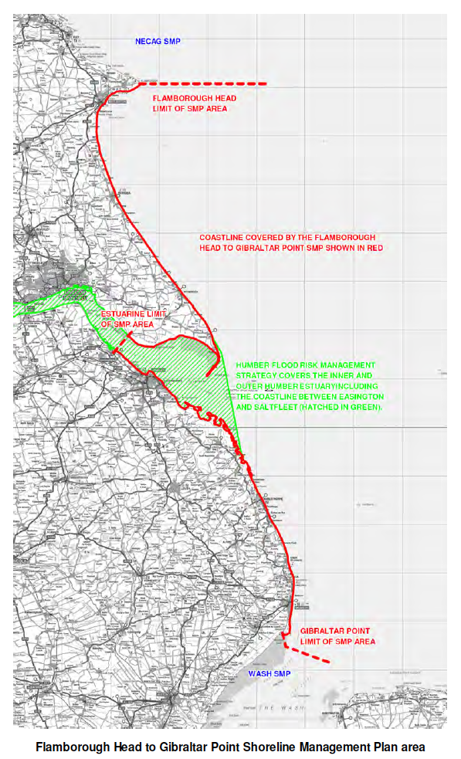
This Shoreline Management Plan covers the coastline from Flamborough Head to Gibraltar Point. The northern boundary of the SMP is at Flamborough Head (as shown on the map).
The southern boundary of the SMP is at Gibraltar Point (as shown on the map) where this SMP joins the adjacent Wash SMP, to the south.
The Humber Flood Risk Management Strategy was published in March 2008 and the area covered by it (shown as the green hatching on the following map) overlaps the SMP area. To ensure this overlap is addressed, there has been close communication between the project teams with the Humber Strategy team represented on the SMP Client Steering Group.
The Plan area covers a highly varied coastline with a range of different land uses and environments. Much of the Holderness coastline has experienced rapid erosion over recent centuries. Due to the presence of human settlement along the coast, there are many conflicting local issues and objectives. The floodplain of the outer Humber Estuary includes some of the most productive agricultural land in the UK as well as major industry and many commercial buildings.

Slide 12
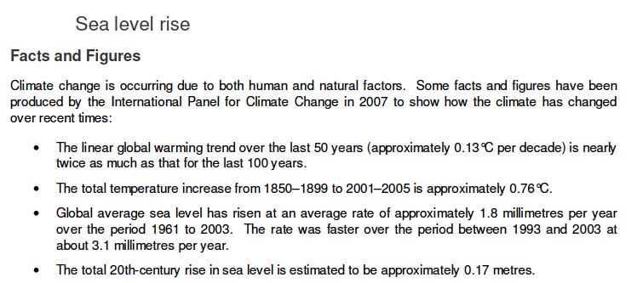
Sea Level Rise – the challenge

Slide 13
Decision making assessments
The Holderness Coast is threatened by the process of erosion and in addition the beach areas, which are important for tourism around some locations, are being depleted at an alarming rate. Land has been reclaimed in the Humber estuary and this is now being used for industry; a key location as it will boost the local economy and also marks the edge of the river and the beginning of the coastline.
The aim of this exercise is for you to develop ideas for a Shoreline Management Plan for whole of the Holderness Coast whilst considering:
existing coastal defence and the use of the land being protected
coastal processes in operation along the whole of the coast
current research into sediment movement along Holderness

Slide 14
Holderness DME
You have been allocated one of the seven sites along the Holderness coast, where coastal management is taking place. You have to choose the best option for the future. You need to put forward your recommendation for managing the coastline in the future to the council at the next meeting choosing from one of the four management options. You will do this after completing the following 3 activities:
Information sorting – see information about your section of coastline
Cost-benefit analysis using a ‘conflict- matrix’
Final recommendation for your stretch of coastline to present to the group.

Slide 15
HOLDERNESS – the challenges represented in sustainable management of the Holderness Coast

Slide 16
The Aims of the SMP along the Holderness Coast | Importance score /5
To balance flood and erosion risk management in a sustainable manner appropriate to the overall value of the features affected
To ensure that shoreline management policies encompass longer term adaptation options, and give time for communities and individuals to adapt to changing climate conditions and levels of risk.
To develop policies for flood and erosion risk management that will inform spatial planning processes and provide a robust evidence base for Local Development Frameworks
To support sustainable patterns of development and consider possible effects on communities and their welfare.
To support the nationally, regionally and locally important social and economic assets of the area in a sustainable manner.
To consider the effects of coastal change on local industries, agriculture and employment and provide a secure environment for economic activity and development.
To ensure that local decisions do not have a disproportionately adverse affect on the natural balance of the coastline and shoreline management elsewhere.
To contribute to the positive management and enhancement of environmentally designated sites and protected species, subject to natural change.
To support the conservation and enhancement of biodiversity in the wider coastal zone.
To support the preservation and enhancement of the historic environment.
Pick 5 of these aims to memorise for the exam. Make sure that they are a range of ideas, with some more important than others so that you can assess.

Slide 17
Discuss the following on the Holderness Coast:
What factors influence the choice of coastal defence strategy? For example, why might traditional approaches to coastal management, such as some of the hard management strategies, be important in management of the coast? Use your example for the decision making exercise to help you.
What do you understand by the term ‘sustainable approaches’ to coastal management?
With the greatest challenge of climate change - what are the most important approaches to coastal management and why?

Slide 18
Sustainable approaches to coastal management will become more important than traditional approaches in dealing with the impacts of climate change.’ To what extent do you agree with this view? [20 marks]

Slide 19
Exam-style Question
‘Sustainable approaches to coastal management will become more important than traditional approaches in dealing with the impacts of climate change.’ To what extent do you agree with this view? [20 marks]

Slide 20
Think about……
AO1 - Knowledge and understanding of sustainable and traditional approaches to coastal management. Knowledge and understanding of the impacts of climate change on coasts.
AO2 – Application of knowledge and understanding to come to an evaluative conclusion as to whether sustainable approaches or traditional approaches will be more important in dealing with impacts of climate change. Analysis and evaluation of approaches to coastal management in dealing with impacts of climate change. Assessment of the view that sustainable approaches will be more important than traditional approaches. Should come to a view on ‘extent’.

Slide 21
Integrated Coastal Zone Management - ICZM
The Shoreline Management Plans deal with just the shoreline sections of the coast. However, there has been a growing awareness around the world that SMPs should be coordinated with other policies affecting the coastal zone.
The term ‘integrated coastal zone management’ originated from the UN Earth Summit of Rio de Janeiro in 1992 and was taken up by the European Commission.

Slide 22
Integrated Coastal Zone Management
A systems perspective recognises that an action in one location is likely to have an impact elsewhere. The development of ICZM plans takes this as a basis for holistic (all components taken into account) planning.
The coastal zone is not only a place for natural marine processes and habitats but shoreline activities, inshore and offshore operations and inland activities that output at the coast through drainage systems that flow into the coastal zone.
Planning
Decision-making
Managing and monitoring of implementation
Information collection

Slide 23
ICZM: AIMS
Different Policies affecting the coastal zone
Nature protection
Aquaculture
Fisheries
Agriculture
Industry
Offshore wind energy
Shipping
Tourism
Development of infrastructure
Adaptation to climate change
The key aim of ICZM planning is to co-ordinate all the potential pressures and conflicts of interest at the coast and manage them fairly, responsibly and sustainably. Specifically:
Monitoring, information-gathering and recording of what is taking place at the coast
Identifying and involving all stakeholders (who may change with time)
Agreeing co-ordinated plans that allow key objectives for stakeholders to be met
Following sustainable strategies
Managing the natural and human systems responsibly
Considering changes to coastal systems and anticipating likely impacts
Adapting plans accordingly

Slide 24
ICZM Vs. SMP?
Integrated coastal zone management is a method of managing the whole coastal zone (near shore, inshore and offshore zones as well as the shoreline) and the shoreline management plan manages the potential risks from coastal processes on the shoreline only and presents a policy to manage these risks.

Slide 25
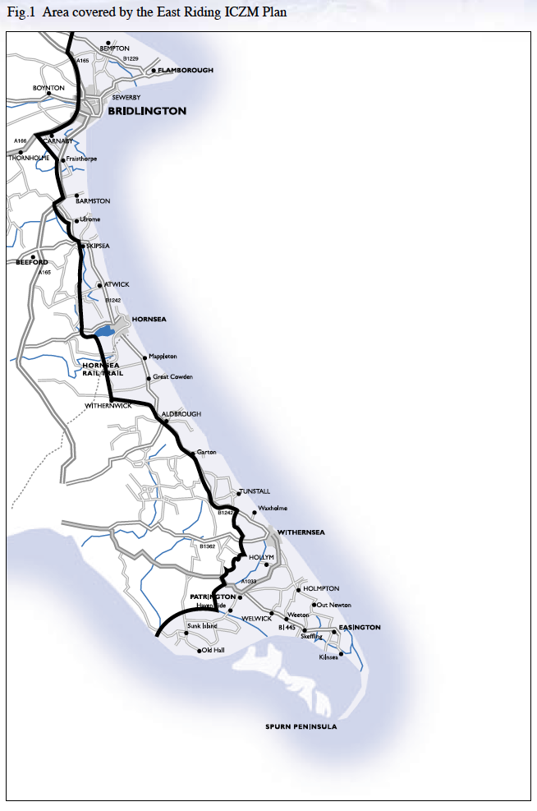
ICZM - Holderness
The relationship between this plan (ICZM) and the Shoreline Management Plan is crucial.
The SMP is, as its name suggests, a plan for the management of the shoreline, and as such has limited scope. The SMP identifies areas needing more integrated management.
The ICZM Plan, on the other hand, lays out policies for managing all aspects of the coastal zone. It will inform the review of the SMP.
The ICZM was used to develop the Flamborough Head to Gibraltor Point Shoreline Management Plan (SMP) – published in 2011. Flamborough Head and Gibraltor Point are the northern and southern limits of a major sediment cell.
What comes out of the SMP review will, likewise, be taken into account in future ICZM plans and reviews.

Slide 26
Group Discussion
Why do you think an ICZM is needed?
Why do you think that it is a global issue?
What are the specific issues facing coastal environments in the future?

Slide 27
ICZM & global issue
We need ICZMs:
To protect the ecology
To protect the 200 million people who live near Europe’s coastline
To protect the assets:-
Settlements
Tourists destinations
Business centres
Ports
ICZM is a global issue because our coastlines are integrated. What happens on one stretch of coastline has an impact on other sections. It is a trans-national issue.

Slide 28
Managing the Odisha coast
https://www.youtube.com/watch?v=wRdos9tG7z8 – 10 minutes version: Managing the coast
Watch the video and take notes on why an ICZM is needed.
How are people and economic activity potentially putting pressure on the coastal environment? What are the issues facing the coastlines of Odisha? Who are the stakeholders?

Slide 29
ICZM Review
You need to know the following:-
What are the origins of ICZM?
What is the background to why an integrated coastal management is needed?
Why is concentrating on people and economic activity putting pressure on coastal environments?
What are the specific issues facing coastal environments in the future?
Who are the stakeholders, who should be considered when thinking about coastal management?
How can ICZM be viewed as a cyclical process?

Slide 30
Homework
Read the Hodder textbook pages 122-124, and use the information to help plan/take notes and then answer the 9 mark question below. (Timed conditions – 12 minutes):
Assess the advantages of integrated management plans such as Shoreline Management Plans (SMPs) and Integrated Coastal Zone Management (ICZM) [9 marks]

