Slide 1
3.1.5.4 Seismic Hazards
Learning Objectives
To be able to explain why tsunamis occur, the characteristics of them and what determines their effects
To complete detailed case study notes for the Tohoku earthquake, evaluating the effects and responses and how perception has changed
Key terms:
Focus
Epicentre
Richter Scale
Mercalli Scale
Moment Magnitude Scale.
Primary (P) Waves
Secondary (S) waves
Surface Love (L) waves
Rayleigh (R) waves
Liquefaction

Slide 2
What are tsunamis? (Secondary effect)
Tsunamis are giant sea waves generated by shallow –focus underwater earthquakes (the most common cause), volcanic eruptions, underwater debris slides and large landslides into the sea.
It is not seismic waves that cause the tsunami but the movement of the overlying plate.
Watch the clip and make notes on the Causes of Tsunamis
https://timeforgeography.co.uk/videos_list/plate-tectonics/tsunamis-causes/

Slide 3
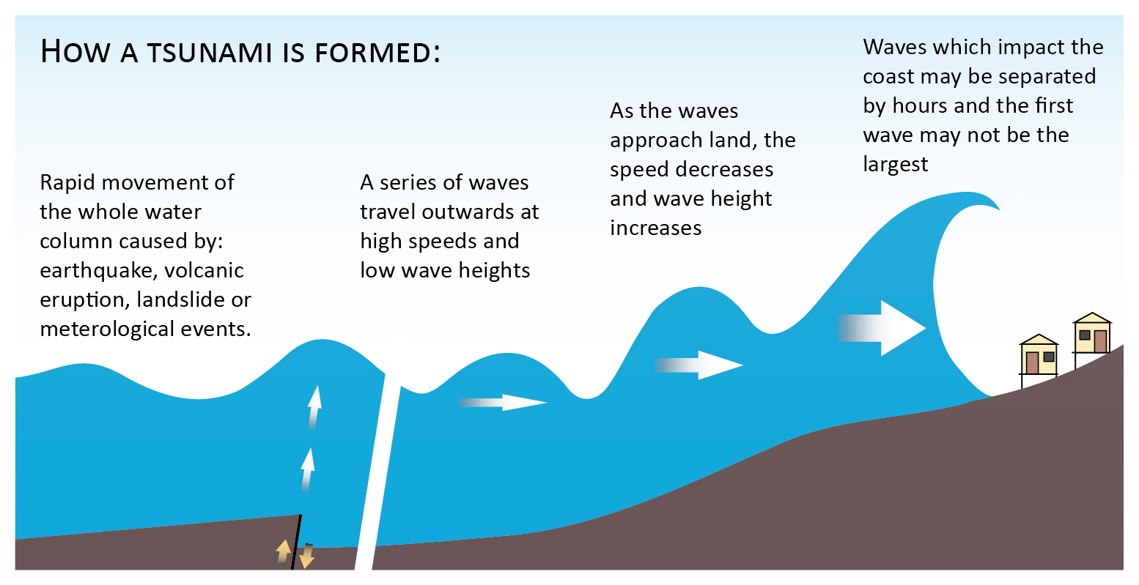
Tsunamis are giant sea waves generated by shallow-focus underwater earthquakes (the most common cause), volcanoes, underwater debris slides and large landslides into the sea.
Tsunamis have a very long wavelength (sometimes over 100km) and a low wave height (under one metre) in the open ocean and that travel at speeds of over 700km/hour but, when approaching land, increase rapidly in height.

Slide 4
Quite often, the first warning given to coastal populations is the wave trough in front of the tsunami which results in the reduction in sea level, known as a drawdown. Behind this comes the tsunami itself which usually consists of a number of waves, the largest not necessarily being the first.
What do you think determines the effects of the tsunami?
The height of the waves and the distance they have travelled
The length of the event (at source)
The extent to which warnings could be given
The coastal geography both offshore and on the coastal area
Coastal land use and the population density

Slide 5
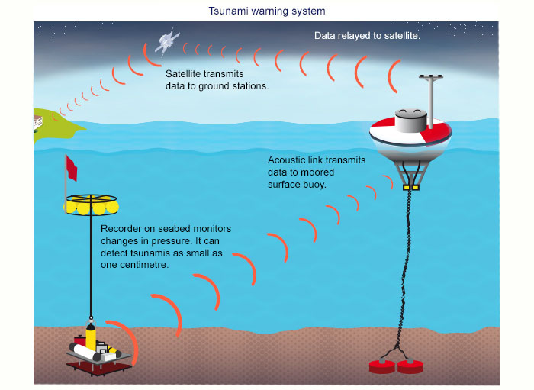
Following the Boxing Day Tsumani in Indonesia, many tsunami buoys have been installed in the Pacific Ocean. What do you think are the advantages and disadvantages of these buoys?

Slide 6
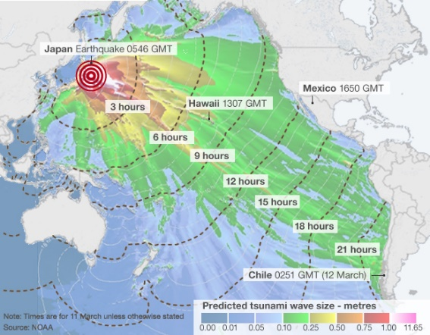
Analyse the map showing the Tohuku Tsunami

Slide 7
Tohuku earthquake and tsunami 2011
https://www.youtube.com/watch?v=oWzdgBNfhQU Introduction
https://www.youtube.com/watch?v=jFv5yY7pMgQ Fukushima

Slide 8
Resources to use:-
Video clip notes
Geo Factsheet 289
Oxford Textbook p246-249
Case Study Tohoku
To include:-
Where and when (include a map)
Why did it happen? How powerful was it?
Why was the area so vulnerable? How prepared was Japan?
Briefly outline the primary and secondary impacts. In more detail – specify the impact that the earthquake (ground shaking) and the tsunami wave have. How large was the tsunami wave and how high were the walls? What % damage did each cause?
What were the preparation failures and what were the successes?
How did the Japanese respond to the hazard and how successful has this been? You need to include both short term and long term responses.

Slide 9
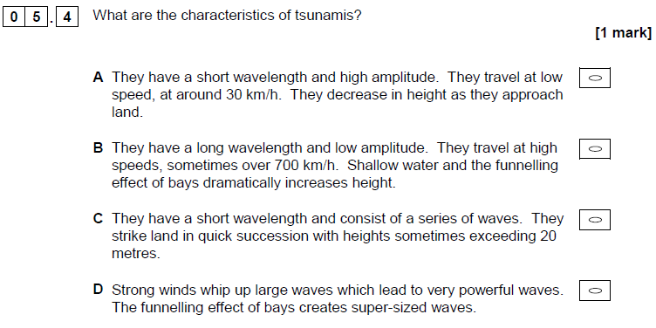
A Level 2018

Slide 10
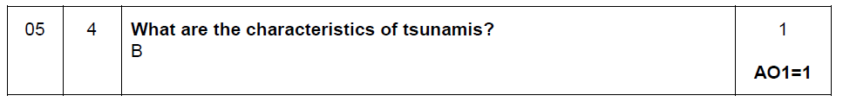
A Level 2018

Slide 11
You need to round up your value e.g. 6.5 would become the 7th position and 4.5 would become the 5th position

Slide 12
Seismic hazards question practice:

Slide 15
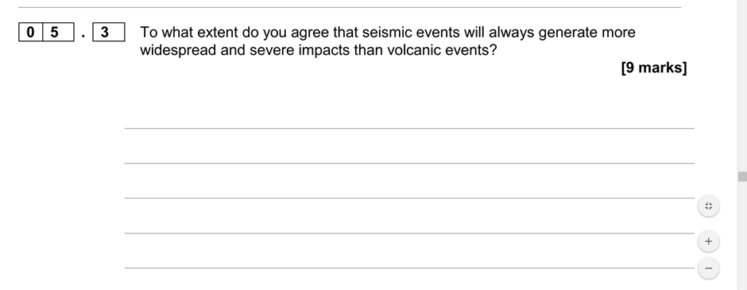

Slide 16
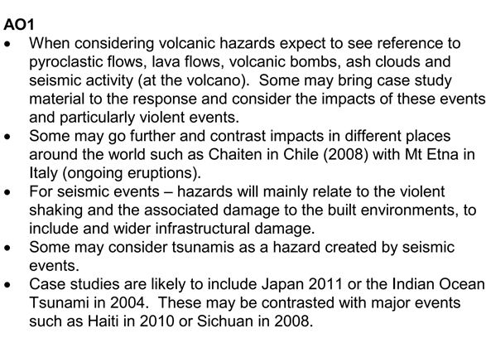
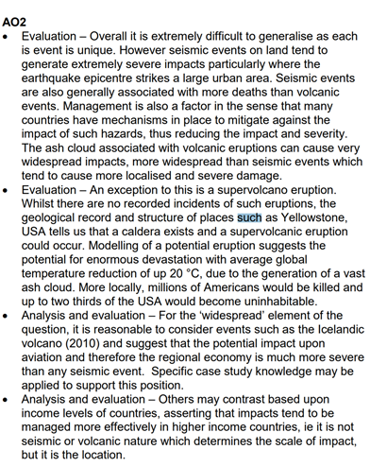

Slide 17
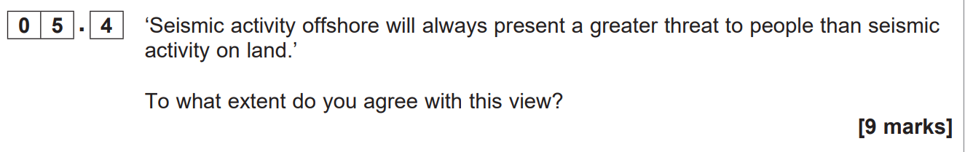

Slide 18
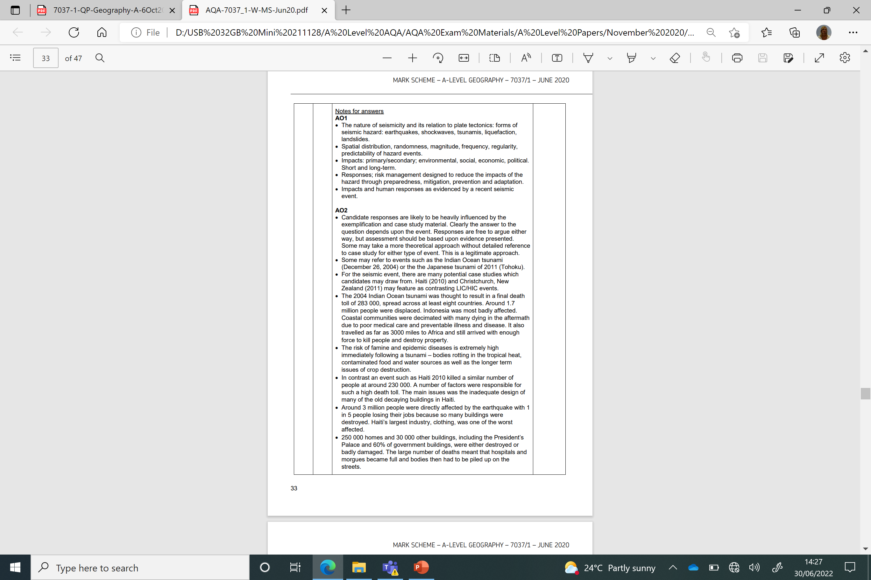
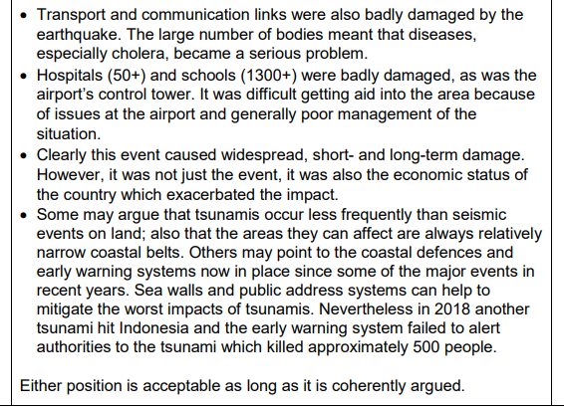

Slide 19
Flip learning – follow up tasks
For discussion the following lesson
What were people’s perception of the seismic hazard prior to the Tohuku earthquake? What was the reason for that perception?
Do you think that people’s perception of the hazard and sense of place has changed? Why do you think this?
Identify 4 impacts of the hazard. Which do you think was the greatest impact and why?
Evaluate the effectiveness of the response? Did they respond effectively? What evidence is there to justify your response?

