Slide 1
Changing Places
The Nature and Importance of Places – Part 2
Learning Objectives
To examine the factors contributing to the character of places
To be able to define the terms endogenous and exogenous
Concept Checker:
What factors contribute to the unique character of a place
To be able to define endogenous and exogenous factors
To identify the factors that may a town a clone town
Key words:
Endogenous
Exogenous

Slide 2
https://www.youtube.com/watch?v=l_JL24u3hpo
Berlin images

Slide 3
What factors contribute to a place’s unique character
Group discussion

Slide 4
Language
Dialect
Belief systems
Rituals
Clothing
Food
Services
Products
Geology
Landscape
Climate
Politics

Slide 5
What unique character do the following places have?
Scotland
Cornwall
New York
London
Bangkok
Brighton

Slide 6
Endogenous and exogenous factors
Endogenous – factors from within
Exogenous - factors from outside

Slide 7
Endogenous factors
Factors that are found within places
Definition - The local internal characteristics that create a place’s identity.
Can you think of examples of places for any of the above?
Location | Site or situation
Topography | Height of land, relief (hills, mountains, coastal plains)
Physical geography | Drainage, flood plain, soil type, valley
Land use | Settlement, commercial, industrial, agricultural
Built environment | Age of buildings, types of buildings
Infrastructure | Road and rail networks, waterways, airports
Demographic | Age structure, ethnicity
Economic | Sector (primary, secondary, tertiary, quaternary)

Slide 8
Exogenous factors
Definition - Exogenous factors are external influences on a place’s identity. They are caused by a place’s relationship with other places.
For each of the above think of at least one example
People | Migrants, workers or visitors come from outside a place to live or work
Capital | Investment from a business based outside the area
Resources | Raw materials, transport infrastructure
Ideas | Urban planners, architects, business and artists bring ideas to shape and change a place

Slide 10
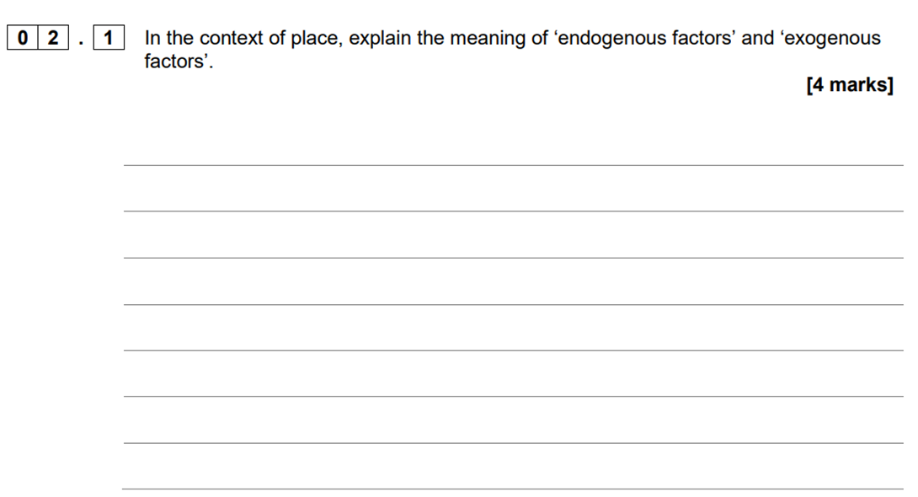

Slide 11
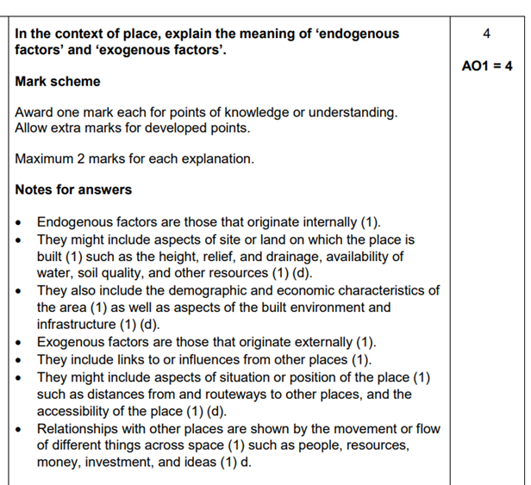

Slide 12
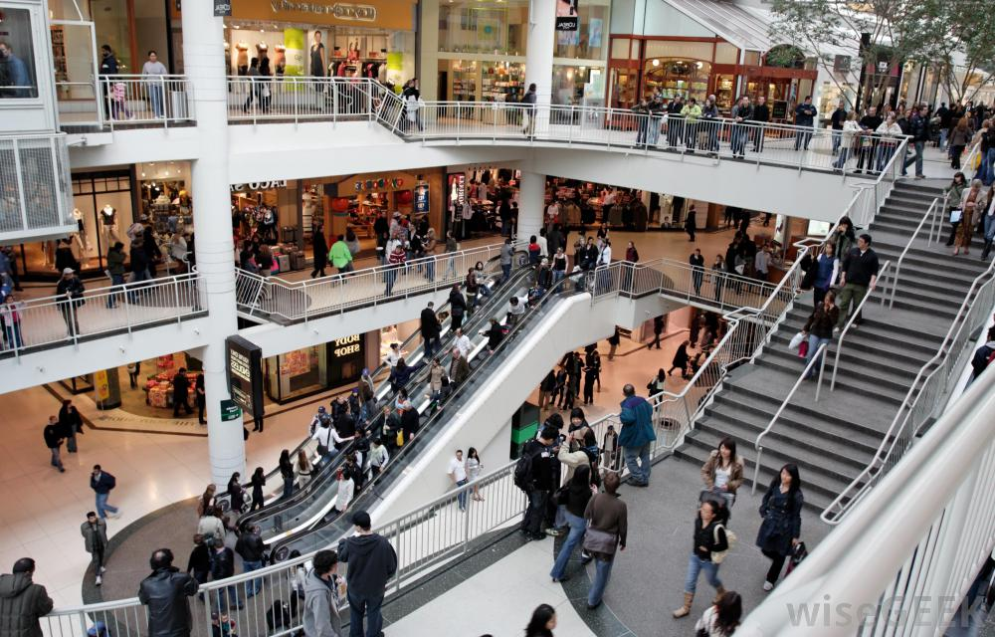
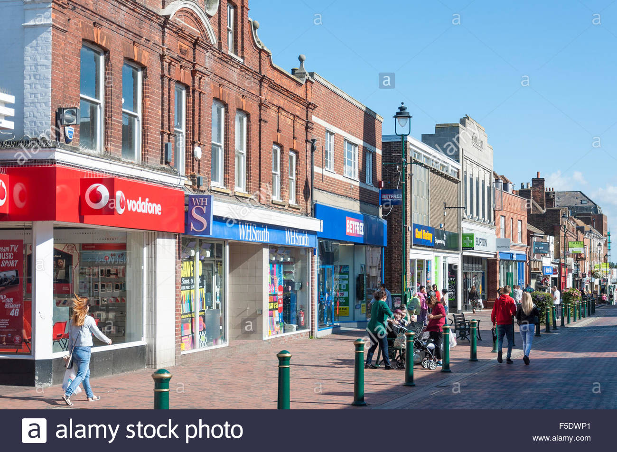
Where are these places? Can you think of other places which are placeless? Does it matter?

Slide 13
Placelessness
Due to globalisation and time-space compression some places appear the same wherever we are in the world
Shopping centres, fast food chains, airports and service stations look similar wherever you are in the world and so are said to be placeless.
In the UK high streets have become clones of each other with the same shops nationwide

Slide 14
Totnes - Costa
https://www.youtube.com/watch?v=dW_ek3sh66U
Why are these people protesting?
Is this the end of the story?..........
http://www.independent.co.uk/news/uk/home-news/a-very-british-insurrection-totnes-residents-win-battle-to-keep-costa-out-amid-clone-town-fears-8226426.html

Slide 15
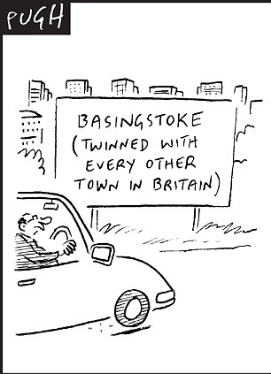
BBC article June 2005
Chain stores are driving out small shops in towns across the UK, a survey has suggested. Four out of 10 of the nation's high streets are "clone towns", according to research conducted by the New Economics Foundation.
This means that "the individuality of high street shops has been replaced by a monochrome strip of global and national chains" and that many towns have become "somewhere that could easily be mistaken for dozens of bland town centres across the country".
A further 26% of towns were on the border of becoming clones, while just 33% were identified in the survey as "home towns" - where a town has "retained its individual character and is instantly recognisable and distinctive to the people who live there, as well as to those who visit".
The creep of huge retail companies on to town centres across the UK does have its benefits. Some people enjoy the choice of goods and competitive prices offered by chain stores.
But some people are asking: "Can anyone tell one High Street from another?"

Slide 16
How have some multinational companies responded to the local marketplace?
What have they done in Bristol to encourage people to support the local economy? How successful has it been?

Slide 17
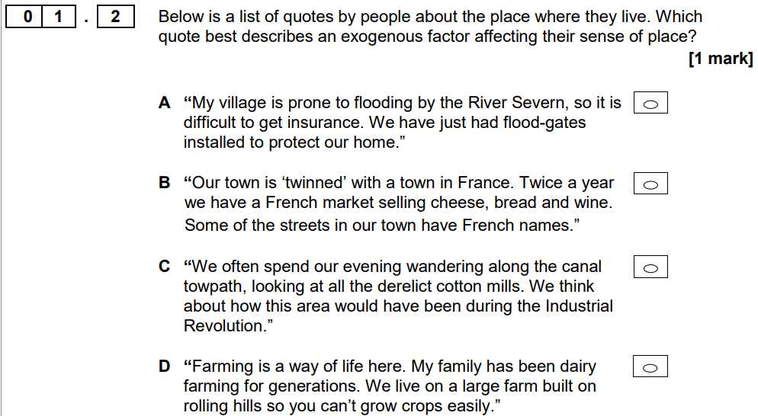

Slide 18
Complete activities in student handout
Q p79 Oxford textbook

