Slide 1
Representations of place and the use of quantitative and qualitative sources
Aims
To investigate and present your two place studies using a variety of quantitative and qualitative sources
To analyse the limitations of the sources available

Slide 2
Quantitative data
Qualitative data
Objective
Subjective
Demography
Provenance

Slide 3
Quantitative data – Data that can be quantified and verified, and is amenable to statistical manipulation
Qualitative data – Information that is non-numerical and used in a relatively unstructured and open-ended way. It is descriptive information, which often comes from interviews, focus groups or artistic depictions such as photographs. Some types of qualitative data, such as interviews, can be coded and may then be subjected to quantitative analysis
Objective – Not influences by personal feelings or opinions in considering and representative facts
Subjective – Based on or influenced by personal feelings, tastes or opinions
Demography – The study of human population
Provenance – The context in which a source is produced and the creator

Slide 4
Statistics
The UK census is conducted every 10 years by the government. It provides large -scale quantitative data about places such as age and gender structure, ethnicity and levels of economic development. It helps the government to better understand and plan for population growth and other demographic changes.
The Office for National Statistics (ONS), together with NOMIS, collect and publish statistics related to the economy, population and society at national, regional and local levels.
The negatives:-
The use of quantifiable data such as statistics is not as objective as it may first appear. This is because people selectively choose the data they wish to use for their particular purpose. The use therefore becomes subjective. Another criticism for using statistics when studying a place is that they tell us very little about the human experience of a place and what it is like to live there.

Slide 5
Complete the exercise gathering data on Stratford and Godalming using the website on the excel spreadsheet
Using the data you have collected in table 1 complete 10 bullet points comparing Stratford and Godalming
How does Waverley and Newham compare?

Slide 6
Analyse this graph – break down this graph into its constituent elements in order to provide an in depth account and convey an understanding of it

Slide 7
Geospatial Mapping
Geospatial mapping is increasingly being used. It is very useful as it allows you to create choropleth maps with additional overlays of spatial information, of the kind represented on OS maps. The overlays help make sense of places represented.
Read through p 92-95 Oxford textbook and log on to the following website http://datashine.org.uk
Choose 3 different criteria from the drop down menus and create geospatial maps of Godalming and Stratford area showing the same information e.g. building age/ethnic group. Annotate your maps to show how the areas compare and print out.
(The postcode to use for Godalming College is GU7 and Stratford E15)

Slide 8
How reliable is secondary information?
Secondary sources of information – people interpret information and their representations of place are subjective. We then interpret the information and add our own subjectivity e.g. we may be influenced by our own feelings – these may be shaped by our own experiences, education and background
Therefore – good policy is to use more than one source or text

Slide 9
Does the source give a +ve or –ve impression?
What is the context in which it was produced?
Who created it?
What was it’s purpose?
How does it compare to other texts?
Was it produced earlier/later?
Was it inspired by or a reaction to an earlier text?
What may not have been included – but was relevant?
Is there a bias?
How does it relate to wider relevant geographies?
Provenance and textual analysis
Research William Blake and the hymn Jerusalem.
Why was it created and what is it about?

Slide 10
Types of qualitative data
Interviews
Media
Photographs
Poetry and songs
TV and Film
Art
Atlas/Maps
Books

Slide 11
Interviews
Good | Bad
They can generate detailed insights about a person’s sense of place or perception of place They are first hand reports of experiences, opinions and feelings They tend to me more informal, open ended, flexible and free flowing | Interviewer bias – only certain questions may be asked which may fit with the interviewer’s agenda Interviewer may ask leading questions People may not be honest as they like to cast themselves in a favourable light
Read through the information on p102 and p103 Oxford textbook.
1)What are the advantages of questionnaire over interviews?
2) How might you select those you wish to interview?
3) What kind of questions are good to ask? Give an example

Slide 12
Maps
Can be used to locate places but they can also influence how we think of feel about a place and as such play a very important role in both our sense of place and perception of place. Maps can show a great deal of history and can show changes over time.
Maps can include hidden bias and influence e.g. Google can direct people towards local business.
Look carefully at the following maps. Who do you think has created the maps and for what purpose?
http://www.ukmapsz.co.uk/godalming.html
http://www.godalmingmuseum.org.uk/index.php?page=map
http://www.wsivc.org.uk/index.cfm?fuseaction=66.704&tab=66&formaction=CMSPage

Slide 13
Textual sources
Novels can evoke a sense of place. Some places have become strongly associated with places that they are now promoted as such e.g. Thomas Hardy and Dorset.
While many associations can play a positive role, sometimes the reverse is true and popular media can be instrumental in creating ‘place prejudice’. An example is Liverpool which has been portrayed negatively in newspapers, with unemployment, deprivations, gang violence, drugs and riots featuring. The city authorities have had to re-brand to distance itself from the image and in 2008 was awarded European Capital of Culture status.
Look again of the slide on contextual analysis and provenance. What questions do you need to ask?

Slide 14
Poetry and songs
Used to describe and evoke a sense of place. John Betjeman and Slough. William Blake and England. Subjective but powerful.
Think about the lyrics of ‘Lose Yourself’. How did these lyrics represent Detroit?

Slide 15
Photographs
Photos may be different due to differences in weather, time of the season, and time of day. They may show changes over time. Photographs are selective in what they show – marketing images tend to focus on the natural beauty or landscape of places without disturbance from humans. The reality is often different – see following slides.

Slide 16
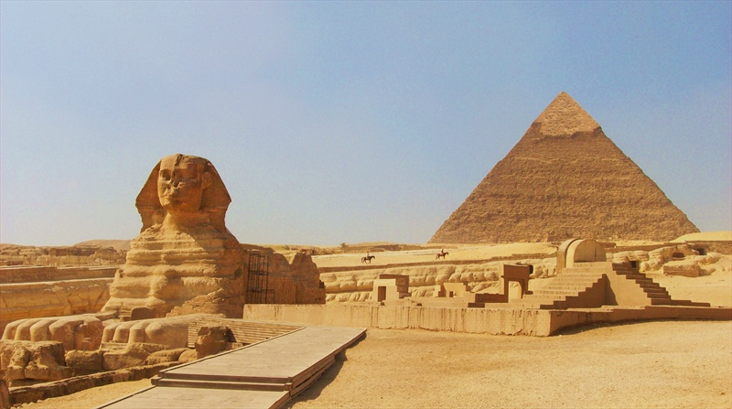

Slide 17
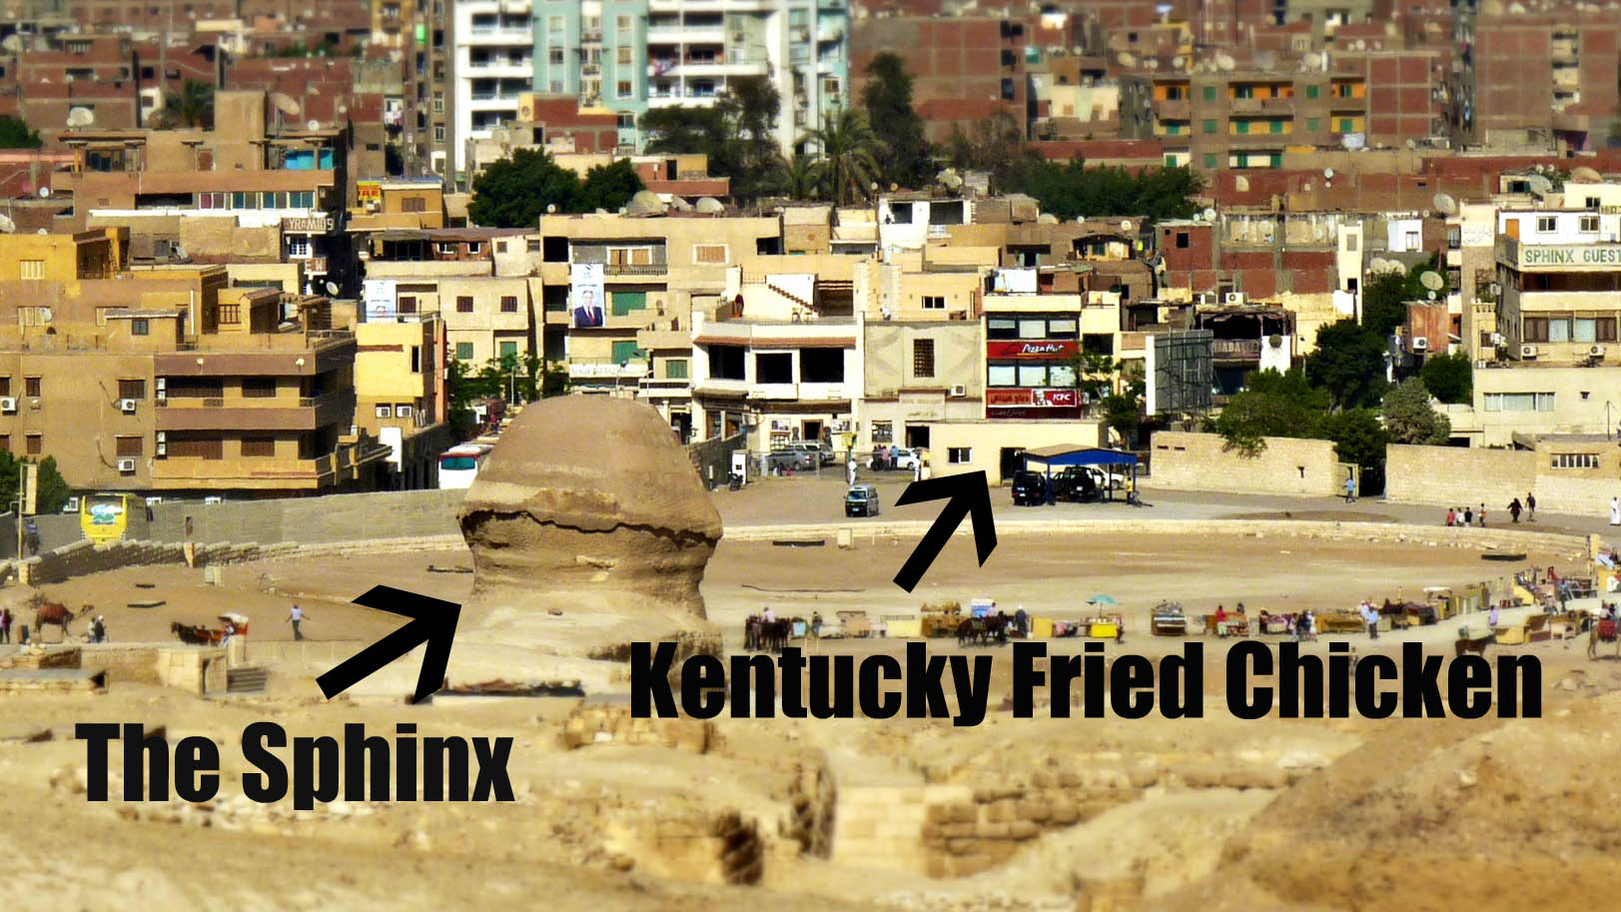

Slide 18
TV and film
Poldark has had a positive representation on Cornwall and has boosted tourism in the area. The Lord of the Rings films has brought a 50% increase in tourism to New Zealand.
Many crime dramas such as Taggart, featuring Glasgow, has had a negative representation.

Slide 19
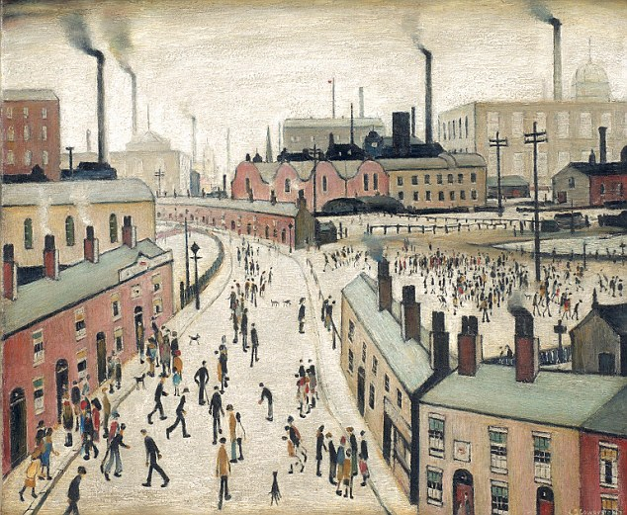
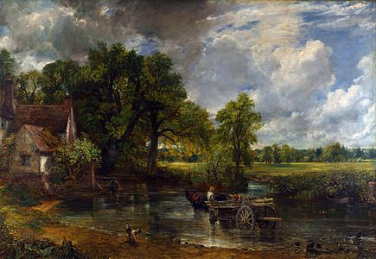
Art
Examples include John Constable known for his Suffolk landscapes and L.S. Lowry and his Industrial landscapes of Northern England

Slide 20
Audio History
Listen carefully to the audio clips of Godalming and make brief notes of what the area was like in the past and how it has changed.

Slide 21
What are the advantages and disadvantages of qualitative data?
Discuss
https://www.coolgeography.co.uk/advanced/Investigating_places.php
Use the above link to make notes on the advantages and disadvantages of using maps, census data, paintings, photos and poetry
A great video clip explaining how to analyse representation of place
https://timeforgeography.co.uk/videos_list/cities/geographical-meanings-and-representations/

Slide 22
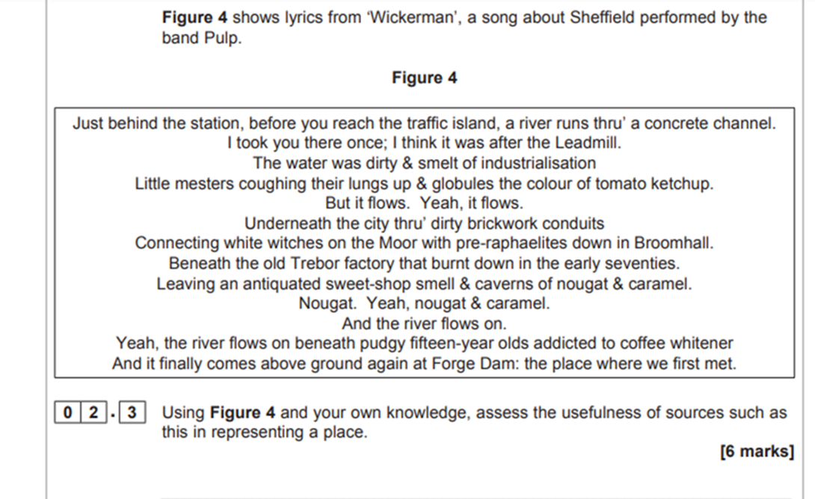
Read carefully through this mark scheme and carefully consider the A01 and AO2 marks that can be gained. Once you have done this have a go at the following two questions.

Slide 23
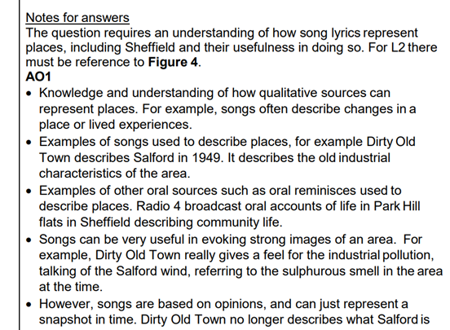
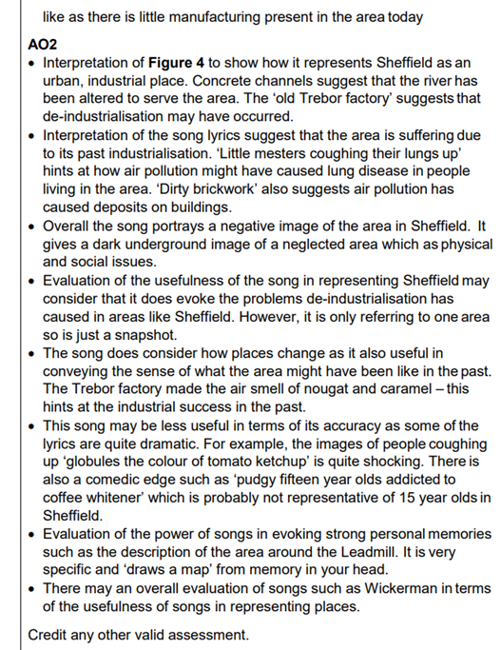

Slide 24
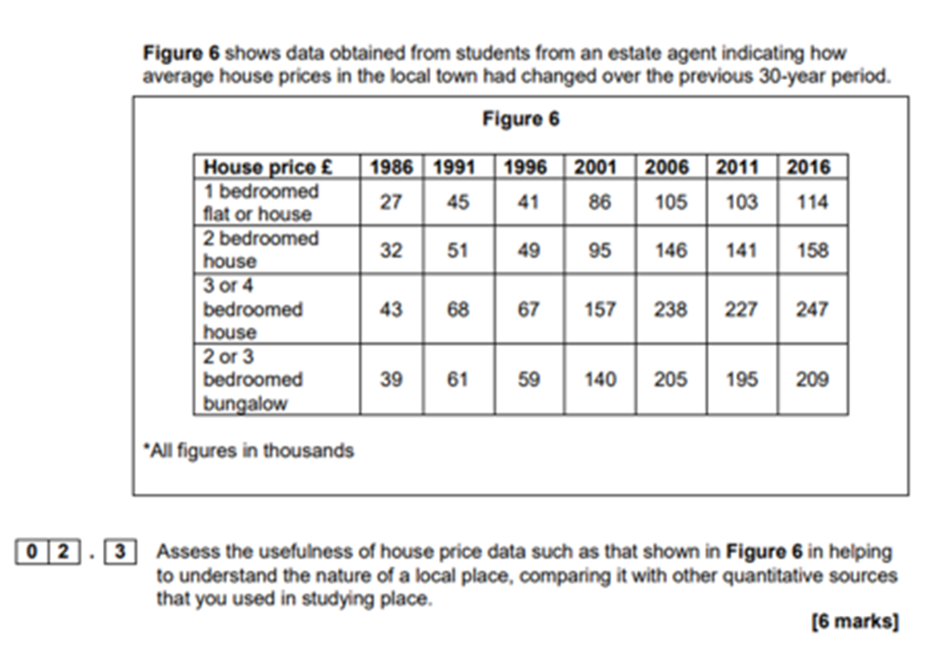

Slide 25
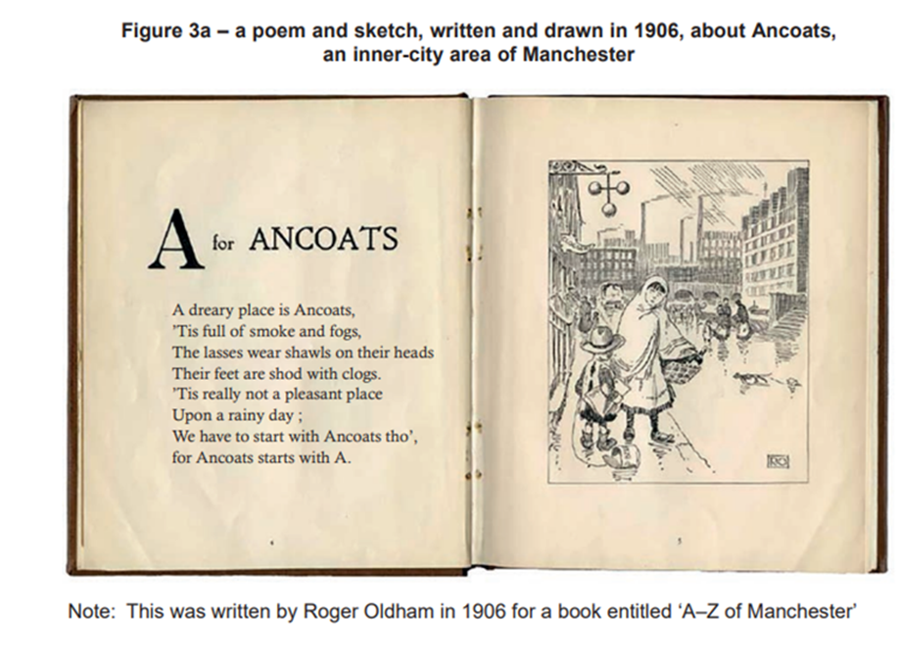
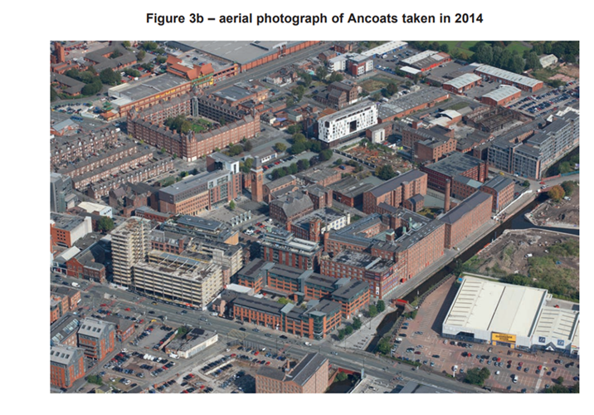
November 2021 paper

