Slide 1
Pre-work/Flipped learning
Review Changing Places case study work on Detroit. Identify causes and consequences of de-industrialisation in Detroit.

Slide 2
Contemporary urban environments
• Urban change: deindustrialisation, decentralisation, rise of service economy.
Learning Objectives:
Describe and explain the processes of deindustrialisation, decentralisation and rise of service economy.
Key words:
Suburbanisation Counter-urbanisation
Urban resurgence Deindustrialisation

Slide 3
Recap Task - complete the following.
TASK: Can you remember the key term definition of De-industrialisation covered in booklet 2?

Slide 4
TASK: Can you remember the key term definition of De-industrialisation covered in booklet 2?

Slide 5
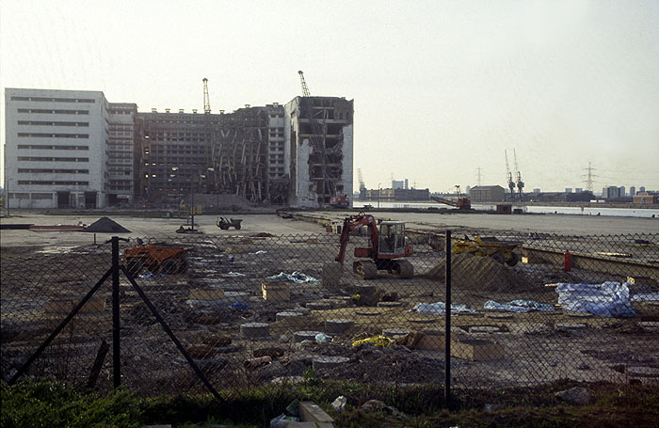
Deindustrialisation is the long-term decline of a country’s manufacturing and heavy industry.

Slide 6
Competition from abroad,
particularly the rapidly
industrialising countries of the time
such as Taiwan, South Korea, India
and China.
Mechanisation: most firms can
produce their goods more cheaply
using machines rather than people.
Causes of Deindustrialisation
Reduced demand for traditional products as new materials and technologies have been developed.

Slide 7
Impacts of de-industrialisation

Slide 8
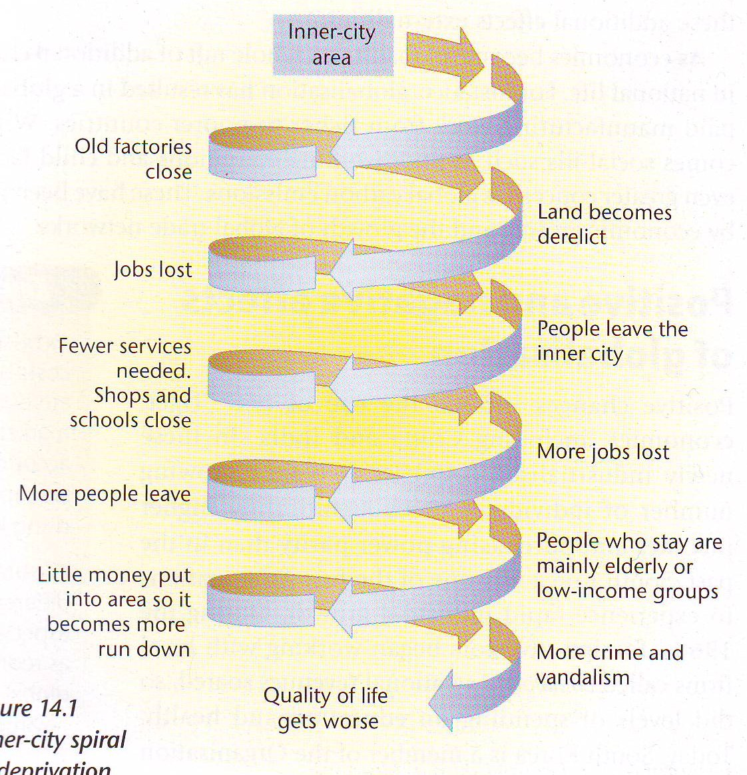
The inner city spiral of decline
Deindustrialisation meant long term unemployment in previously industrial cities e.g. London, Detroit leading to longer term social problems.
TASK: Does Detroit show evidence of the inner city spiral of decline? Use evidence including facts and figures from the Changing Places case study to support your answer.
Notes:
Briefly remind pupils of the process of deindustrialisation.

Slide 9
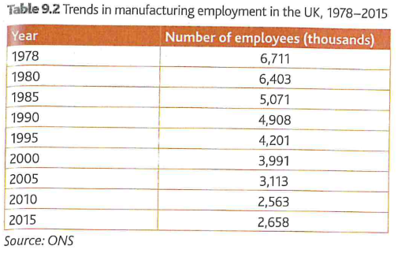
Urban Change in the UK
TASK: What trends does the table show?
How could you show manipulation of data in your answer?

Slide 10
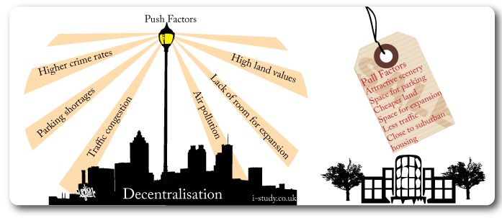
Key Term: Decentralisation
The process of redistributing people, functions or power away from the centre to the periphery.

Slide 11
Decentrialisation
Manufacturing cities and inner city areas were most affected. Name examples we have studied.
Inner cities lacked suitable land for expansion of existing manufacturing.
New investment focussed on the edge of urban areas or more rural locations.
This movement was part of a wider process ‘decentralisation’ which also affected residential and retail land use in the late 20th century.

Slide 12
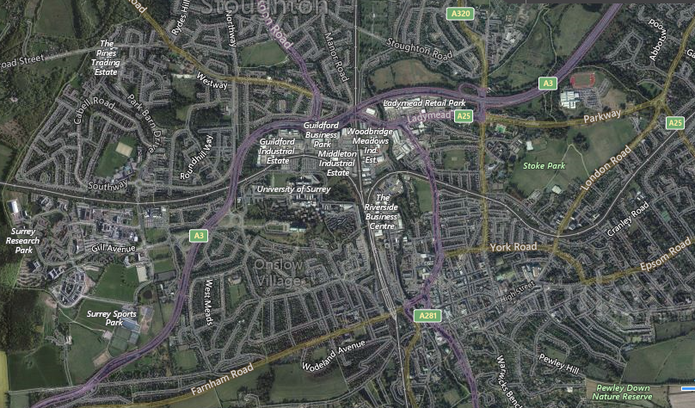
TASK: Study the map of Guildford and label examples of decentralisation

Slide 13
More Space on outskirts
Custom built business parks, industrial estates, shopping developments with
Space for expansion and car parks.
-
Easier access/Increased mobility
-Increased car ownership and use of private car
-Traffic congestion in town centres. Parking is expensive and restrictive
-Free parking, close to the shops/businesses out of town
-Easier to park at a petrol station for convenience goods rather than a local store
-Accessible business parks, industrial estates, shopping developments.
Shopping as recreation
-Seen as family social activity
-Shopping centres include cinemas, cafes and play areas
What factors have affected
decentralisation
Land values
-Often higher in town centres, leading to high rents. 500% increase
-Cheaper on the outskirts.
Government Policies
Relaxing of planning regulations
making it easier to build on the outskirts.

Slide 14
Analyse the graph on structural shift in employment.
Scan of graph p129 Oxford
P – Pattern A – Anomalies D - Data (manipulation) L - Links

Slide 15
The rise of the Service Economy
The decline in the manufacturing employment in the late 20th century was accompanied by the rise of the service economy.
The service economy covers a range of activities including:
Tertiary activities: financial services e.g. banking, accountancy and insurance.
Quaternary activities: knowledge and ideas are the main output e.g. advertising, computer programming, software design.

Slide 16
Population growth fuels the service sector but it has also grown
because:
Financial services are needed to support manufacturing industries, which are still important in many cities today
As societies become
more technologically
sophisticated, they
need a larger range
of specialised services to keep them running
What caused
the rise of
service economy?
As societies become wealthier, they demand more leisure and retail services

Slide 17
TASK: Whilst the growth in the service sector has reduce unemployment why has it not solved all the problems of de-industrialisation in urban areas? Consider examples we studied.

Slide 18
TASK: Whilst the growth in the service sector has reduce unemployment why has it not solved all the problems of de-industrialisation in urban areas? Consider examples we studied.
Lack of skills for the new service jobs.
Many staff who lost jobs suffer from long-term unemployment.
Many service jobs are part-time or temporary.
The number of service jobs created has not always equalled the loss of manufacturing.
Inner city locations are often avoided by service industries or newer manufacturing companies.

Slide 19
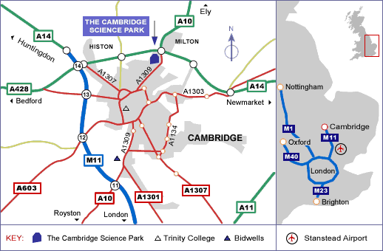
Location map – Cambridge Science Park
TASK: Study the map, read the extract (on next slide), watch the video clip (link below) and suggest reasons why the Cambridge Science Park is located here. What type of businesses is it aimed at

Slide 20
What is the purpose of a Science Park?
https://www.youtube.com/watch?v=jeZWeFyL6EQ
Video clip link on Cambridge Science Park

Slide 21
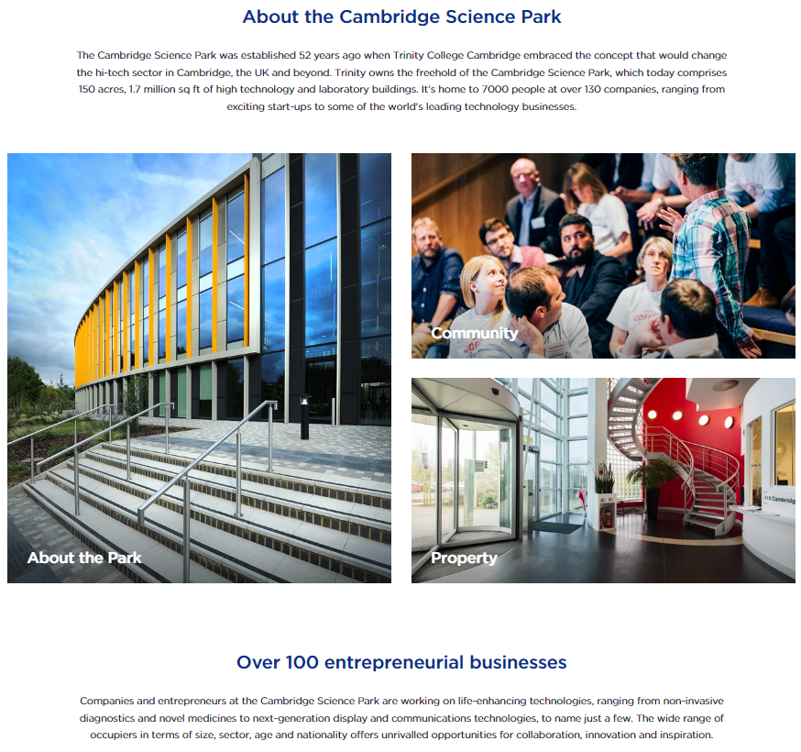
TASK: Look at the list of companies at
Cambridge Science Park - Building a better world
Name examples of types of industry and businesses that are located at Cambridge Science Park.

Slide 22
Complete the following.

Slide 24
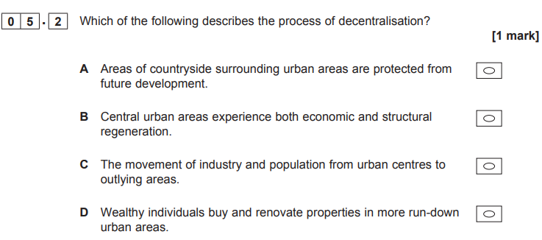
AS June 2019

Slide 25
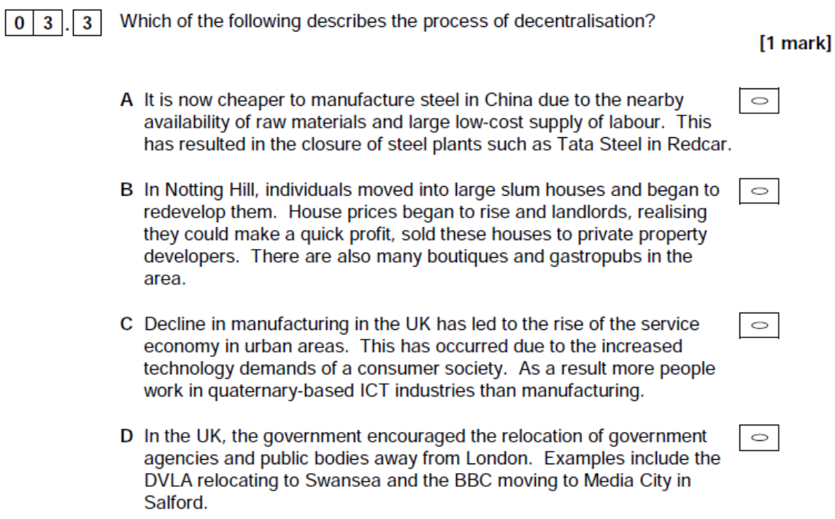
Exam Question

Slide 26
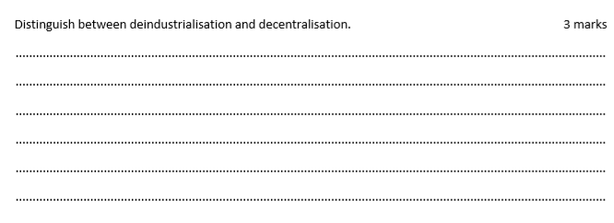
Exam Practice – AS Zig Zag

Slide 27
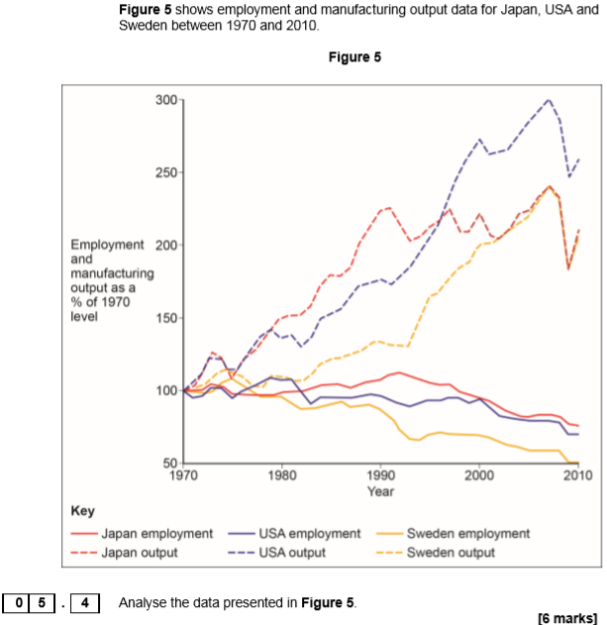
Exam question AS Paper 1 2017
PADL
Pattern-overall trend,
Anomaly,
Data - simple data lifted from resource and data manipulation,
Links - can they link two graphs/resources or show understanding.

