Slide 1
Godalming Fieldtrip Preparation Work

Slide 2
Thursday 1st December
Time in Godalming Microclimate session time
3M2 12.30-2.30pm 12.30-1.15pm
3D1 1.15-3.15pm 1.15-2.00pm
Meeting point:-
Outside Fat Face
You will be required to sign in with a teacher at the start of your fieldwork session and at the end.
You will also need to ensure that you turn up on time in your groups for your microclimate session so that equipment can be issued to you.

Slide 3
Friday 2nd December
Time in Godalming Microclimate session time
3M1 10.45-12.45 10.45 -11.30
3G1 10.45-12.45 10.45 -11.30
3E1 12.30-2.30pm 12.30-1.15pm
3C1 1.15-3.15pm 1.15-2.00pm
Meeting point:-
Outside Fat Face
You will be required to sign in with a teacher at the start of your fieldwork session and at the end.
You will also need to ensure that you turn up on time in your groups for your microclimate session so that equipment can be issued to you.

Slide 4
Purpose of trip
To explore a range of data collection techniques that could be used to answer the following potential investigation titles:-
To what extent is Godalming a ‘Placeless Town’?
How globally connected is Godalming town centre?
How does the microclimate of Godalming change?

Slide 5
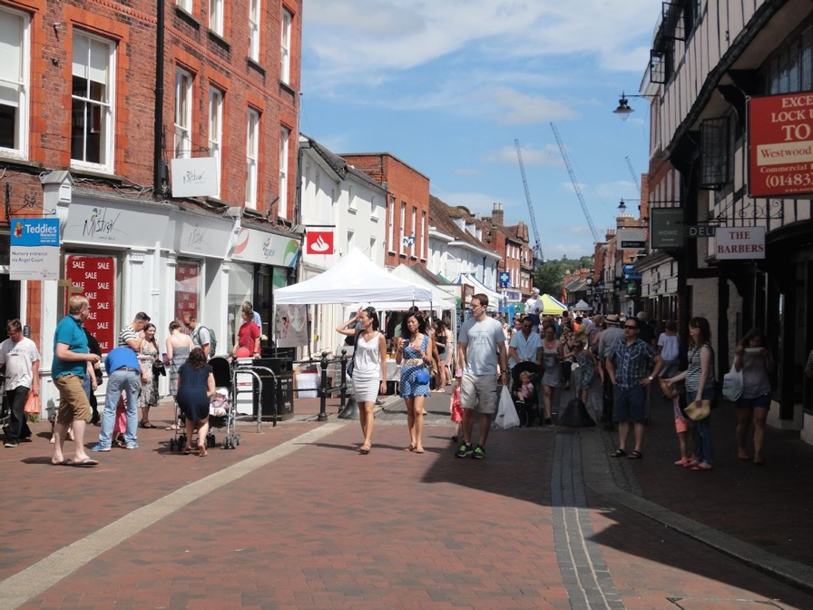
To what extent is Godalming a ‘Placeless Town’?
How could we test this?
How could we test this?

Slide 6
To what extent is Godalming a ‘Placeless Town’?
Clone town survey
Photographs to show any features which might represent the identity of Godalming
Questionnaires – asking individuals a series of questions as to how they feel about Godalming and if they think that it has an individual character

Slide 7
Clone town survey
  Where do you think you will start your survey? What will you need to consider?

Slide 8
Questionnaires
What sort of questions can you ask?
  Closed questions – those that you answer with a yes or no. e.g. Do you live in Godalming?
  Questions with a choice on answers. e.g. Why have you come to Godalming today? Shopping, work, appointment or other
  Questions that allow people to rate their opinion on a scale. e.g. on a scale of 1 to 5 with 5 being high and 1 being low, how would you rate the schools in Godalming?
  Open questions – What 3 words would you use to describe Godalming?
How useful are the above questions in answering our question:
To what extent is Godalming a ‘Placeless Town’?
In pairs come up with a range of questions which will help you investigate the question. These questions are the ones that you will use on the day.

Slide 9
Think about who you want to ask and what you need to know about them.
You may need to make sure that you ask people who live in Godalming and not tourists. You could ask if they live in Godalming in the questionnaire.
You may wish to check you get a range of ages to see how people’s opinions differ. How might you ask people’s ages without offending them?
What sampling technique will you use?
Where will you conduct the questionnaire?
How many questions and how many questionnaires to complete? People will not want to spend too long answering questions so make it quick and easy to complete
How many questionnaires to complete? You need a decent number of questionnaire so that your research is detailed enough. (At least 25-50 is a good number – the more the better)

Slide 10
Be polite…and smile
Explain briefly what you are doing. (Most people will be willing to stop for school/college kids so use that!)
Wear your college lanyard and make sure that it is visible
Be willing to accept the “no I’m very busy”, and do not been offended when you are rejected

Slide 11
Respondent | Resident of Godalming (yes/no) | Age range category | Reason for visit | Education rating | Words used to describe Godalming
1
2
3
4
5
6
7
8
9
10
Design a recording sheet for your responses

Slide 12
The Chi Squared Test is a statistical test that is often carried out at the start of an intended geographical investigation.
We may have noticed a pattern, distribution or anomaly in a feature of the human or physical world and have a hunch that ‘something is going on’ to produce it.
The Chi Squared Test tells us whether our ‘hunch’ is statistically significant – i.e. that – yes, we have noticed a valid geographical phenomenon that deserves further investigation as part of a geographical enquiry. Alternatively, it can indicate that what we think is a ‘phenomenon’ is actually just a random variation in the feature we’ve noticed, and doesn’t deserve further investigation or research.
So it’s a test to indicate: ‘There’s something valid going on here – investigate it further and work out what it is and what’s causing it’, or ‘Don’t waste your time – it’s just ‘chance’ or ‘random events’ that you’re seeing – move on and give your time to studying some other aspect of geography.
I have a hunch that the students in this room prefer marmite to jam or peanut butter.
I am going to test this hunch to see if it is statistically significant. If it is, I will then investigate it further.
With chi squared tests we come up with a null hypothesis.
What do you think this could be for this example?
There is not/no ……………..

Slide 13
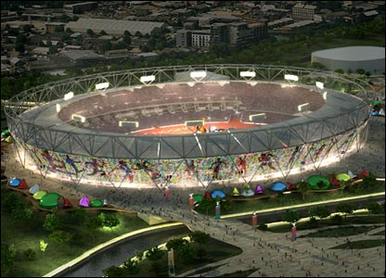
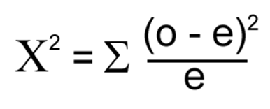
Performing the calculation
You would use chi-squared if you were investigating difference between what you actually observed (by collecting primary or secondary data) and what you might normally expect to find.
Here is an example from a piece of human geography research into urban development relating to the 2012 Olympics site. First, look at the chi-squared formula:
o = the observed frequencies
e = the expected frequencies
Σ = the ‘sum of’

Slide 14
Case Study: Using chi-squared to analyse questionnaire responses
A student collected data on local people’s viewpoints about the building of the 2012 Olympic venue in Stratford, east London. She was interested in seeing if viewpoints changed according to the perspectives of different groups.
Method
She decided to collect 20 responses from each category of local person. After this, she discontinued the data collection. She know nothing about the local population’s demographic characteristics and did not try to reflect this in her study. Her questionnaire was a survey of viewpoints about the usefulness of the new Olympic developments for different groups (categories) of locals. This is the statement she posed:
‘The 2012 Olympic Games development will be of benefit to the whole community of Stratford, east London.’
1 | 2 | 3 | 4
Strongly agree | Agree | Disagree | Strongly disagree

Slide 15
She wanted to find out if the type of local person influenced feelings about how useful the developments would be. She was particularly interested in those who felt negatively about the Olympic developments (disagreed or strongly disagreed)
Here are the results of the survey. The residents had to choose which category best suited their own characteristics. Some of those questioned could have fitted into more than one category. For example, a business owner may also be a local resident. In this case the person questioned was disregarded from the study. Remember that 20 people responded from each category and she only recorded the frequency of negative response, i.e. those who either disagreed or strongly disagreed with the statement/
Category (type) | Frequency of negative responses (Observed values: o)
Business owner | 4
School student | 6
Adult male resident | 14
Adult female resident | 10
Senior citizen | 16

Slide 16
The student added up the number of times a negative response to the question above was given. You can see that the categories seem to show large differences of opinion between the groups.
A glance at the results suggests that different groups have responded very differently to the questionnaire. The chi-squared calculation helps us decide if there is a statistically significant difference between the groups. You can then use the critical values to assess the likelihood of the results being a chance or fluke set of figures.
The first task is to generate a null hypothesis (Hₒ):
‘There is no significant difference between the category of local person and the frequency of negative response.’
Now lets test this null hypothesis (Hₒ). It is much easier to start the calculation with a table.

Slide 17
 | Business owner | School student | Adult male resident | Adult female resident | Senior citizen | Total
o | 4 | 6 | 14 | 10 | 16 | 50
e | 10 | 10 | 10 | 10 | 10 | 50
o - e | -6 |  |  |  |  | --------
(o – e)² | 36 |  |  |  |  | --------
(o – e)² e | 3.6 |  |  |  |  | --------
x² | 3.6
In this example, the expected data (e) is simply taken as being the mean negative frequency of response. It is calculated by adding up all of the observed data (o) and then dividing by the number of categories, i.e. 5. This gives an expected frequency of 10 for each category.

Slide 18
 | Business owner | School student | Adult male resident | Adult female resident | Senior citizen | Total
o | 4 | 6 | 14 | 10 | 16 | 50
e | 10 | 10 | 10 | 10 | 10 | 50
o - e | -6 | -4 | 4 | 0 | 6 | --------
(o – e)² | 36 | 16 | 16 | 0 | 36 | --------
(o – e)² e | 3.6 | 1.6 | 1.6 | 0 | 3.6 | --------
x² | 3.6 | 1.6 | 1.6 | 0 | 3.6 | 10.4
In this example, the expected data (e) is simply taken as being the mean negative frequency of response. It is calculated by adding up all of the observed data (o) and then dividing by the number of categories, i.e. 5. This gives an expected frequency of 10 for each category.

Slide 19
Interpreting your Chi-Squared Value
Negative responses = 10.4
Calculate degrees of freedom:
  df = n-1 (where n is the no. of categories)
  In this case df = 5 - 1 = 4
Use a critical values table to work out the significance of your result.
Significance tells us how confidently we can disprove the null hypothesis

Slide 20
Interpreting your Chi-Squared Value
Negative responses = 10.4
4 degrees of freedom.
Critical values for 4 df are:
Confidence level | 0.10 90% | 0.05 95% | 0.01 99% | 0.005 99.5%
Critical value | 7.78 | 9.49 | 13.28 | 14.86
What do our results mean?

Slide 21
Interpreting the results
The value of x² = 10.4
Using degrees of freedom and significance levels we can decide whether we are able to reject the null hypothesis (Hₒ) of:
There is no significant difference between the category of local person and the frequency of negative response.’
For this study, the degrees of freedom is calculated as n - 1, where n is the number of categories in the sample. As were 5 categories, there are 4 degrees of freedom
In order to reject the null hypothesis (Hₒ), our chi-squared score must be greater than the critical value at the 0.05 level of significance. Our value of 10.4 is higher than the 0.05 level of significance value of 9.49, therefore we can reject the null hypothesis (Hₒ).
Confidence level | 0.10 90% | 0.05 95% | 0.01 99% | 0.005 99.5%
Critical value | 7.78 | 9.49 | 13.28 | 14.86

Slide 22
Look back at the questions on your questionnaire.
Have you a question that will give you data to do a chi squared test? If not add one.

Slide 23
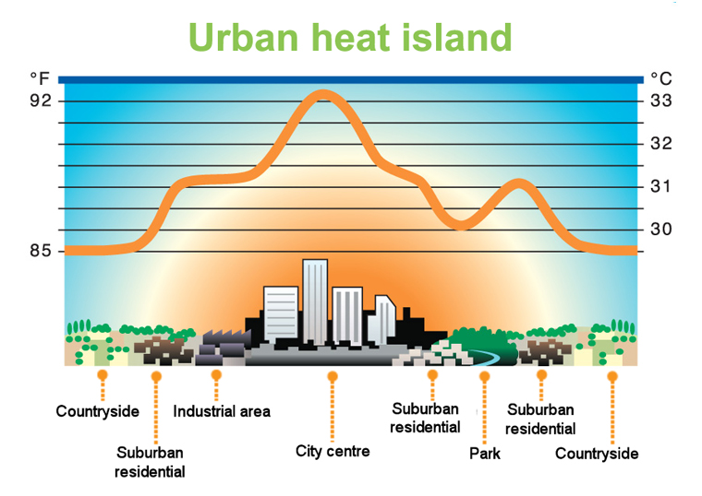
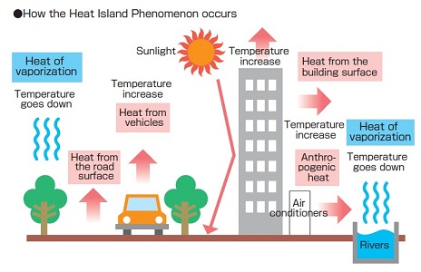
Does Godalming have on urban heat island?
Hypothesis to test:
Temperature will decrease as you move further from the town centre

Slide 24
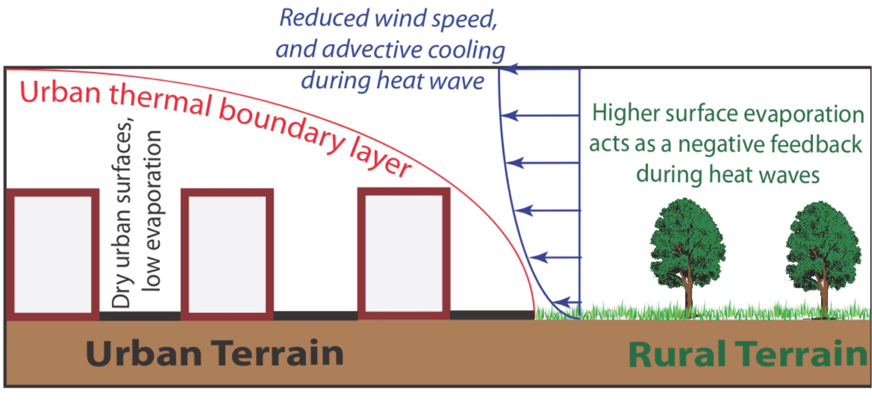
Hypothesis to test:
Humidity will increase as you move further from the town centre

Slide 25
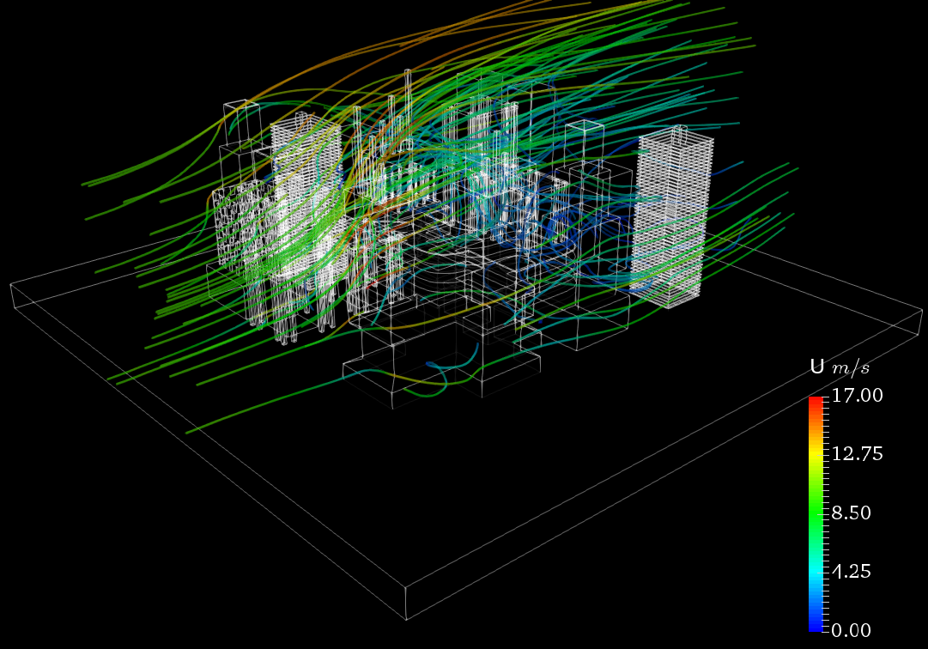
Hypothesis to test:
Wind speed will increase as you move further from the town centre

Slide 26
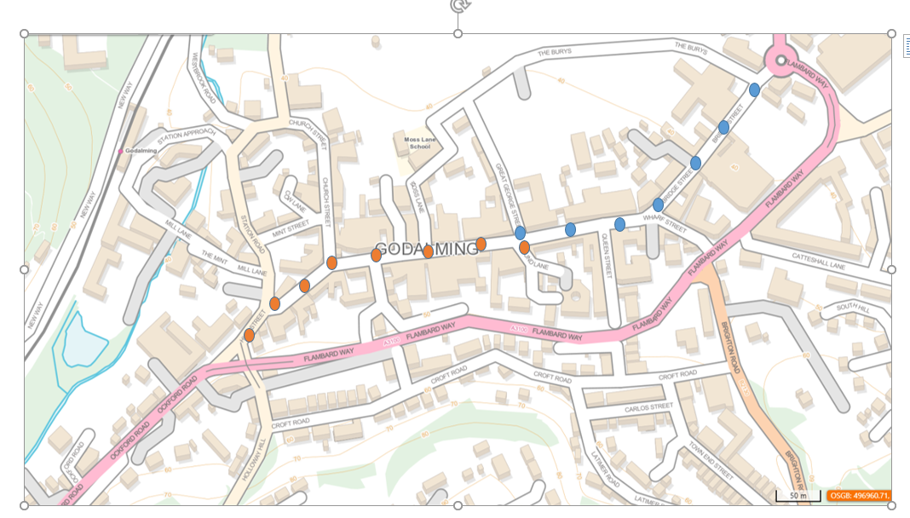
Your group will either be assigned the transect going west (orange dots) or the transect going east (blue dots). You will recording temperature, humidity, wind speed (mph), wind direction and whether the sample point is in the sun and shade every 50m.
Surface type is also another factor that could be recorded but we are not going to record it on this occasion as we will be walking along the high street and the surface type is likely to be similar throughout the transect.

Slide 27
Distance from starting point – corner of Great George Street (WEST) | Temperature °C | Humidity % | Wind speed (mph) | Wind direction | Sun/shade | Surface type
0 |  |  |  |  |  | Not applicable for this transect. We are walking down a high street and so the surface type will not vary. However, it may be something to record if different surfaces e.g. grass were encountered. Surface type
50m
100m
150m
200m
250m
Distance from starting point – corner of Great George Street (EAST) | Temperature | Humidity | Wind speed | Wind direction | Sun/shade
0
50m
100m
150m
200m
250m
300m
Recording table

Slide 28
How globally connected is Godalming town centre?
What is globalisation?
  A process by which national economies, societies and cultures have become increasingly integrated through the global network of trade, communication, transportation and immigration.
What evidence do you think there is of globalisation in Godalming?

Slide 29
Data collection tasks:
International business survey
International product survey
Mapping evidence that represent Godalming’s links with the wider world (blank map provided)
Photos evidencing globalisation (make sure that you map the location of your photo on the blank map)

Slide 30
International business survey
Start at one end the High Street and record the first 50 shops that you pass from wherever you start. As you walk along the High Street fill in the form in the booklet and note whether the company is owned by an International brand or not. You may need to google this or go in and ask. At the end you will have a list of different businesses and whether they tend to be global brands or not. You could then calculate the ratio or proportion of local/national versus international businesses.

Slide 31
International product survey
Name of shop | Products found and where grown/made
Choose 5 different shops in Godalming (make sure that they are not all the same e.g. food shops). Try to do this systematically e.g. every 5th shop. Randomly select 5 items from each shop and record where the product was made or grown. This can then be plotted on a map. Make sure that you record the name of the shop

Slide 32
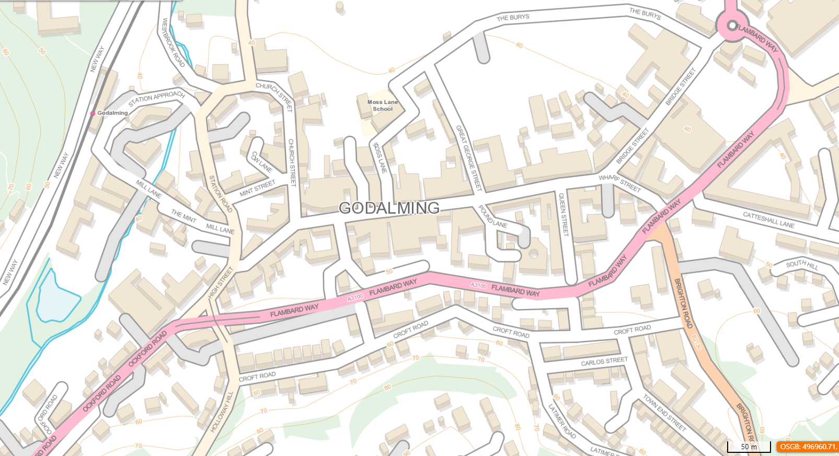

Slide 33
Ethical dimensions
Be ethical
When planning your fieldwork you need to consider the ethical implications that your fieldwork might have. These considerations then need to be included in your write-up.
You will need to ensure that you minimise the harm that your investigation may have upon the environment and the people in it.
P63-64 in the coursework workbook contains further information on ethical dimensions to fieldwork
Create a mind map of the ethical dimensions which need to be considered when on your fieldtrip to Godalming.
How might these ethical dimensions differ to when you went on the fieldtrip to the Witterings?

