Slide 1
Guildford Fieldtrip Preparatory Work
Aims
To create survey forms to be used on the Guildford Fieldtrip
To choose suitable sampling points
To consider the risk assessments and ethical considerations needed for an urban study

Slide 2
ArcGIS has many functions that you can use for your NEA and the Esri for Schools website has a wide range of teaching resources, including videos that can guide you through the different functions. (You have already explored some of these functions when completing the pre-work)
We do not have time in class to go through all of them – it is up to you as to whether or not you choose to use the resources available, and to do some further research on the ArcGIS capabilities.
ArcGIS is a new tool for us too and so if you find some useful functions please do share these with your teacher!

Slide 3
Guildford Fieldtrip – to investigate
How does central Guildford vary in land use, quality of the environment, footfall and/or characteristics of cultural quarters.
How does land use change from the centre of Guildford to the outskirts?
How has gentrification impacted the area to the north of York Road, Guildford
How does the urban land use in central Guildford vary and is regeneration required in some areas?
How does Guildford show evidence of sustainability?

Slide 4
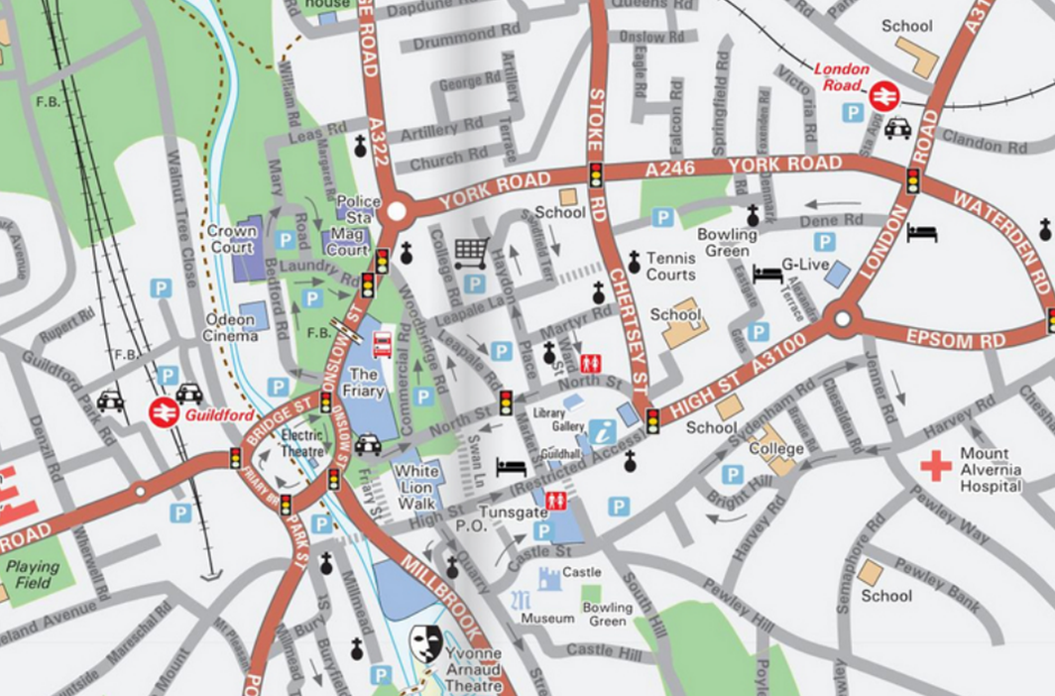
Meeting Point – The Friary
10am

Slide 5
Data collection methods to be used in Guildford
Environmental quality surveys
Land use surveys
Pedestrian counts
Housing decay surveys
Retail value assessments
Questionnaires
Photographs
Sustainability index
You will be working in groups of 3-4 people to complete the required survey forms for this fieldtrip. You will need to discuss how things should be done and allocate tasks to individual members of your group. It is important that you discuss what needs to go into the forms and where your sampling points will be before doing any individual work.
The survey forms will then need to be shared with team members.

Slide 6
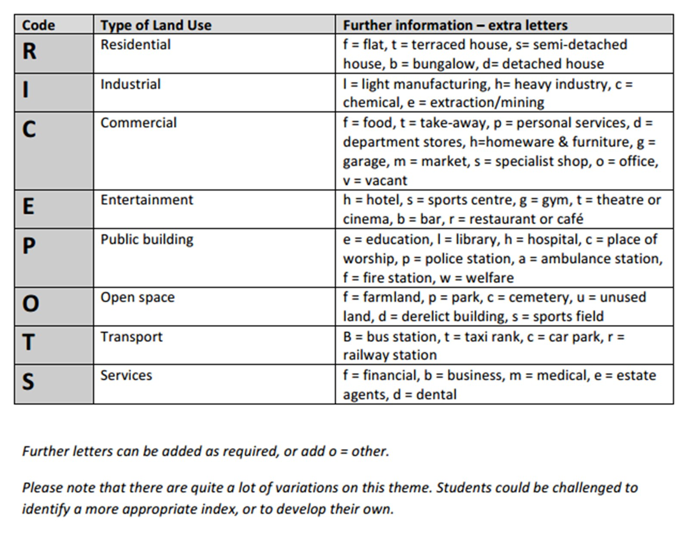
Measuring land use function
You are going to complete 2 land use surveys in Guildford.
One comparing land use between the High Street and North Street.
The other a 1km transect coming outwards from the city centre towards the suburbs.

Slide 7
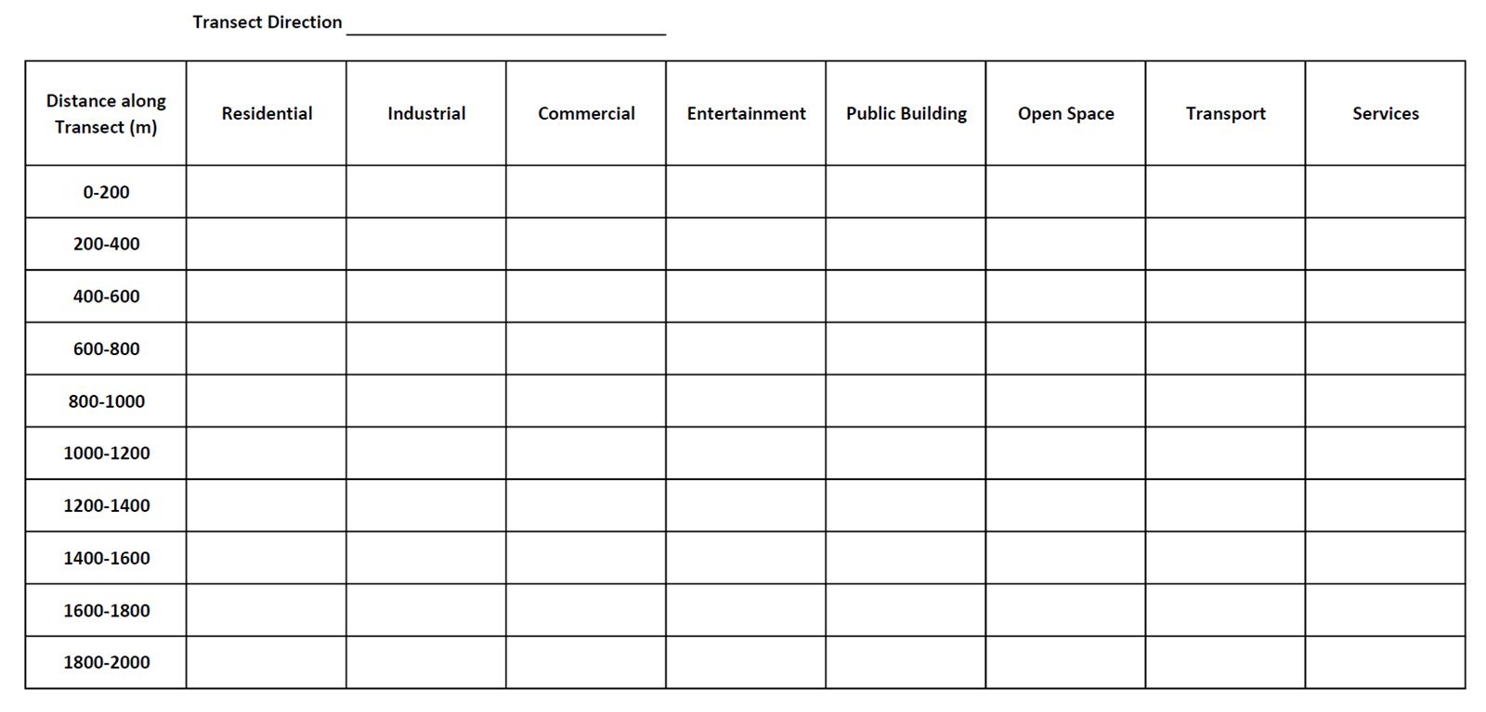
You could collect the land use data systematically like in this table. This would work well along your 1km land use transect.
For the town centre you will collect your data at every land use change. This is more suitable for smaller areas like the two streets being compared, where land use changes frequently.
You will need to use the map function in ArcGIS to identify a suitable 1km transect that has a variety of land use changes (follow a road so that it is accessible). Use the measure tool that you practiced in the pre-work to identify locations every 100m. Create a map and mark on those sampling points.
Create a survey form on ArcGIS which will enable you to collect land use data along the 1km transect.
Create another survey form that can then be used to record land use change along the High Street and North Street.

Slide 8
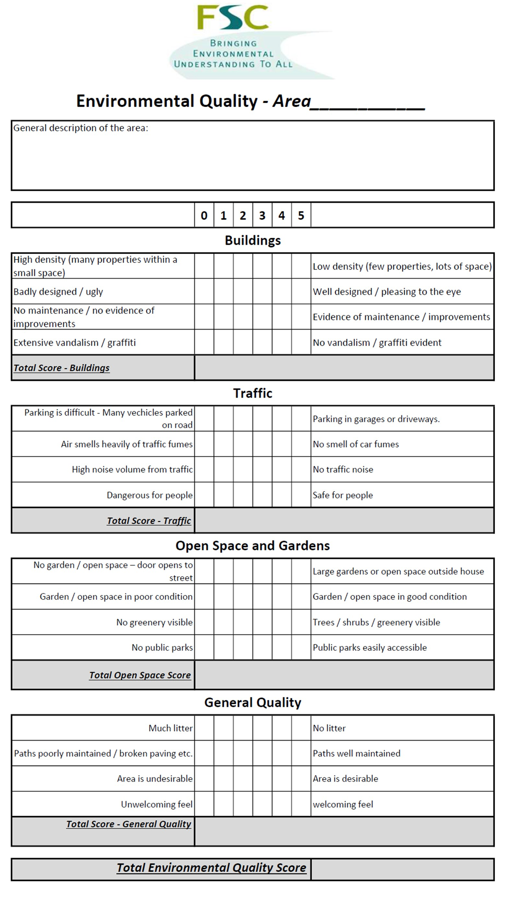
Environmental quality survey
An environmental quality survey uses an observer’s judgements to assess environmental quality against a range of indicators. Often they work on a sliding scale of quality (like 1 to 5) to represent less good to good. Alternatively you can use a Bi-polar scale (like -5 to +5) to indicate a negative assessment through to a positive assessment, with 0 representing neither good or bad.
As it is based on personal judgements the data collected using environmental quality surveys is subjective. Benchmarking the scoring between different observers will help reduce this subjectivity.
Sampling for environmental quality surveys within a study:
Either an overall judgement of an area – walk around the whole area and then complete the survey as a summary or at a number of points within the area – which may be selected using a random, systematic or stratified sample
Create a survey form to collect information to examine the environmental quality of two contrasting areas. You could choose to do it between two areas of the town centre or two different streets north of York Road. You have examples of two different environmental quality surveys in your handout – think about which questions will be most relevant for your chosen areas. Include the ability to record photographs in your surveys.

Slide 9
Pedestrian surveys - advice from Field Studies Council (FSC)
Think about the which day of the week to count pedestrians. Pedestrian numbers are likely to be higher on a Saturday or Sunday then during the week, during school holidays, during dry weather and if there is a popular event happening in the city centre
Time of day is also important. Pedestrian numbers are likely to be higher during "rush hours" (like 8am-9am) or shift changes and during office lunchtime. Around 11am and 2.30pm are often good times to choose.
You need at least 20-25 survey points. Choose survey points across the city centre. If you are working in groups, each group can walk different routes across the city centre.
This is up to you, but make sure that you survey in the same way each time. Think about how long to count pedestrians for - 2 minutes is enough. If your survey points are close together (perhaps every 100 metres), you might be able to do 3 or 4 pedestrian counts in 10 minutes. Whether to count people on one side of the road or both sides of the road - if you are working in groups, different members of the group could count different sides of the road, with someone else holding a stopwatch.
Decide where you are going to do your pedestrian surveys. This is a learning exercise and so you do not need to do the number of survey points recommended above. Instead choose four locations (You may wish to choose locations in the two study areas used for the retail survey) and create a survey form to collect this data.

Slide 10
Retail Value
An indicator that regeneration might be required in an area is to look at the retail value. This might also be a useful form of data collection for investigations linked to clone town surveys and sense of place or whether an area would benefit from regeneration. There are likely to be areas of higher and lower retail quality in Guildford City Centre. One way in which this can be done is to choose a study area, then score each shop within the area as follows:-
Shop type Score
Department store 5
High street chain 4
Independent specialist shop 3
Convenience store 2
Charity shop 1
Vacant retail premises 0
Identify two areas of Guildford Town Centre where comparisons of retail value can be made.
Create a survey form on ArcGIS that you can use to collect this data.

Slide 11
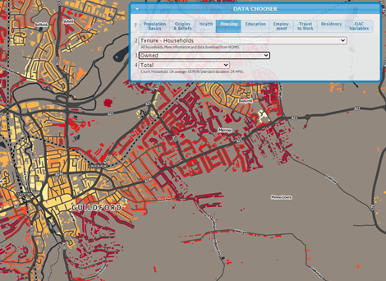
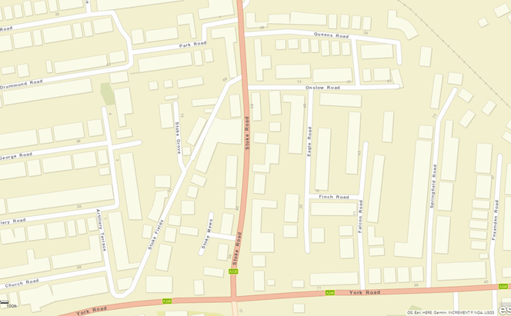
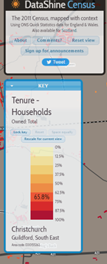
Map from ArcGis (Street view)

Slide 12
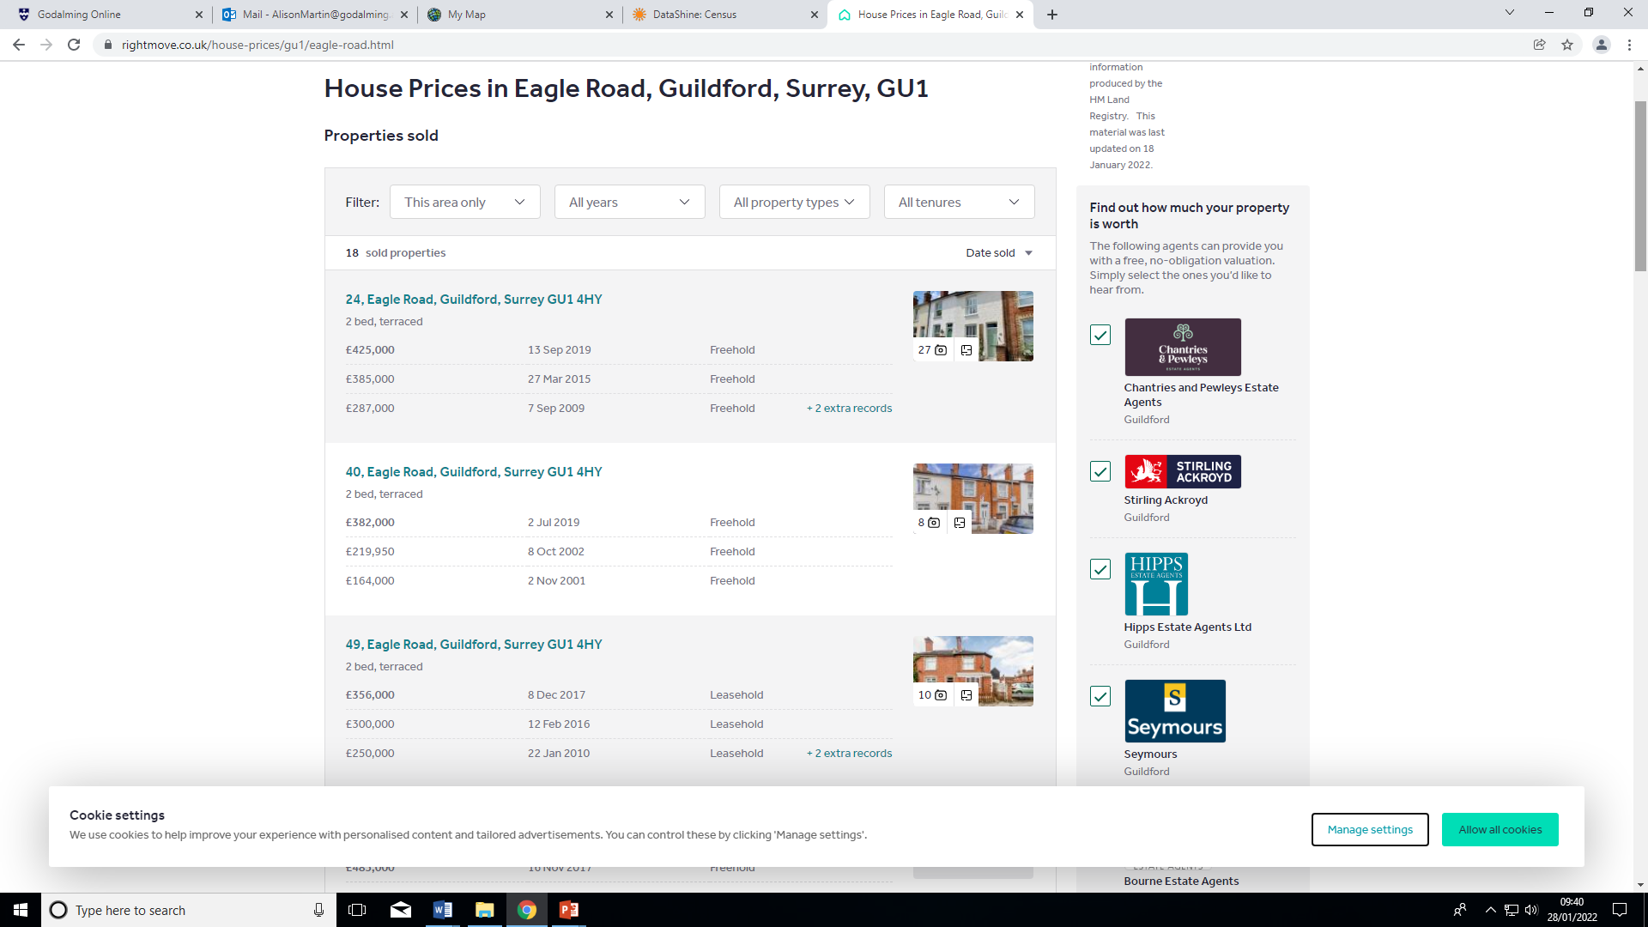
Website – Rightmove

Slide 13
Housing decay survey
You can also measure the condition of housing. Make sure that you sample houses fairly. You might, for example, choose to sample two streets picked at random, and then sample house numbers 5, 15 and 25 on each street. (Guidance from the FSC) Alternatively you could sample every 5th house. Whatever you choose to do you will need to be able to justify it.
Study a map of the area north of York Road and select two streets that you can survey. You may wish to use Google maps and street view to select suitable streets.
Decide what sampling strategy are you going to use (systematic, stratified or random) and create a survey form on ArcGIS to collect this data. Include the ability to include a photographic image of sample sites.

Slide 14
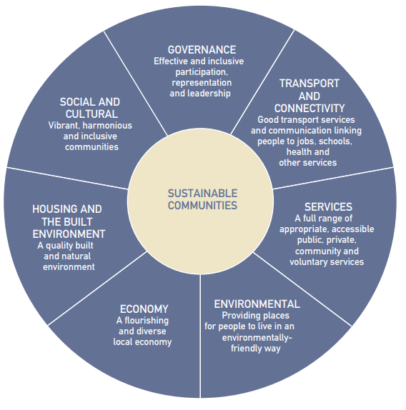
How does Guildford show evidence of sustainability?
Sustainability is defined as meeting the needs of the present without compromising the ability of future generations to meet their own needs.
The Egan approach to sustainability is a holistic approach that believes at the heart of being sustainable is:
  Making effective use of natural resources
  Enhancing the environment
  Promoting social cohesion and inclusion and
  Strengthening economic prosperity (The Egan Review, 2004)
Fieldwork could include: Fieldwork ideas and resources (geography.org.uk)
green spaces, recycling facilities and evidence of renewable energy use
congestion on the roads, presence of public transport and/or cyclists
signs of a vibrant local economy with independent shops and businesses
evidence of plentiful services such as schools and hospitals
urban design - does the city appear well-planned and aesthetically pleasing?
The Egan Wheel

Slide 15
Is Guildford active, inclusive, and safe? - Questionnaires – advice from FSC
Questioning can be quantitative or qualitative.
Closed questions. Answers are limited to single words, numbers or listed options. The collated data is quantitative.
Example: ‘Do you feel safe in High Street at 11pm?‘ Answers: Yes / No / Don’t know
Statements. There are two ways of presenting statements:
  (a) Semantic differential scale – use 8-12 pairs of words and a scale from negative to positive. For example:
  (b) Likert scale – ask participants whether they agree or disagree with a series of statements. Use 8-12 statements with a balance of positive and negative.
  Example statement: ‘High Street is safe at 11pm.‘ Answers: Strongly agree / Agree / Don’t know / Disagree / Strongly disagree
Open questions. Answers are detailed text. The data is qualitative. If the results are categorised, the number of responses per category (i.e. frequencies) can be treated as quantitative data. Example: ‘Is the High Street safe?‘
Questionnaires can cover a large sample population. They are useful for gathering data on people’s perceptions and experiences of place.
Threatening | -2 | -1 | 0 | +1 | +2 | Friendly
Dangerous | -2 | -1 | 0 | +1 | +2 | Safe
Isolated | -2 | -1 | 0 | +1 | +2 | Surveilled

Slide 16
Is Guildford active, inclusive, and safe? - Questionnaires – advice from FSC
Convenience sampling
Select people who are easy to reach, e.g. questioning/giving out a questionnaire to the first 100 people you see in the High Street on a particular morning.
Decide on the questions you are going to ask.
Decide where you are going to do your questionnaires. This is a learning exercise and so you do not need to do a large number of questionnaires. Instead choose one/two locations where footfall will be high and create a survey form on ArcGIS to collect this data.
Example questions:
Do you live in Guildford?
Do you think Guildford is a safe area?
Do you feel as if there is good community spirit in Guildford?
Do you think there are active and approachable police in Guildford?
Do you think there are low levels of antisocial behaviour in Guildford?

Slide 17
Sustainability Index - Fieldwork ideas and resources (geography.org.uk)
Create a survey form to collect the sustainability index data
Choose three locations to complete the survey and average your results.
Make a note of the places you undertook the surveys.
Decide where you are going to do your surveys. This is a learning exercise so choose two locations and create a survey form on ArcGIS to collect this data.
Site details (criteria) | 5 strongly agree – 1 strongly disagree (Total out of 35)
Site 1 Site 2 Site 3
Access to a full range of shopping facilities and services (toilets, litter bins etc).
Landscape and open space (evidence of public access to open spaces)
Urban environment (pleasant area and clean and tidy)
Cultural heritage (historical buildings protected from development)
Living accommodation (evidence of people living in centre – above shops, central flats etc)
Health, security and feeling of safety (CCTV cameras, security guards, police)
Transport efficiency (buses etc, cycle routes, bike locks etc).
Score – Total out of 35

Slide 18
Think about the different data collection methods that you will be piloting on the Guildford Fieldtrip. Which of the methods could help you to answer each of these questions?
How does central Guildford vary in land use, quality of the environment, footfall and/or characteristics of cultural quarters.
How does land use change from the centre of Guildford to the outskirts?
How do social, economic and environmental factors vary between two residential areas?
How does the urban land use in central Guildford vary and is regeneration required in some areas?
How does Guildford show evidence of sustainability?

Slide 19
Ethical issues
There are ethical issues that need to be addressed for all fieldwork trips e.g. not asking sensitive personal information when completing questionnaires and ensuring that all responses are confidential.
What ethical considerations might we need to take when completing housing decay surveys, completing questionnaires and taking photographs in busy areas?

Slide 20
Risk assessment
Use the same table as for the Witterings:
Risk | Level of threat (1 - 5 with 5 being high) | Likelihood of occurrence (1 - 5 with 5 being high) | Strategy to minimise threat

