Slide 1
Preparatory and follow up work
Fieldtrip 1 – East Head, The Witterings
Aims
To conduct research on the location, physical features and processes occurring at West Wittering
To understand how spearman’s rank and standard deviation can be used to analyse data
To practise presenting data in a variety of ways and how to critically analyse it

Slide 2
Background research for fieldtrip 1
Read through and make notes from each of the website pages from Chichester Harbour Conservancy. The notes you make will be used next lesson as a starter activity.
https://www.conservancy.co.uk/page/east-head
https://www.conservancy.co.uk/page/people-and-environment
https://www.conservancy.co.uk/page/sea-defence
Check flip learning task has been completed through Q&A

Slide 3
Explore the following website – The National Library of Scotland
https://maps.nls.uk/
There are two links that are particularly useful. These are the side by side viewer and the georeferenced maps.
Explore both of these typing in West Wittering as a location. With the georeferenced map you need to change the transparency of the overlay. Notice how the spit has changed direction over the years and how the coastline has been eroded.
Print out two maps of your choice to show how the coastline has changed over the years.

Slide 4
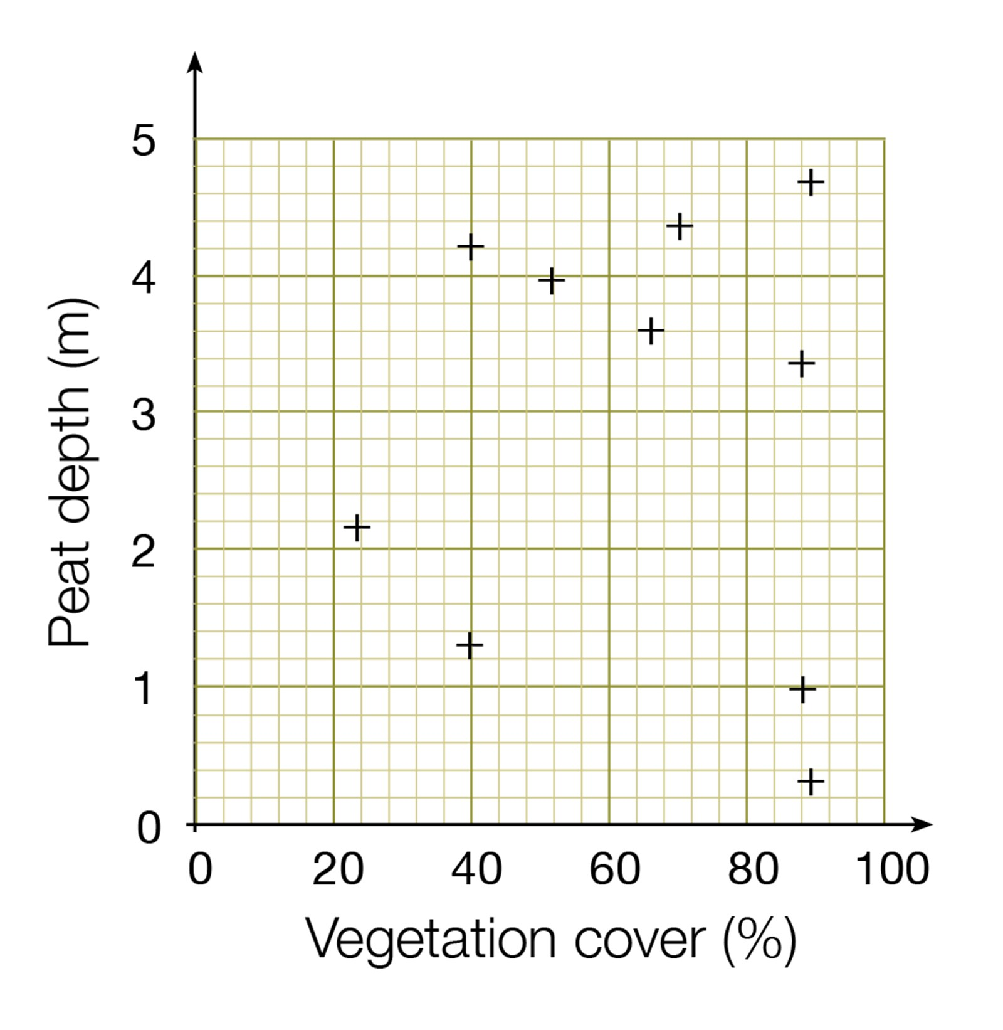
Spearman’s rank correlation
The Spearman's Rank Correlation Coefficient is used to discover the strength of a link between two sets of data.
If your data can be incorporated into a scattergraph you could conduct a Spearman’s Rank test to see how related they are.
At least 8 sets of data are required when conducting Spearman’s rank analysis and so this is something you need to consider before conducting your fieldwork.

Slide 5
 | Hours studied | % exam result
Tom | 10 | 32
Alice | 16 | 67
Mary | 5 | 52
Albert | 19 | 78
Stuart | 4 | 8
Victor | 12 | 56
Leonard | 20 | 88
Fiona | 15 | 60
Chris | 16 | 72
Fred | 13 | 59
For example you would expect that the more hours of revision a student does then the higher the exam result.
You could then collect data on both hours studied and result, rank the two sets of data and then conduct the statistical test to see how strong the relationship is.
Use the guidance document provided to complete a statistical test to see if there is a significant relationship between the two sets of data.
Null hypothesis – there is no significant correlation between the amount of hours studied and exam result

Slide 6

What does this R value of 0 mean?
The closer R is to +1 or -1, the stronger the likely correlation. A perfect positive correlation is +1 and a perfect negative correlation is -1. A high R value suggests a strong correlation and a low value suggests a weak or no correlation.
0.05 is 95% confidence level
0.01 is 99% confidence level
The Degrees of Freedom is the number of pairs (n)
If the significance level is higher than the coefficient at 0.05 then we can be 95% confident that there is a correlation.
If the significance level is higher than the coefficient at 0.01 then we can be 95% confident that there is a correlation.

Slide 7
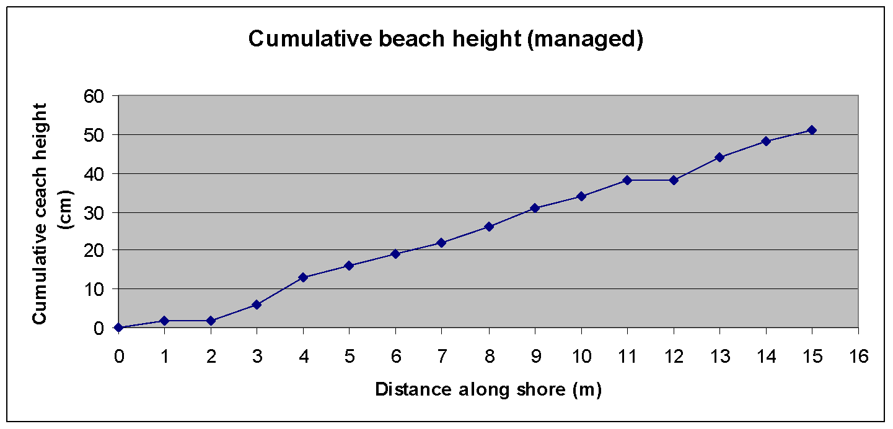
Spearman’s Rank Correlation
On the fieldtrip to the Witterings you will be collecting data that can be used to conduct a spearman’s rank
Other possible uses of Spearman’s rank
The further away from the CBD the lower the temperature
The further up the beach the larger the sediment size
The further from the CBD the lower the pedestrian footfall
The higher the school performance the higher the house prices
The further east you go along the beach the greater the cross sectional area

Slide 8
Complete the Spearman’s rank exercise p1-2 in the booklet

Slide 9
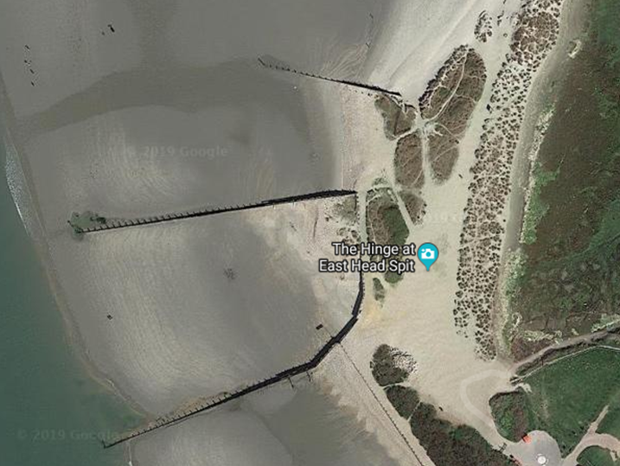
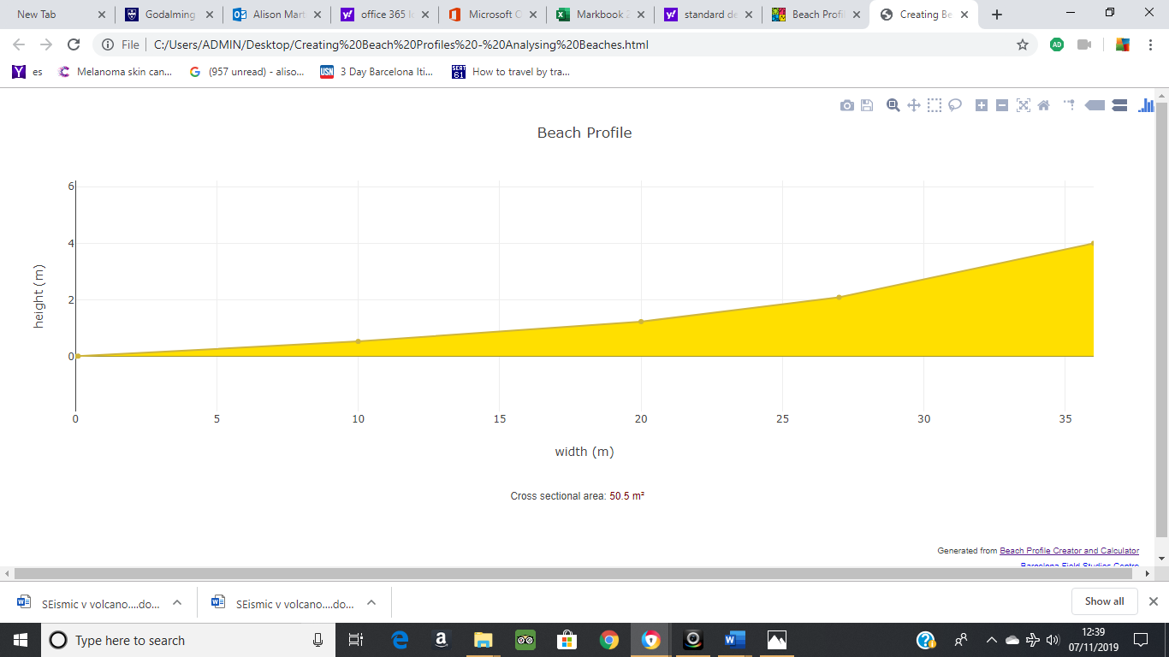
Data Presentation Analysis – Cross – sectional area along a beach
Hypothesis – the cross-sectional area to the north of the beach (transect 2) will be greater than the cross-sectional area to the south of the beach
Task 1 – creating a beach profile diagram
Use the beach groyne transect data you have been provided with – distance from last point (m) and angle of slope (°) and the following web link to create a beach profile like the one below. Copy and paste into a word document and label it Transect 2.
https://geographyfieldwork.com/BeachProfile.htm
Cumulative distance | Slope angle (+ or -)
0 | 0
0.1 | 3
10 | 3
20 | 6
24 | 13
35 | 8
42 | 11
43 | 2
Transect 2 data
Transect 1
Transect 1
Transect 2

Slide 10
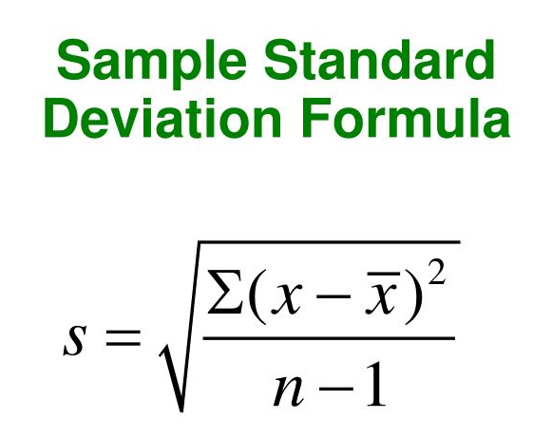
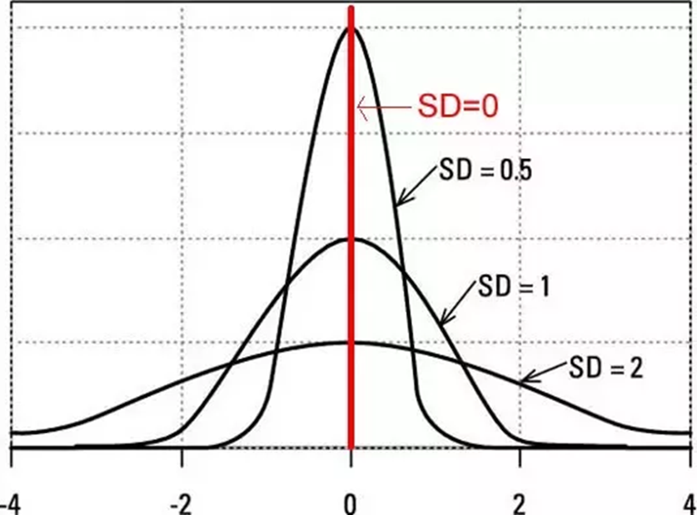
Standard Deviation
Standard deviation (SD) is a measure of the degree of dispersion about the mean.
It is possible that two sets of data can have the same mean but have a very different spread of data. SD will show you the extent of this spread.
Annotate the equation above to show what each symbol represents using the key from the exam question.
Complete the standard deviation exam question on the spread of social inequality between two areas of a local town.

Slide 11
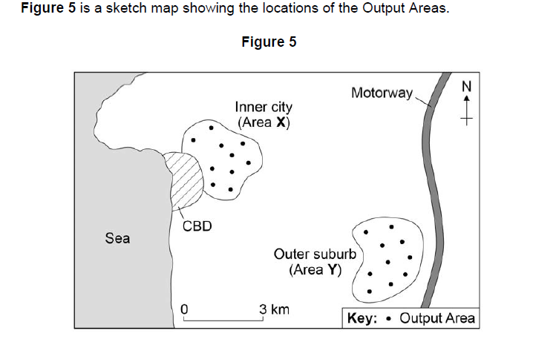
A group of students carried out an investigation into social inequality between two areas of their local town.
They chose an inner-city area (X) and an outer suburb (Y). Their idea was that there would be a greater amount of social deprivation in the inner-city area than the outer suburb. They conducted both primary and secondary data collection methods. One measure they focused on was level of education. They tested the hypothesis:
‘There will be a greater percentage of people educated to degree level in Area Y than in Area X.’
The students used the Office for National Statistics website to collect secondary data. They selected 10 Output Areas in both the inner city and the outer suburb. For each Output Area they recorded the number of residents with qualifications at degree level and converted this to a percentage of all residents.

Slide 12
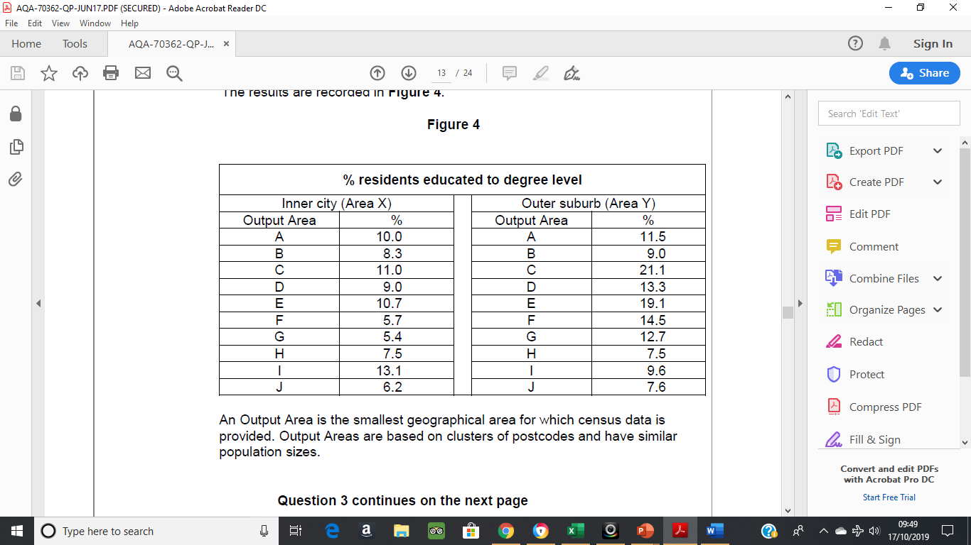
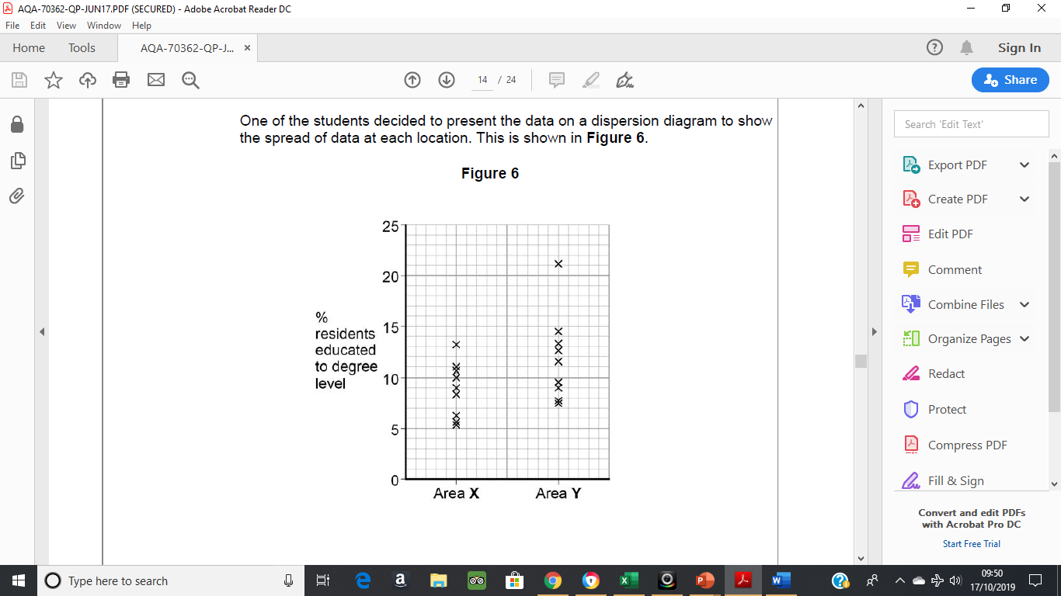
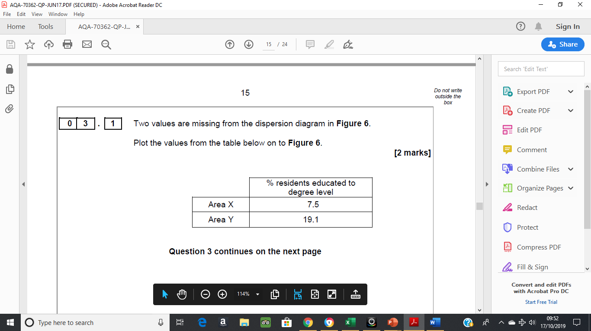

Slide 13
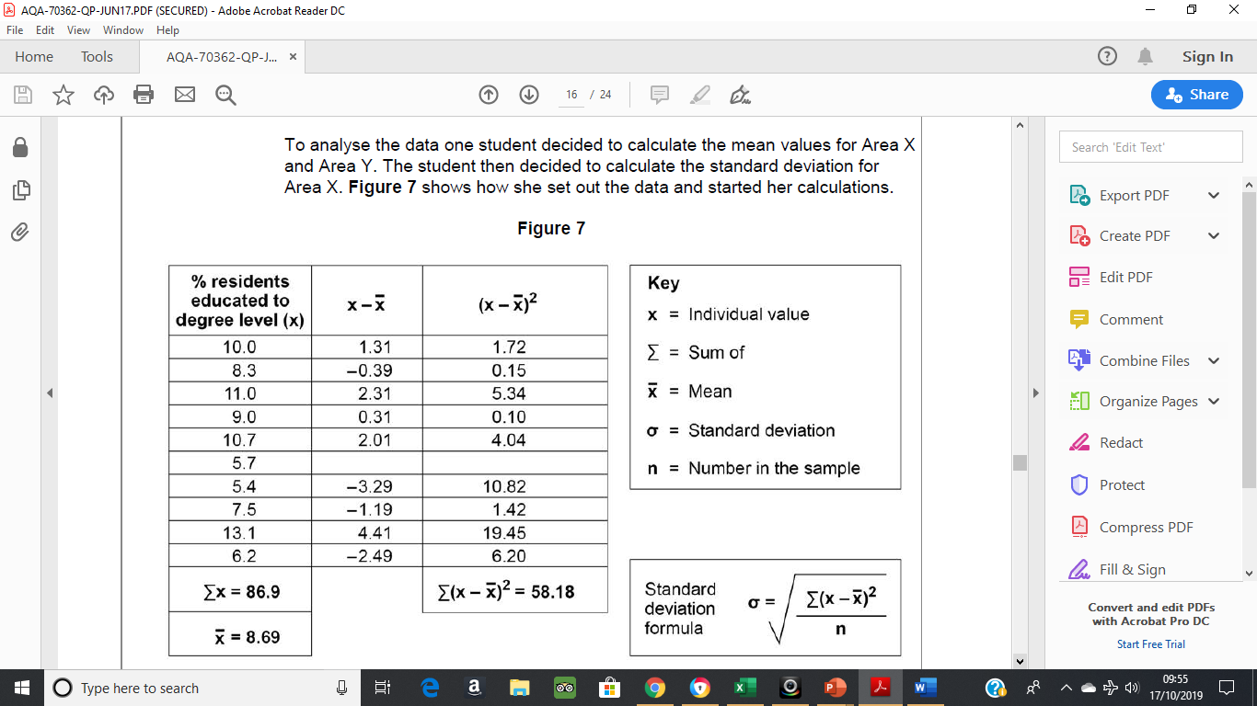
Complete Figure 7 and calculate the standard deviation to two decimal places. Show your working in the space provided.

Slide 14
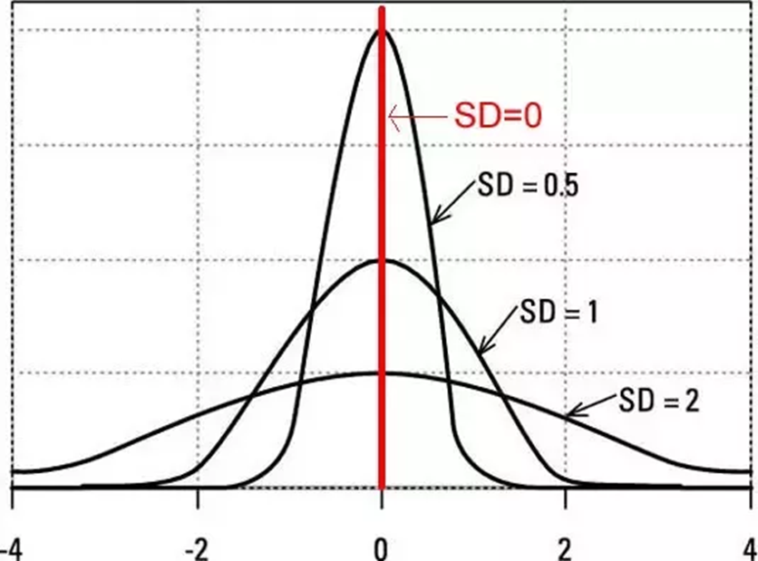
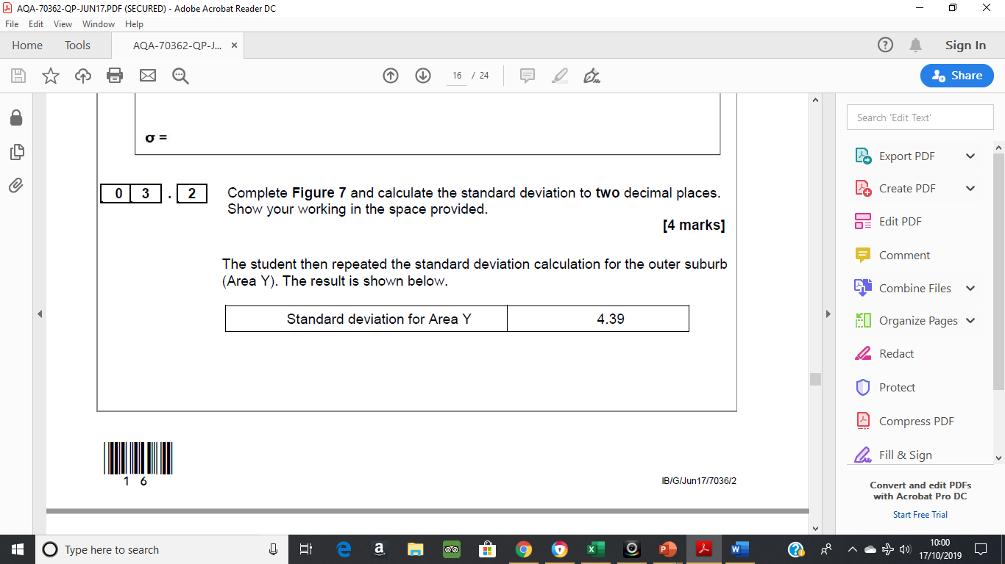
Use the standard deviation values to contrast the two data
sets.
Evaluate the usefulness of standard deviation and/or alternative techniques to analyse the data in Figure 4.

Slide 15
Mark scheme
Allow correct interpretation of an incorrect calculation.
• The SD values mean there is more variation from the mean in the % of people with degrees in the outer suburbs (1) this is because there are more extreme values in the Outer Suburbs (1)
• The SD value shows there is more clustering of % people with degrees around the mean in the Inner City Area. (1) This means that the mean is more typical of the data set in the inner city (1)
• The SD score of Y is higher than area X (1) this means that is more variation in area Y (1)
Max 1 if separate accounts or if only one area considered.
No credit for simply restating the SD values without any development.
Standard deviation is useful as it allows us to consider the spread of the data around the mean, which means that in Figure 4 we can prove that there is a greater variation in the outer suburbs.
• SD indicates the extent of the spread of data. So, it is very useful when comparing two data sets as in Figure 4. In this case SD is an appropriate technique as we can compare the two areas.
• SD is more useful than just comparing the mean as in this case the mean is much larger in the outer suburbs but this is affected by some extreme values. SD allows us to be able to show this mathematically.
• A description of the alternative analysis techniques and how they would be constructed
• It could be considered that you could use measures of central tendency such as the mean or median, allowing direct comparison and analysis of averages.
• Range could also be used to consider basic variation in education levels across each area allowing a comparison to be made

Slide 16
Complete the standard deviation in the booklet

Slide 17
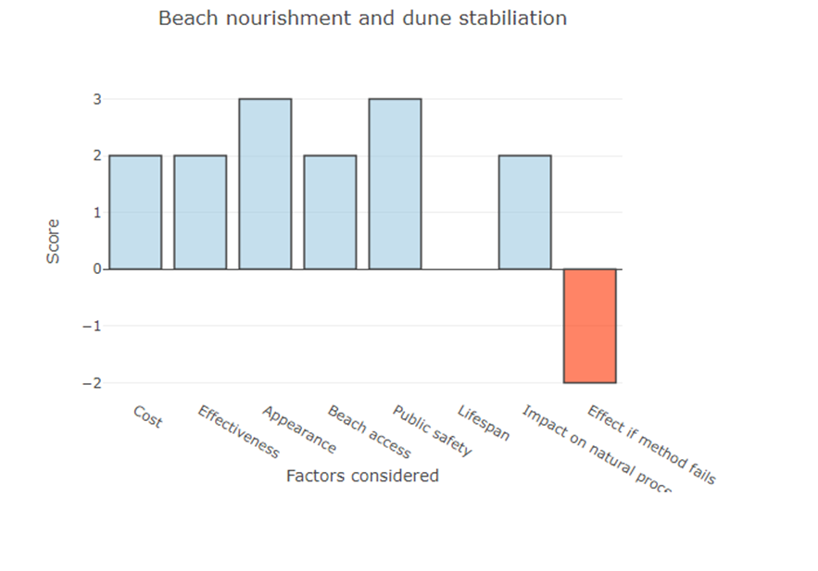
Bi-polar analysis of management techniques
https://geographyfieldwork.com/BipolarChartCreator.html
Task 1
Use the above link and the information from the fieldtrip workbooks to create bi-polar graphs for two of the coastal management techniques that you examined on the fieldwork day. An example of how one should look is below.
Task 2
Analyse your bi-polar graphs identifying the strengths and weaknesses of each of the schemes.
How do your graphs compare to other peoples?
Why might this be an issue?

