Slide 1
Exam technique
Autumn 2021

Slide 2
Common question formats:
4 marks
6 marks
9 marks
20 Marks
Assessment Objectives:
AO1 | AO2 | AO3
Demonstrate knowledge and understanding of places, environments, concepts processes, interactions and change at a variety of scales. | Apply knowledge and understanding in different contexts to interpret, analyse and evaluate geographical information. | Use a variety of relevant quantitative, qualitative and fieldwork skills.
Most questions test AO1 and AO2, with some AO3 (mostly tested in the Independent Investigation).

Slide 3
Command words
Command words are the key direction you are given in a question to tell you what to do. The question won’t always start with the command word. You must learn their meaning.
Match up the descriptions in the table below with the command words in the list below:
 | Form and express a view as to the merit or validity of a view or statement after examining the evidence available and/or different sides of an argument.
 | Consider several options or arguments and weigh them up so as to come to a conclusion about their effectiveness or validity.
 | Provide a brief account of relevant information.
 | Consider carefully and provide a detailed account of the indicated topic.
 | Break down concepts, information and/or issues to convey an understanding of them by finding connections and causes and/or effects.
 | Often occurs before ‘Assess’ or ‘Evaluate’ inviting an examination of an issue from the point of view of a critic with a particular focus on the strengths and weaknesses of the points of view being expressed.
 | Consider several options, ideas or arguments and come to a conclusion about their importance/success/worth.
 | Set out the causes of a phenomenon and/or the factors which influence its form/nature.
ANALYSE ASSESS CRITICALLY EVALUATE
EXAMINE OUTLINE TO WHAT EXTENT… EXPLAIN

Slide 4
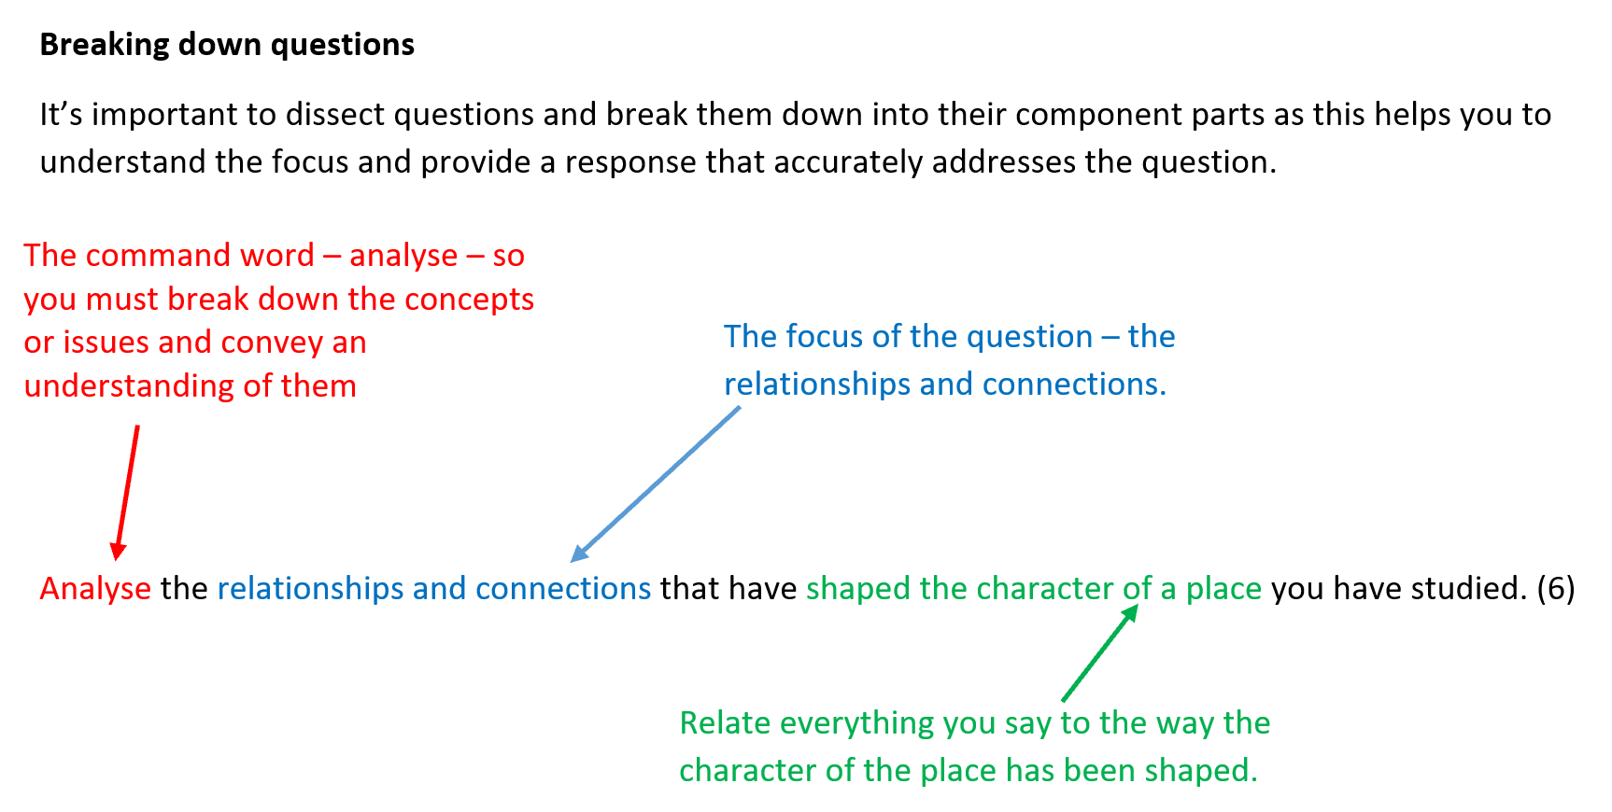

Slide 5
Try to dissect and break down the following questions:
Evaluate this statement: ‘Today, media places are as real as experienced places for many’. (6)
With reference to named places, outline how local or community groups have attempted to reshape place meaning and evaluate their level of success. (6)
Explain the differences between landforms found along high and low energy coasts, using examples you have studied. (6)

Slide 6
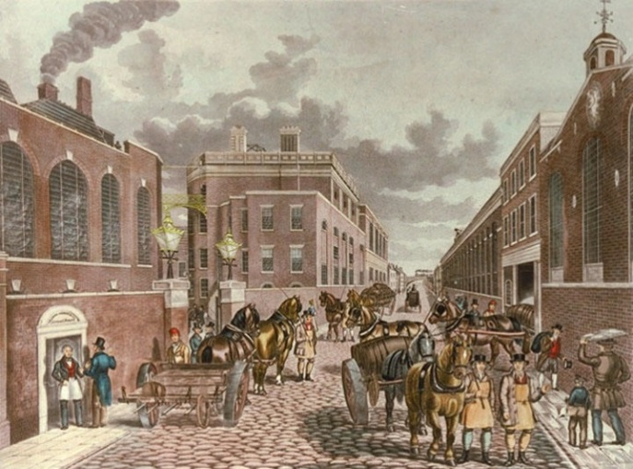
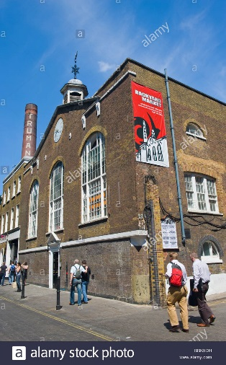
Resource-based questions
Analyse the image: what does it show? How is the place being represented? Has the representation changed?

Slide 7
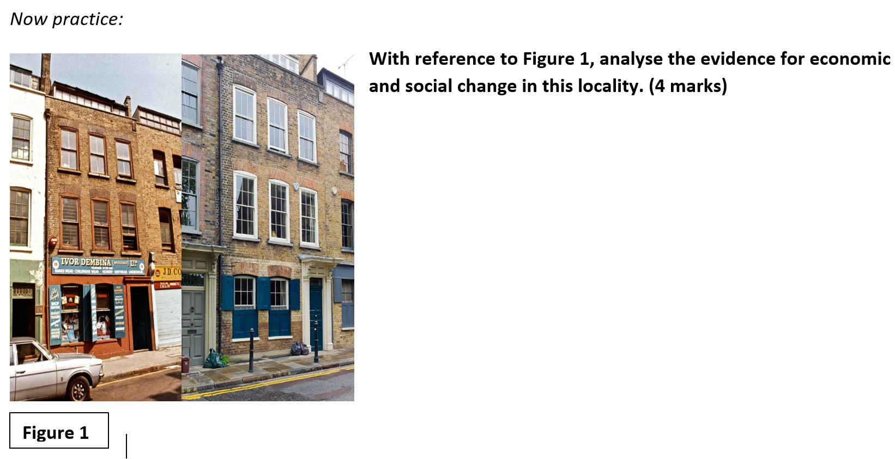

Slide 8
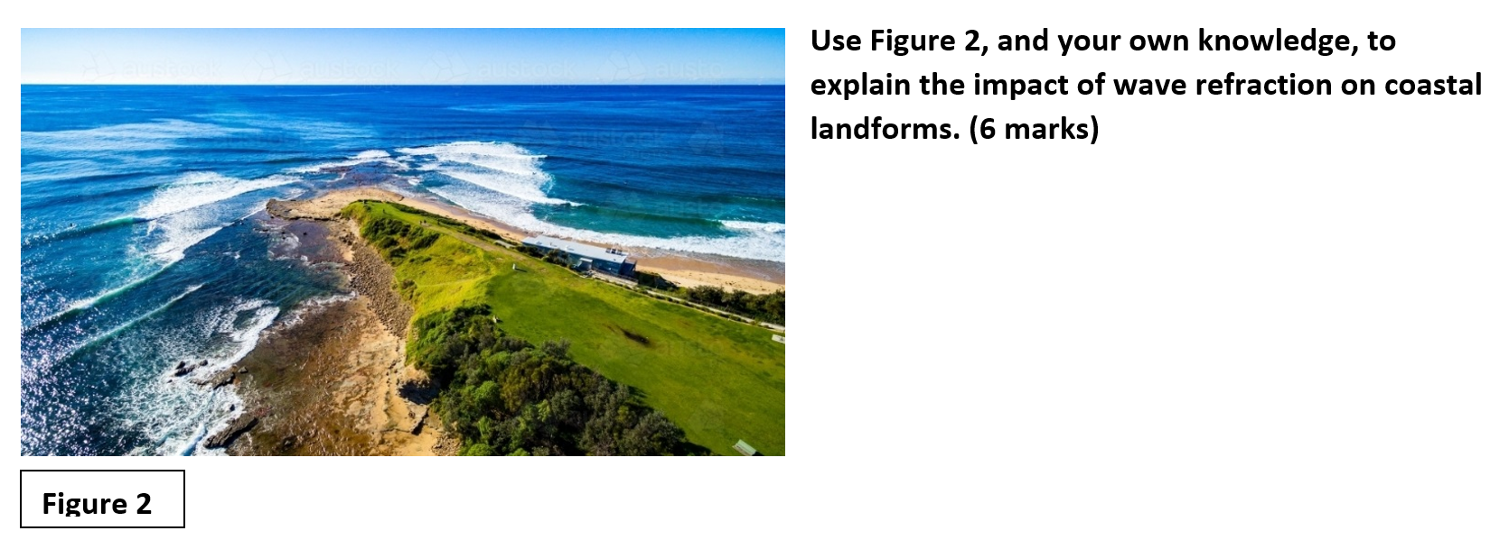

Slide 9
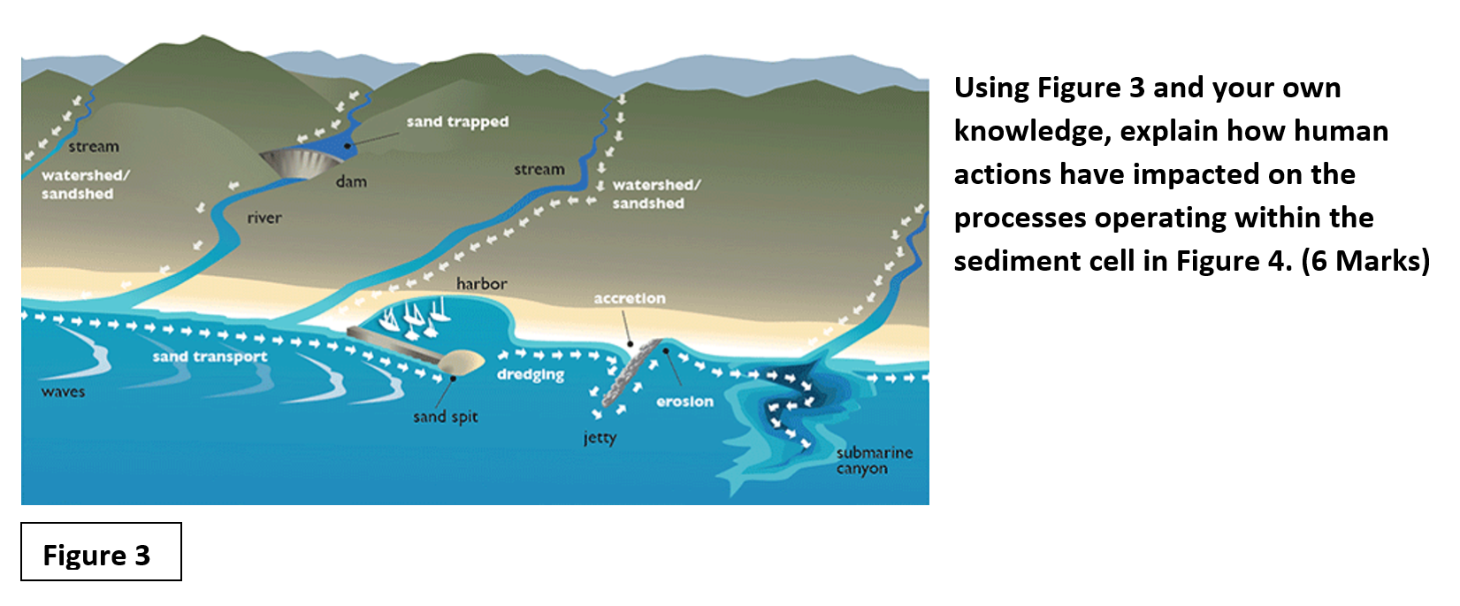

Slide 10
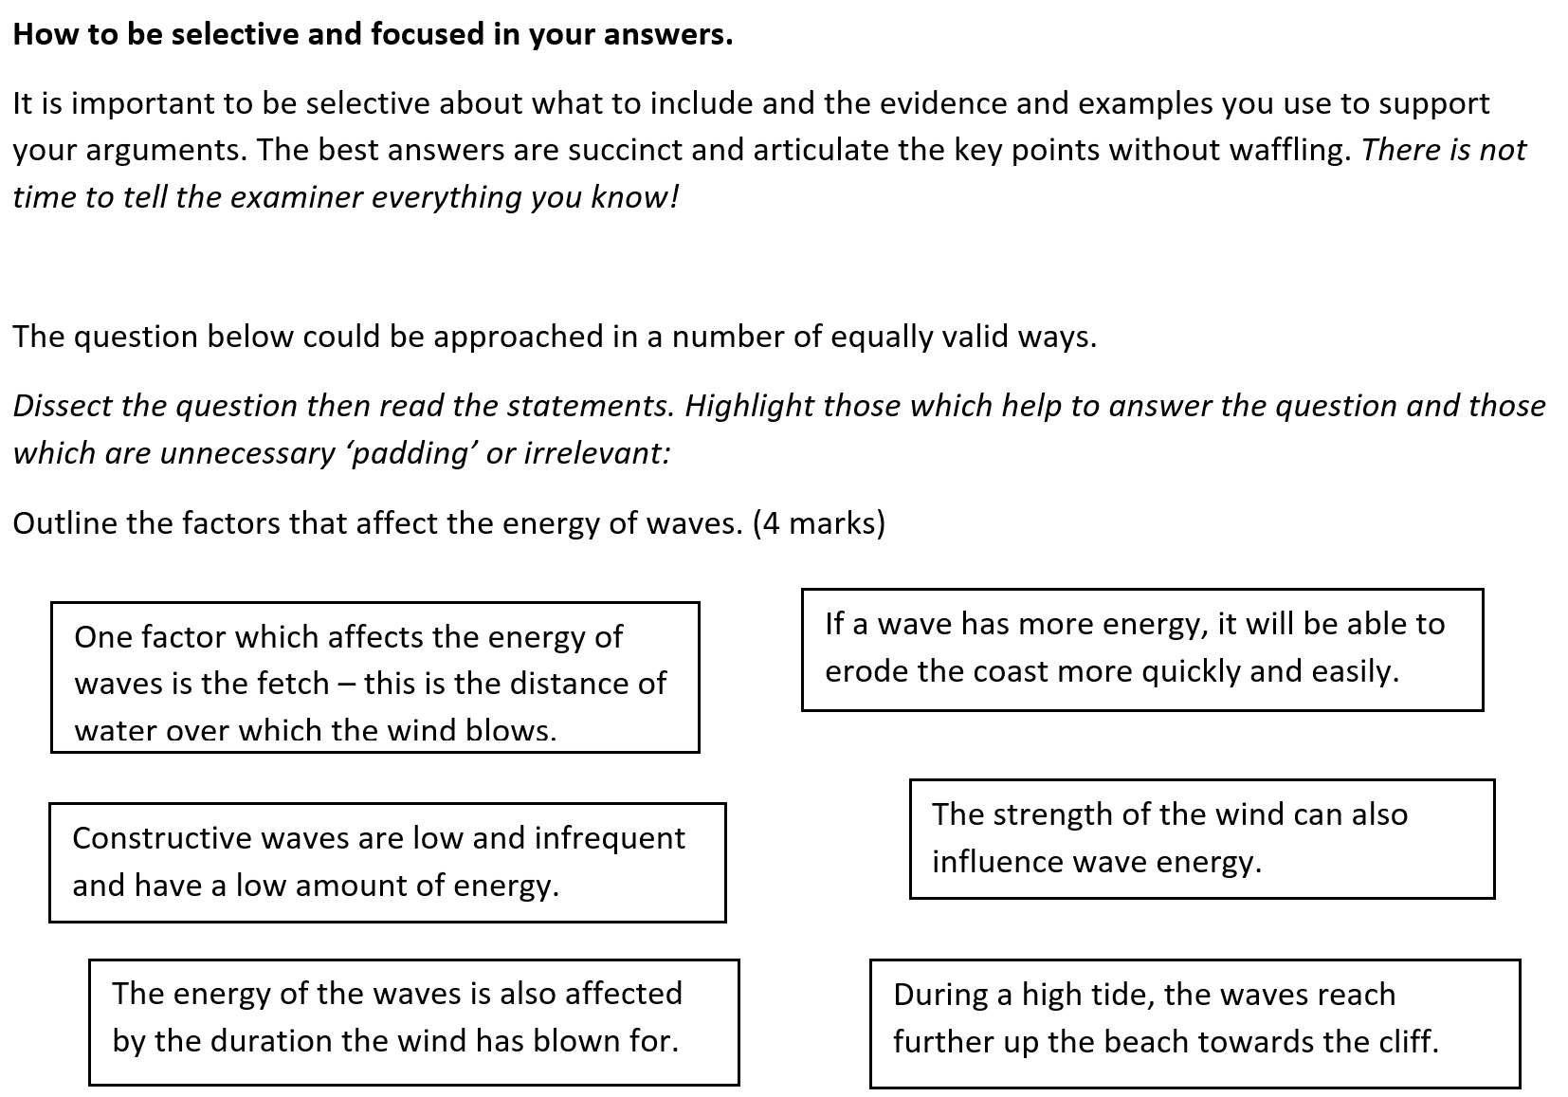
Now, use the statements that you have identified as useful to help you construct a coherent answer to the question:

Slide 12
